Slide 1
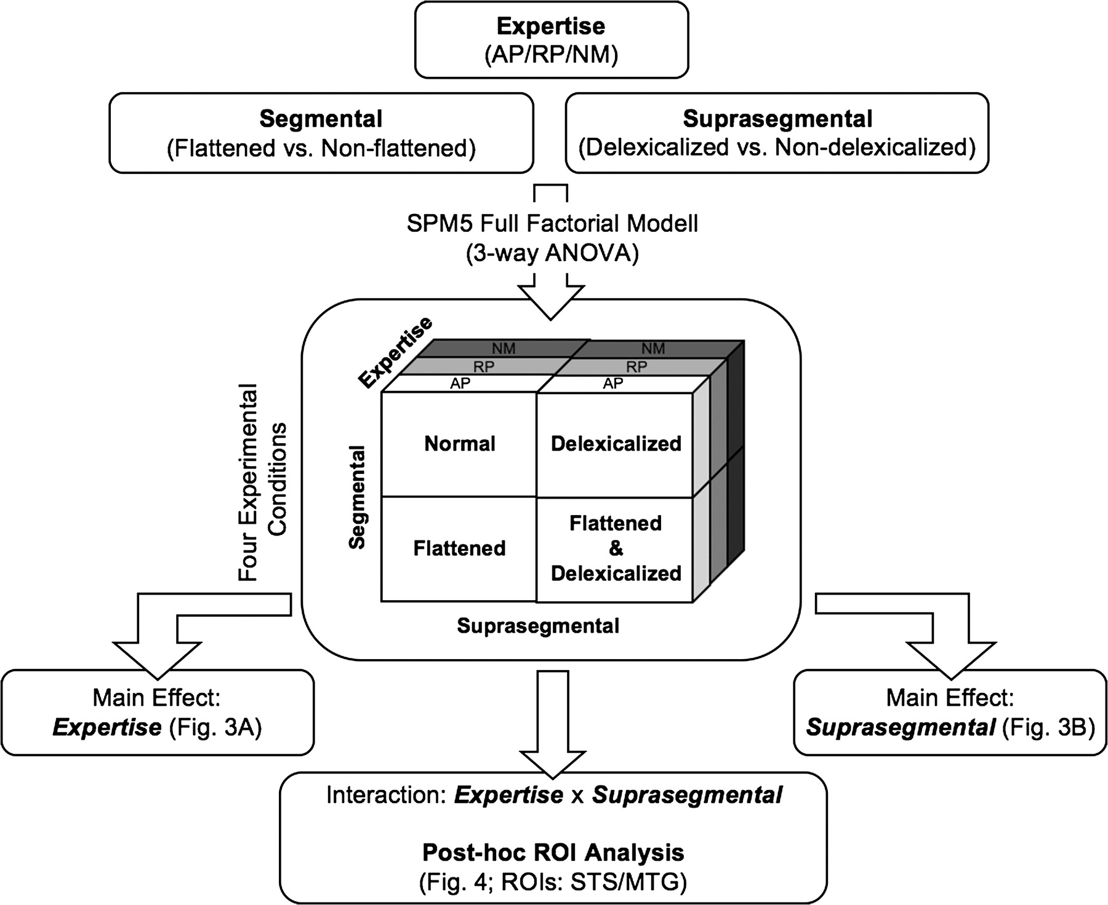
Figure 1. In this figure the methodical framework is depicted. The 3 factors expertise, suprasegmental and segmental ...
Notes:
Figure 1. In this figure the methodical framework is depicted. The 3 factors expertise, suprasegmental and segmental leads us to an orthogonal design that has been calculated by using a full factorial design (3-way ANOVA), provided by SPM5: expertise (AP/RP/NM) × segmental (flattened vs. nonflattened) × suprasegmental (delexicalized vs. nondelexicalized). The significant interaction expertise × suprasegmental has been further analyzed by applying a post hoc ROI analysis comparing delexicalized versus nondelexicalized conditions.
Unless provided in the caption above, the following copyright applies to the content of this slide: © 2009 The AuthorsThis is an Open Access article distributed under the terms of the Creative Commons Attribution Non-Commercial License (http://creativecommons.org/licenses/by-nc/2.0/uk/) which permits unrestricted non-commercial use, distribution, and reproduction in any medium, provided the original work is properly cited.

Slide 2
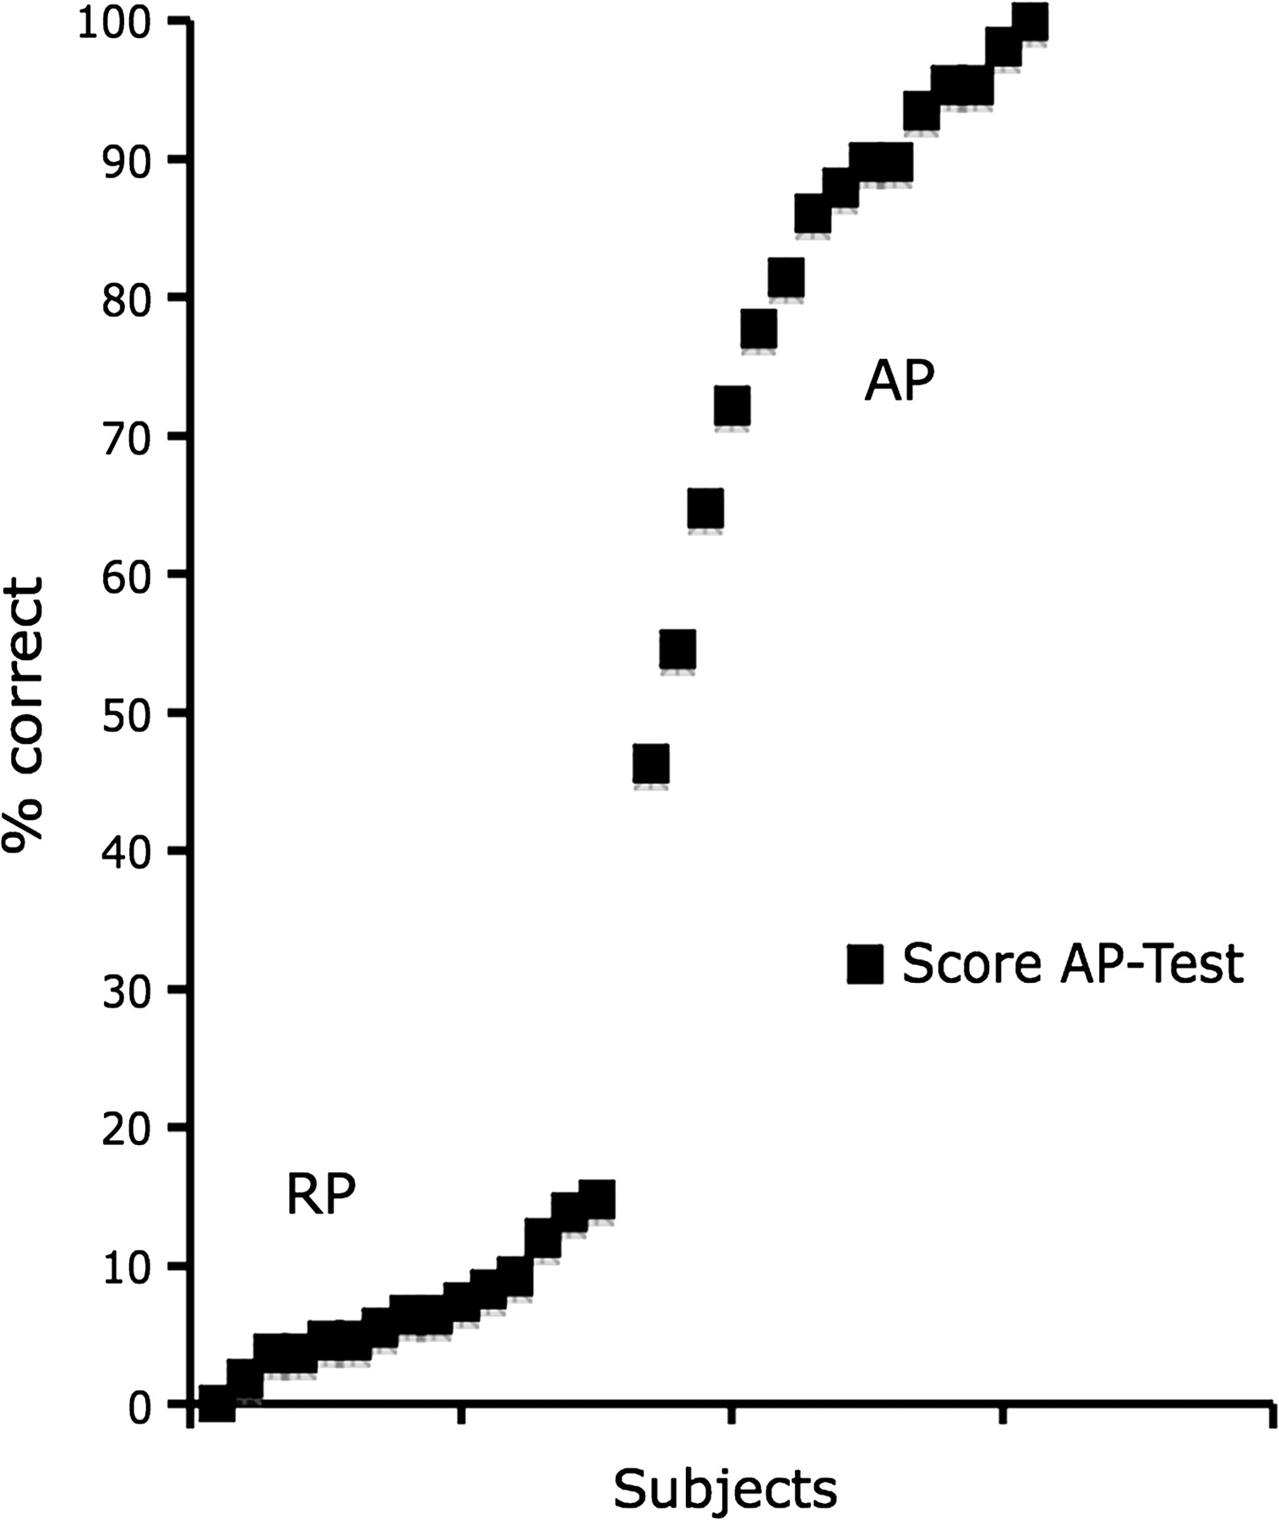
Figure 2. Plotted scores of the AP test (AP [n = 15, Average: 82.2%, SD: 16.2] and RP [n = 15, Avg.: 6.9%, SD: 4.2]).
Notes:
Figure 2. Plotted scores of the AP test (AP [n = 15, Average: 82.2%, SD: 16.2] and RP [n = 15, Avg.: 6.9%, SD: 4.2]).
Unless provided in the caption above, the following copyright applies to the content of this slide: © 2009 The AuthorsThis is an Open Access article distributed under the terms of the Creative Commons Attribution Non-Commercial License (http://creativecommons.org/licenses/by-nc/2.0/uk/) which permits unrestricted non-commercial use, distribution, and reproduction in any medium, provided the original work is properly cited.

Slide 3
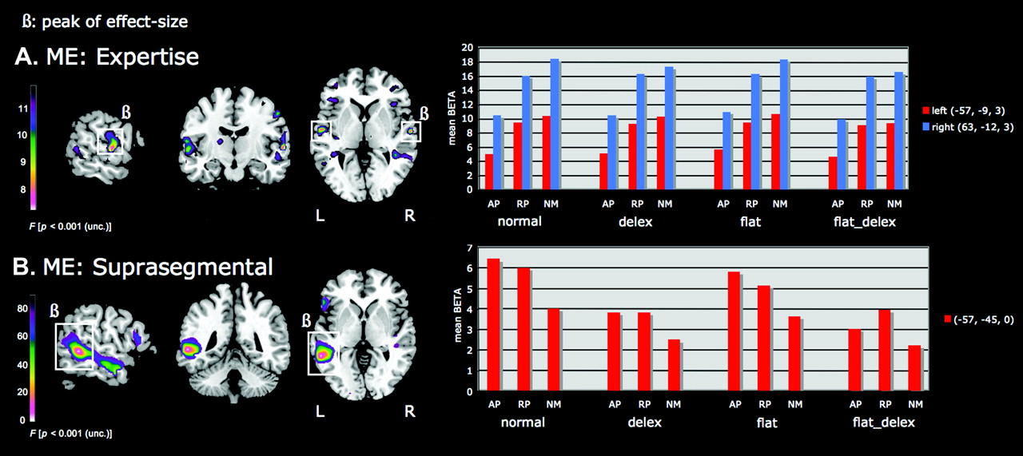
Figure 3. Selected results of the 3-way ANOVA (segmental × suprasegmental × expertise) On the left side, cortical views ...
Notes:
Figure 3. Selected results of the 3-way ANOVA (segmental × suprasegmental × expertise) On the left side, cortical views show the significant results of a full factorial design performed with SPM5: (A) the main effect expertise (STG, PT) and (B) the main effect suprasegmental (MTG, STG, ITG). On the right, mean BETA values at the sites of effect peaks (white small boxes) are plotted for all 3 groups of subjects (AP/RP/NM) and against the 4 experimental conditions: normal speech (normal), delexicalized speech (delex), flattened speech (flat) and flattened-delexicalized speech (flat_delex).
Unless provided in the caption above, the following copyright applies to the content of this slide: © 2009 The AuthorsThis is an Open Access article distributed under the terms of the Creative Commons Attribution Non-Commercial License (http://creativecommons.org/licenses/by-nc/2.0/uk/) which permits unrestricted non-commercial use, distribution, and reproduction in any medium, provided the original work is properly cited.

Slide 4
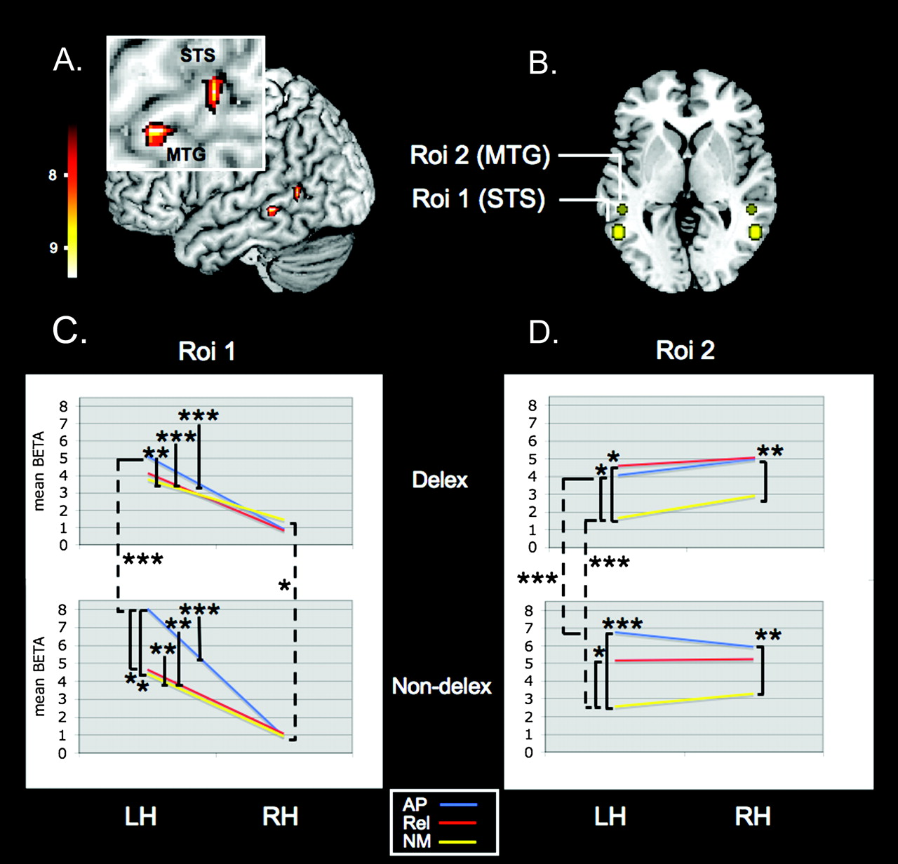
Figure 4. Detailed data of ROI-analysis regarding the significant interaction suprasegmental × expertise (A) STS and ...
Notes:
Figure 4. Detailed data of ROI-analysis regarding the significant interaction suprasegmental × expertise (A) STS and MTG interaction cluster with two equivalent left-hemispheric peaks of interaction (ROI 1 [STS]: (−54, −57, 6), F = 9.28; ROI 2 (MTG): (−51, −39, −6), F = 9.28, P < 0.001, k = 5), (B) two post hoc defined ROIs according to the peaks of interaction at left STS and MTG (left hemisphere) and two corresponding mirror related ROIs (right hemisphere). The left two (C) and right two (D) plots are defined by the separately assigned two clusters of significant interaction (ROI 1: [−54, −57, 6], F = 9.28; ROI 2: [−51, −39, −6]). The upper two plots represent the mean BETA values for the collapsed delexicalized conditions (delexicalized speech and flattened-delexicalized speech) in the left (LH) and the right (RH) hemisphere respectively, and the lower two plots represent the mean BETA values for the collapsed nondelexicalized conditions (normal speech and flattened speech); asterisks indicate significant levels (*P < 0.05, **P < 0.01, ***P < 0.001) as revealed by un-/paired t-tests.
Unless provided in the caption above, the following copyright applies to the content of this slide: © 2009 The AuthorsThis is an Open Access article distributed under the terms of the Creative Commons Attribution Non-Commercial License (http://creativecommons.org/licenses/by-nc/2.0/uk/) which permits unrestricted non-commercial use, distribution, and reproduction in any medium, provided the original work is properly cited.

