Slide 1
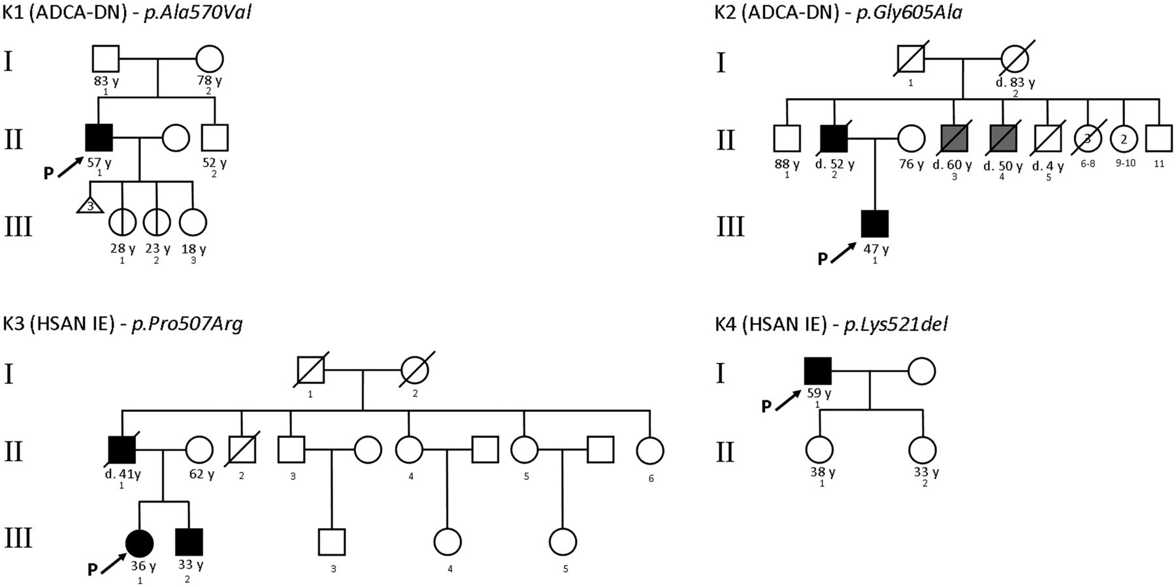
Figure 1 Pedigrees. Age at the time of the study is reported next to each symbol. Black symbol indicates affected ...
Notes:
Figure 1 Pedigrees. Age at the time of the study is reported next to each symbol. Black symbol indicates affected individuals, grey symbol indicates the state of presumed affected, split symbols indicate asymptomatic carriers. P = proband.
Unless provided in the caption above, the following copyright applies to the content of this slide: © The Author (2014). Published by Oxford University Press on behalf of the Guarantors of Brain. All rights reserved. For Permissions, please email: journals.permissions@oup.com

Slide 2
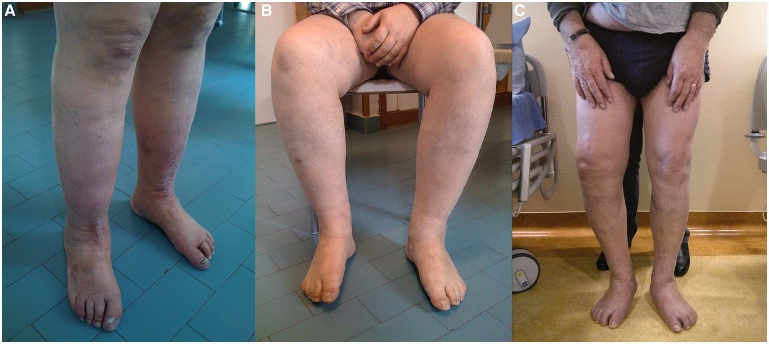
Figure 2 Pictures of patients’ limbs. (A) Patient K1 II-1; (B) Patient K2 III-1; (C) Patient K4 I-1.
Notes:
Figure 2 Pictures of patients’ limbs. (A) Patient K1 II-1; (B) Patient K2 III-1; (C) Patient K4 I-1.
Unless provided in the caption above, the following copyright applies to the content of this slide: © The Author (2014). Published by Oxford University Press on behalf of the Guarantors of Brain. All rights reserved. For Permissions, please email: journals.permissions@oup.com

Slide 3
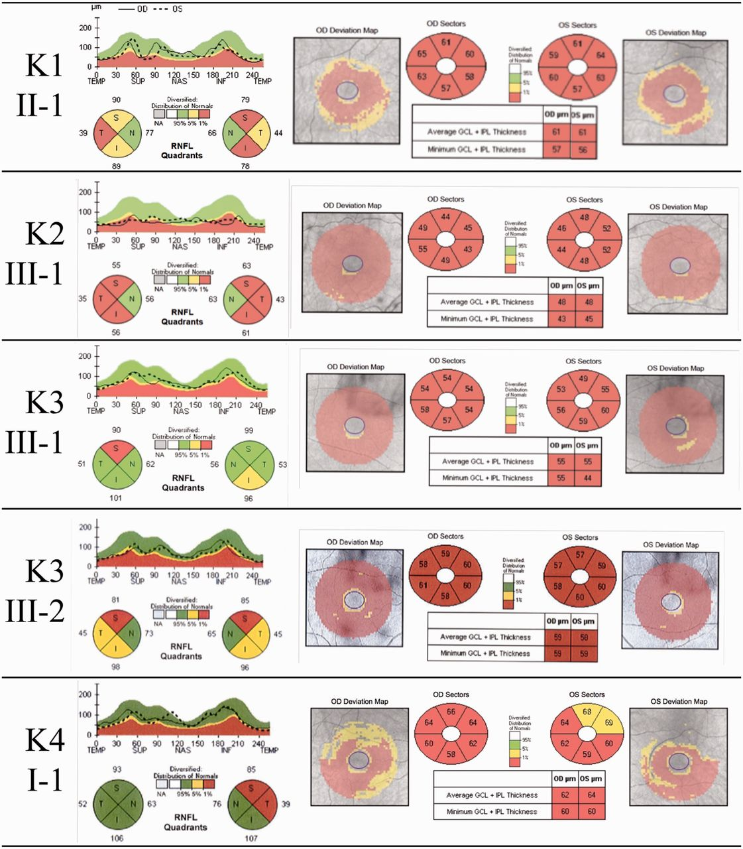
Figure 3 Optical coherence tomography retinal nerve fibre layer thickness (RNFL; left) and macular ganglion cell layer ...
Notes:
Figure 3 Optical coherence tomography retinal nerve fibre layer thickness (RNFL; left) and macular ganglion cell layer analysis (right) in Patients K1 II-1, K2 III-1, K3 III-1, K3 III-2 and K4 I-1. GCL = ganglion cell layer; IPL = inner plexiform layer.
Unless provided in the caption above, the following copyright applies to the content of this slide: © The Author (2014). Published by Oxford University Press on behalf of the Guarantors of Brain. All rights reserved. For Permissions, please email: journals.permissions@oup.com

Slide 4
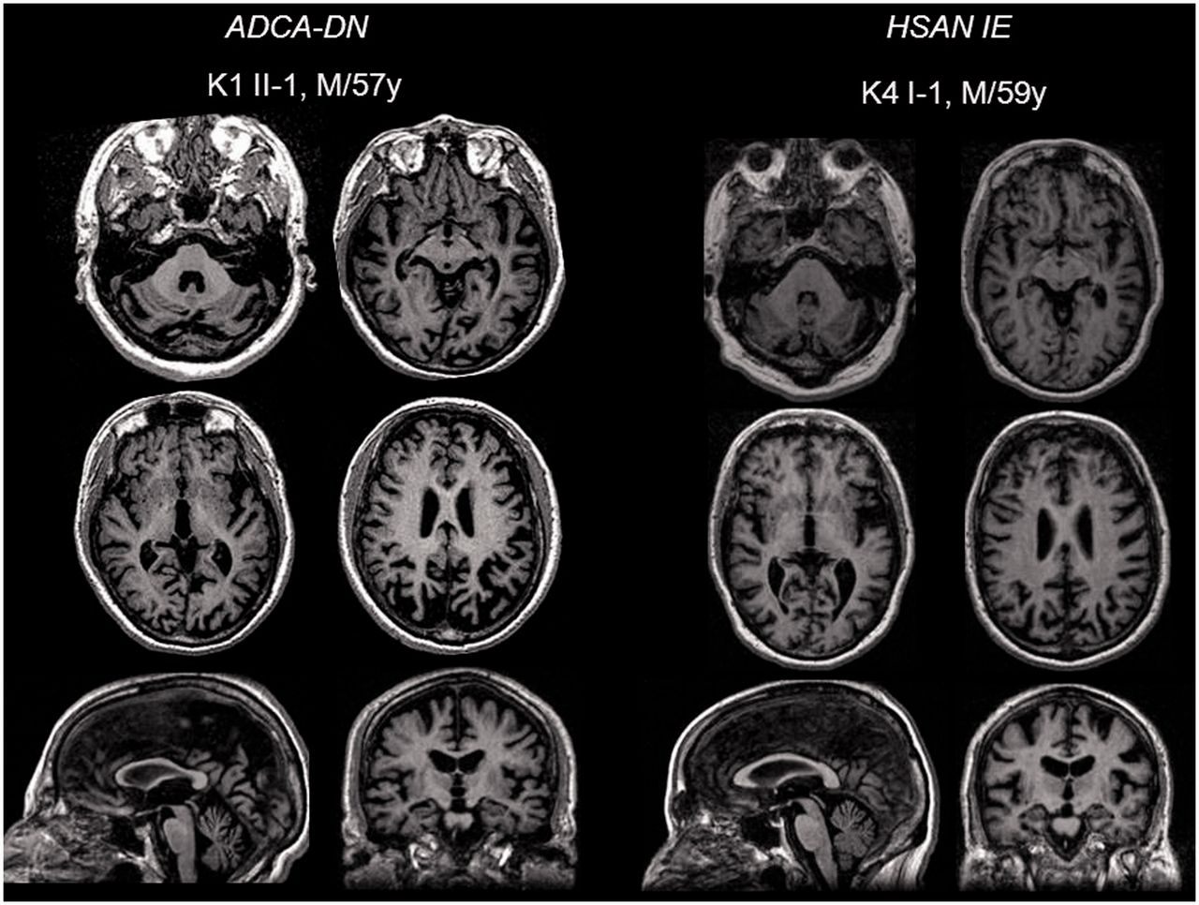
Figure 4 Brain MRI. Axial, sagittal and coronal reconstructions of volumetric high resolution FSPGR T₁ ...
Notes:
Figure 4 Brain MRI. Axial, sagittal and coronal reconstructions of volumetric high resolution FSPGR T1 images of one patient with ADCA-DN and one with HSAN-IE showing sovra- and infra-tentorial atrophy, that was quantified semi-quantitatively, as reported in Table 3.
Unless provided in the caption above, the following copyright applies to the content of this slide: © The Author (2014). Published by Oxford University Press on behalf of the Guarantors of Brain. All rights reserved. For Permissions, please email: journals.permissions@oup.com

