Slide 1
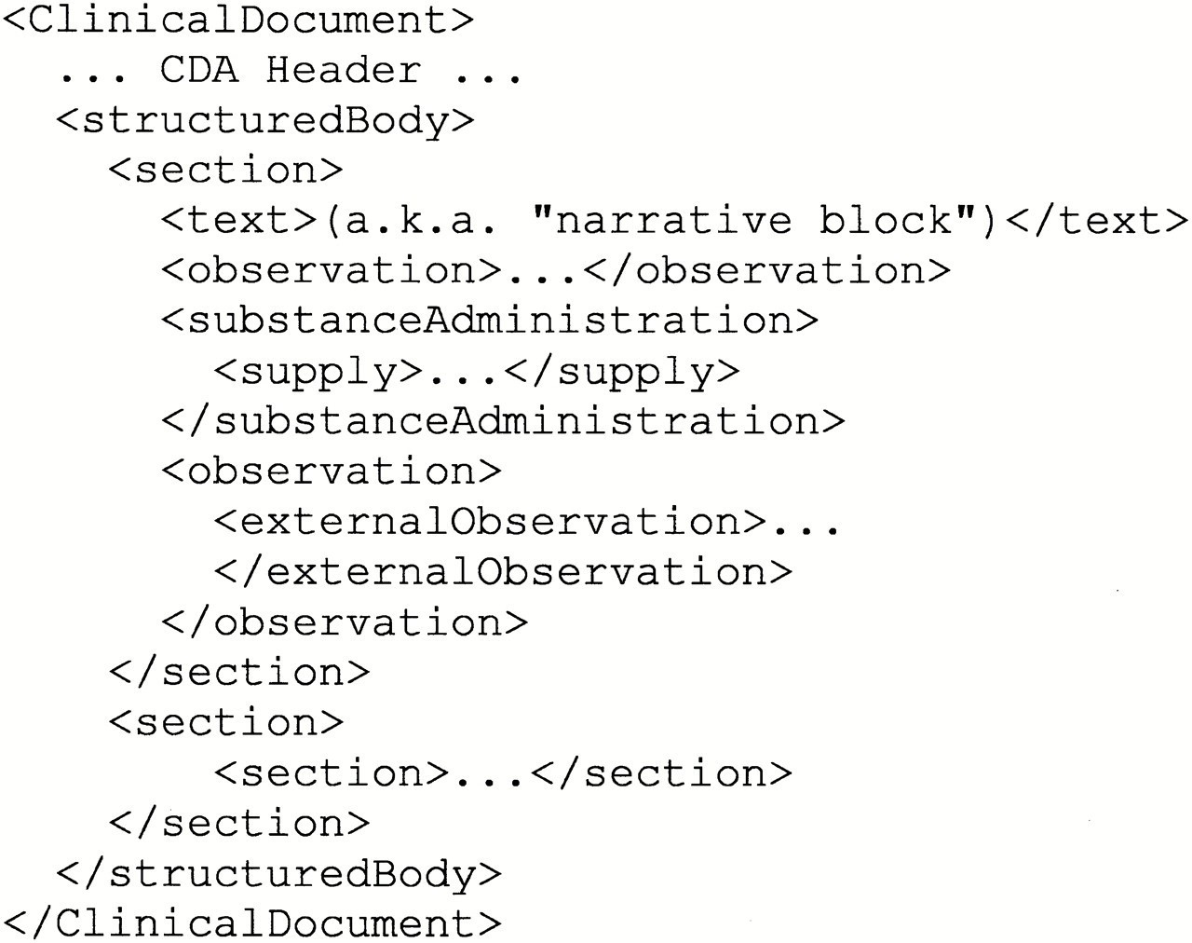
Figure 1 Major components of a Clinical Document Architecture (CDA) document.
Notes:
Figure 1 Major components of a Clinical Document Architecture (CDA) document.
Unless provided in the caption above, the following copyright applies to the content of this slide: American Medical Informatics Association

Slide 2
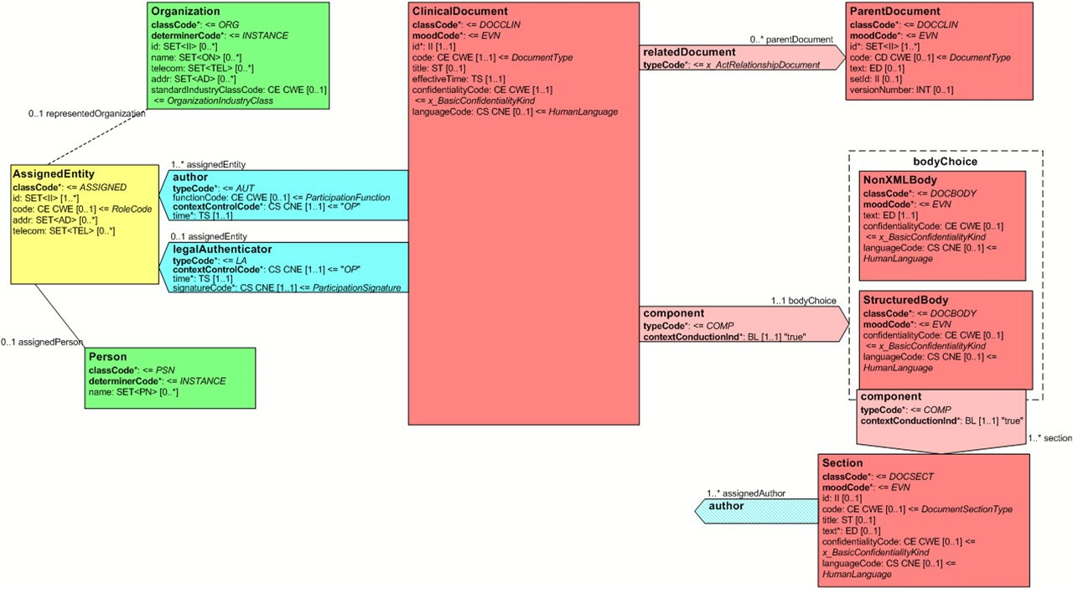
Figure 2 Clinical Document Architecture (CDA) Release 2 object model showing a portion of the header and its ...
Notes:
Figure 2 Clinical Document Architecture (CDA) Release 2 object model showing a portion of the header and its connection to the document body.
Unless provided in the caption above, the following copyright applies to the content of this slide: American Medical Informatics Association

Slide 3
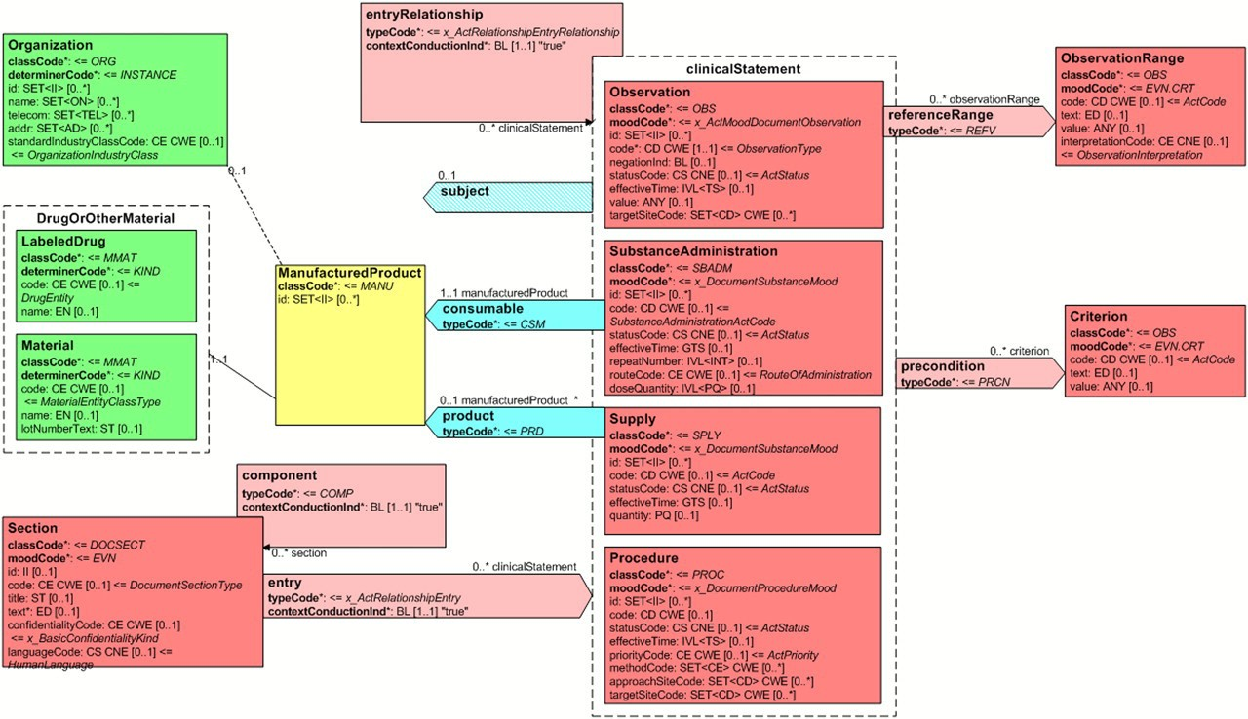
Figure 3 Clinical Document Architecture (CDA) Release 2 object model showing the connection from a document section to ...
Notes:
Figure 3 Clinical Document Architecture (CDA) Release 2 object model showing the connection from a document section to a portion of the CDA clinical statement model.
Unless provided in the caption above, the following copyright applies to the content of this slide: American Medical Informatics Association

Slide 4
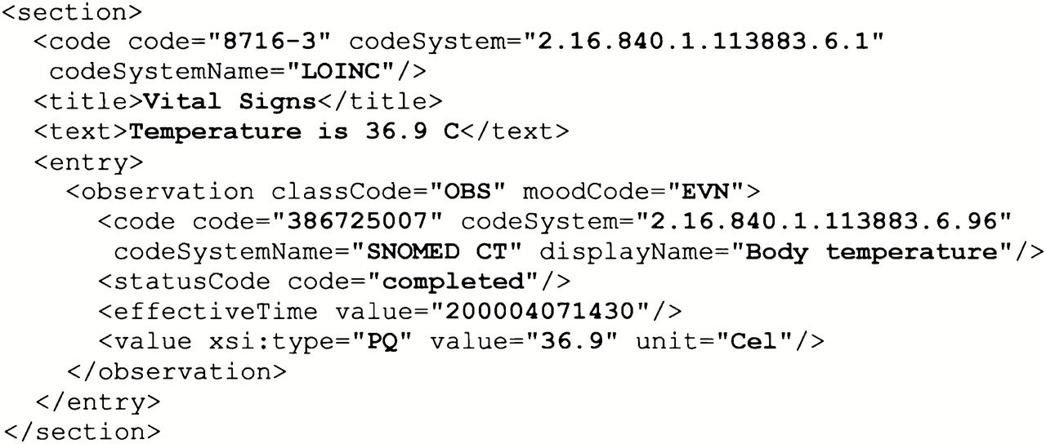
Figure 4 An example of a simple observation.
Notes:
Figure 4 An example of a simple observation.
Unless provided in the caption above, the following copyright applies to the content of this slide: American Medical Informatics Association

Slide 5
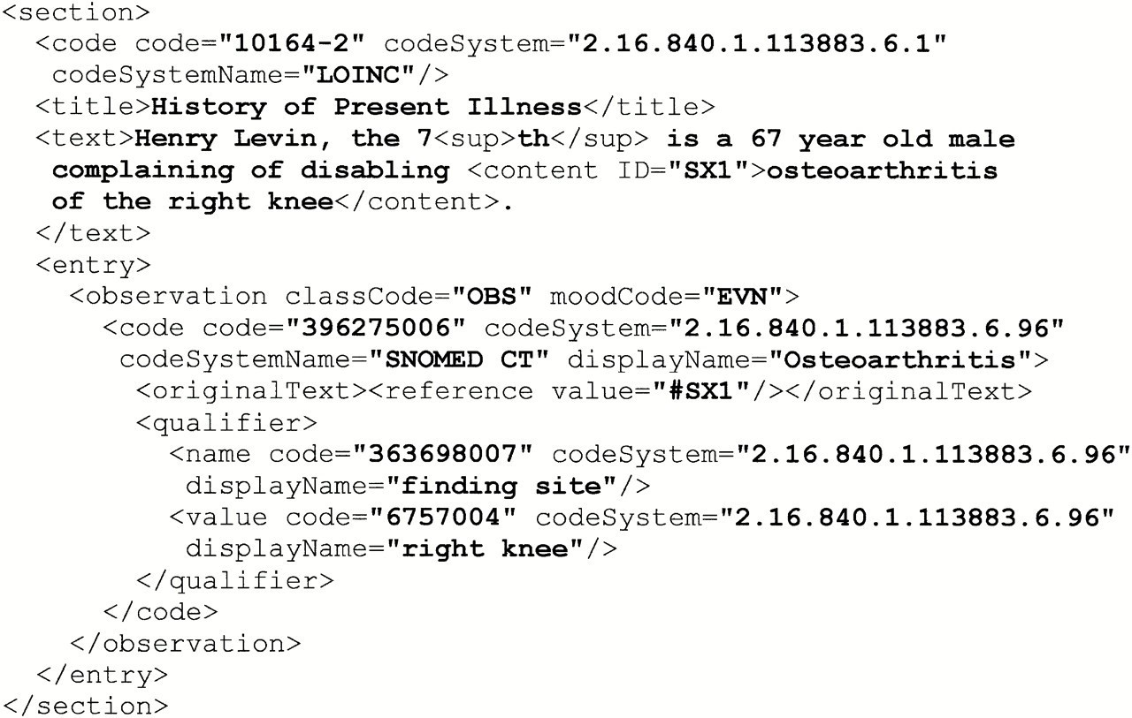
Figure 5 An example of a more complex observation.
Notes:
Figure 5 An example of a more complex observation.
Unless provided in the caption above, the following copyright applies to the content of this slide: American Medical Informatics Association

Slide 6
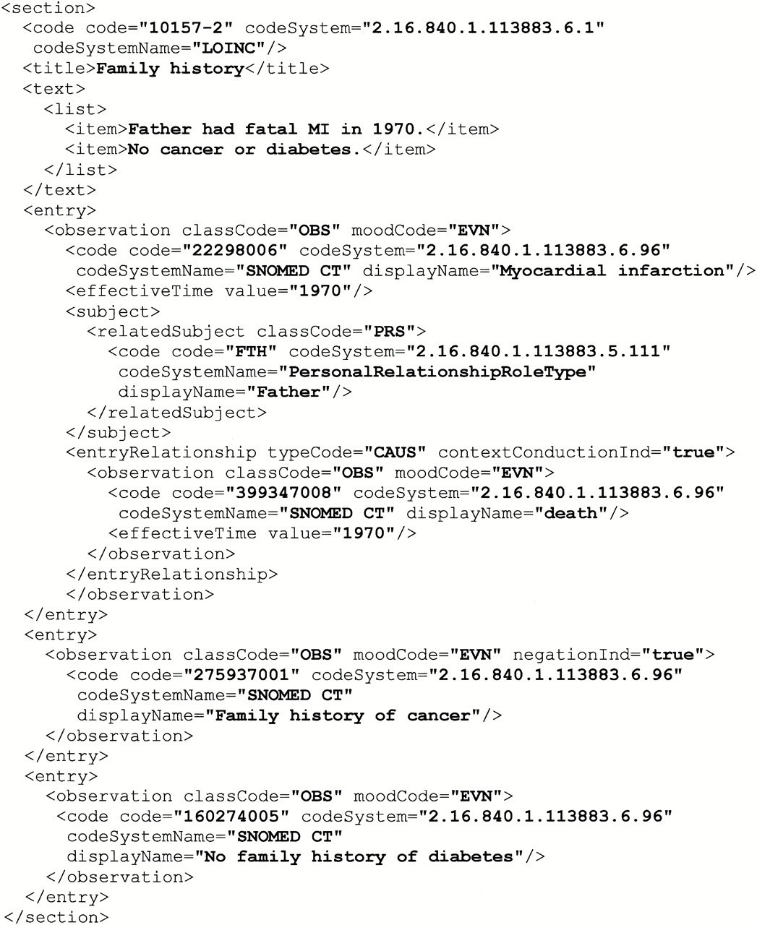
Figure 6 An example of family history observations.
Notes:
Figure 6 An example of family history observations.
Unless provided in the caption above, the following copyright applies to the content of this slide: American Medical Informatics Association

Slide 7
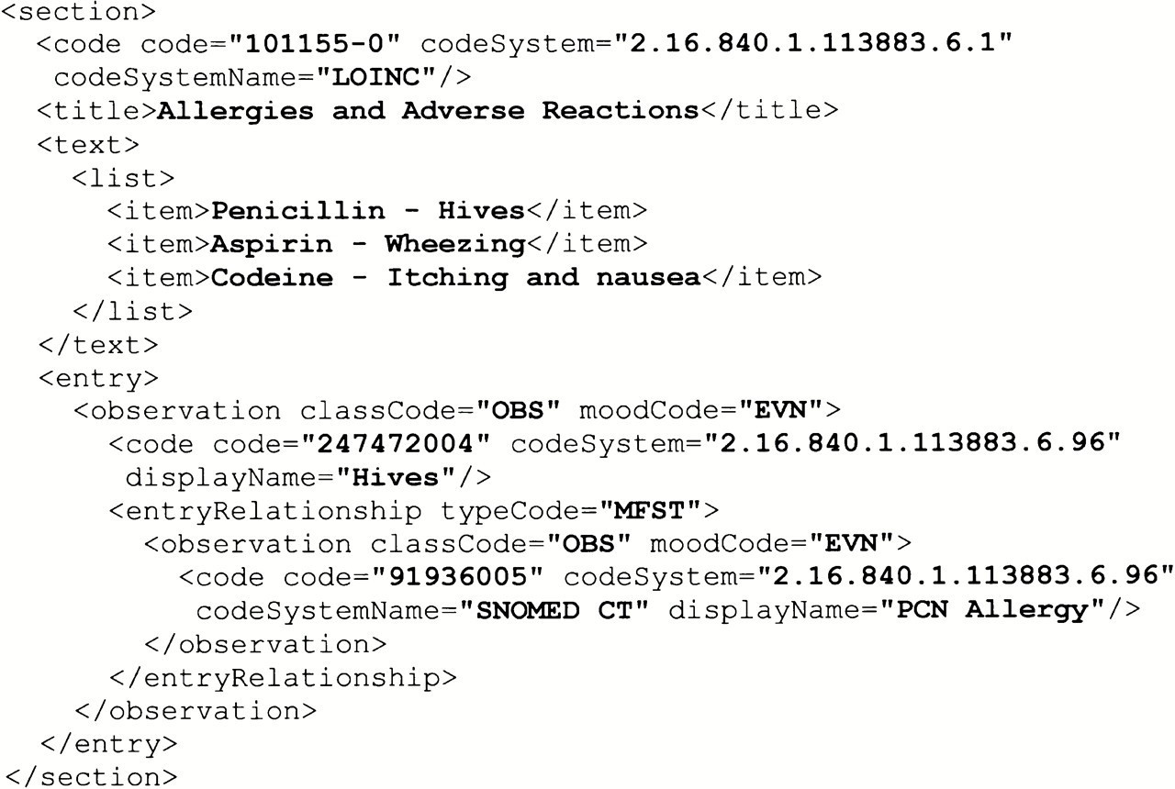
Figure 7 An example of allergies and adverse reactions.
Notes:
Figure 7 An example of allergies and adverse reactions.
Unless provided in the caption above, the following copyright applies to the content of this slide: American Medical Informatics Association

Slide 8
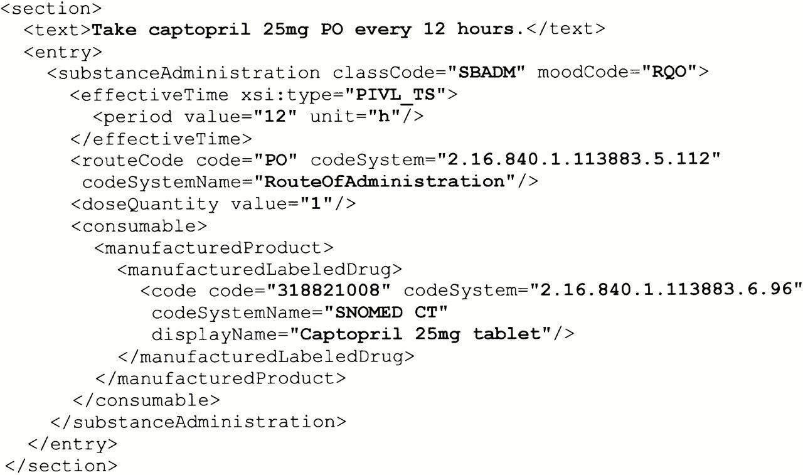
Figure 8 An example of a substance administration.
Notes:
Figure 8 An example of a substance administration.
Unless provided in the caption above, the following copyright applies to the content of this slide: American Medical Informatics Association

