Slide 1
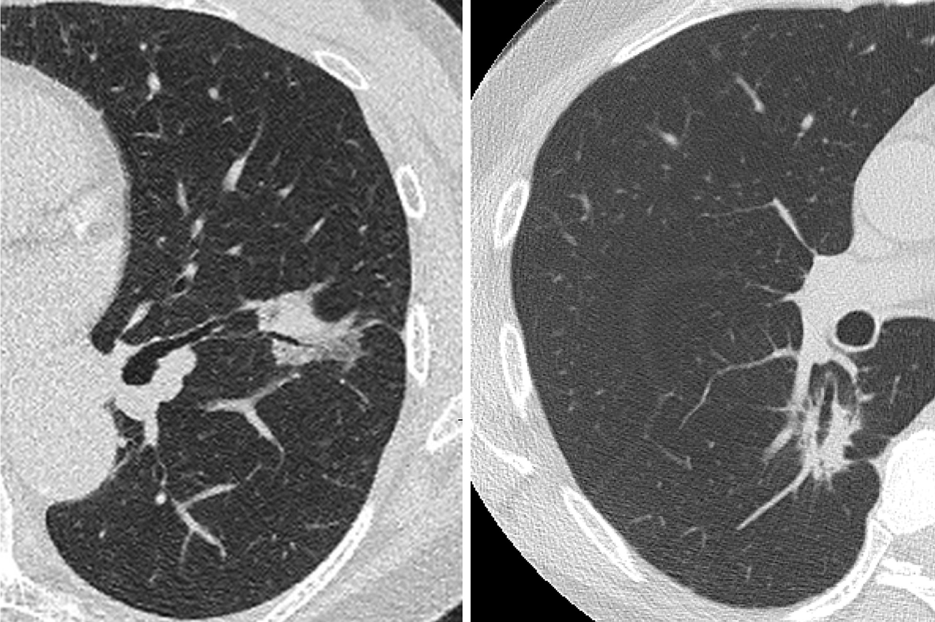
Figure 1: Typical images of pure-solid lung cancer with air bronchogram. An air-filled bronchus is surrounded by a lung ...
Notes:
Figure 1: Typical images of pure-solid lung cancer with air bronchogram. An air-filled bronchus is surrounded by a lung tumour that only shows consolidation without ground-grass opacity on thin-section CT scan.
Unless provided in the caption above, the following copyright applies to the content of this slide: © The Author 2013. Published by Oxford University Press on behalf of the European Association for Cardio-Thoracic Surgery. All rights reserved.

