Slide 1
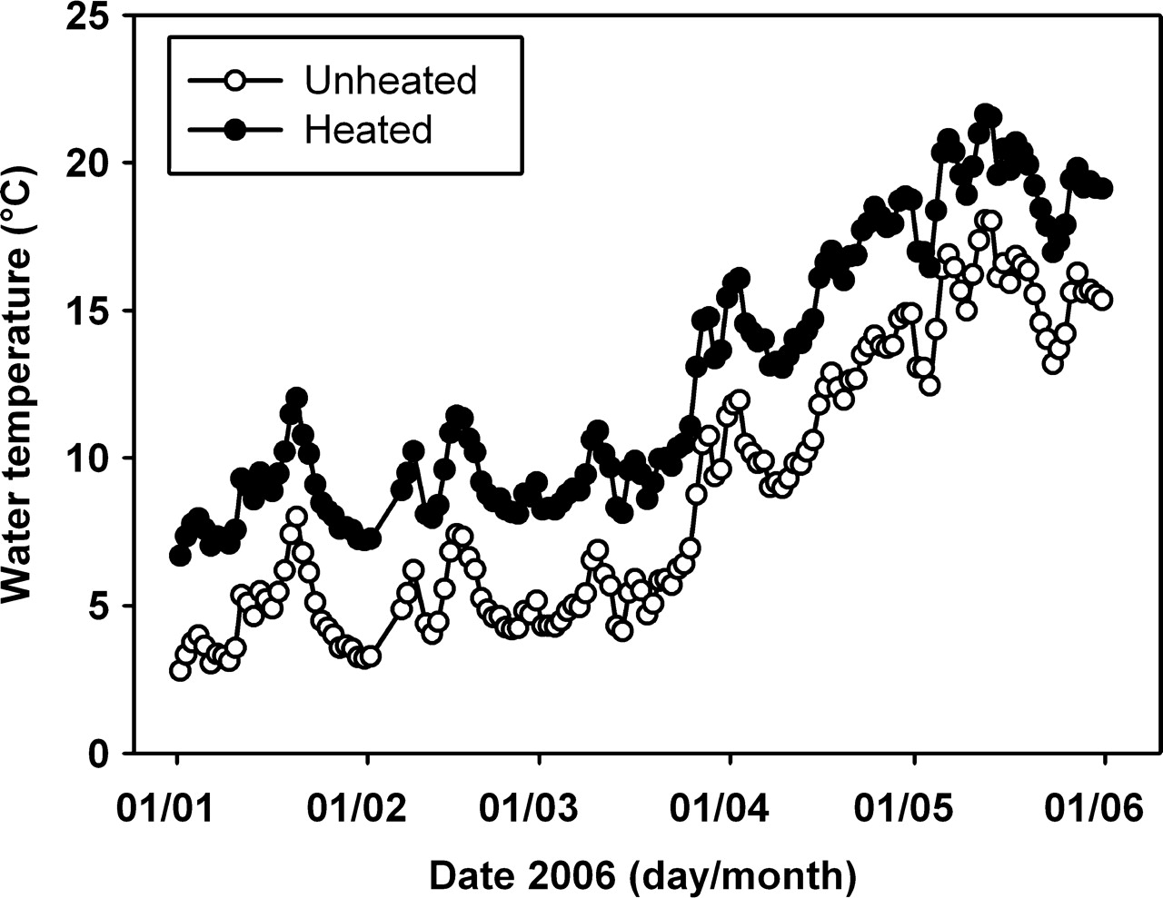
Fig. 1. Mean daily water temperatures averaged over 24 ambient (open circles) and 23 heated (filled circles) ...
Notes:
Fig. 1. Mean daily water temperatures averaged over 24 ambient (open circles) and 23 heated (filled circles) mesocosms from January to end of May 2006.
Unless provided in the caption above, the following copyright applies to the content of this slide: © The Author 2010. Published by Oxford University Press. All rights reserved. For permissions, please email: journals.permissions@oxfordjournals.org

Slide 2
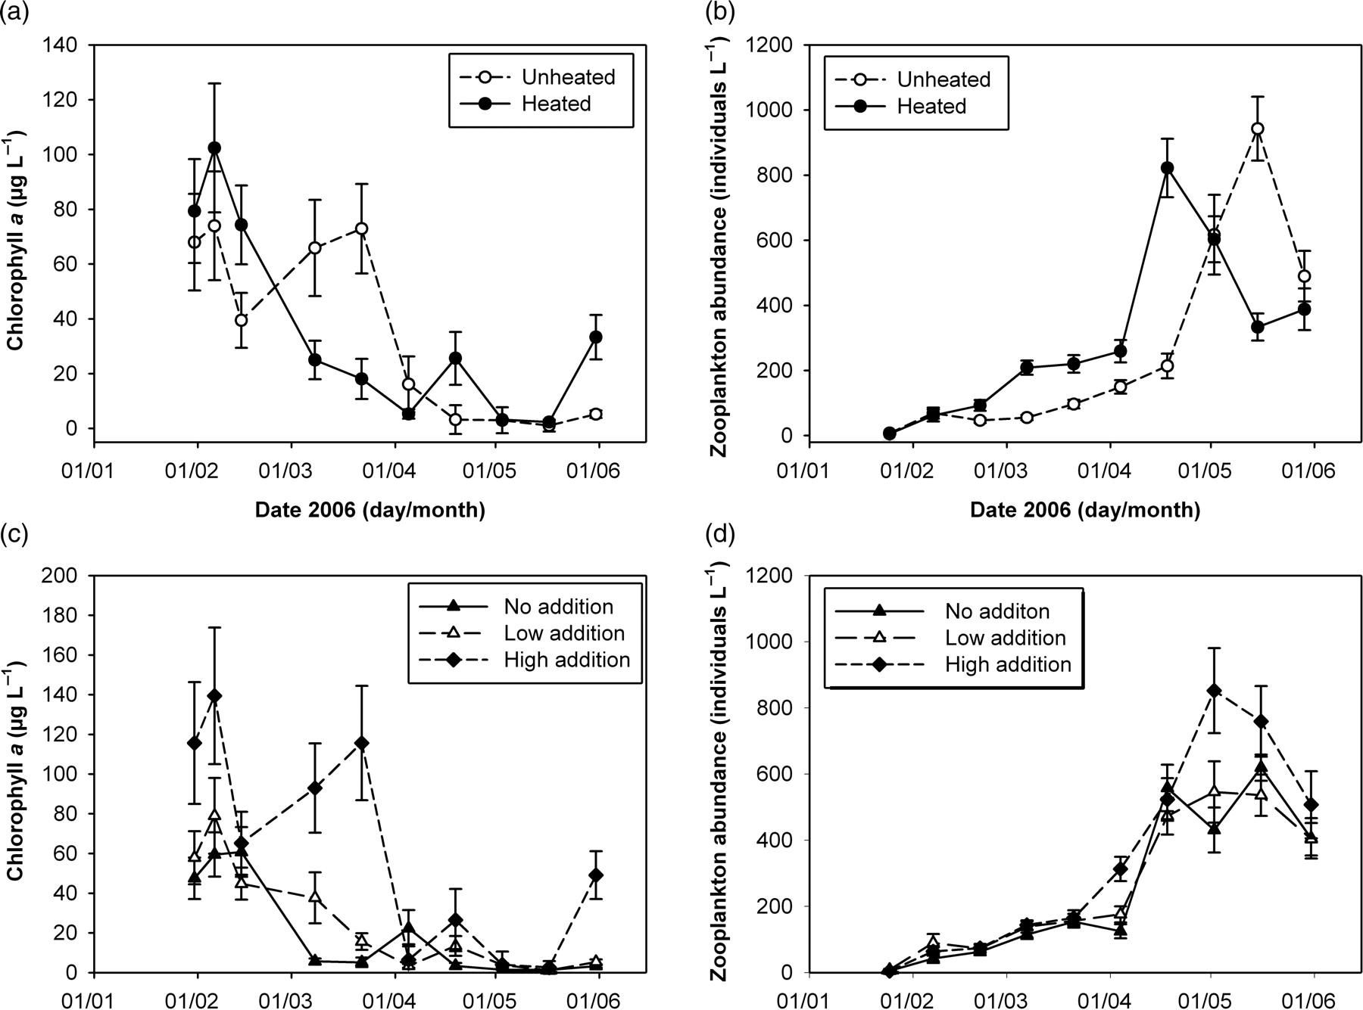
Fig. 2. Mean ± SE of (a) chlorophyll a concentrations (µg L⁻¹) and (b) crustacean zooplankton abundances ...
Notes:
Fig. 2. Mean ± SE of (a) chlorophyll a concentrations (µg L−1) and (b) crustacean zooplankton abundances (L−1) from end of January to end of May 2006 in heated and unheated mesocosms. Mean ± SE of (c) chlorophyll a concentrations (µg L−1) and (d) crustacean zooplankton abundances (L−1) from end of January to end of May 2006 in mesocosms with no nutrient addition, low nutrient addition (addition of P and low addition of N) and high nutrient addition (addition of P and high addition of N).
Unless provided in the caption above, the following copyright applies to the content of this slide: © The Author 2010. Published by Oxford University Press. All rights reserved. For permissions, please email: journals.permissions@oxfordjournals.org

Slide 3
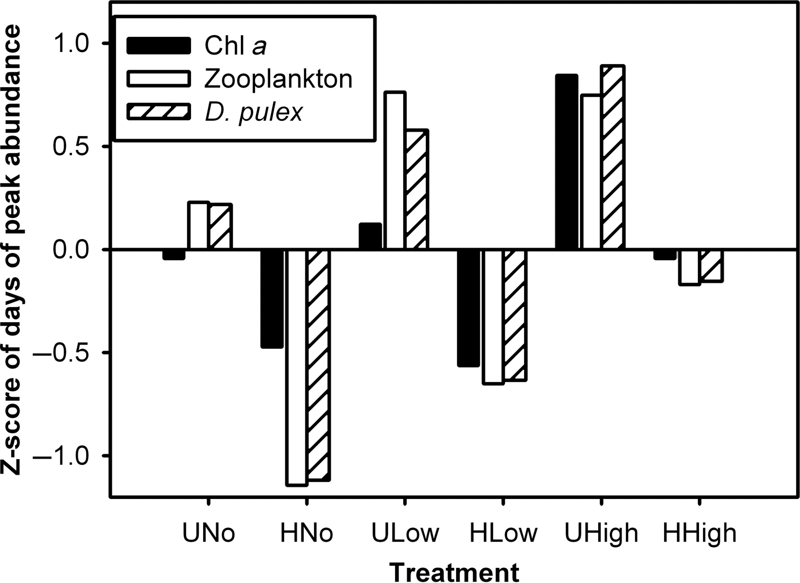
Fig. 3. Z-scores for chlorophyll a (black bars), total zooplankton (white bars) and D. pulex (diagonally lined bars) ...
Notes:
Fig. 3. Z-scores for chlorophyll a (black bars), total zooplankton (white bars) and D. pulex (diagonally lined bars) peak abundance determined with Weibull-type functions (based on Rolinski et al. (2007)), in 47 mesocosms from February to end of May 2006. Negative z-scores indicate earlier peaks compared with the average time of peak occurrence, positive values indicate later peaks (Treatments: UNo, Unheated and No nutrient addition; HNo, Heated and No nutrient addition; ULow, Unheated and Low nutrient addition; HLow, Heated and low nutrient addition; UHigh, Unheated and High nutrient addition; HHigh, Heated and high nutrient addition).
Unless provided in the caption above, the following copyright applies to the content of this slide: © The Author 2010. Published by Oxford University Press. All rights reserved. For permissions, please email: journals.permissions@oxfordjournals.org

Slide 4
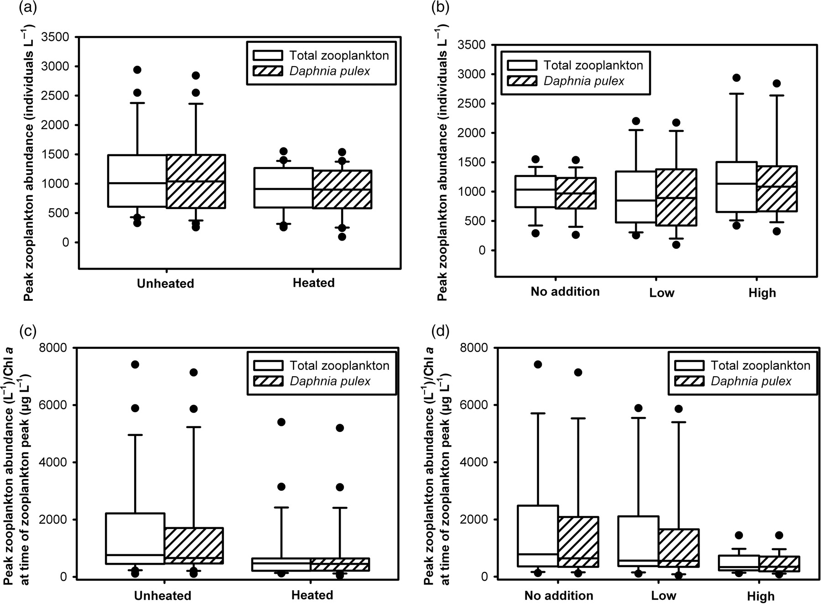
Fig. 4. (a) Boxplots of total zooplankton and D. pulex peak abundances in heated and unheated mesocosms ...
Notes:
Fig. 4. (a) Boxplots of total zooplankton and D. pulex peak abundances in heated and unheated mesocosms (F1,45 = 2.02, P= 0.16 for total zooplankton, F1,45 = 2.21, P= 0.15 for D. pulex) and (b) in mesocosms with no nutrient addition (No), low (Low) and high (High) addition (F2,45= 1.08, P= 0.35 for total zooplankton, F2,45 = 0.87, P= 0.43 for D. pulex). (c) Boxplots of peak zooplankton abundances (L−1) per chlorophyll a concentrations (µg L−1) 1 day after the zooplankton peak in heated and unheated mesocosms (F1,43= 2.97, P= 0.09 for zooplankton, F1,43= 1.80, P= 0.19 for D. pulex) and (d) in mesocosms with no nutrient addition, low (Low) and high (High) addition (F2,43= 2.58, P= 0.09 for zooplankton, F2,43 = 2.07, P= 0.14 for D. pulex). Two chlorophyll a readings were negative and were not included in the analysis; the large box represents data between the 25th and 75th percentile; the line within the box represents the median. Vertical bars show the upper and lower 10 percentiles, dots represent outliers.
Unless provided in the caption above, the following copyright applies to the content of this slide: © The Author 2010. Published by Oxford University Press. All rights reserved. For permissions, please email: journals.permissions@oxfordjournals.org

