Slide 1
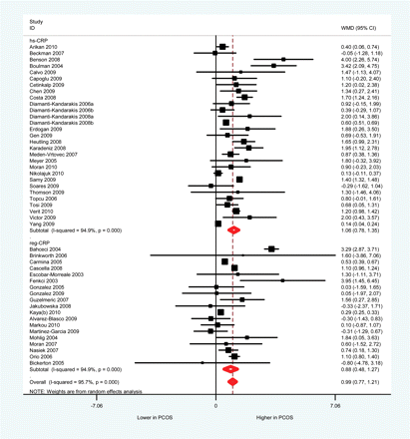
Figure 1 C-reactive protein serum concentrations in women with PCOS and controls.
Notes:
Figure 1 C-reactive protein serum concentrations in women with PCOS and controls.
Unless provided in the caption above, the following copyright applies to the content of this slide: © The Author 2011. Published by Oxford University Press on behalf of the European Society of Human Reproduction and Embryology. All rights reserved. For Permissions, please email: journals.permissions@oup.com

Slide 2
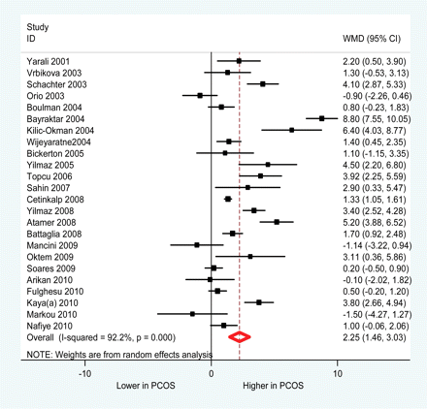
Figure 2 Homocysteine serum concentrations in women with PCOS and controls.
Notes:
Figure 2 Homocysteine serum concentrations in women with PCOS and controls.
Unless provided in the caption above, the following copyright applies to the content of this slide: © The Author 2011. Published by Oxford University Press on behalf of the European Society of Human Reproduction and Embryology. All rights reserved. For Permissions, please email: journals.permissions@oup.com

Slide 3
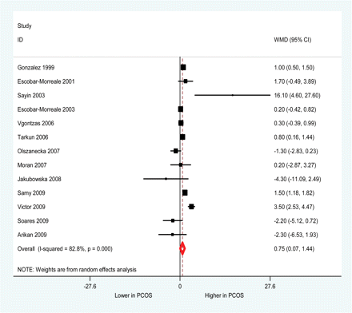
Figure 3 TNF-α serum concentrations in women with PCOS and controls.
Notes:
Figure 3 TNF-α serum concentrations in women with PCOS and controls.
Unless provided in the caption above, the following copyright applies to the content of this slide: © The Author 2011. Published by Oxford University Press on behalf of the European Society of Human Reproduction and Embryology. All rights reserved. For Permissions, please email: journals.permissions@oup.com

Slide 4
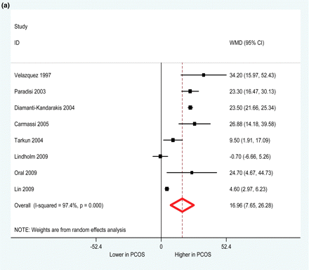
Figure 4 Plasminogen activator inhibitor-1 antigen (a) and activity (b) serum concentrations in women with PCOS and ...
Notes:
Figure 4 Plasminogen activator inhibitor-1 antigen (a) and activity (b) serum concentrations in women with PCOS and controls.
Unless provided in the caption above, the following copyright applies to the content of this slide: © The Author 2011. Published by Oxford University Press on behalf of the European Society of Human Reproduction and Embryology. All rights reserved. For Permissions, please email: journals.permissions@oup.com

Slide 5
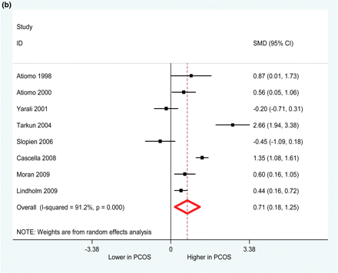
Figure 4 Plasminogen activator inhibitor-1 antigen (a) and activity (b) serum concentrations in women with PCOS and ...
Notes:
Figure 4 Plasminogen activator inhibitor-1 antigen (a) and activity (b) serum concentrations in women with PCOS and controls.
Unless provided in the caption above, the following copyright applies to the content of this slide: © The Author 2011. Published by Oxford University Press on behalf of the European Society of Human Reproduction and Embryology. All rights reserved. For Permissions, please email: journals.permissions@oup.com

Slide 6
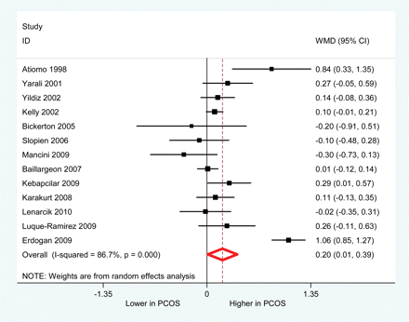
Figure 5 Fibrinogen serum concentrations in women with PCOS and controls.
Notes:
Figure 5 Fibrinogen serum concentrations in women with PCOS and controls.
Unless provided in the caption above, the following copyright applies to the content of this slide: © The Author 2011. Published by Oxford University Press on behalf of the European Society of Human Reproduction and Embryology. All rights reserved. For Permissions, please email: journals.permissions@oup.com

Slide 7
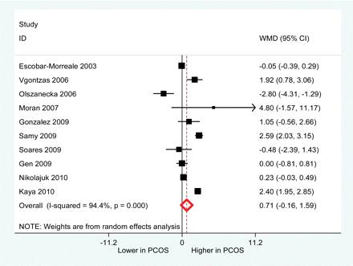
Figure 6 IL-6 serum concentrations in women with PCOS and controls.
Notes:
Figure 6 IL-6 serum concentrations in women with PCOS and controls.
Unless provided in the caption above, the following copyright applies to the content of this slide: © The Author 2011. Published by Oxford University Press on behalf of the European Society of Human Reproduction and Embryology. All rights reserved. For Permissions, please email: journals.permissions@oup.com

Slide 8
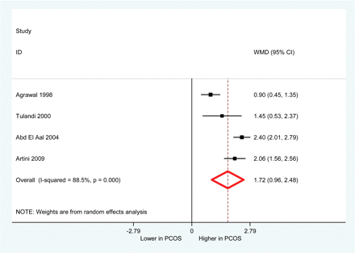
Figure 7 VEGF serum concentrations in women with PCOS and controls.
Notes:
Figure 7 VEGF serum concentrations in women with PCOS and controls.
Unless provided in the caption above, the following copyright applies to the content of this slide: © The Author 2011. Published by Oxford University Press on behalf of the European Society of Human Reproduction and Embryology. All rights reserved. For Permissions, please email: journals.permissions@oup.com

Slide 9
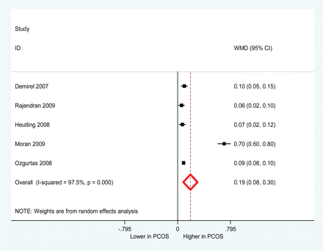
Figure 8 ADMA serum concentrations in women with PCOS and controls.
Notes:
Figure 8 ADMA serum concentrations in women with PCOS and controls.
Unless provided in the caption above, the following copyright applies to the content of this slide: © The Author 2011. Published by Oxford University Press on behalf of the European Society of Human Reproduction and Embryology. All rights reserved. For Permissions, please email: journals.permissions@oup.com

Slide 10
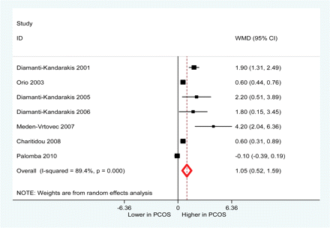
Figure 9 ET-1 serum concentrations in women with PCOS and controls.
Notes:
Figure 9 ET-1 serum concentrations in women with PCOS and controls.
Unless provided in the caption above, the following copyright applies to the content of this slide: © The Author 2011. Published by Oxford University Press on behalf of the European Society of Human Reproduction and Embryology. All rights reserved. For Permissions, please email: journals.permissions@oup.com

Slide 11
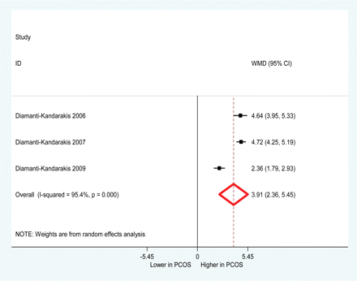
Figure 10 Advanced glycation end product serum concentrations in women with PCOS and controls.
Notes:
Figure 10 Advanced glycation end product serum concentrations in women with PCOS and controls.
Unless provided in the caption above, the following copyright applies to the content of this slide: © The Author 2011. Published by Oxford University Press on behalf of the European Society of Human Reproduction and Embryology. All rights reserved. For Permissions, please email: journals.permissions@oup.com

Slide 12
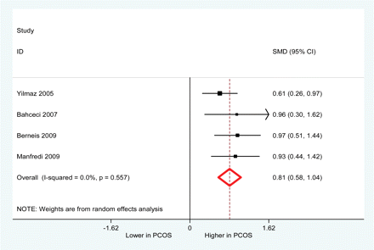
Figure 11 Lipoprotein(a) serum concentrations in women with PCOS and controls.
Notes:
Figure 11 Lipoprotein(a) serum concentrations in women with PCOS and controls.
Unless provided in the caption above, the following copyright applies to the content of this slide: © The Author 2011. Published by Oxford University Press on behalf of the European Society of Human Reproduction and Embryology. All rights reserved. For Permissions, please email: journals.permissions@oup.com

