Slide 1
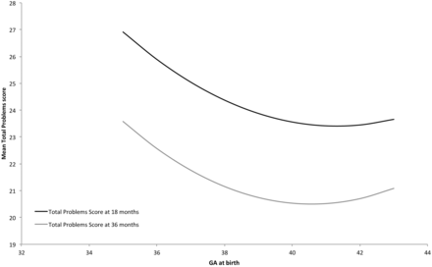
Figure 1 The unadjusted association between GA at birth and total behavioural and emotional problem score
Notes:
Figure 1 The unadjusted association between GA at birth and total behavioural and emotional problem score
Unless provided in the caption above, the following copyright applies to the content of this slide: Published by Oxford University Press on behalf of the International Epidemiological Association © The Author 2012; all rights reserved.

