Slide 1
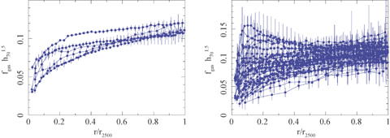
Figure 1 The X-ray gas mass fraction profiles for the ΛCDM reference cosmology (Ω_{m}= 0.3, Ω_{Λ}= ...
Notes:
Figure 1 The X-ray gas mass fraction profiles for the ΛCDM reference cosmology (Ωm= 0.3, ΩΛ= 0.7, h= 0.7) with the radial axes scaled in units of r2500. Left-hand panel: Results for the six lowest redshift clusters with z≲ 0.15. Right-hand panel: Results for the entire sample. Note fgas(r) is an integrated quantity and so error bars on neighbouring points in a profile are correlated.
Unless provided in the caption above, the following copyright applies to the content of this slide: 2007 The Authors. Journal compilation © 2007 RAS

Slide 2
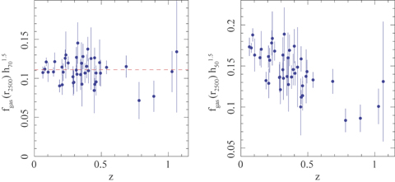
Figure 2 The apparent variation of the X-ray gas mass fraction measured within r₂₅₀₀ as a function of ...
Notes:
Figure 2 The apparent variation of the X-ray gas mass fraction measured within r2500 as a function of redshift for the (left-hand panel) reference ΛCDM and (right-hand panel) reference SCDM (Ωm= 1.0, ΩΛ= 0.0, h= 0.5) cosmologies. The plotted error bars are statistical rms 1σ uncertainties. The global, absolute normalization of the fgas value should be regarded as uncertain at the ∼10–15 per cent level due to systematic uncertainties in instrument calibration, modelling and the level of non-thermal pressure support (Section 4.2).
Unless provided in the caption above, the following copyright applies to the content of this slide: 2007 The Authors. Journal compilation © 2007 RAS

Slide 3
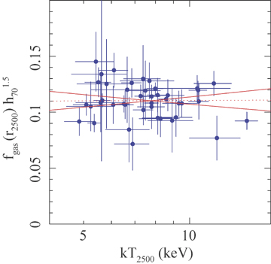
Figure 3 The X-ray gas mass fraction as a function of mass-weighted temperature measured within r₂₅₀₀ for ...
Notes:
Figure 3 The X-ray gas mass fraction as a function of mass-weighted temperature measured within r2500 for the reference ΛCDM cosmology. The dotted line shows the best-fitting power-law model which provides a good description of the data (χ2= 43.5 for 40 degrees of freedom) and is consistent with a constant value (slope α= 0.005 ± 0.058). The solid lines shows the 2σ limits on the slopes allowed by the data. The figure demonstrates that fgas is essentially independent of temperature for the massive, dynamically relaxed clusters in the present sample.
Unless provided in the caption above, the following copyright applies to the content of this slide: 2007 The Authors. Journal compilation © 2007 RAS

Slide 4
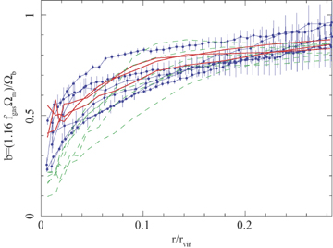
Figure 4 The X-ray depletion or bias factor, b (i.e. the enclosed baryon fraction relative to the universal value) as ...
Notes:
Figure 4 The X-ray depletion or bias factor, b (i.e. the enclosed baryon fraction relative to the universal value) as a function of radius, in units of the virial radius rvir, from the simulations of Eke et al. (1998). The simulated clusters have similar masses to the systems studied here. The results (at zero redshift) for the three most dynamically relaxed clusters in the simulations are shown as bold red curves. Less relaxed simulated clusters are shown as dashed green curves. The Chandra observations for the six lowest redshift clusters in the fgas sample are plotted as blue circles, with error bars. (The Chandra profiles are identical to those shown in Fig. 1, but are scaled assuming Ωm= 0.27, Ωb= 0.0413 and r2500= 0.25 rvir.) The agreement between the observed and predicted profiles argues that the non-radiative simulations provide a reasonable approximation for the purpose of predicting the baryonic mass distributions.
Unless provided in the caption above, the following copyright applies to the content of this slide: 2007 The Authors. Journal compilation © 2007 RAS

Slide 5
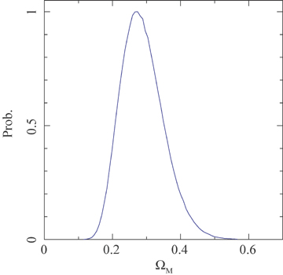
Figure 5 The marginalized constraints on Ω_{m} from the Chandraf_{gas} data for the six lowest ...
Notes:
Figure 5 The marginalized constraints on Ωm from the Chandrafgas data for the six lowest redshift clusters, using the non-flat ΛCDM model and standard priors on Ωbh2 and h. Uncertainties due to the evolution in b and s and the nature of the dark energy component are negligible in the analysis (although allowances for these uncertainties are included). We obtain a marginalized result Ωm= 0.28 ± 0.06 (68 per cent confidence limits).
Unless provided in the caption above, the following copyright applies to the content of this slide: 2007 The Authors. Journal compilation © 2007 RAS

Slide 6
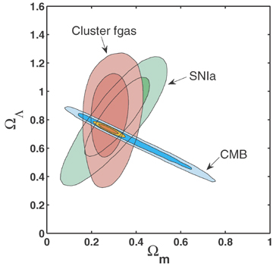
Figure 6 The 68.3 and 95.4 per cent (1 and 2 σ) confidence constraints in the (Ω_{m}, Ω_{Λ}) plane for ...
Notes:
Figure 6 The 68.3 and 95.4 per cent (1 and 2 σ) confidence constraints in the (Ωm, ΩΛ) plane for the Chandrafgas data (red contours; standard priors on Ωbh2 and h are used). Also shown are the independent results obtained from CMB data (blue contours) using a weak, uniform prior on h (0.2 < h < 2), and SNIa data (green contours; the results for the Davis et al. 2007 compilation are shown). The inner, orange contours show the constraint obtained from all three data sets combined (no external priors on Ωbh2 and h are used). A ΛCDM model is assumed, with the curvature included as a free parameter.
Unless provided in the caption above, the following copyright applies to the content of this slide: 2007 The Authors. Journal compilation © 2007 RAS

Slide 7
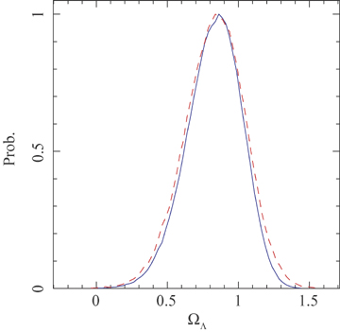
Figure 7 The marginalized constraints on Ω_{Λ} determined from the Chandraf_{gas} data using the ...
Notes:
Figure 7 The marginalized constraints on ΩΛ determined from the Chandrafgas data using the non-flat ΛCDM model and standard (solid curve) and weak (dashed curve) priors on Ωbh2 and h. The fgas data provide a detection of the effects of dark energy at the ∼99.99 per cent confidence level.
Unless provided in the caption above, the following copyright applies to the content of this slide: 2007 The Authors. Journal compilation © 2007 RAS

Slide 8
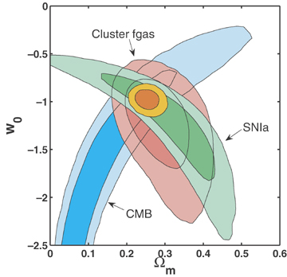
Figure 8 The 68.3 and 95.4 per cent (1 and 2σ) confidence constraints in the (Ω_{m}, w) plane obtained from ...
Notes:
Figure 8 The 68.3 and 95.4 per cent (1 and 2σ) confidence constraints in the (Ωm, w) plane obtained from the analysis of the Chandrafgas data (red contours) using standard priors on Ωbh2 and h. Also shown are the independent results obtained from CMB data (blue contours) using a weak, uniform prior on h (0.2 < h < 2.0) and SNIa data (green contours; Davis et al. 2007). The inner, orange contours show the constraint obtained from all three data sets combined: Ωm= 0.253 ± 0.021 and w=−0.98 ± 0.07 (68 per cent confidence limits). No external priors on Ωbh2 and h are used when the data sets are combined. A flat cosmology with a constant dark energy equation of state parameter w is assumed.
Unless provided in the caption above, the following copyright applies to the content of this slide: 2007 The Authors. Journal compilation © 2007 RAS

Slide 9
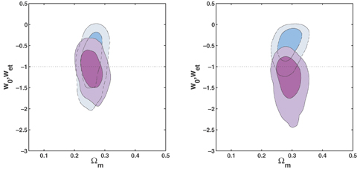
Figure 9 The 68.3 and 95.4 per cent confidence limits in the (Ω_{m}; w₀, w_{et}) plane ...
Notes:
Figure 9 The 68.3 and 95.4 per cent confidence limits in the (Ωm; w0, wet) plane determined from the fgas+ CMB + SNIa data using our most general dark energy model (equation 6) with the transition scalefactor marginalized over the range 0.5 < at < 0.95. The solid, purple contours show the results on (Ωm, w0). The dashed, turquoise lines show the results on (Ωm, wet). The horizontal dotted line denotes the cosmological constant model (w0=wet=−1). The left- and right-hand panels show the results obtained for the two SNIa samples: (left-hand panel) Davis et al. (2007) and (right-hand panel) Riess et al. (2007). A flat geometry (Ωk= 0) is assumed. The data provide no significant evidence for evolution in w and are consistent with the cosmological constant (ΛCDM) model (w=−1; Section 5.5).
Unless provided in the caption above, the following copyright applies to the content of this slide: 2007 The Authors. Journal compilation © 2007 RAS

Slide 10
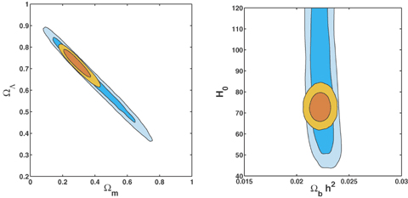
Figure 10 The degeneracy-breaking power of the f_{gas}+ CMB data. Contours show the 68.3 and 95.4 per cent ...
Notes:
Figure 10 The degeneracy-breaking power of the fgas+ CMB data. Contours show the 68.3 and 95.4 per cent confidence limits determined from the CMB data alone (larger, blue contours) and combined fgas+ CMB data (smaller, orange contours). Left-hand panel: The constraints on Ωm and ΩDE for the ΛCDM model with the curvature included as a free parameter. Right-hand panel: The tight constraints on H0 and Ωbh2 for the flat, constant w model, demonstrating why external priors on these two parameters are not required when the fgas and CMB data are combined.
Unless provided in the caption above, the following copyright applies to the content of this slide: 2007 The Authors. Journal compilation © 2007 RAS

Slide 11
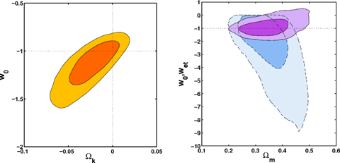
Figure 11 Left-hand panel: The 68.3 and 95.4 per cent confidence limits on the dark energy equation of state and ...
Notes:
Figure 11 Left-hand panel: The 68.3 and 95.4 per cent confidence limits on the dark energy equation of state and curvature from the analysis of the fgas+ CMB + SNIa data using the non-flat, constant w model. The SNIa compilation of Davis et al. (2007) has been used. The horizontal and vertical dotted lines denote the loci for cosmological constant models and geometric flatness, respectively, both of which are consistent with the data. Right-hand panel: The 68.3 and 95.4 per cent confidence limits in the (Ωm; w0, wet) plane determined from the fgas+ CMB + SNIa data for the general dark energy model (equation 6) with the curvature also included as a free parameter. Other details are as in the left-hand panel of Fig. 9.
Unless provided in the caption above, the following copyright applies to the content of this slide: 2007 The Authors. Journal compilation © 2007 RAS

