Slide 1
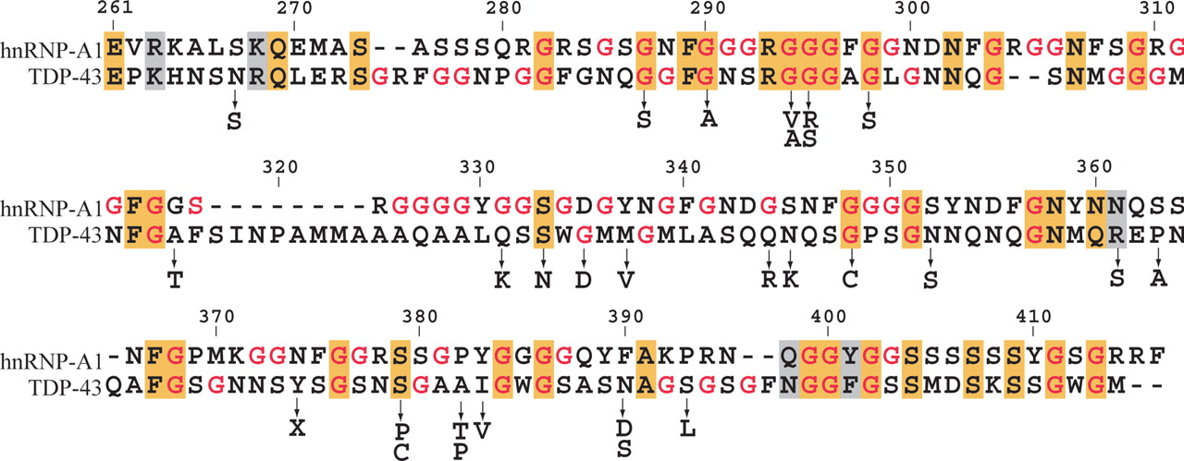
Figure 1. The glycine-rich domain protein sequence alignment of TDP-43 and hnRNP-A1 is shown with amino acid numbering ...
Notes:
Figure 1. The glycine-rich domain protein sequence alignment of TDP-43 and hnRNP-A1 is shown with amino acid numbering (top) corresponding to the TDP-43 amino acid number. Identical and similar amino acid residues are boxed and colored in orange and grey, respectively. Glycines are highlighted in red and the arrows indicate missense mutations in TDP-43 with their corresponding amino acid change.
Unless provided in the caption above, the following copyright applies to the content of this slide: © The Author 2009. Published by Oxford University Press. All rights reserved. For Permissions, please email: journals.permissions@oxfordjournals.org

Slide 2
Figure 2. Immunohistochemical staining of TDP-43 in spinal cord motor neurons from control subject (left), a sporadic ...
Notes:
Figure 2. Immunohistochemical staining of TDP-43 in spinal cord motor neurons from control subject (left), a sporadic ALS patient (middle) and a fALS patient harboring the G298S mutation (right) illustrate that TDP-43 pathology in ALS cases with and without a TARDBP missense mutation is indistinguishable.
Unless provided in the caption above, the following copyright applies to the content of this slide: © The Author 2009. Published by Oxford University Press. All rights reserved. For Permissions, please email: journals.permissions@oxfordjournals.org

