Slide 1
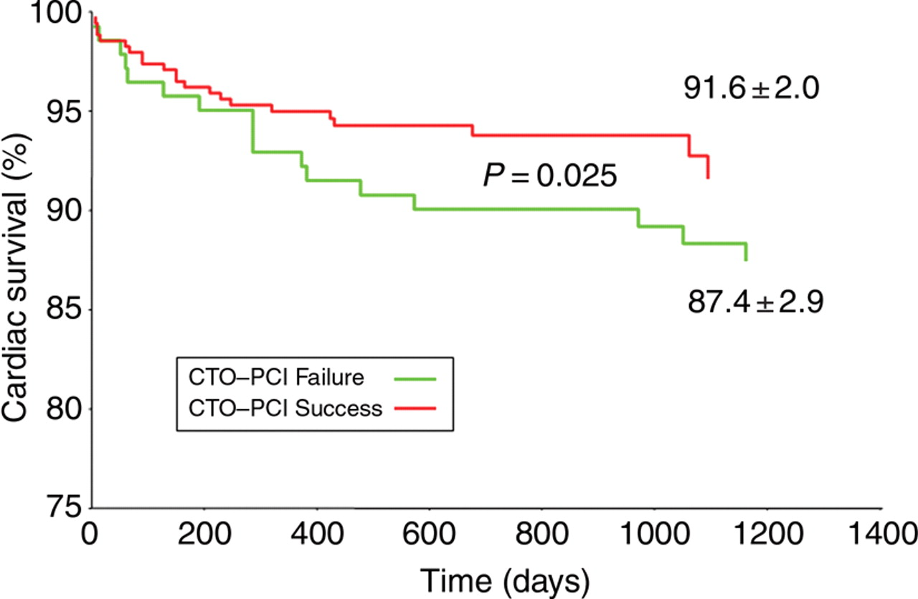
Figure 1 Kaplan–Meier analysis of cardiac survival in patients with chronic total occlusion (CTO)–percutaneous ...
Notes:
Figure 1 Kaplan–Meier analysis of cardiac survival in patients with chronic total occlusion (CTO)–percutaneous coronary intervention (PCI) success when compared to patients with CTO–PCI failure.
Unless provided in the caption above, the following copyright applies to the content of this slide: Published on behalf of the European Society of Cardiology. All rights reserved. © The Author 2008. For permissions please email: journals.permissions@oxfordjournals.org

Slide 2
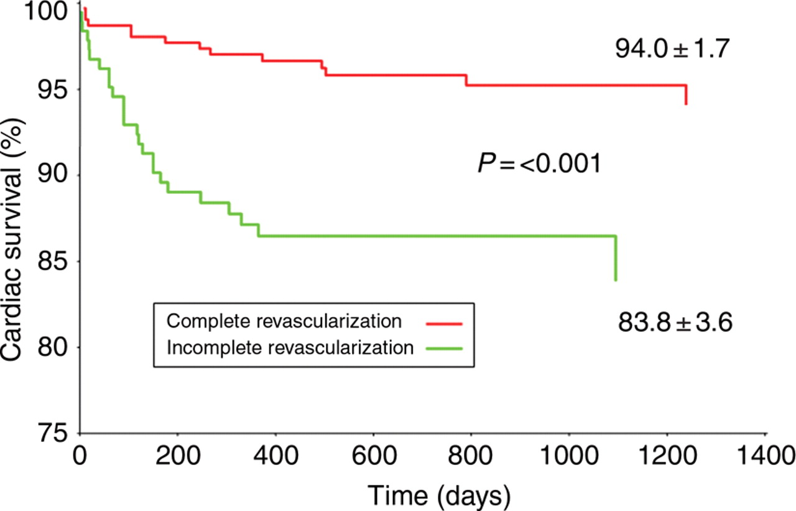
Figure 2 Kaplan–Meier analysis of cardiac survival in patients with complete revascularization when compared to ...
Notes:
Figure 2 Kaplan–Meier analysis of cardiac survival in patients with complete revascularization when compared to patients with incomplete revascularization.
Unless provided in the caption above, the following copyright applies to the content of this slide: Published on behalf of the European Society of Cardiology. All rights reserved. © The Author 2008. For permissions please email: journals.permissions@oxfordjournals.org

