Slide 1
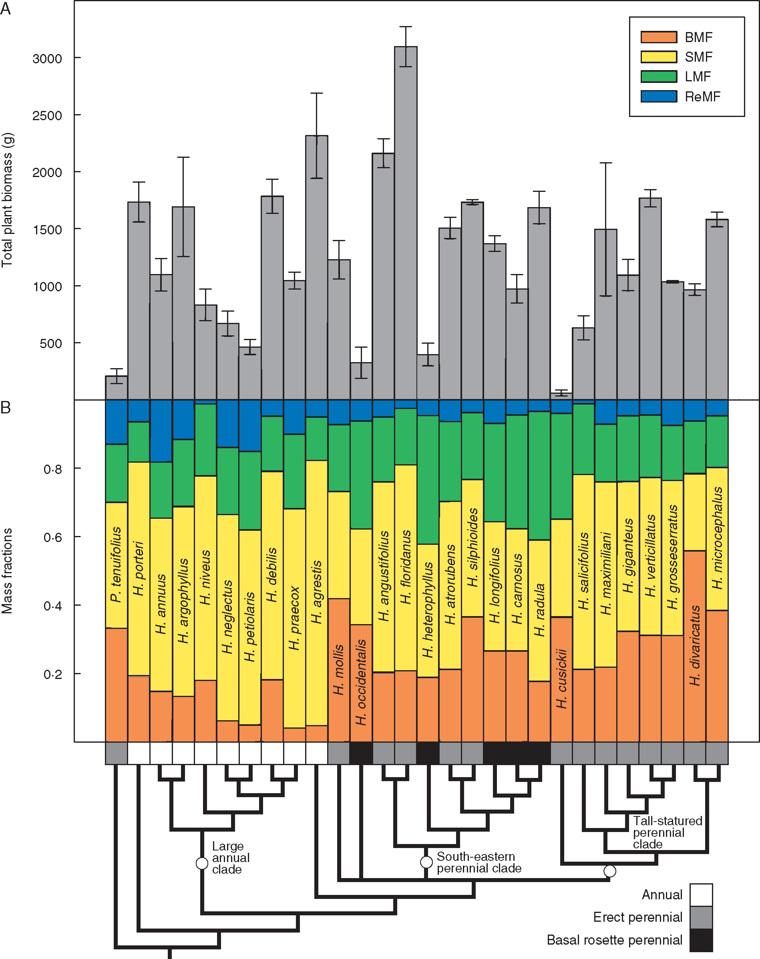
Fig. 1. Variation in biomass allocation and total plant size across Helianthus. (A) Species mean total plant biomass ...
Notes:
Fig. 1. Variation in biomass allocation and total plant size across Helianthus. (A) Species mean total plant biomass at harvest. Error bars reflect standard errors of species means calculated from population means. (B) Relative biomass allocation among plant organs represented as species mean below-ground, stem, leaf and reproductive mass fractions. Note that infraspecific epithets are omitted for space.
Unless provided in the caption above, the following copyright applies to the content of this slide: © The Author 2017. Published by Oxford University Press on behalf of the Annals of Botany Company. All rights reserved. For Permissions, please email: journals.permissions@oup.com

Slide 2
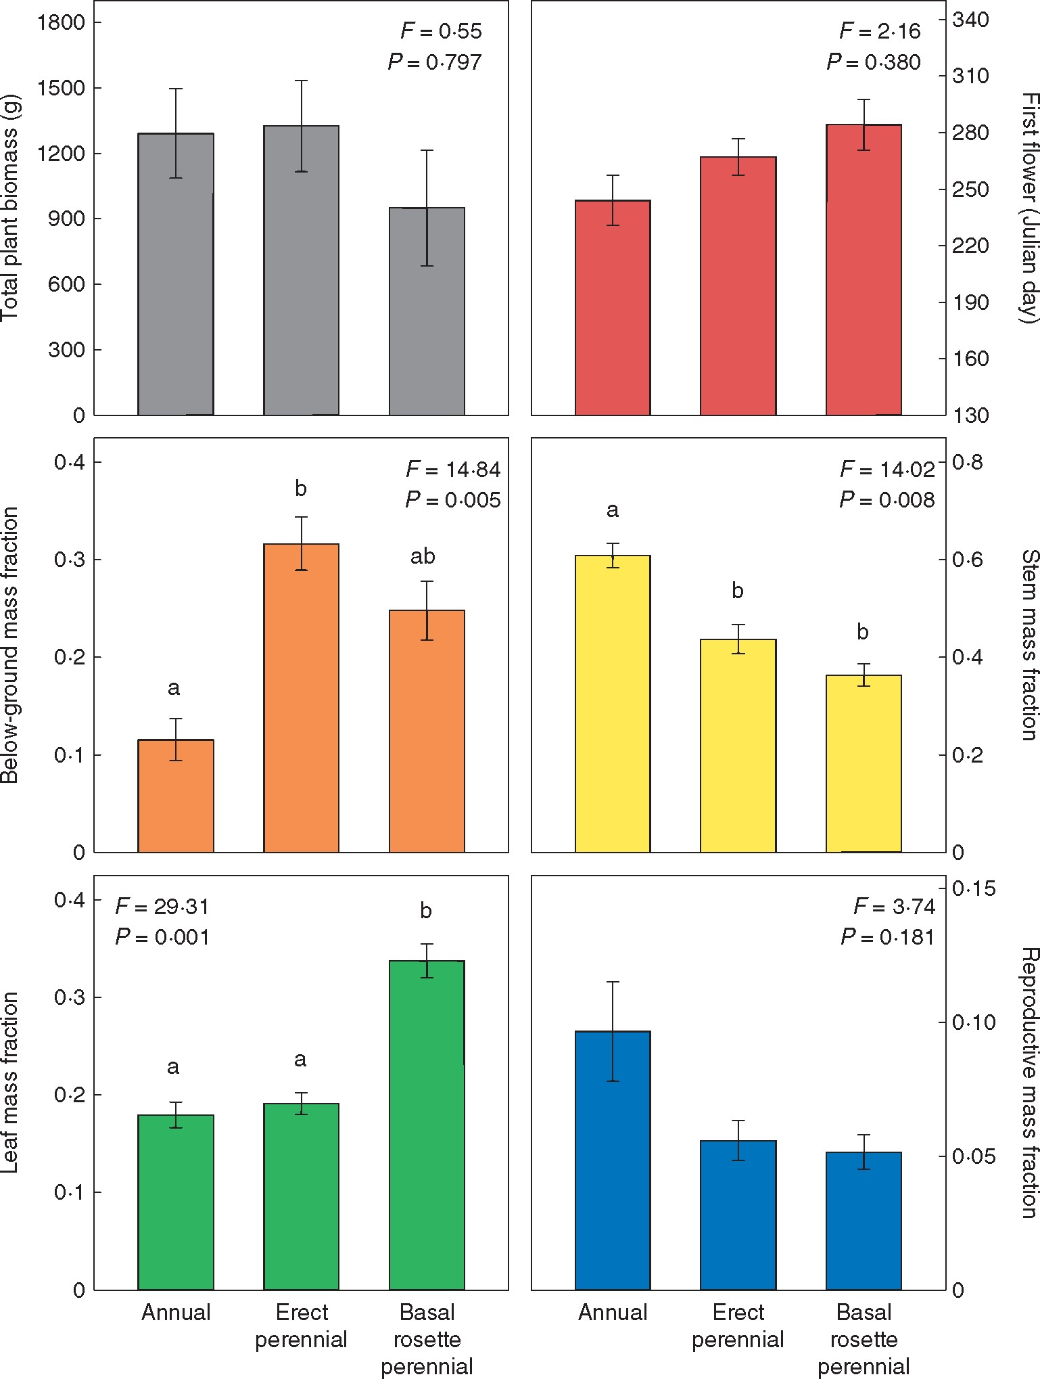
Fig. 2. Differences in plant traits among species based on growth form and life history using phylogenetic ANOVA ...
Notes:
Fig. 2. Differences in plant traits among species based on growth form and life history using phylogenetic ANOVA (Garland et al., 1993) in the R package ‘phytools’ (Revell, 2012). Bars that do not share letters are significantly different by the Holm post-hoc test.
Unless provided in the caption above, the following copyright applies to the content of this slide: © The Author 2017. Published by Oxford University Press on behalf of the Annals of Botany Company. All rights reserved. For Permissions, please email: journals.permissions@oup.com

Slide 3
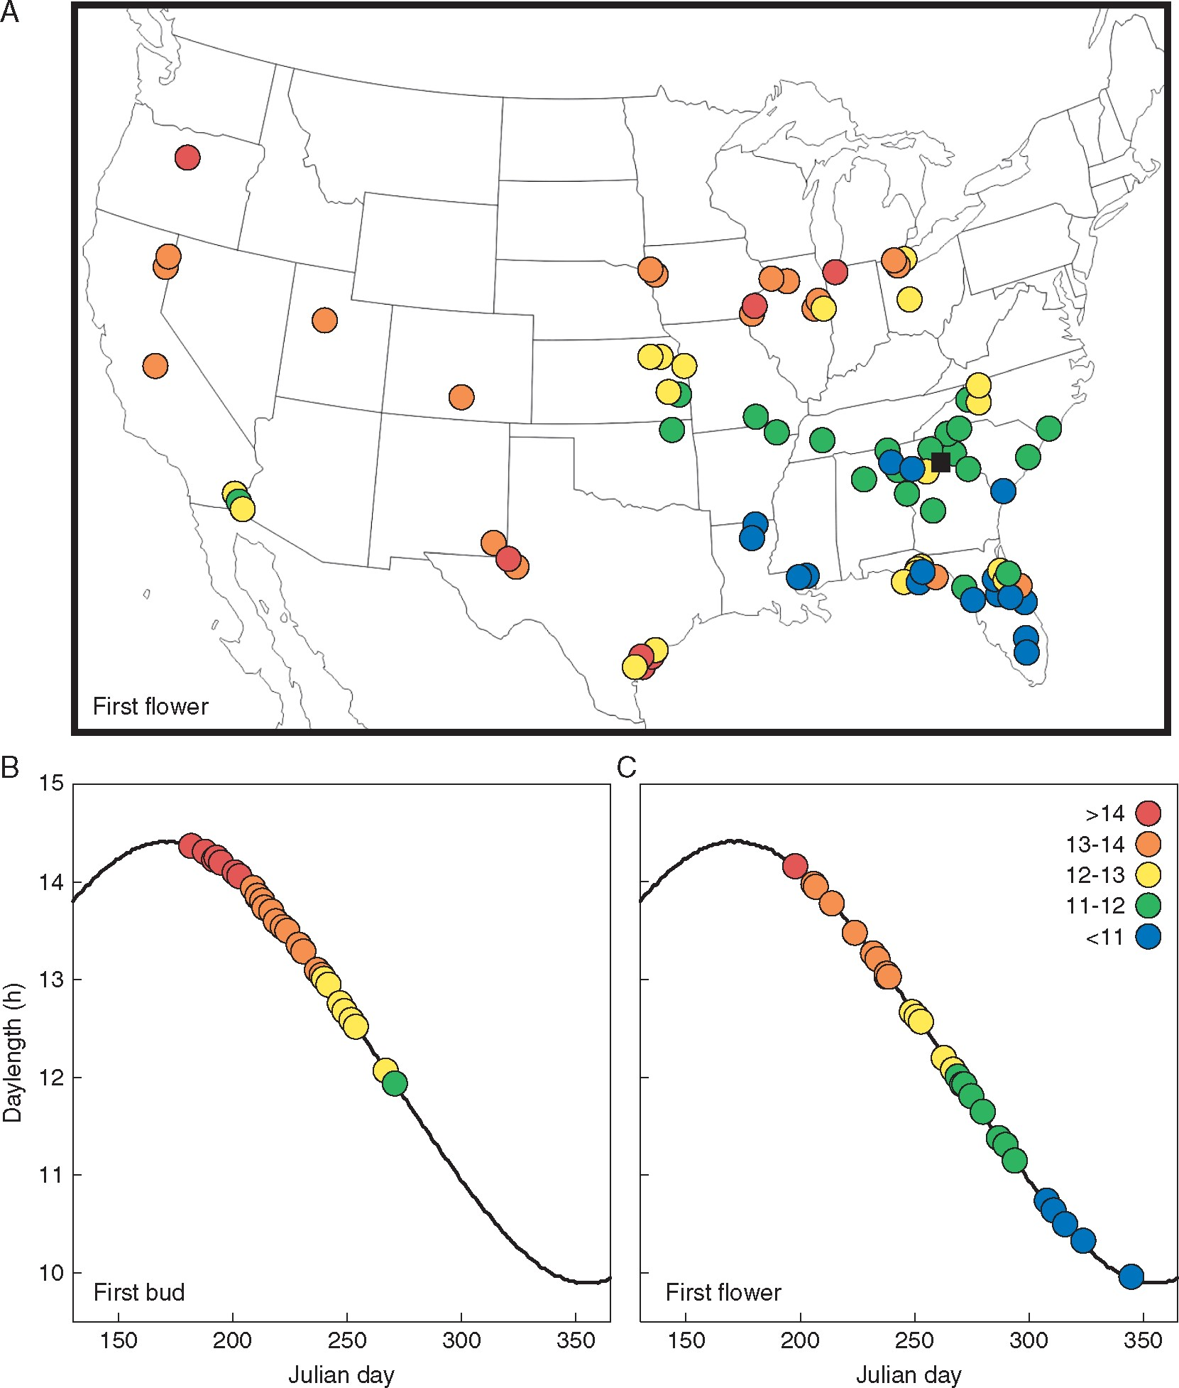
Fig. 3. Variation in reproductive timing across Helianthus. (A) Population mean daylength at first flower in Athens, ...
Notes:
Fig. 3. Variation in reproductive timing across Helianthus. (A) Population mean daylength at first flower in Athens, Georgia common gardens (black square) plotted on population source sites across North America. (B) Species mean daylength at first bud and (C) first flower in Athens, Georgia common gardens.
Unless provided in the caption above, the following copyright applies to the content of this slide: © The Author 2017. Published by Oxford University Press on behalf of the Annals of Botany Company. All rights reserved. For Permissions, please email: journals.permissions@oup.com

