Slide 1
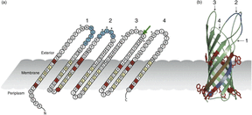
1 Structure of OmpA. (a) A topological model OmpA showing the major features of the protein. Residues in ...
Notes:
1 Structure of OmpA. (a) A topological model OmpA showing the major features of the protein. Residues in β-sheets are in diamonds, those coloured in red make up the aromatic girdle while those in yellow are the alternating hydrophobic residues. Loops are numbered. Residues in loops 1 and 2 are important for binding endothelial cells and C4bp are highlighted in blue. Positions that may differ between enterobacteria are asterixed (Gophna et al., 2004; Power et al., 2006). The position of an insertion of three to four amino acids in loop 3 of invasive enterobacteria is indicated (Gophna et al., 2004). (b) Three-dimensional structure of OmpA. The view was generated using PyMOL (PDB-code 1BXW, Pautsch & Schulz, 1998). The aromatic girdle is shown in red and the first and last β-strands are highlighted in brown and blue to aid in the location of the termini, respectively. Loops are arrowed and numbered. Regions of loops 1 and 2 required for binding to endothelial cells and C4bp are highlighted in blue.
Unless provided in the caption above, the following copyright applies to the content of this slide: © 2007 Federation of European Microbiological Societies

Slide 2
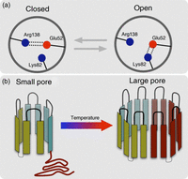
2 Pore formation by OmpA. (a) Viewing the OmpA molecule from above the backbone of the barrel is represented by ...
Notes:
2 Pore formation by OmpA. (a) Viewing the OmpA molecule from above the backbone of the barrel is represented by the grey circle. Arg138 forms a strong electrostatic interaction with Glu52, the salt bridge formed across the inside of the barrel blocks ion transport. Lys82 may impinge on this interaction and stochastic movement of this residue towards Glu52 can result in the formation of another mutually exclusive ion pair. In this conformation, Glu52 does not block the movement of ions through the pore. (b) The eight-stranded β-barrel of OmpA is depicted. The β-sheets are indicated by rectangles and the external loops are also indicated. In the eight-stranded conformation, a large carboxy-terminal domain remains in the periplasm. Upon elevation of the temperature a 16-stranded β-barrel is formed, with eight of the strands from the domain formerly located in the periplasm.
Unless provided in the caption above, the following copyright applies to the content of this slide: © 2007 Federation of European Microbiological Societies

Slide 3
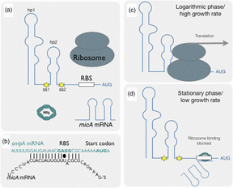
3 Ribo-regulation of ompA. (a) The leader sequence of ompA mRNA can fold into two stem-loop structures hp1 and ...
Notes:
3 Ribo-regulation of ompA. (a) The leader sequence of ompA mRNA can fold into two stem-loop structures hp1 and hp2. RNaseE cleaves the mRNA at ss1 and ss2 (yellow stars). (b) The micA mRNA forms a highly folded mRNA. The micA mRNA can base pair with ompA mRNA in the vicinity of the RBS This binding is facilitated by Hfq. (c) During the logarithmic phase or when growth rate is high, less MicA is produced and translation of ompA mRNA proceeds. (d) At the stationary phase or under conditions of low growth rate, micA copy number is elevated and it binds to the RBS of ompA mRNA, preventing ribosomal recruitment and facilitating ribonucleolytic degradation. Binding is facilitated by the protein Hfq.
Unless provided in the caption above, the following copyright applies to the content of this slide: © 2007 Federation of European Microbiological Societies

Slide 4
4 Comparison of the ompA1 and ompA2 alleles. The translated sequences of the ompA1 and ompA2 alleles in the ...
Notes:
4 Comparison of the ompA1 and ompA2 alleles. The translated sequences of the ompA1 and ompA2 alleles in the vicinity of loops 2 and 3 are aligned (Power et al., 2006). Perfect matches are shaded black.
Unless provided in the caption above, the following copyright applies to the content of this slide: © 2007 Federation of European Microbiological Societies

