Slide 1
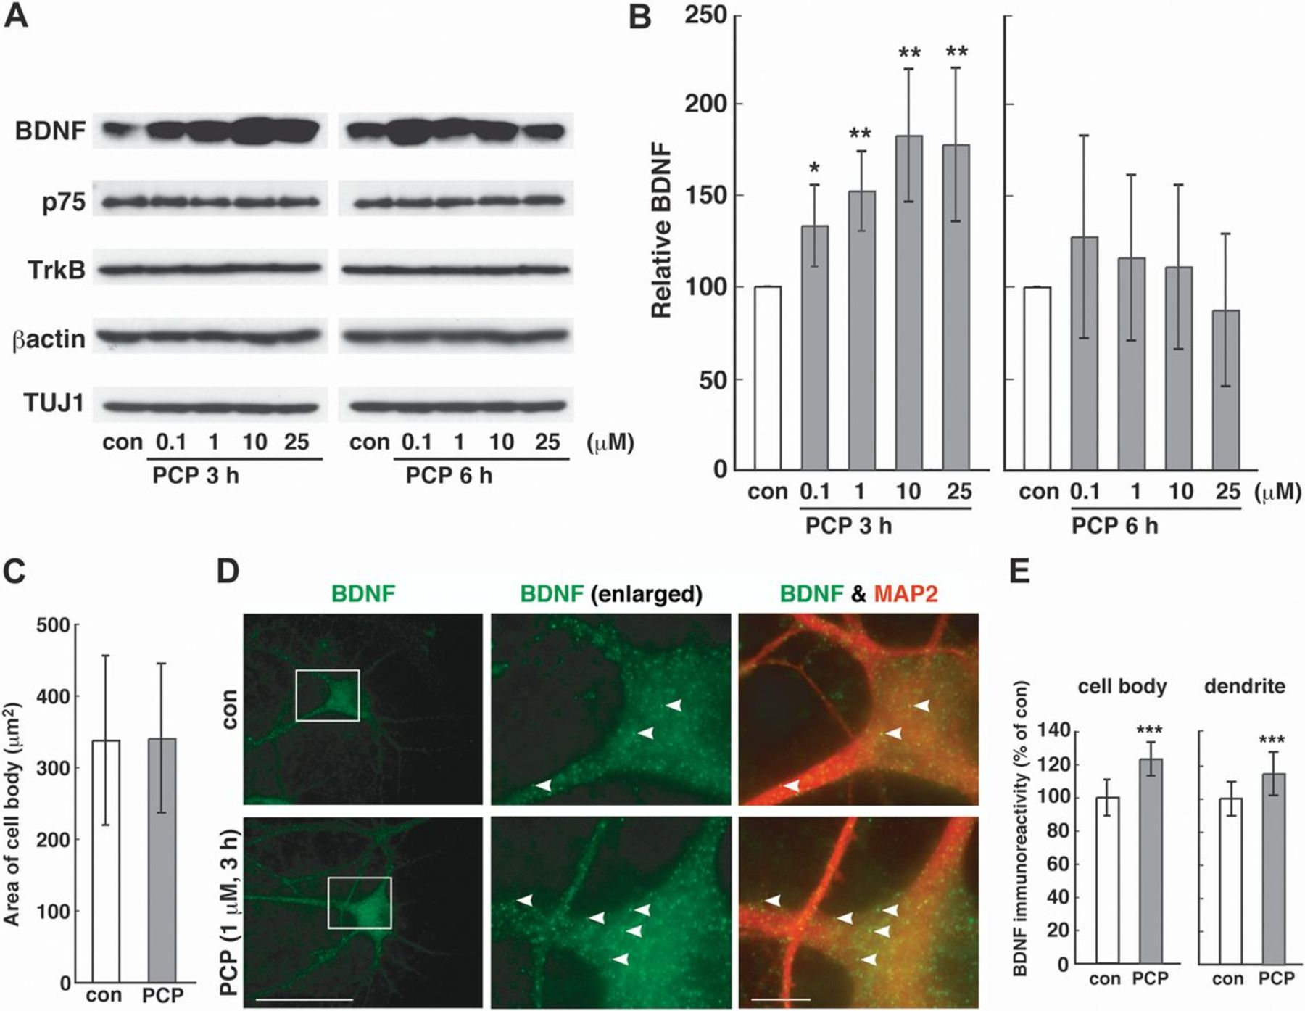
Figure 1. PCP increased levels of intracellular BDNF in cultured cortical neurons. (A) BDNF levels (14 kD, mature BDNF) ...
Notes:
Figure 1. PCP increased levels of intracellular BDNF in cultured cortical neurons. (A) BDNF levels (14 kD, mature BDNF) in total lysate were rapidly increased after PCP treatment, whereas expression levels of TrkB and p75 were unchanged. Cultured cortical neurons at DIV 10 and 11 were treated with PCP at indicated doses. Samples were collected 3 or 6 h after PCP addition. TUJ1 and β-actin were represented as controls. (B) The mature BDNF expression was quantified. Data represent mean ± standard deviation (n = 6, obtained from 6 independent cultures. n indicates the number of experiments if not otherwise specified.). **P < 0.01, *P < 0.05 versus con (without PCP). Statistical significance was evaluated by one-way ANOVA followed by Scheffe's post hoc test. (C) Size of cell body area was not changed by PCP. After 48 h of PCP (10 μM) treatment, neuronal cell body sizes were measured (con: n = 13; PCP: n = 12, n indicates the number of neurons in each experimental condition). (D) Immunocytochemistry revealed a significant increase in BDNF immunoreactivity in cortical neurons in PCP-treated cultures. Cells were immunostained with anti-BDNF and anti-MAP2 antibodies. PCP (1 μM) was applied for 3 h. Left: images after staining with anti-BDNF antibody (green). Bar = 50 μm. Middle: magnified images of insets in Left panels. Right: double staining with anti-BDNF (green) and anti-MAP2 (red) antibodies. Typical BDNF-containing vesicles are indicated by arrowheads. Bar = 10 μm. (E) Quantification of BDNF immunoreactivity. Mean intensity of BDNF immunoreactivity in one or two areas of cell body per 1 cell (around 200 μm2) and in 4–6 primary dendrites (around 50 μm2) were measured (cell body: con, n = 20 and PCP, n = 22; primary dendrite: con, n = 95 and PCP, n = 80; n indicates the number of areas obtained from 14 randomly selected neurons in 4 different dishes of the same culture preparation). ***P < 0.001 (t-test).
Unless provided in the caption above, the following copyright applies to the content of this slide: © The Author 2012. Published by Oxford University Press. All rights reserved. For permissions, please e-mail: journals.permissions@oup.com

Slide 2
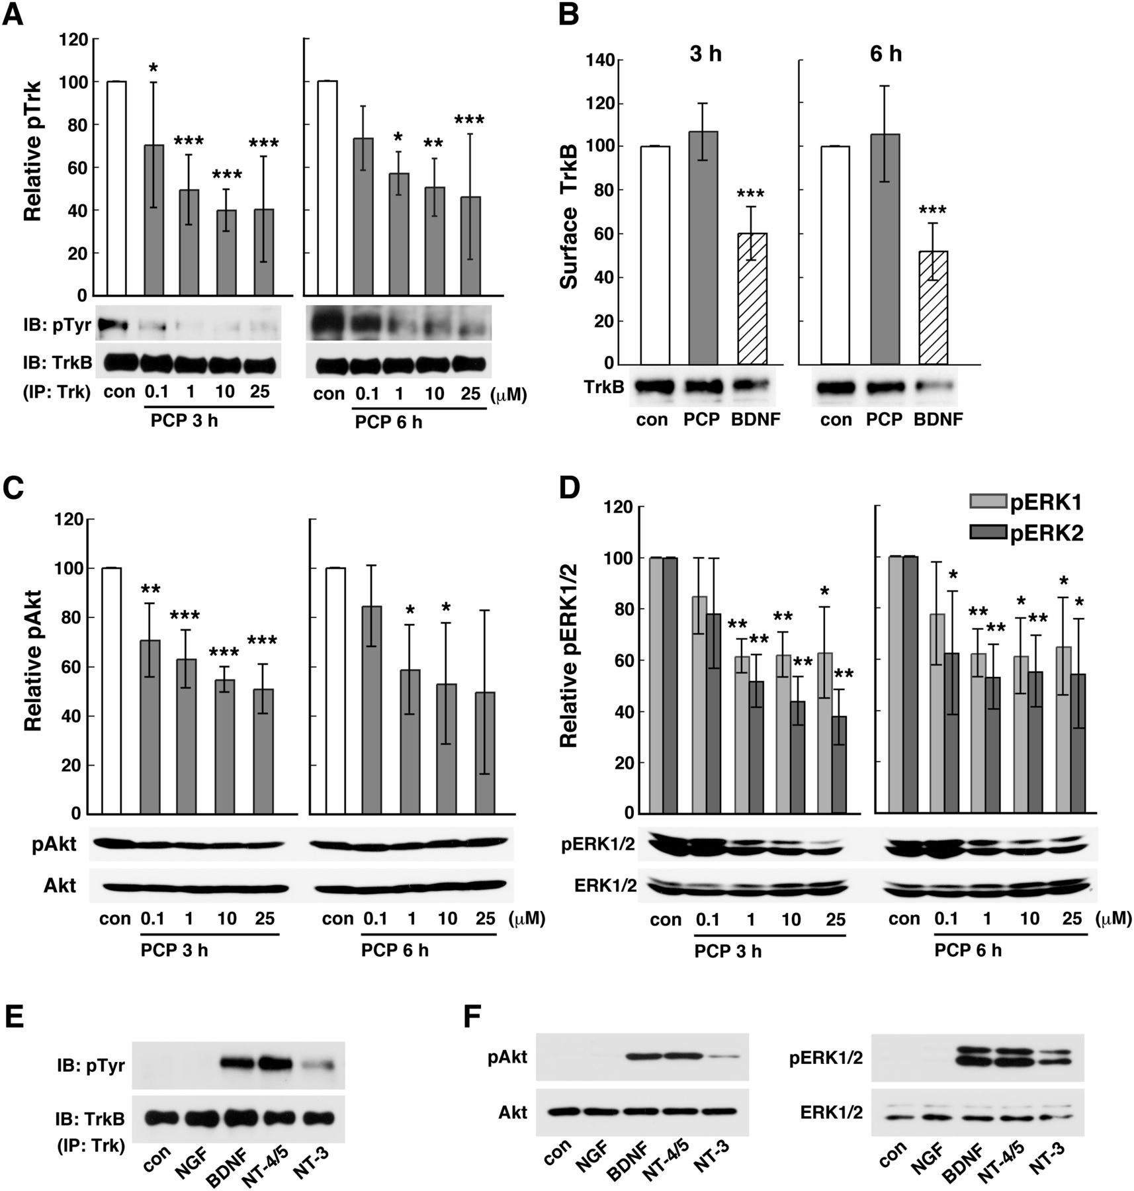
Figure 2. PCP decreased activation of Trk receptors, MAPK/ERK1/2 and PI3K/Akt pathways. (A) Phosphorylation of Trk ...
Notes:
Figure 2. PCP decreased activation of Trk receptors, MAPK/ERK1/2 and PI3K/Akt pathways. (A) Phosphorylation of Trk receptors was suppressed after PCP treatment for 3 and 6 h. Cell lysates were immunoprecipitated with anti-Trk antibody. For immunoblotting, anti–phospho-Tyr (pTyr) or anti-TrkB antibodies were used. Phosphorylated Trk receptors (pTrk) were quantified (3 h: n = 10; 6 h: n = 6, obtained from 5 independent cultures). ***P < 0.001, **P < 0.01, *P < 0.05 versus con (one-way ANOVA followed by Scheffe's post hoc test). (B) The amount of TrkB receptors on the cell surface after PCP (10 μM) treatment for 3 or 6 h was shown. Note that BDNF (100 ng/mL, positive control for TrkB internalization) exposure decreased surface expression of TrkB while PCP did not. ***P < 0.001 versus con. (C,D) Activation of Akt (a component of the PI3K pathway) and ERK1/2 (MAPK pathway) were reduced up to 6 h after PCP addition. Quantification of phosphorylated Akt (pAkt) (C) and ERK1/2 (pERK1/2) (D) was conducted (n = 4, respectively. Obtained from 4 independent cultures). ***P < 0.001, **P < 0.01, *P < 0.05 versus con. (E,F) Trk signaling in cortical neurons stimulated by various neurotrophins. (E) Following immunoprecipitation with anti-Trk antibody, immunoblotting with anti-pTyr and TrkB antibodies was performed. Each neurotrophin was applied at 100 ng/mL. Note that BDNF and NT-4/5 significantly stimulated Trk receptors in cortical neurons. (F) PI3K/Akt (Left) and MAPK/ERK1/2 (Right) pathways.
Unless provided in the caption above, the following copyright applies to the content of this slide: © The Author 2012. Published by Oxford University Press. All rights reserved. For permissions, please e-mail: journals.permissions@oup.com

Slide 3
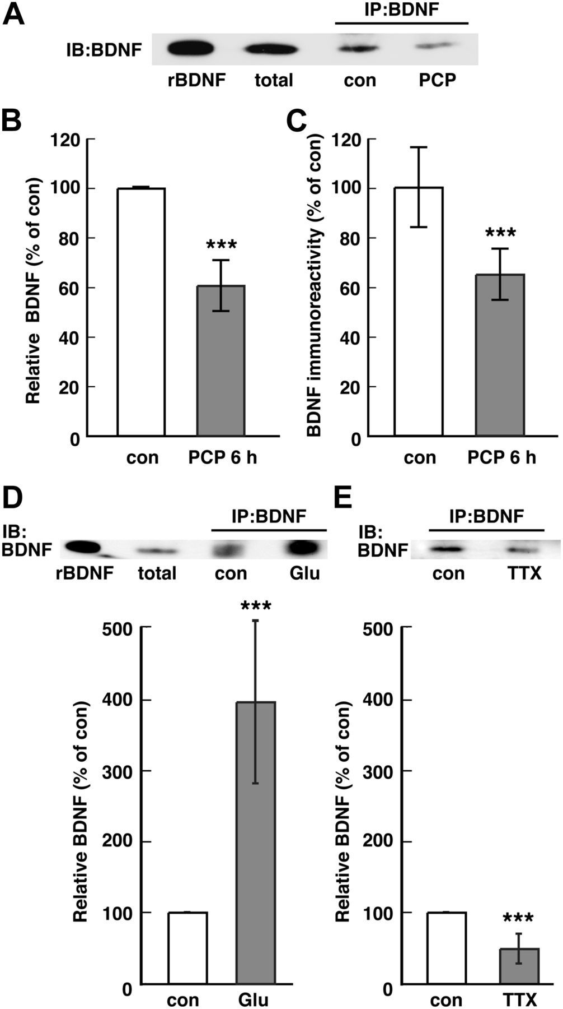
Figure 3. PCP decreased secretion of BDNF from cortical neurons. Secreted BDNF into culture medium was ...
Notes:
Figure 3. PCP decreased secretion of BDNF from cortical neurons. Secreted BDNF into culture medium was immunoprecipitated with anti-BDNF antibody. In the presence of anti-BDNF antibody (2 μg/mL), cortical neurons were incubated with or without PCP at 1 μM for 6 h, followed by immunoprecipitation. A representative Western blot (A) and quantified data (B) were shown (n = 12, from 5 independent cultures). ***P < 0.001 versus con (t-test). rBDNF: recombinant BDNF; total: total lysates (10% input). (C) ELISA analysis also showed a decreased amount of BDNF secretion by PCP (con: n = 11; PCP: n = 12, n indicates the number of dishes for each experimental condition). (D, E) Glutamate increased secretion of BDNF while TTX decreased it. Cortical neurons were treated with glutamate (1 μM, 15 min) (D) or TTX (3 μM, 6 h) (E). (Glutamate: n = 6, TTX: n = 5, from 5 independent cultures, respectively). ***P < 0.001 versus con (t-test).
Unless provided in the caption above, the following copyright applies to the content of this slide: © The Author 2012. Published by Oxford University Press. All rights reserved. For permissions, please e-mail: journals.permissions@oup.com

Slide 4
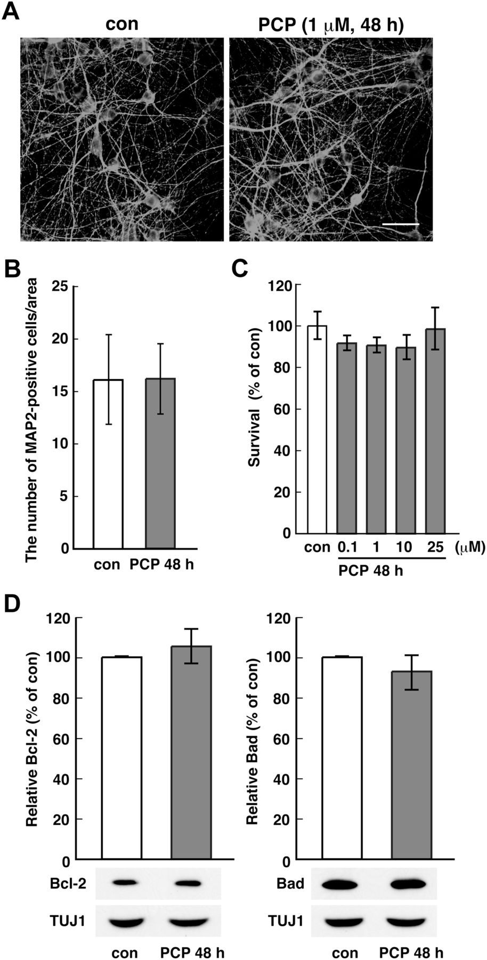
Figure 4. PCP did not affect neuronal viability. (A) Forty-eight hours after PCP (1 μM) treatment, cortical neurons ...
Notes:
Figure 4. PCP did not affect neuronal viability. (A) Forty-eight hours after PCP (1 μM) treatment, cortical neurons were stained with anti-MAP2 antibody. Bar = 50 μm. (B) These MAP2-positive cells were counted (n = 18, n indicates the number of randomly selected 250 × 250 μm2 fields from 5 dishes for each experimental condition). (C) PCP (0.1–25 μM, 48 h) treatment did not affect the cell viability, which was determined by MTT assay (n = 4). Normalization to control was carried out. (D) Both Bcl-2 (an antiapoptotic protein) and Bad (a proapoptotic protein) levels were not altered by PCP (1 μM, 48 h) (n = 4). TUJ1 is represented as control.
Unless provided in the caption above, the following copyright applies to the content of this slide: © The Author 2012. Published by Oxford University Press. All rights reserved. For permissions, please e-mail: journals.permissions@oup.com

Slide 5
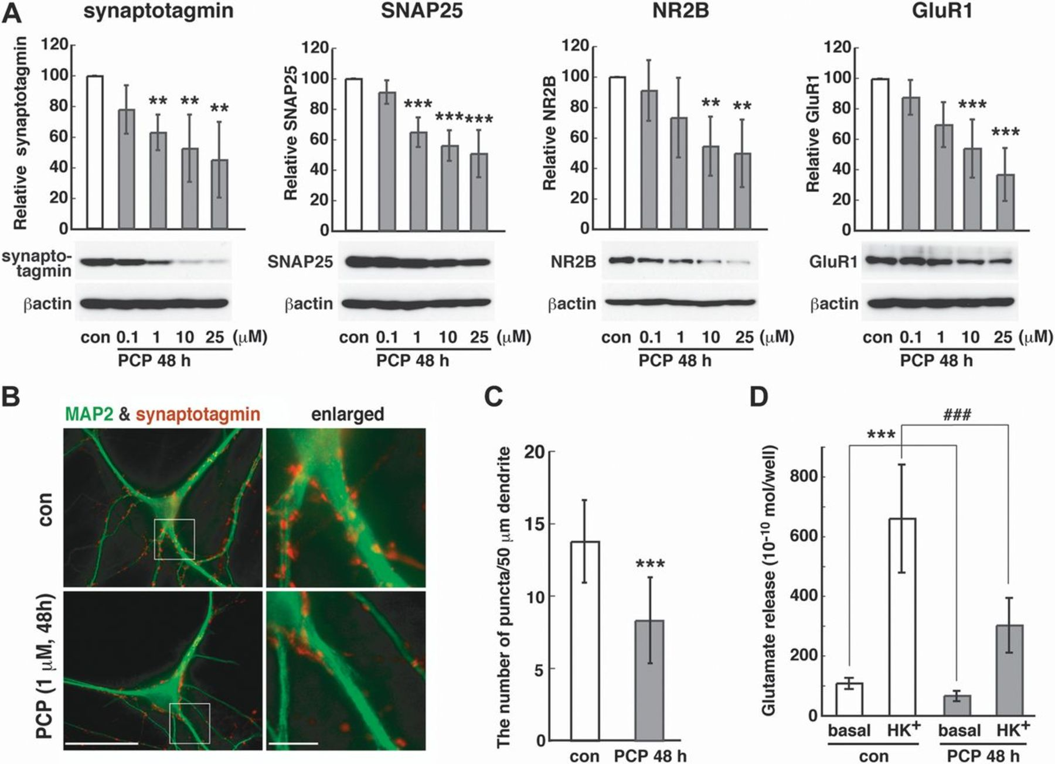
Figure 5. PCP reduced the number of synaptic sites, expression of synaptic proteins, and release of glutamate. (A) The ...
Notes:
Figure 5. PCP reduced the number of synaptic sites, expression of synaptic proteins, and release of glutamate. (A) The amount of synaptic proteins, including synaptotagmin, SNAP25, NR2B, and GluR1, were reduced by PCP. Samples were collected and analyzed after 48 h PCP (0.1–25 μM) treatment. ***P < 0.001, **P < 0.01, *P < 0.05 versus con (one-way ANOVA followed by Scheffe's post hoc test). (n = 7, from 5 independent cultures.) (B) The number of presynaptic sites was decreased by PCP (1 μM, 48 h). Representative images after synaptotagmin (red) and MAP2 (green) immunostaining are shown. Left: Bar = 50 μm, Right: inset in Left panels was magnified. Bar = 10 μm. (C) Synaptotagmin-positive presynaptic sites were counted. Thirty-eight randomly selected primary dendrites (per 50 μm) from 14 neurons in 4 randomly selected dishes for each experimental condition were selected. ***P < 0.001 versus con (t-test). (D) Glutamate release from cultured neurons was diminished by exposure to PCP. Glutamate from cortical cultures was collected for 1 min as nonstimulated basal and as high potassium-stimulated release. HK+; high potassium (KCl, 50 mM) condition. ***P < 0.001, ###P < 0.001 (t-test). n = 6. n indicates the number of dishes for each experimental condition.
Unless provided in the caption above, the following copyright applies to the content of this slide: © The Author 2012. Published by Oxford University Press. All rights reserved. For permissions, please e-mail: journals.permissions@oup.com

Slide 6
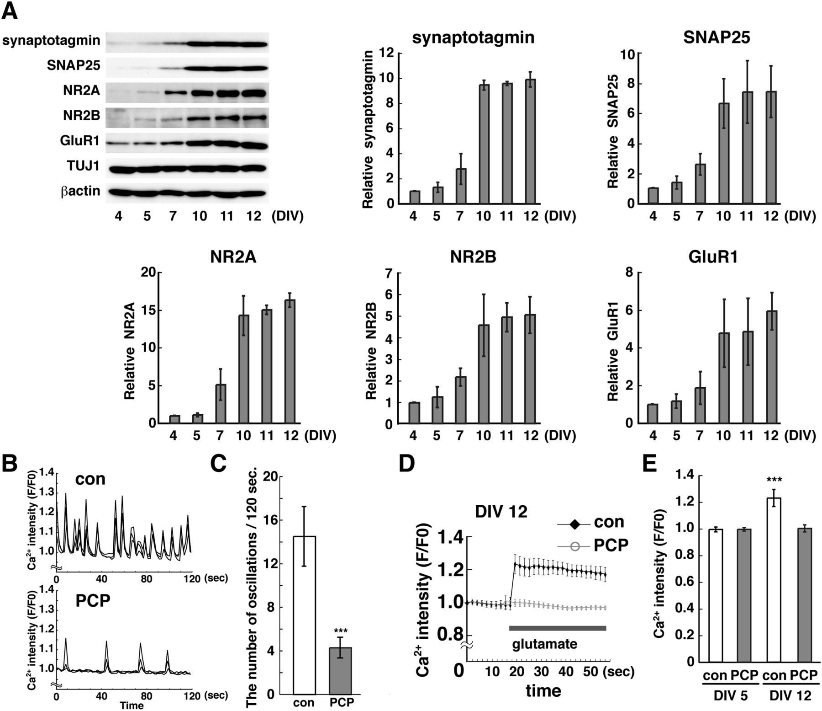
Figure 8. PCP inhibited intracellular Ca²⁺ elevation in mature cortical neurons. (A) Developmental change in ...
Notes:
Figure 8. PCP inhibited intracellular Ca2+ elevation in mature cortical neurons. (A) Developmental change in the expression of glutamate receptors (NR2A, NR2B, and GluR1), in addition to synaptotagmin and SNAP25, were shown. Expression of these synaptic proteins was gradually increased during in vitro maturation and reached maximum levels around DIV 10. (n = 3, from 3 independent cultures). TUJ1 and β-actin are controls. (B) Spontaneous Ca2+ oscillations were decreased in cultured cortical neurons in the presence of PCP (1 μM, 3 h). Traces were obtained from 3 neurons at DIV 12 in the same dish for each condition. The fluorescence ratio (F/F0, F0; basal intensity) was calculated. (C) The number of the frequency in Ca2+ oscillations was counted. (n = 6, n indicates the number of dishes of a sister culture). ***P < 0.001 versus con. (D) Glutamate-triggered intracellular Ca2+ elevation was blocked by PCP. PCP (1 μM) was applied 3 h before glutamate (1 μM) stimulation. DIV 12. (E) Quantified data of the evoked Ca2+ in the presence or the absence of PCP at DIV 5 or at DIV 12. Summarized data from 50 randomly selected cells for each experimental condition. ***P < 0.001 versus con. (one-way ANOVA followed by Scheffe's post hoc test).
Unless provided in the caption above, the following copyright applies to the content of this slide: © The Author 2012. Published by Oxford University Press. All rights reserved. For permissions, please e-mail: journals.permissions@oup.com

Slide 7
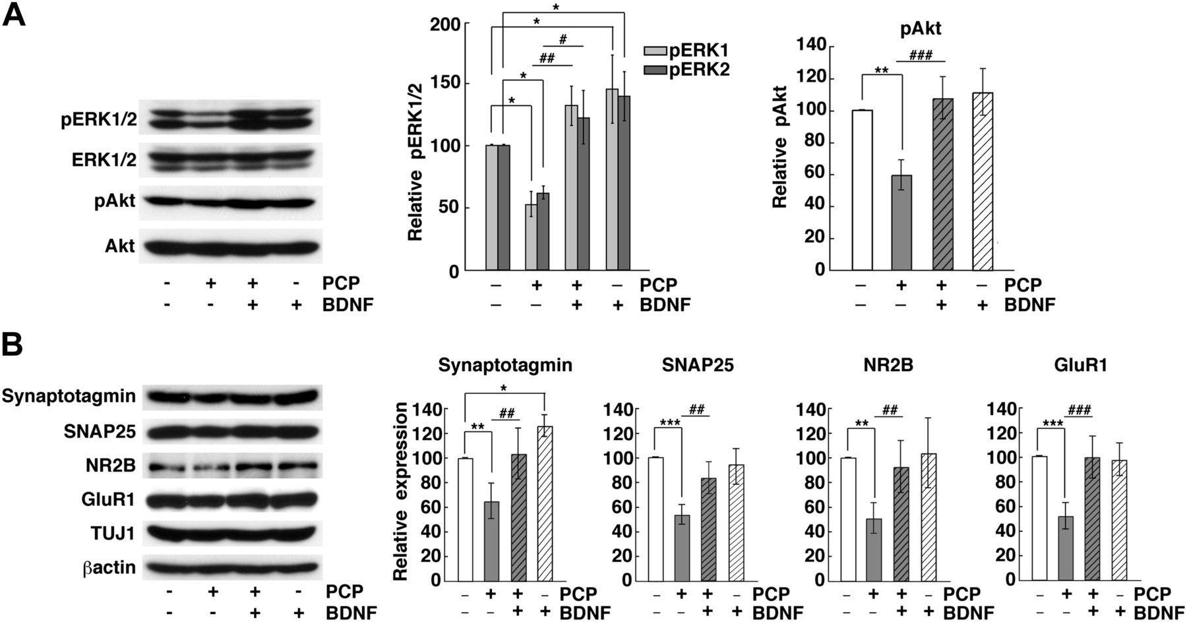
Figure 7. Exogenous BDNF prevented down regulation of intracellular signaling and synaptic protein expression. BDNF (10 ...
Notes:
Figure 7. Exogenous BDNF prevented down regulation of intracellular signaling and synaptic protein expression. BDNF (10 ng/mL) was added immediately after PCP (10 μM) application. (A) Exogenous BDNF prevented the negative effect of PCP on ERK 1/2 and Akt activation. Samples were collected at 3 h after PCP application. (n = 4, from 2 independent cultures.) **P < 0.01, *P < 0.05 versus con; ###P < 0.001, ##P < 0.01, #P < 0.05 versus PCP (one-way ANOVA followed by Scheffe's post hoc test). (B) Decrease in levels of synaptic proteins, including synaptotagmin, SNAP25, NR2B, and GluR1 after PCP treatment (10 μM, 48 h) did not occur in the presence of BDNF (10 ng/mL). TUJ1 and β-actin are controls. (n = 5, from 3 independent cultures.) ***P < 0.001, **P < 0.01, *P < 0.05 versus con; ###P < 0.001, ##P < 0.01 versus PCP (one-way ANOVA followed by Scheffe's post hoc test).
Unless provided in the caption above, the following copyright applies to the content of this slide: © The Author 2012. Published by Oxford University Press. All rights reserved. For permissions, please e-mail: journals.permissions@oup.com

Slide 8
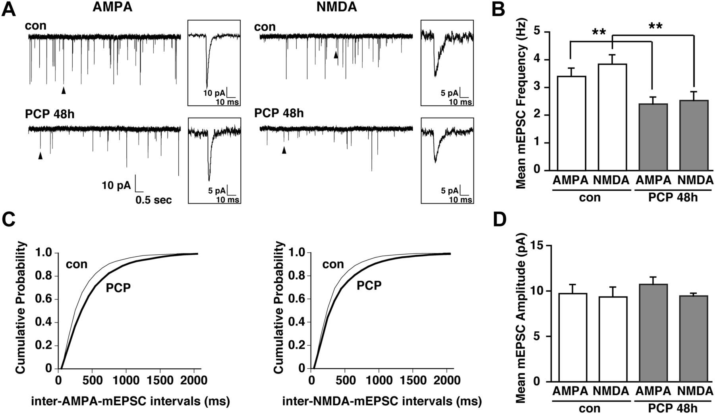
Figure 6. PCP decreased the frequency (but not amplitude) of mEPSCs. Cortical cultures were exposed to PCP (1 μM, 48 ...
Notes:
Figure 6. PCP decreased the frequency (but not amplitude) of mEPSCs. Cortical cultures were exposed to PCP (1 μM, 48 h), followed by recording of mEPSCs. (A) AMPA component of mEPSCs (AMPA-mEPSC) was recorded in control- and PCP-treated neurons in the presence of D-APV (25 μM) (Left). NMDA component of mEPSPs (NMDA-mEPSC) in both control and PCP conditions in the presence of CNQX (5 μM) with Mg2+ free was also measured (Right). Typical mEPSC for each condition (arrowhead) are shown in the inset. (B) Mean mEPSC frequency for control cells and PCP-treated cells. Error bars represent SEM. **P < 0.05 (t-test). (C) Cumulative probability histogram for inter-AMPA-mEPSC (Left) and inter-NMDA-mEPSC intervals (Right) from control (thin) and PCP treatments (solid). Each data point represents the mean from 5 cells. (D) Mean amplitude of mEPSC in control and in PCP treatments. n indicates the number of cells obtained from 6 to 10 independent cultures.
Unless provided in the caption above, the following copyright applies to the content of this slide: © The Author 2012. Published by Oxford University Press. All rights reserved. For permissions, please e-mail: journals.permissions@oup.com

