Slide 1
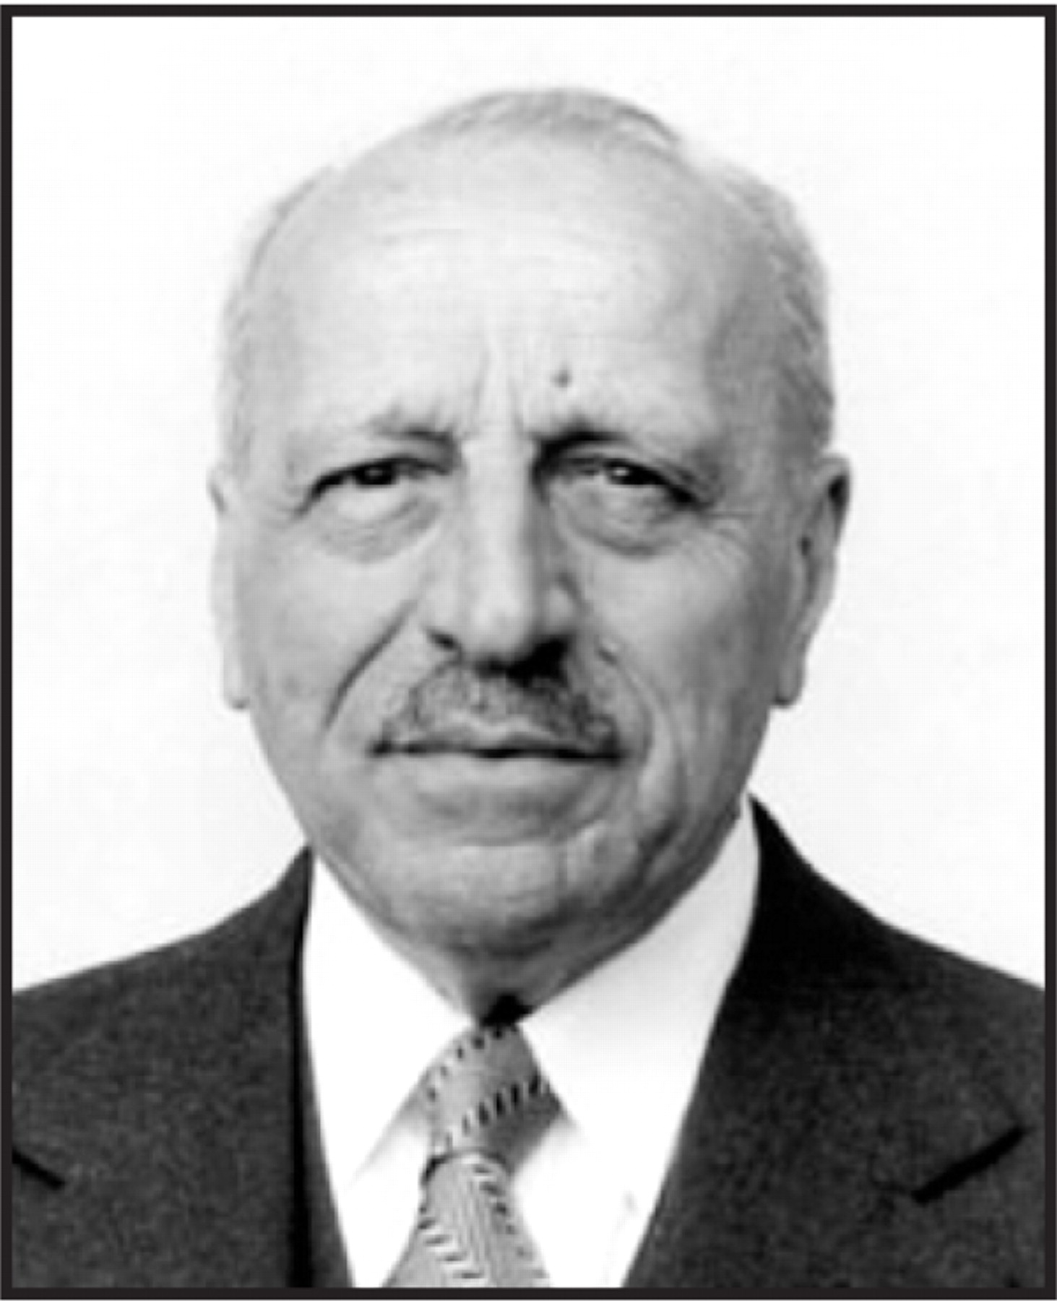
George N. Papanicolaou (1883–1962) The Pap Test
Notes:
George N. Papanicolaou (1883–1962) The Pap Test
Unless provided in the caption above, the following copyright applies to the content of this slide: © American Society of Clinical Pathologists

