Slide 1
Figure 1. Extraction of eye-blink events and resulting theoretical convolved signal. (A) Vertical eye position recorded ...
Notes:
Figure 1. Extraction of eye-blink events and resulting theoretical convolved signal. (A) Vertical eye position recorded over time. The trace presented has been extracted from a single run. Sharp transient drops of the signal characterize blink events. The red dashed-line box represents the 2° fixation window the monkeys are rewarded to stay in. Signal outside this window is identified as fixation breakdown and referred to either saccades or blinks depending on the amplitudes and durations of these events. (B) Blink-related convoluted signal. The temporal occurrence of the blink events are convoluted with the appropriate hemodynamic response function (see Material and Methods for more details). In this figure, the resulting signal has been temporally aligned with the vertical eye trace. (C) Close-up of vertical eye position and the resulting convoluted signal extracted from Figure 1(A, B) (black rectangles). A high blink event frequency is associated with an increase in the convoluted response function.
Unless provided in the caption above, the following copyright applies to the content of this slide: © The Author 2014. Published by Oxford University Press. All rights reserved. For Permissions, please e-mail: journals.permissions@oup.com

Slide 2
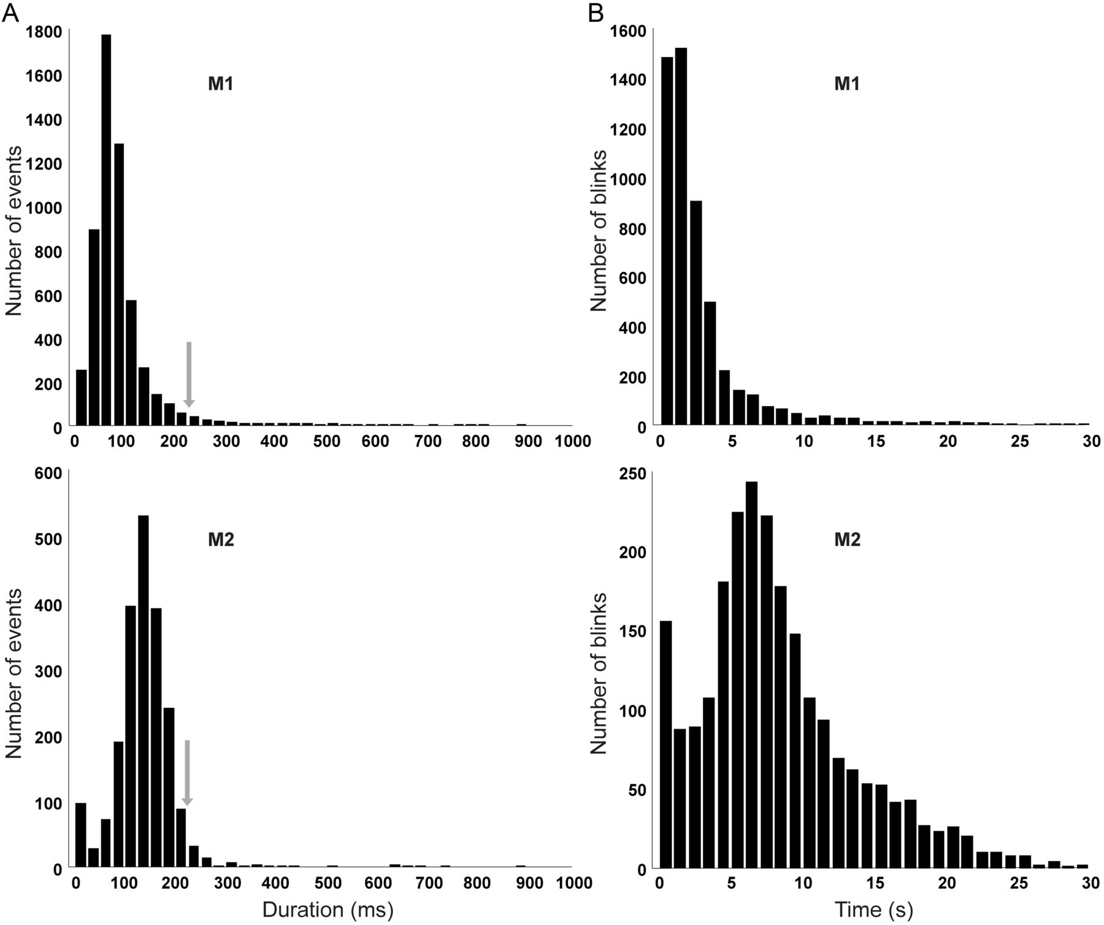
Figure 2. Temporal characteristics of blinks. (A) Duration of eye saturation distributions (time bins of 25 ms) for ...
Notes:
Figure 2. Temporal characteristics of blinks. (A) Duration of eye saturation distributions (time bins of 25 ms) for monkey M1 (upper part) and monkey M2 (lower part). The red arrow represents the criterion chosen to categorize the eye signal interruption as a blink (inferior to 225 ms, excluding 3.3% of the events for M1 and 3.2% for M2). (B) Interblink interval distributions. The temporal intervals between 2 consecutive blinks (time bins of 1 s) are represented for monkey M1 (upper part) and monkey M2 (lower part).
Unless provided in the caption above, the following copyright applies to the content of this slide: © The Author 2014. Published by Oxford University Press. All rights reserved. For Permissions, please e-mail: journals.permissions@oup.com

Slide 3
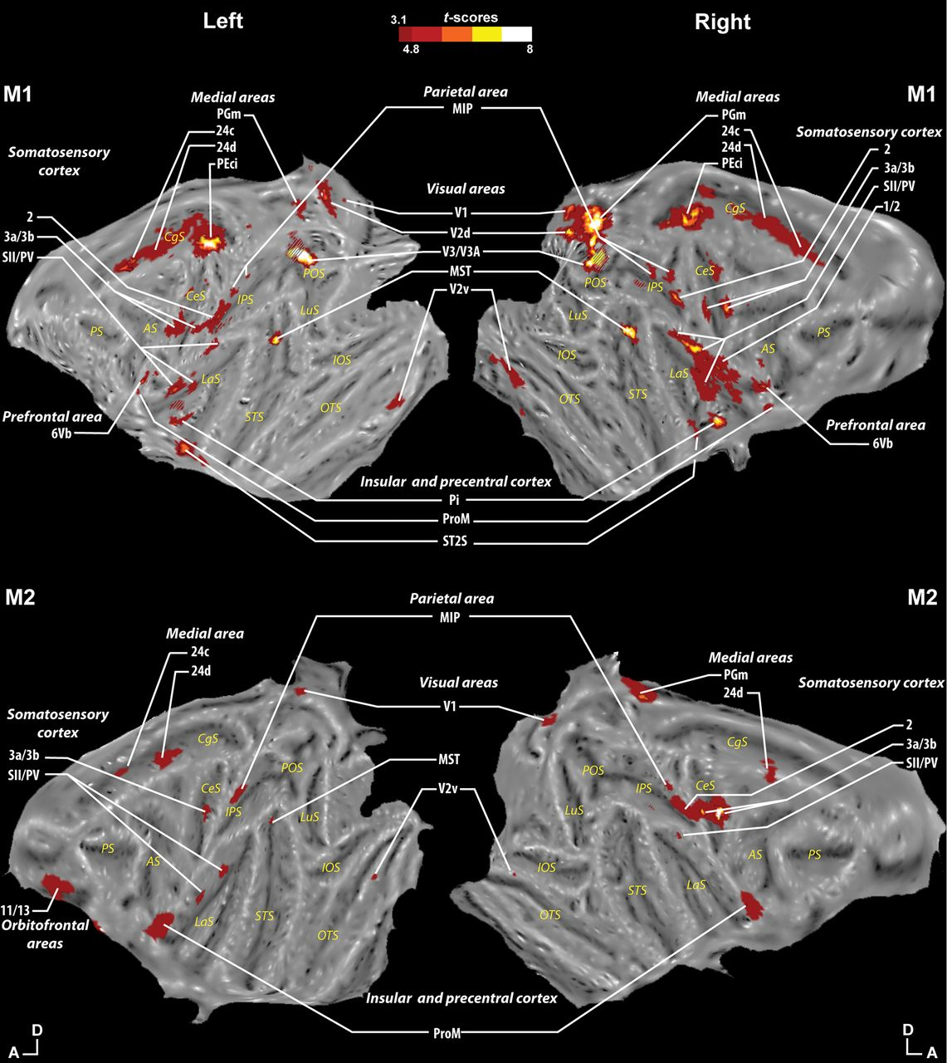
Table 2 Summary of the blink-related cortical activations, per monkey (M1/M2), per hemisphere (left/right) For each ...
Notes:
Table 2 Summary of the blink-related cortical activations, per monkey (M1/M2), per hemisphere (left/right) For each area, peak location (x, y, and z coordinates with respect to the anterior commissure) and t-score at the local maximum are indicated. Bold characters code for the areas identified in 3 or more hemispheres. Italic characters code for the areas identified in 2 or less hemispheres. The areas are identified and labeled in reference to the nomenclature used in the Lewis and Van Essen atlas as available in Caret and in the Scalable brain atlas http://scalablebrainatlas.incf.org. Abbreviations: ST2S, superior temporal sulcus area 2. Figure 3.Representation of the blink-related activations on whole-brain flat maps. The activations (monkey M1: upper part and monkey M2: lower part) result from the correlation of the blink-related response function and the hemodynamic functional signal (red color t-score scale, P < 0.001 uncorrected level, color transition being adjusted to t-scores = 4.8 familywise error (FWE) corrected level). Orientation: A, anterior; D, dorsal. Cortical areas: MIP, medial intraparietal area; MST, medial superior temporal area; PEci, cingulate part of area PE; PGm, medial part of area PG; Pi, parainsular cortex; ProM, promotor area; PV, parietoventral cortex; SII, secondary somatosensory cortex; V1, visual area V1; V2v, ventral part of visual area V2; V2d, dorsal part of visual area V2; V3, visual area V3; V3A, visual area V3A; 1, somatosensory area 1; 2,somatosensory area 2; 3a, somatosensory area 3a; 3b, somatosensory area 3b; 6Vb, ventral premotor area 6Vb; 11, orbitofrontal area 11; 13, orbitofrontal area 13; 24d, cingulate area 24d. Cortical sulci: AS, arcuate sulcus; CgS, cingulate sulcus; CeS, central sulcus; IOS, inferior occipital sulcus; IPS, intraparietal sulcus; LaS, lateral (Sylvian) sulcus; LuS, lunate sulcus; OTS, occipital temporal sulcus; POS, parieto-occipital sulcus; PS, principal sulcus; STS, superior temporal sulcus.
Unless provided in the caption above, the following copyright applies to the content of this slide: © The Author 2014. Published by Oxford University Press. All rights reserved. For Permissions, please e-mail: journals.permissions@oup.com

Slide 4
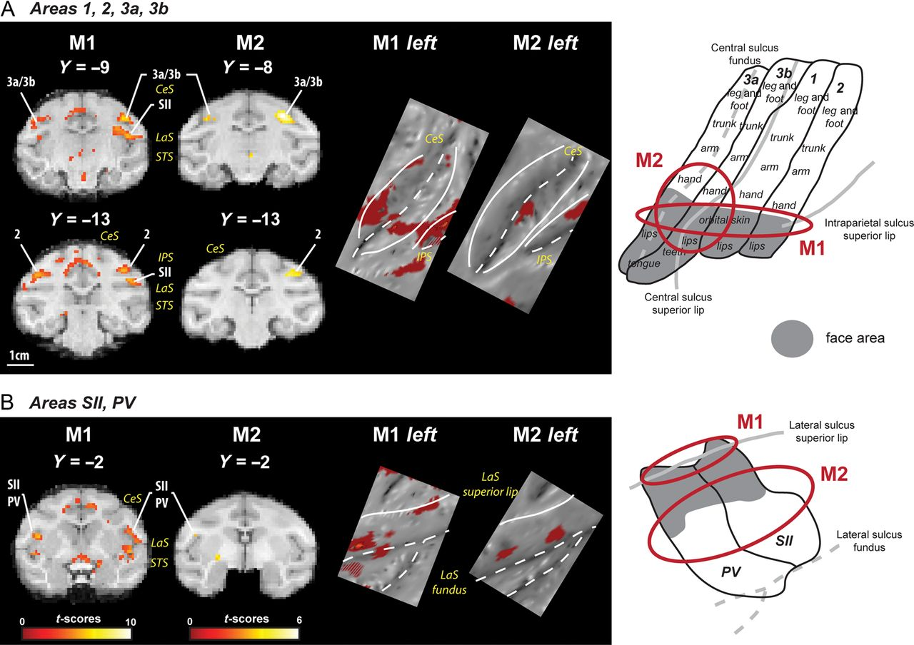
Figure 4. Topographic somatosensory activations in areas 1, 2, 3a and 3b (A) and in the complex SII-PV (B). On the left ...
Notes:
Figure 4. Topographic somatosensory activations in areas 1, 2, 3a and 3b (A) and in the complex SII-PV (B). On the left are displayed statistical parametric maps (SPMs) showing the bilateral activations relative to the blink events in both monkeys (yellow scale, P < 0.001, uncorrected level). In the middle, the same activations are shown on a portion of the flattened map for the left hemisphere in both monkeys. The topographic organization for the corresponding regions is presented on the right part (A: adapted from Krubitzer et al. 2004; Padberg et al. 2005; Seelke et al. 2012; B: adapted from Krubitzer et al. 1995). The gray areas correspond to the face representations. The solid lines correspond to the lips of the sulci, the dashed lines to the fundus of the sulci. The approximate locations of our blink-related activations (as presented in the middle part of the figure) on these topographic maps are represented in red. Abbreviations are given in Figure 3.
Unless provided in the caption above, the following copyright applies to the content of this slide: © The Author 2014. Published by Oxford University Press. All rights reserved. For Permissions, please e-mail: journals.permissions@oup.com

Slide 5
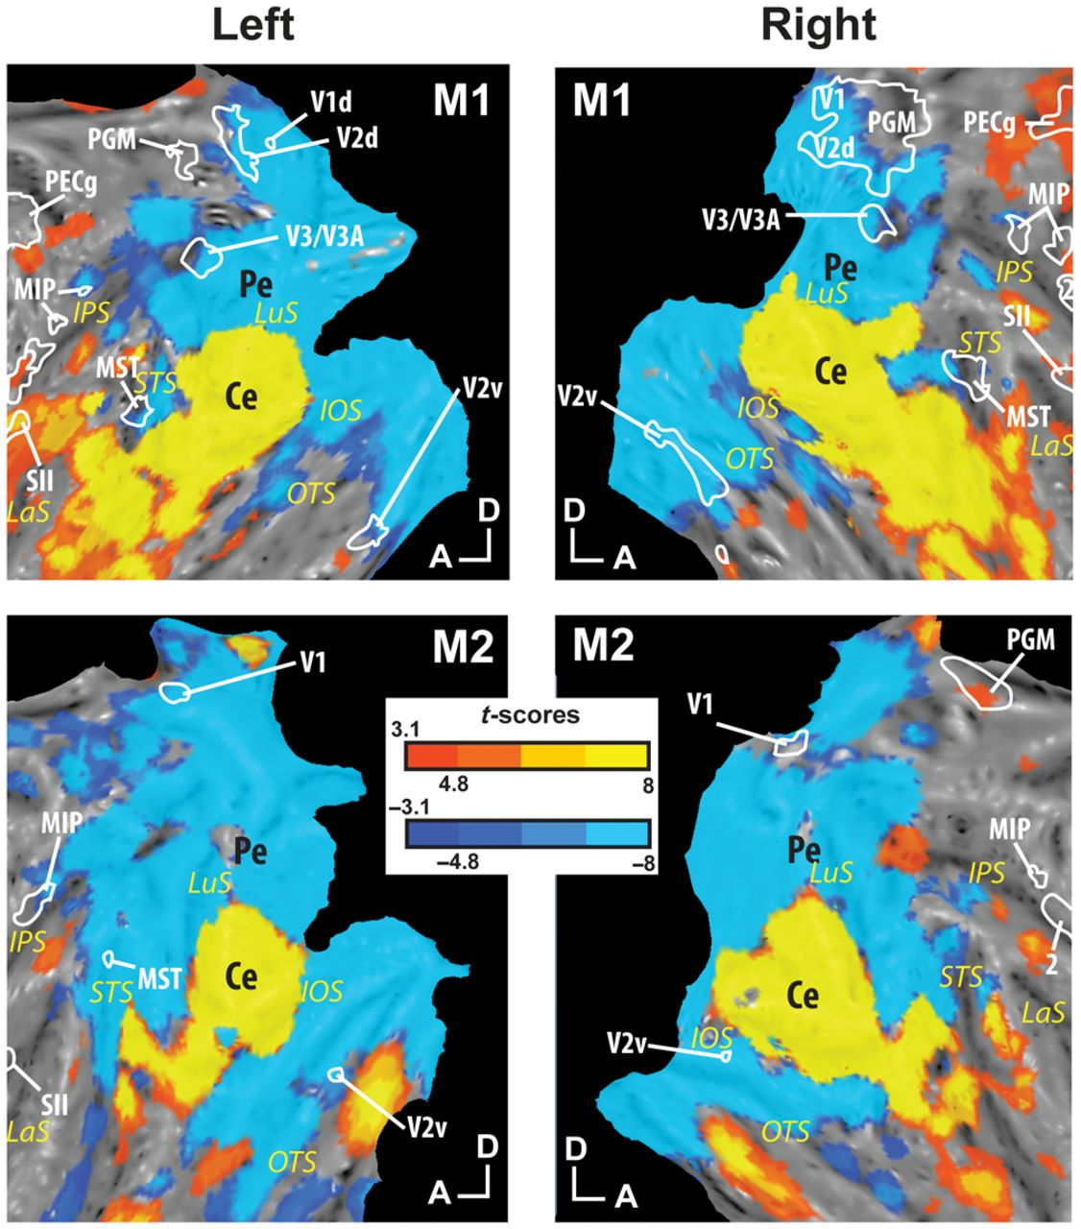
Figure 5. Close-up of the occipital representations of the blink-related activations (boundaries in white solid lines) ...
Notes:
Figure 5. Close-up of the occipital representations of the blink-related activations (boundaries in white solid lines) superimposed on retinotopic central (yellow scale, color transition being adjusted to t-scores = 4.8 FWE corrected level) and peripheral (blue scale) visual fields. Ce: central visual field; Pe: peripheral visual field. Other abbreviations as in Figure 3.
Unless provided in the caption above, the following copyright applies to the content of this slide: © The Author 2014. Published by Oxford University Press. All rights reserved. For Permissions, please e-mail: journals.permissions@oup.com

