Slide 1
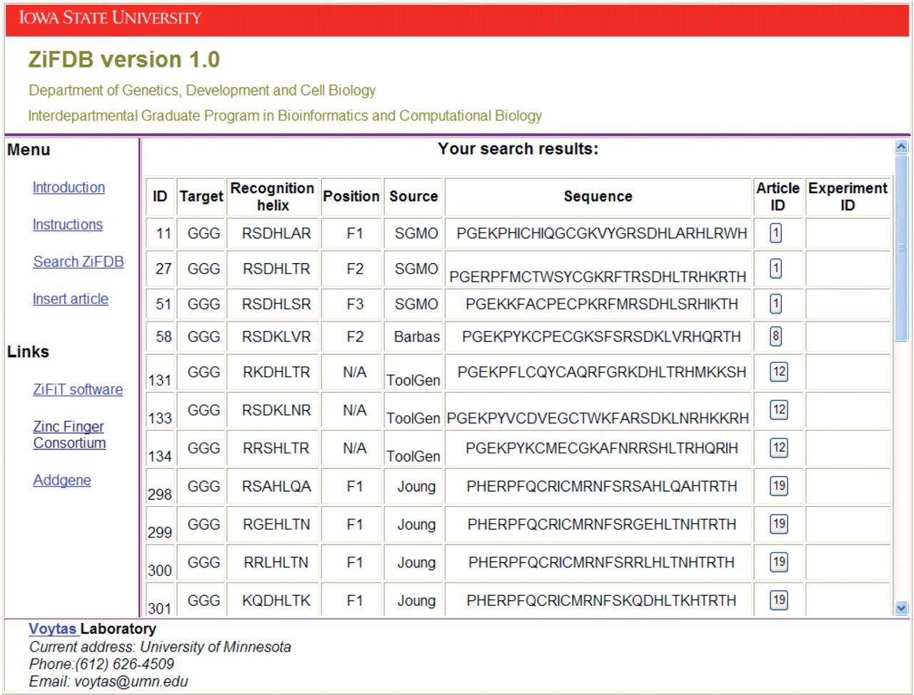
Figure 1. Sample output from the finger search page when GGG is provided as the target and the position and source are ...
Notes:
Figure 1. Sample output from the finger search page when GGG is provided as the target and the position and source are left blank.
Unless provided in the caption above, the following copyright applies to the content of this slide: © 2008 The Author(s)This is an Open Access article distributed under the terms of the Creative Commons Attribution Non-Commercial License (http://creativecommons.org/licenses/by-nc/2.0/uk/) which permits unrestricted non-commercial use, distribution, and reproduction in any medium, provided the original work is properly cited.

Slide 2
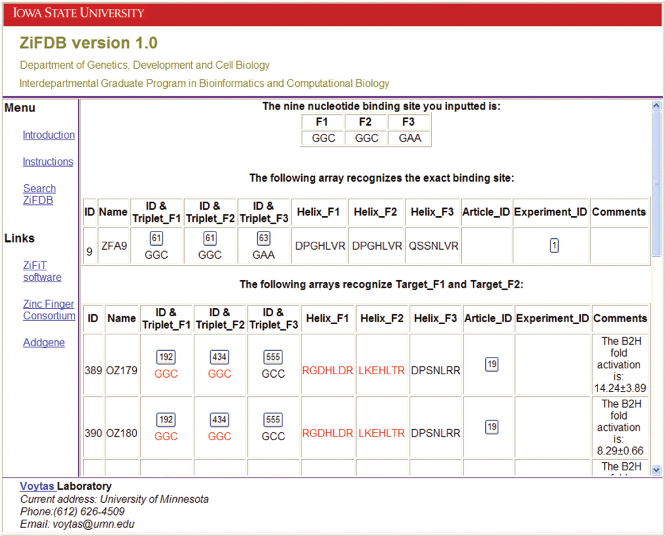
Figure 2. Sample output returned when searching for arrays with the binding site 5′-GAAGGCGGC-3′.
Notes:
Figure 2. Sample output returned when searching for arrays with the binding site 5′-GAAGGCGGC-3′.
Unless provided in the caption above, the following copyright applies to the content of this slide: © 2008 The Author(s)This is an Open Access article distributed under the terms of the Creative Commons Attribution Non-Commercial License (http://creativecommons.org/licenses/by-nc/2.0/uk/) which permits unrestricted non-commercial use, distribution, and reproduction in any medium, provided the original work is properly cited.

