Slide 1
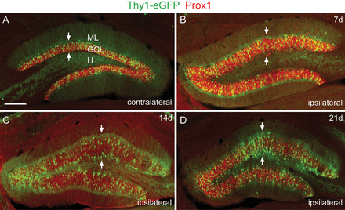
Figure 1. Thy1-eGFP-positive GCs, counterstained by immunolabeling for Prox1, contribute to GCD in vivo. (A, B) Frontal ...
Notes:
Figure 1. Thy1-eGFP-positive GCs, counterstained by immunolabeling for Prox1, contribute to GCD in vivo. (A, B) Frontal sections through the dentate gyrus 7 days after unilateral KA injection. A normal, compact granule cell layer (arrows) is seen on the side contralateral to the KA injection (A), whereas the ipsilateral dentate gyrus (B) shows a broadening of the granule cell layer (granule cell dispersion, GCD). (C, D) GCD on the injected side has further developed 14 and 21 days after KA injection. GCL, granule cell layer; H, hilus; ML, molecular layer. Scale bar: 80 µm.
Unless provided in the caption above, the following copyright applies to the content of this slide: © The Author 2013. Published by Oxford University Press. All rights reserved. For Permissions, please e-mail: journals.permissions@oup.com

Slide 2
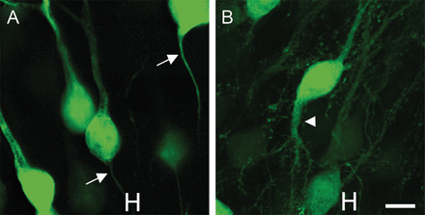
Figure 2. (A, B) High-power magnification of mosaic Thy1-eGFP-labeled GCs on the contralateral side (A) and on the side ...
Notes:
Figure 2. (A, B) High-power magnification of mosaic Thy1-eGFP-labeled GCs on the contralateral side (A) and on the side of KA injection (B) into the hippocampus (21 days after KA injection). Arrows points to axons, arrowhead to a basal dendrite of the KA-exposed cell. H indicates side of hilus. Scale bar: 5 µm.
Unless provided in the caption above, the following copyright applies to the content of this slide: © The Author 2013. Published by Oxford University Press. All rights reserved. For Permissions, please e-mail: journals.permissions@oup.com

Slide 3
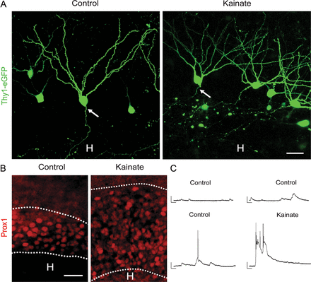
Figure 3. Kainate-induced GCD in hippocampal slice culture. (A) Thy1-eGFP-labeled differentiated GCs showing dendrites, ...
Notes:
Figure 3. Kainate-induced GCD in hippocampal slice culture. (A) Thy1-eGFP-labeled differentiated GCs showing dendrites, spines, and axon (arrows) in a control culture (incubated in vitro for 11 days) and in a culture incubated for 10 days, followed by incubation in the presence of KA for 24 h. H, hilus. Scale bar: 15 µm. (B) Immunostaining for Prox1, a marker of dentate GCs, revealed an expansion of the GC layer (dashed lines) in KA-treated slice cultures when compared to control cultures (incubated on 3 consecutive days for 8 h each with KA followed by washout and an additional incubation period of 7 days). H, hilus. Scale bar: 50 µm. (C) Examples of current clamp recordings of GCs from control slice cultures and a KA-treated slice culture at resting membrane potential. While only excitatory postsynaptic potentials (EPSPs, upper trace) and single action potentials (lower trace) were recorded from control GCs, all KA-exposed GCs showed bursts of action potentials. Scale bars: 50 ms, 20 mV.
Unless provided in the caption above, the following copyright applies to the content of this slide: © The Author 2013. Published by Oxford University Press. All rights reserved. For Permissions, please e-mail: journals.permissions@oup.com

Slide 4
Figure 4. Somal translocation and dendritic reorientation following KA application. Representative granule cell from a ...
Notes:
Figure 4. Somal translocation and dendritic reorientation following KA application. Representative granule cell from a control culture and a culture exposed to KA. The control GC shown does not change its structure and position during the recording period. Conversely, there was considerable movement of the granule cell soma following KA application. This movement of the cell body shifted the origin of a dendrite (arrow) toward the basal pole of the cell body. The dendrite becomes a recurrent basal dendrite. H indicates location of hilus. Scale bars: 10 µm.
Unless provided in the caption above, the following copyright applies to the content of this slide: © The Author 2013. Published by Oxford University Press. All rights reserved. For Permissions, please e-mail: journals.permissions@oup.com

Slide 5
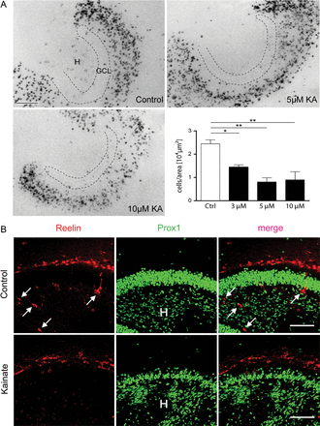
Figure 5. Loss of reelin mRNA expressing and Reelin-immunoreactive cells following KA application. (A) Loss of reelin ...
Notes:
Figure 5. Loss of reelin mRNA expressing and Reelin-immunoreactive cells following KA application. (A) Loss of reelin mRNA synthesizing neurons in the hilus (H) of the dentate gyrus following the application of different concentrations of KA in the incubation medium for 45 min (mean ± SEM). *P < 0.05; **P < 0.01; 1-way ANOVA followed by Tukey's multiple comparison test. GCL, granule cell layer. Scale bar: 100 µm. (B) Loss of Reelin-immunoreactive hilar neurons (arrows) following KA application for 8 h each on 3 consecutive days and an additional incubation in fresh medium for 7 days. Note GCD in the KA-treated culture. Scale bar: 50 µm.
Unless provided in the caption above, the following copyright applies to the content of this slide: © The Author 2013. Published by Oxford University Press. All rights reserved. For Permissions, please e-mail: journals.permissions@oup.com

Slide 6
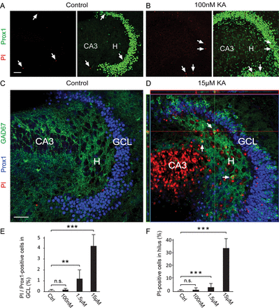
Figure 6. Neuronal degeneration in the GCL and hilus following KA application for 24 h. (A) Control slice culture, (B) ...
Notes:
Figure 6. Neuronal degeneration in the GCL and hilus following KA application for 24 h. (A) Control slice culture, (B) slice culture incubated in 100 nM KA. Arrows point to PI-positive cells. H, hilus. Scale bar: 50 µm. (C, D) Triple labeling for PI, Prox1, and GAD67. (C) Same control slice culture as in (A), (D) slice culture incubated in 15 µM KA. Arrows point to PI/GAD67-positive hilar neurons. Note abundant PI-stained cells in hippocampal region CA3 when compared with the relatively low number of PI-positive, Prox1-stained GCs. Following the strong, KA-induced activity many Prox1-positive GCs show immunoreactivity for GAD67. GCL, granule cell layer. Scale bar: 50 µm. (E) Percentage of PI/Prox1-positive cells in GCL and (F) percentage of PI-positive neurons in the hilar region following incubation in different concentrations of KA for 24 h. Ctrl, control cultures; n.s., not significant. Mean ± SEM; **P < 0.01; ***P < 0.001.
Unless provided in the caption above, the following copyright applies to the content of this slide: © The Author 2013. Published by Oxford University Press. All rights reserved. For Permissions, please e-mail: journals.permissions@oup.com

