Slide 1
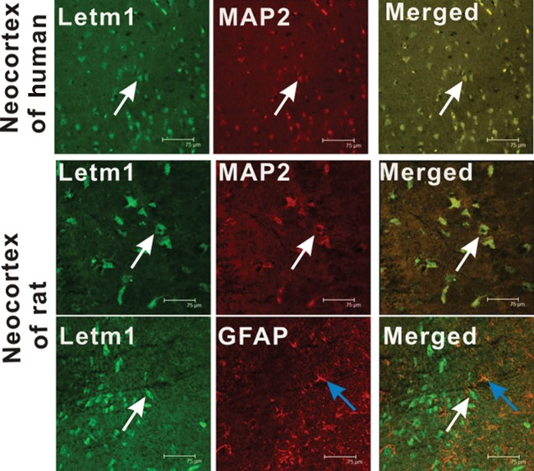
Figure 1. Immunofluorescent labeling for Letm1 in the neocortex. (A) Letm1 (green) and MAP2 (red) are coexpressed ...
Notes:
Figure 1. Immunofluorescent labeling for Letm1 in the neocortex. (A) Letm1 (green) and MAP2 (red) are coexpressed (merged) in the temporal neocortex of a TLE patient. (B) Letm1 (green) and MAP2 (red) are coexpressed (merged) in the cortex of an epileptic rat at 7 days postseizure. (C) Letm1 and GFAP are not coexpressed in the cortex of an epileptic rat at 7 days postseizure. Arrows show the positive cells (Scale bar = 75 μm).
Unless provided in the caption above, the following copyright applies to the content of this slide: © The Author 2013. Published by Oxford University Press. All rights reserved. For Permissions, please e-mail: journals.permissions@oup.com

Slide 2
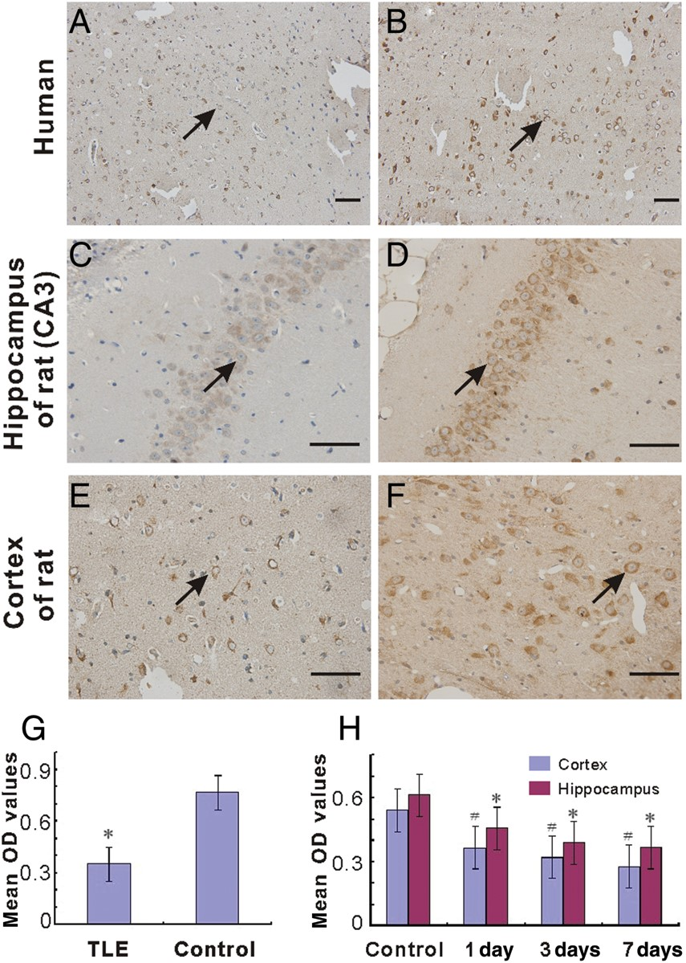
Figure 2. Immunohistochemical images showing Letm1-positive cells in the brain specimens. (A) Weak immunoreactive ...
Notes:
Figure 2. Immunohistochemical images showing Letm1-positive cells in the brain specimens. (A) Weak immunoreactive stainings of Letm1 are shown in the temporal neocortex of a patient with TLE. (B) Relatively strong immunoreactive stainings of Letm1 are shown in the temporal neocortex of a control subject. In the rat model, (C and E) faint immunoreactivity of Letm1 was in the hippocampus (C) and adjacent cortex (E) of a rat at day 7 after seizure. (D and F) Strong immunoreactive staining of Letm1 in the hippocampus (D) and adjacent cortex (F) of a normal rat. The arrows indicate Letm1-positive cells. (Scale bar = 50 μm). (G) Summary of mean OD values of Letm1 in both the TLE and control groups (*P < 0.05). (H) Histogram of the mean OD values of Letm1 in the rat cortex (#P < 0.05) and hippocampus (*P < 0.05), respectively, compared with control.
Unless provided in the caption above, the following copyright applies to the content of this slide: © The Author 2013. Published by Oxford University Press. All rights reserved. For Permissions, please e-mail: journals.permissions@oup.com

Slide 3
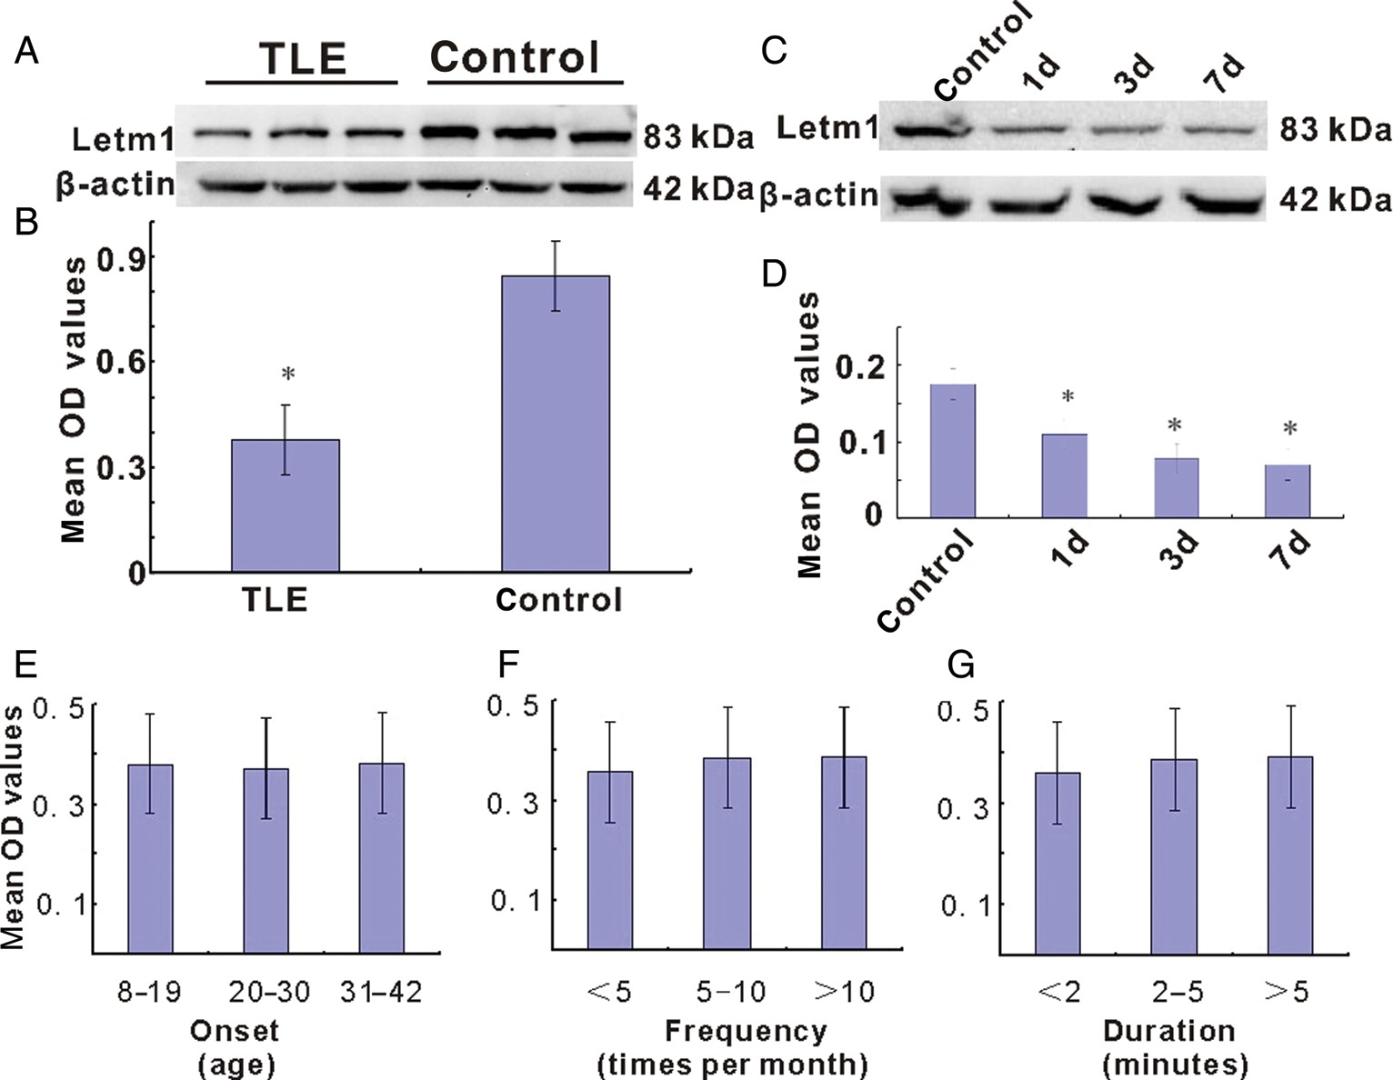
Figure 3. Western blotting analysis of Letm1 expression in both the temporal neocortex and the hippocampus. (A) ...
Notes:
Figure 3. Western blotting analysis of Letm1 expression in both the temporal neocortex and the hippocampus. (A) Representative images of Letm1 expression (83 kDa) in the temporal neocortex from control and TLE groups. (B) Summary of normalized Letm1 values (Letm1/β-actin) in the TLE and control groups. *P < 0.05. (C) Representative images of Letm1 (83 kDa) in the hippocampus and adjacent cortex at different time points after seizures. (D) Summary of normalized Letm1 values in the hippocampus and adjacent cortex before and after seizures. *P 0.05).
Unless provided in the caption above, the following copyright applies to the content of this slide: © The Author 2013. Published by Oxford University Press. All rights reserved. For Permissions, please e-mail: journals.permissions@oup.com

Slide 4
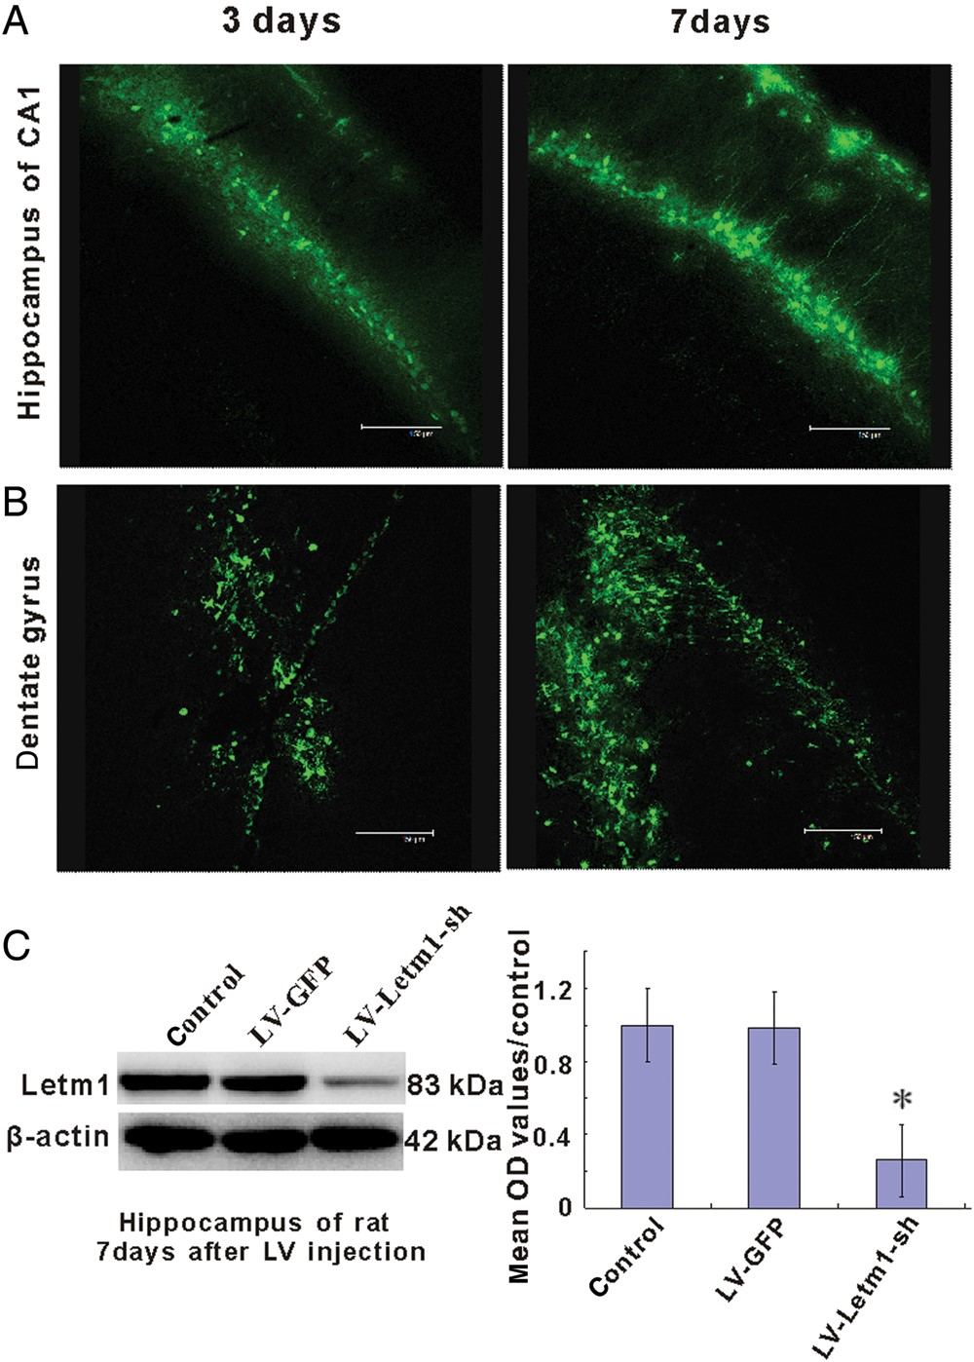
Figure 4. Expressions of green fluorescent protein (GFP) and Letm1 after injection of recombinant LV. (A) ...
Notes:
Figure 4. Expressions of green fluorescent protein (GFP) and Letm1 after injection of recombinant LV. (A) Immunofluorescent images showing GFP expression in CA1 of the hippocampus after 3 and 7 days of injection. (B) Immunofluorescent images GFP expression in the dentate gyrus after 3 and 7 days of injection. (C) Western blotting images showing Letm1 (83 kDa) and β-actin expressions with or without injection of LV-GFP and LV-Letm1-sh at day 7. (D) Bar-plot summary showing normalized Letm1 expression before and after recombinant LV injection. *P < 0.05, compared with control and LV-GFP.
Unless provided in the caption above, the following copyright applies to the content of this slide: © The Author 2013. Published by Oxford University Press. All rights reserved. For Permissions, please e-mail: journals.permissions@oup.com

Slide 5
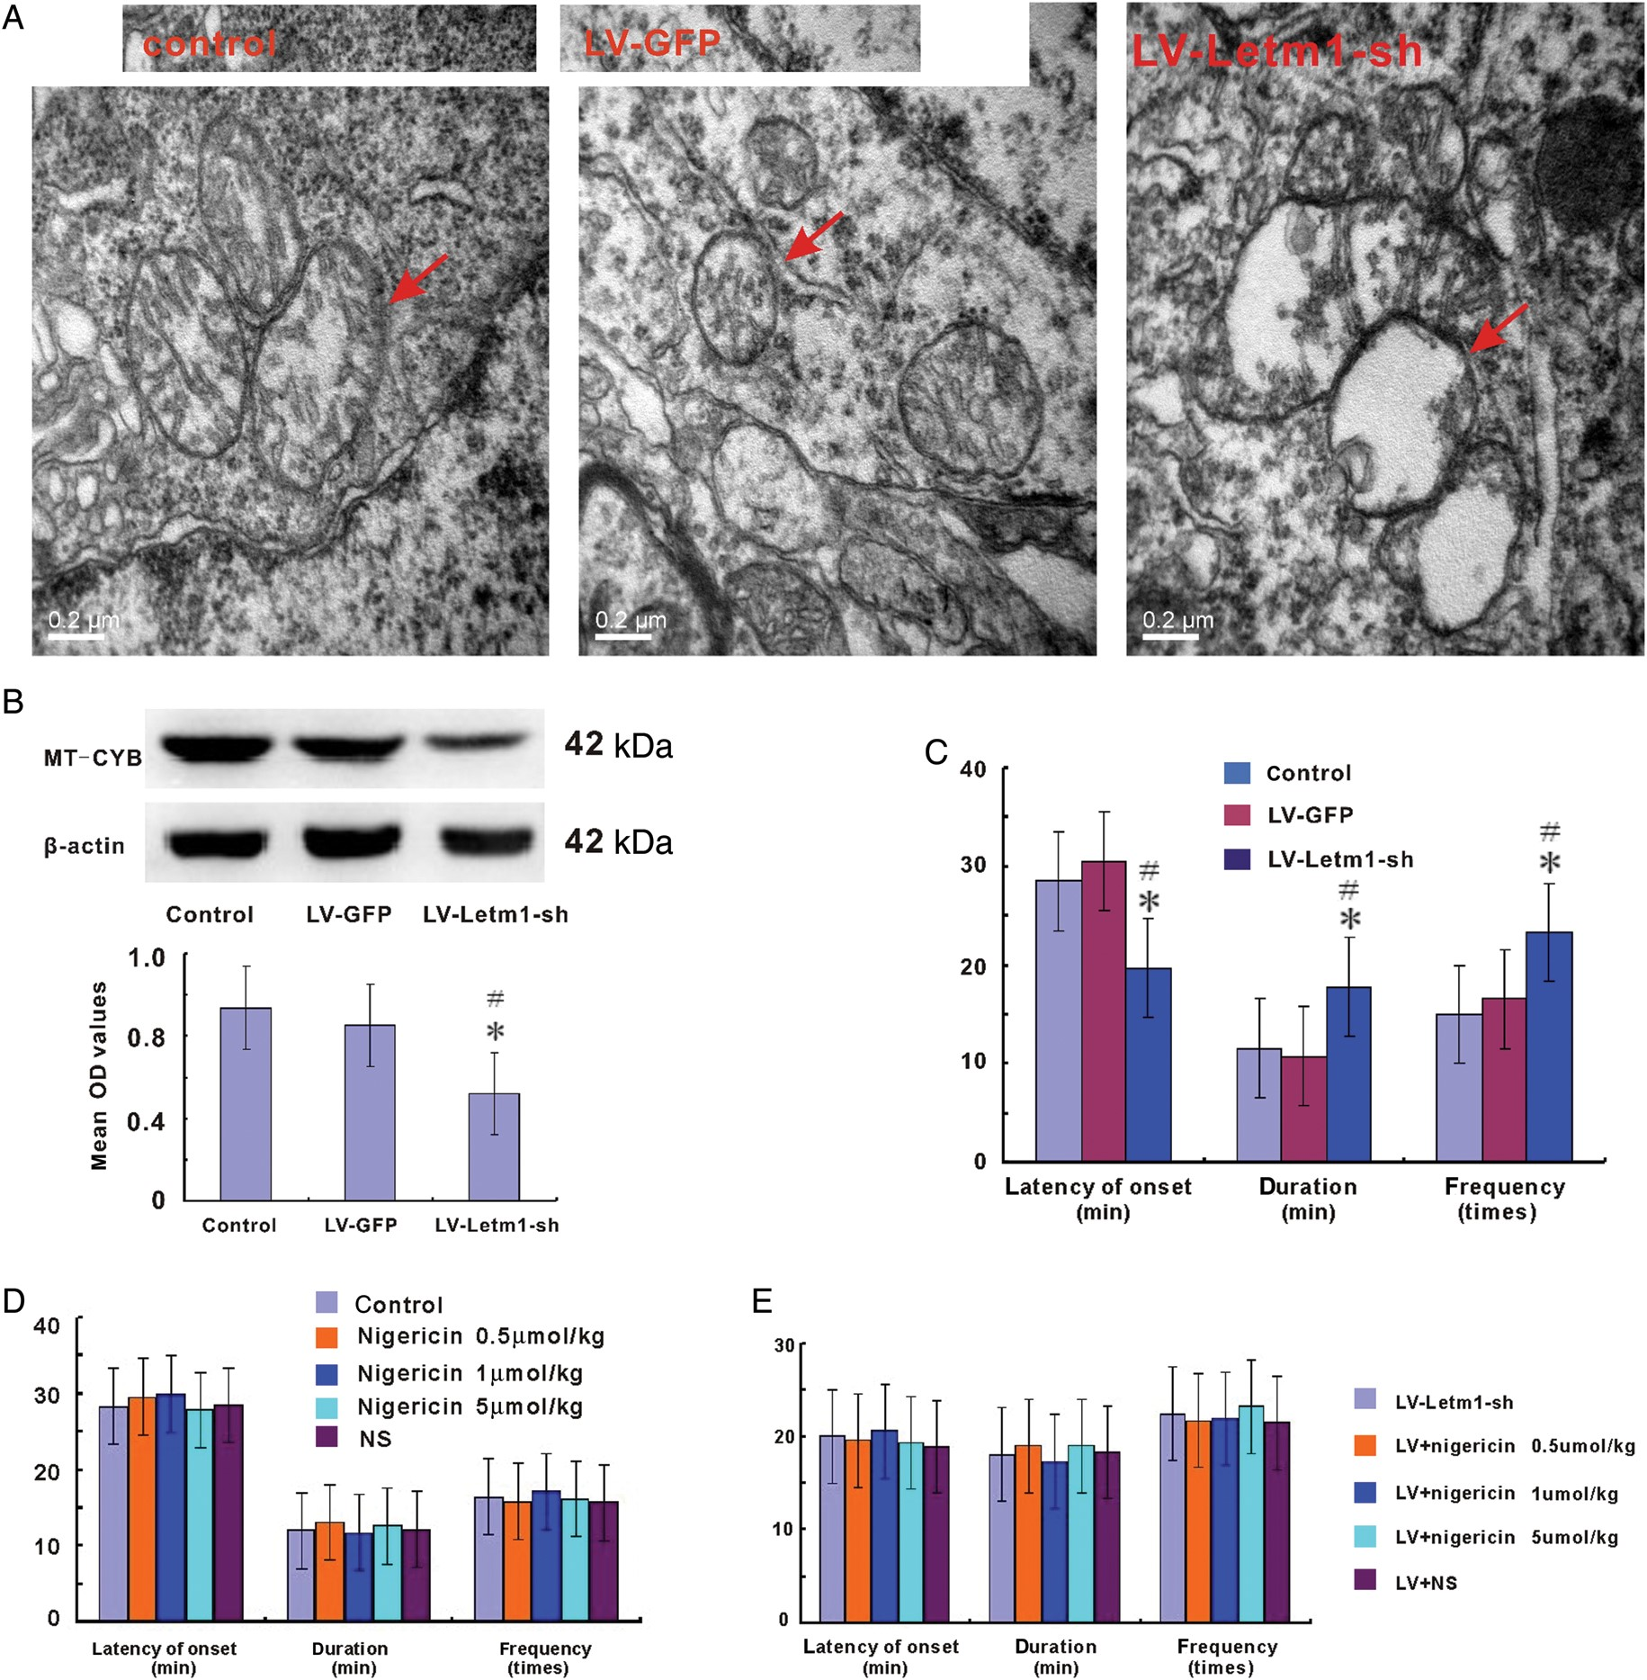
Figure 5. Morphological and functional changes of mitochondria and seizure susceptibility after down-regulation of ...
Notes:
Figure 5. Morphological and functional changes of mitochondria and seizure susceptibility after down-regulation of Letm1. (A) Transmission electron microscopic images showing morphological changes of mitochondria before and after LV injection. After seizures are evoked by administration of pilocarpine at day 1, the mitochondria is slight swollen in the neurons of control and LV-GFP groups, but significant mitochondrial swelling are presented in the LV-Letm1-sh group. (B) Upper panel, representative western blotting images of mitochondrially encoded cytochrome b (MT-CYB) expression (42 kDa) in control, LV-GFP, and LV-Letm1-sh groups 1 day after administration of pilocarpine. Lower panel, histogram of the normalized MT-CYB expression in these groups. *P < 0.05, compared with control, #P < 0.05, compared with LV-GFP. (C) Bar-plot summary of seizure susceptibility with or without LV injection. The latency of the first seizure, the duration, and frequency during the first hour after administration of pilocarpine are compared in groups with or without LV injection. *P < 0.05 compared with control, #P 0.05). (E) In the rats treated with LV-Letm1-sh 1 week before experiments, the latency of the first seizure, frequency of seizures, and the total time spent in seizures during the first hour after SE among each group are also without significant difference (P > 0.05).
Unless provided in the caption above, the following copyright applies to the content of this slide: © The Author 2013. Published by Oxford University Press. All rights reserved. For Permissions, please e-mail: journals.permissions@oup.com

