Slide 1
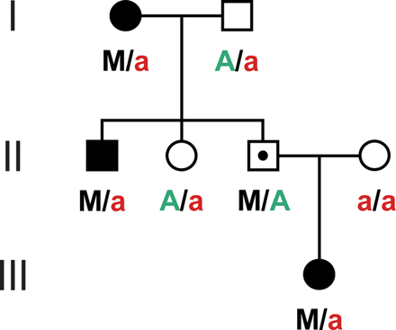
Figure 1. RP11-associated isoalleles and penetrance of PRPF31 mutations, according to the model by McGee et al. (12). A ...
Notes:
Figure 1. RP11-associated isoalleles and penetrance of PRPF31 mutations, according to the model by McGee et al. (12). A hypothetical family segregating the PRPF31 mutation M is depicted. RP11-associated isoalleles (A), inherited from the parent that does not carry the mutation and polymorphic in the general population, protect an asymptomatic patient (symbol with a dot) from the disease. Conversely, when this isoallele is not present (a), PRPF31 mutations cause RP.
Unless provided in the caption above, the following copyright applies to the content of this slide: © The Author 2008. Published by Oxford University Press. All rights reserved. For Permissions, please email: journals.permissions@oxfordjournals.org

Slide 2
Figure 2. Quantification of PRPF31 mRNA expression in lymphoblastoid cell lines (LCLs). Sorted expression levels of ...
Notes:
Figure 2. Quantification of PRPF31 mRNA expression in lymphoblastoid cell lines (LCLs). Sorted expression levels of PRPF31 mRNA in LCLs from 200 control individuals (CEPH), 3 asymptomatic (AS) and 7 affected (AFF) patients with PRPF31 mutations are shown, as measured by real-time PCR. PRPF31 mRNA expression is normalized to a median expressor, arbitrarily set to have a value of 1.0. Error bars refer to the standard error of the mean.
Unless provided in the caption above, the following copyright applies to the content of this slide: © The Author 2008. Published by Oxford University Press. All rights reserved. For Permissions, please email: journals.permissions@oxfordjournals.org

Slide 3
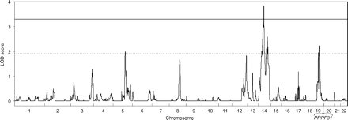
Figure 3. Results of genome-wide quantitative multipoint linkage analysis. Result plot obtained from the regress-based ...
Notes:
Figure 3. Results of genome-wide quantitative multipoint linkage analysis. Result plot obtained from the regress-based method implemented in the MERLIN software (53). The continuous horizontal line indicates the threshold for significant LOD scores and the dotted line is the threshold for ‘suggestive linkage’, as defined by Lander and Kruglyak (56). A significant peak with a LOD score of 3.83 (P = 1 × 10−5) was detected at 69.36 cM from the pter of chromosome 14. Four other LOD scores suggestive of linkage were observed on chromosome 5, 14 and 19 (containing two peaks). The location of PRPF31 on chromosome 19 is indicated.
Unless provided in the caption above, the following copyright applies to the content of this slide: © The Author 2008. Published by Oxford University Press. All rights reserved. For Permissions, please email: journals.permissions@oxfordjournals.org

Slide 4
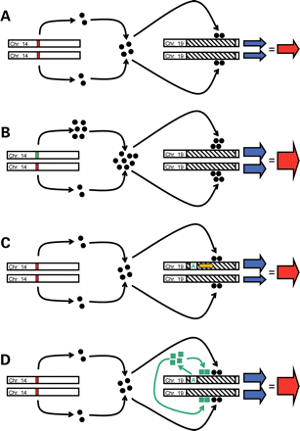
Figure 4. Models for regulation of PRPF31 expression. Diagrammatic representation of various models by which the ...
Notes:
Figure 4. Models for regulation of PRPF31 expression. Diagrammatic representation of various models by which the RP11-distant regulator eQTL identified in this study and RP11-associated isoalleles may affect the expression of PRPF31. Open rectangles are the graphical representations of segments of interest of chromosomes 14 and 19. Red and green rectangles on chromosome 14 correspond to polymorphic alleles of the RP11-distant regulator. Black circles represent proteins or other diffusible modulators produced by this eQTL. Hatched rectangles indicate the PRPF31 locus. Blue and red arrows symbolize allelic and total PRPF31 mRNA amounts, respectively, their thickness being proportional to the rate of expression. (A and B) Schematic representation of an individual who does not carry any RP11-associated isoallele. In a heterozygote individual for a polymorphic allele in the RP11-distant regulator, one eQTL allele produces more modifier than the other, resulting eventually in increased PRPF31 total mRNA production. Regardless of the genotype at the RP11-distant regulator locus and of the total PRPF31 mRNA production, each PRPF31 allele contribute equally to gene expression. (C) Model of an individual carrying an RP11-associated isoallele (green ‘A’). Hypothesizing that this isoallele acts in cis, inducing PRPF31 expression (orange arrow), an overexpression of the corresponding PRPF31 allele should be observed, compared to the allele in trans. (D) Alternatively, RP11-associated isoalleles producing a diffusible element (green squares) could act in cis and in trans, increasing with equal strength the amount of PRPF31 pre-mRNA and mRNA derived from both alleles.
Unless provided in the caption above, the following copyright applies to the content of this slide: © The Author 2008. Published by Oxford University Press. All rights reserved. For Permissions, please email: journals.permissions@oxfordjournals.org

Slide 5
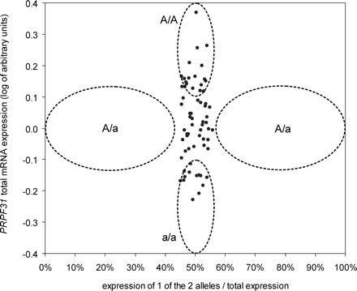
Figure 5. PRPF31 mRNA allelic expression in CEPH cell lines. Data (black dots) are represented as the ratio of one ...
Notes:
Figure 5. PRPF31 mRNA allelic expression in CEPH cell lines. Data (black dots) are represented as the ratio of one allele over the total PRPF31 mRNA expression, and were generated by RFLP analyses of PRPF31 coding SNPs present in 65 heterozygous CEPH cell lines. Total expression of PRPF31 mRNA was measured by real-time PCR. Dotted ovals delimit expected values in the hypothesized model of an exclusive cis-acting regulation of PRPF31 expression by the RP11-associated isoalleles. Under this assumption, one allele should be more expressed than the other in LCLs from heterozygous individuals (with the genotypes Aa). ‘A’ and ‘a’ stand for the presence or absence of the RP11-associated isoallele, respectively, as defined in Fig. 1.
Unless provided in the caption above, the following copyright applies to the content of this slide: © The Author 2008. Published by Oxford University Press. All rights reserved. For Permissions, please email: journals.permissions@oxfordjournals.org

Slide 6
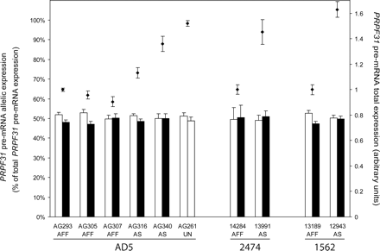
Figure 6. PRPF31 pre-mRNA total and allelic quantification in LCLs from carriers of RP11-associated isoalleles. AD5, ...
Notes:
Figure 6. PRPF31 pre-mRNA total and allelic quantification in LCLs from carriers of RP11-associated isoalleles. AD5, 2474 and 1562 indicate the family codes for individuals AG261, AG293, AG305, AG307, AG316, AG340, 14284, 13991, 12943 and 13189. AFF, AS and UN refer to affected and asymptomatic patients, or the unaffected control AG261, respectively. Diamond symbols indicate total PRPF31 pre-mRNA expression (right ordinates). Bars represent allelic quantifications, as percents of total expression, of pre-mRNA from either the PRPF31 wild-type (white) or mutant (black) allele (left ordinates). Error bars are standard errors of the mean. In all families, LCLs from carriers of an RP11-associated isoallele (asymptomatics and AG261) express more PRPF31 pre-mRNA than those from affected patients, but all cell lines express the same ratio of allelic pre-mRNA, regardless of the presence of mutations and of the clinical classification of the donors. Total pre-mRNA expression is normalized relatively to the LCLs from affected individuals AG293, 14284 and 13189 for families #AD5, #2474 and #1562, respectively.
Unless provided in the caption above, the following copyright applies to the content of this slide: © The Author 2008. Published by Oxford University Press. All rights reserved. For Permissions, please email: journals.permissions@oxfordjournals.org

