Slide 1
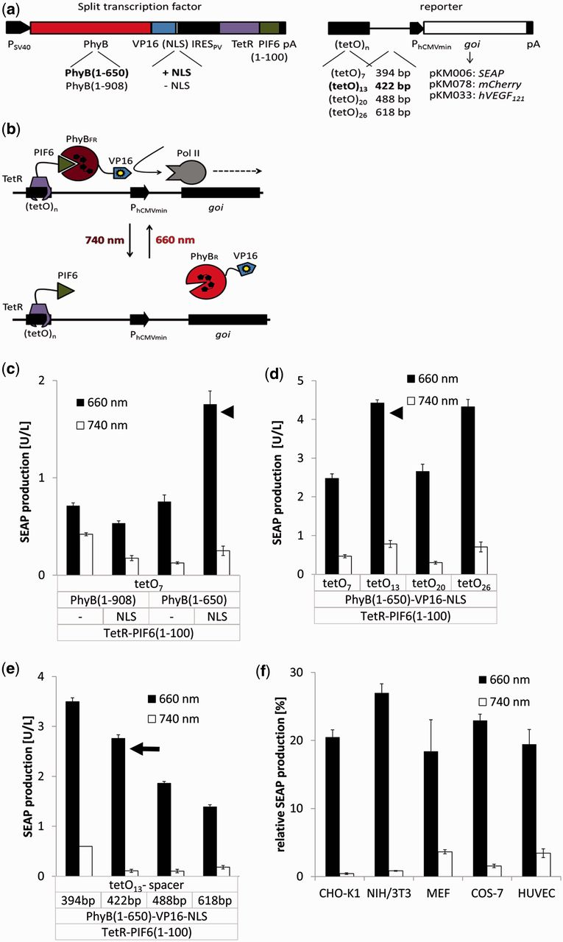
Figure 1. Design, optimization and validation of the red light-inducible transgene expression system. (a) Configuration ...
Notes:
Figure 1. Design, optimization and validation of the red light-inducible transgene expression system. (a) Configuration of the red light-inducible expression system. The building blocks for the split transcription factor are encoded on a bicistronic expression vector under the control of the simian virus 40 promoter PSV40. In the first cistron, the N-terminal fragments of PhyB (amino acids 1–650 or 1–908) are fused to VP16 and optionally to an NLS. In the second cistron, the N-terminal 100 amino acids of PIF6 are fused to the tetracycline repressor TetR. Translation of the second cistron is induced by a polioviral internal ribosome entry site, IRESPV. The response vectors comprise multiple repeats of the TetR-specific operator tetO fused via spacers of different length to the minimal human cytomegalovirus immediate early promoter PhCMVmin. This chimeric promoter was configured to control expression of different genes of interest (goi): SEAP, secreted alkaline phosphatase; hVEGF121, 121 amino acid splice variant of human vascular endothelial growth factor or the fluorescent protein mCherry. (b) Mode of function. Red light illumination converts PhyB into the FR form (PhyBFR) and induces heterodimerization with PIF6 tethered via TetR to the tetOn operator site. The PhyB-fused VP16 domain recruits the transcription initiation complex and triggers activation of the minimal promoter PhCMVmin. Absorption of a far-red photon (740 nm) converts PhyB into the R form (PhyBR) and triggers dissociation from PIF6, thereby resulting in de-activation of the target promoter and transcriptional silence. (c–e) Optimization of the red light-inducible expression system in CHO-K1. The indicated configurations of the red light-inducible expression system were transfected into 70 000 CHO-K1 cells. After incubation for 24 h, medium containing 15 µM PCB was added. After 1 h incubation in the dark, the cells were exposed for 24 h to red (660 nm) or far-red (740 nm) light before quantification of the reporter gene SEAP. (c) Impact of PhyB variant (908 or 650 amino acids) and the absence or presence of an NLS. (d) Impact of the tetO copy number. (e) Impact of spacer length between the operator and the minimal promoter. Arrowheads mark the configurations that were optimized in the subsequent experiments. The configuration showing the best induction ratio (arrow) was used for the subsequent studies. (f) Characterization of red light-inducible gene expression in different mammalian cell lines. Plasmids pKM022 and pKM006 were transfected into CHO-K1, mouse fibroblasts (NIH/3T3, MEF), monkey fibroblasts (COS-7) and primary HUVEC. After 24 h, medium containing 15 µM PCB was added. The cells were subsequently incubated for 1 h in the dark, and further cultivated under 660 or 740 nm light for 24 h before quantification of SEAP production. To correct for different transfection efficiencies for the different cell lines, the expression data were normalized to SEAP expression levels under the control of the tetracycline-inducible expression system (vectors pSAM200 and pKM006, Table 1). Data are means of four independent experiments, and error bars indicate the standard deviation.
Unless provided in the caption above, the following copyright applies to the content of this slide: © The Author(s) 2013. Published by Oxford University Press.This is an Open Access article distributed under the terms of the Creative Commons Attribution Non-Commercial License (http://creativecommons.org/licenses/by-nc/3.0/), which permits unrestricted non-commercial use, distribution, and reproduction in any medium, provided the original work is properly cited.

Slide 2
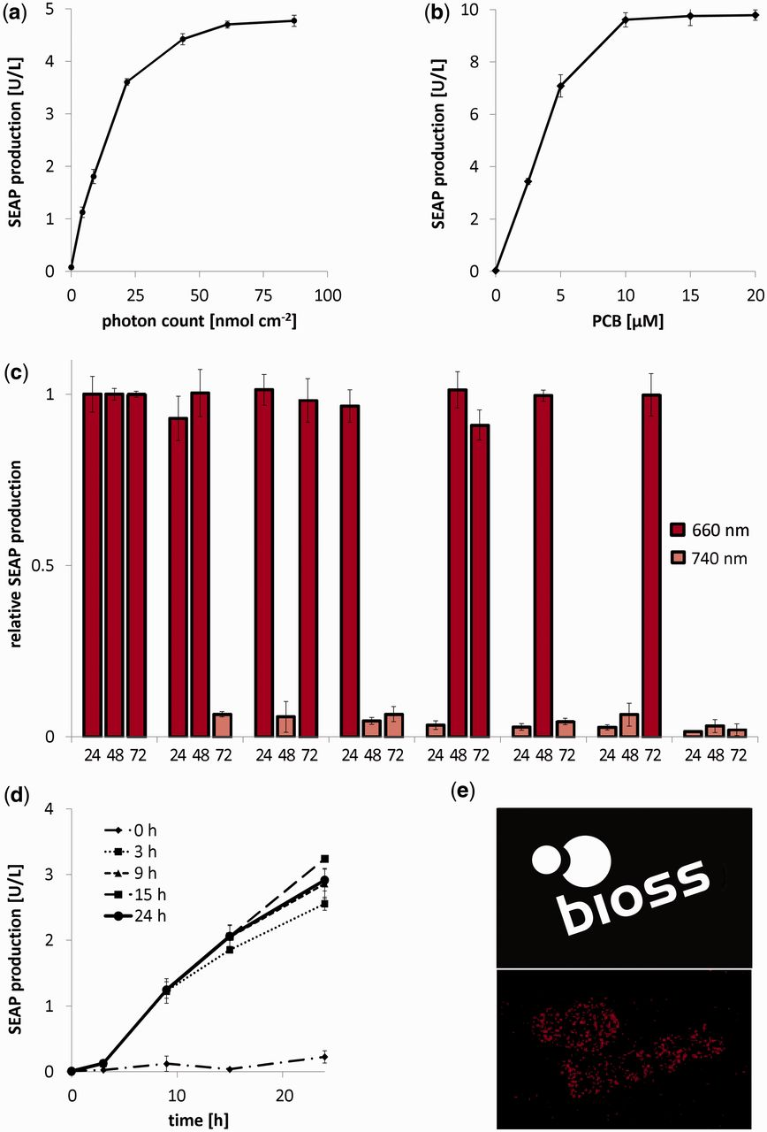
Figure 2. Detailed characterization of red light-inducible gene expression. (a–d) 70 000 CHO-K1 cells were transfected ...
Notes:
Figure 2. Detailed characterization of red light-inducible gene expression. (a–d) 70 000 CHO-K1 cells were transfected with the red light-inducible SEAP expression system (plasmids pKM006 and pKM022). After 24 h, the medium was replaced by fresh medium containing PCB (15 µM unless stated otherwise). The cells were cultivated for 1 h in the dark and subsequently subjected to the indicated illumination conditions before quantification of SEAP production. (a) Dose–response curve for red light-inducible SEAP expression. Cells were exposed to a 25 min pulse of 660 nm light at different intensities, resulting in the indicated photon number. After 24 h incubation in the dark, SEAP production was quantified. (b) PCB-adjustable transgene expression levels. Cells were exposed to a 25 min pulse of 660 nm light, resulting in a photon number of 80 nmol cm−2 for full induction of gene expression in the presence of increasing PCB concentrations. Subsequently, the cells were cultivated in the dark for 24 h before the quantification of SEAP production. (c) Reversibility of red light-inducible gene expression. Every 24 h, the cell culture medium was replaced by fresh PCB-containing medium, and the cells were illuminated at the indicated wavelengths. SEAP production was measured every 24 h. To correct for changes in gene expression over time because of cell growth, expression levels were normalized to the configuration, where cells were constantly kept under 660 nm light. (d) Effect of dark reversion of the PhyB–PIF6 interaction on transgene expression. Cells were grown under 660 nm light for the indicated periods before moving the cells to the dark. At the indicated time points, SEAP production was quantified. (e) Spatially resolved control of gene expression. CHO-K1 cells transgenic for red light-inducible mCherry expression (plasmids pKM022 and pKM078) were illuminated through a photo mask (top image) for 1 h (0.5 µmol m−2 s−1). After 23 h incubation in the dark, mCherry production was visualized. Scale bar, 1 cm. In Figure 2a–d, data represent the mean of four independent experiments, and error bars indicate the standard deviations.
Unless provided in the caption above, the following copyright applies to the content of this slide: © The Author(s) 2013. Published by Oxford University Press.This is an Open Access article distributed under the terms of the Creative Commons Attribution Non-Commercial License (http://creativecommons.org/licenses/by-nc/3.0/), which permits unrestricted non-commercial use, distribution, and reproduction in any medium, provided the original work is properly cited.

Slide 3
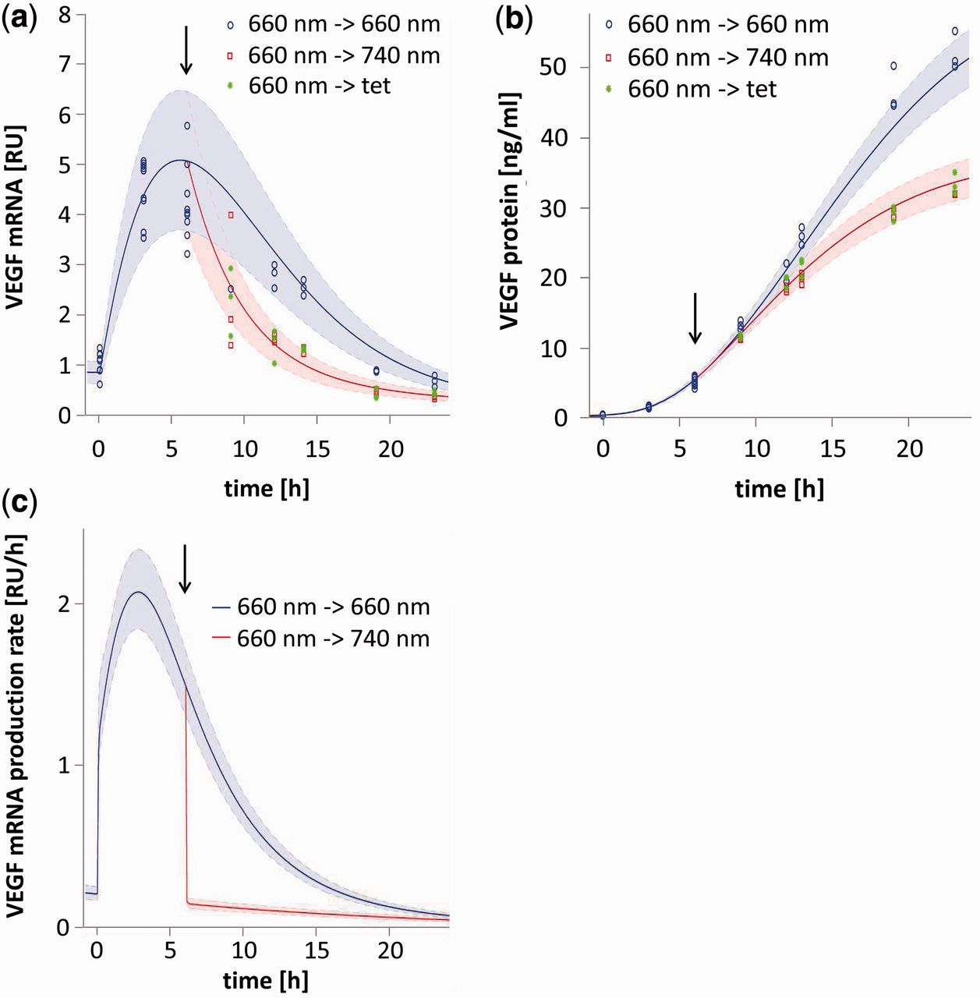
Figure 3. Model-based analysis of the light-responsive gene expression kinetics. In all, 70 000 CHO-K1 cells were ...
Notes:
Figure 3. Model-based analysis of the light-responsive gene expression kinetics. In all, 70 000 CHO-K1 cells were transfected for red-light inducible hVEGF121 expression (plasmids pKM022 and pKM033). After 24 h, the medium was supplemented with 15 µM PCB (t = −1 h). Cells were subsequently illuminated for 6 h at 660 nm and were then either switched to 660 nm, 740 nm or tetracycline-containing medium (arrow). (a) Switch-off kinetics of hVEGF121 mRNA. At the indicated points in time, cells were lysed, and hVEGF121 mRNA was quantified. (b) Switch-off kinetics of hVEGF121 protein production. At the indicated points in time, hVEGF121 was quantified in the cell culture supernatant. (c) Model prediction for the de novo synthesis of hVEGF121 mRNA. In (a) and (b), the shaded error bands are based on the error model detailed in Equation (9). The shaded bands in (c) indicate the 95% prediction confidence interval, which was calculated by propagating the uncertainties of the estimated parameters.
Unless provided in the caption above, the following copyright applies to the content of this slide: © The Author(s) 2013. Published by Oxford University Press.This is an Open Access article distributed under the terms of the Creative Commons Attribution Non-Commercial License (http://creativecommons.org/licenses/by-nc/3.0/), which permits unrestricted non-commercial use, distribution, and reproduction in any medium, provided the original work is properly cited.

Slide 4
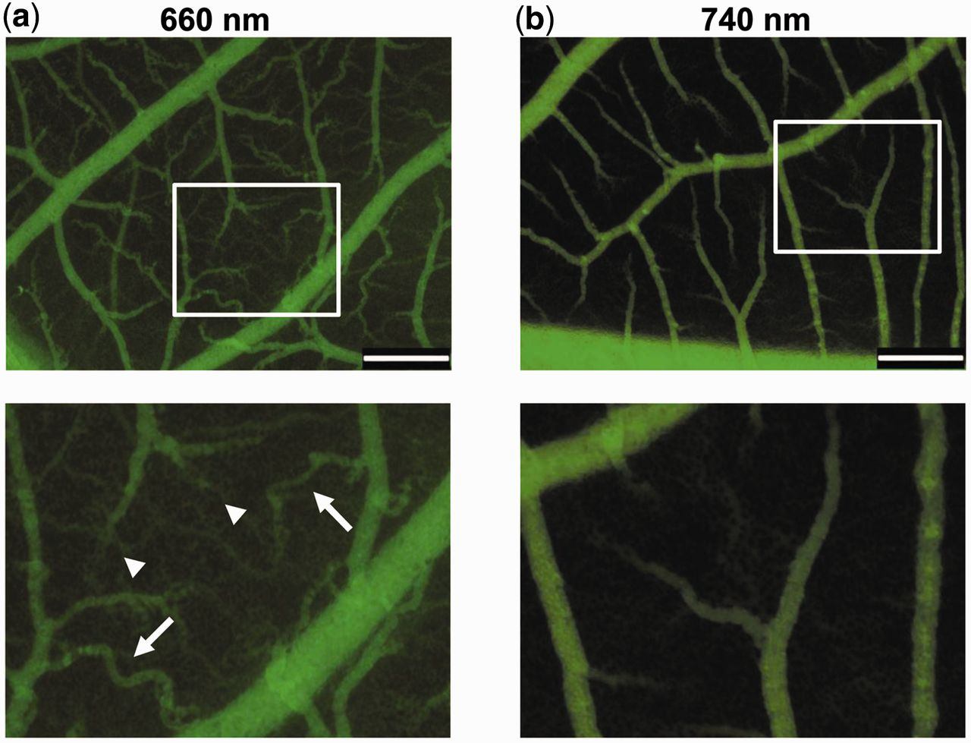
Figure 4. In vivo red light-controlled vascularization in chicken embryos. CHO-K1 cells were engineered for red ...
Notes:
Figure 4. In vivo red light-controlled vascularization in chicken embryos. CHO-K1 cells were engineered for red light-inducible expression of the 121 amino acid splice variant of human vascular endothelial growth factor hVEGF121. One million cells were embedded in 3% polyethylene glycol gel and were applied onto the CAM of 9 days old chicken embryos. After illumination at (a) 660 or (b) 740 nm for 48 h, the microvasculature was visualized by injection of FITC–dextran and video imaging (see Supplementary Material for videos). Brush- and delta-like endpoint patterns (arrowheads) and tortuously shaped vascularization (arrows) are indicated. Top panels, overview; lower panels, insets at higher magnification. Scale bar, 500 µm.
Unless provided in the caption above, the following copyright applies to the content of this slide: © The Author(s) 2013. Published by Oxford University Press.This is an Open Access article distributed under the terms of the Creative Commons Attribution Non-Commercial License (http://creativecommons.org/licenses/by-nc/3.0/), which permits unrestricted non-commercial use, distribution, and reproduction in any medium, provided the original work is properly cited.

