Slide 1
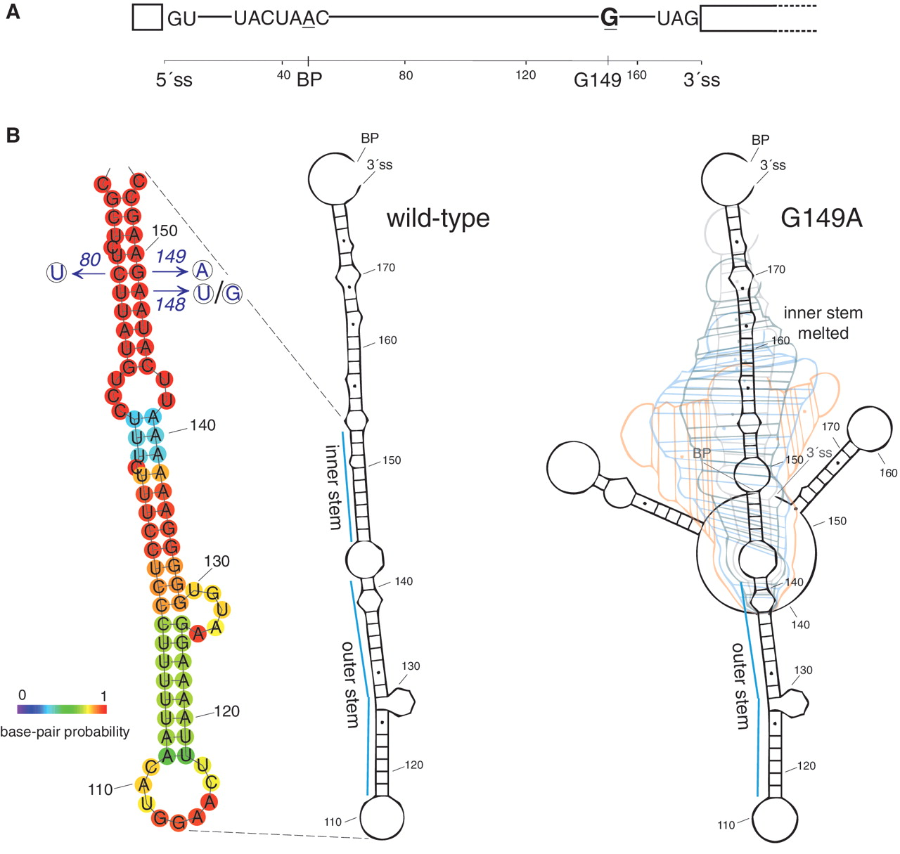
Figure 1. G149A substitution destabilizes predicted secondary structure between branch point and 3′ splice site of ...
Notes:
Figure 1. G149A substitution destabilizes predicted secondary structure between branch point and 3′ splice site of COF1 intron. ( A ) Schematic representation of COF1 intron. The numbering starts at the first intron nucleotide; all substitutions in this study are numbered according to the nucleotide position in non-manipulated intron. 5′ss, branch point region, 3′ss and G149 nucleotide are depicted. ( B ) Secondary structure predicted between BP and 3′ss of wild-type (left panel) and G149A (right panel) COF1i . Models were generated by RNAshapes program. Dynamic structure of G149A variant is depicted as a set of six overlaid still images extracted from an animated output of the program. Structure representation of the ‘inner’ and ‘outer’ stem containing part of wild-type COF1i including the sequence and base pair probabilities was generated by RNAfold. Mutations of the inner stem used in this study are shown in the left panel.
Unless provided in the caption above, the following copyright applies to the content of this slide: © The Author(s) 2011. Published by Oxford University Press.This is an Open Access article distributed under the terms of the Creative Commons Attribution Non-Commercial License (http://creativecommons.org/licenses/by-nc/3.0), which permits unrestricted non-commercial use, distribution, and reproduction in any medium, provided the original work is properly cited.

Slide 2
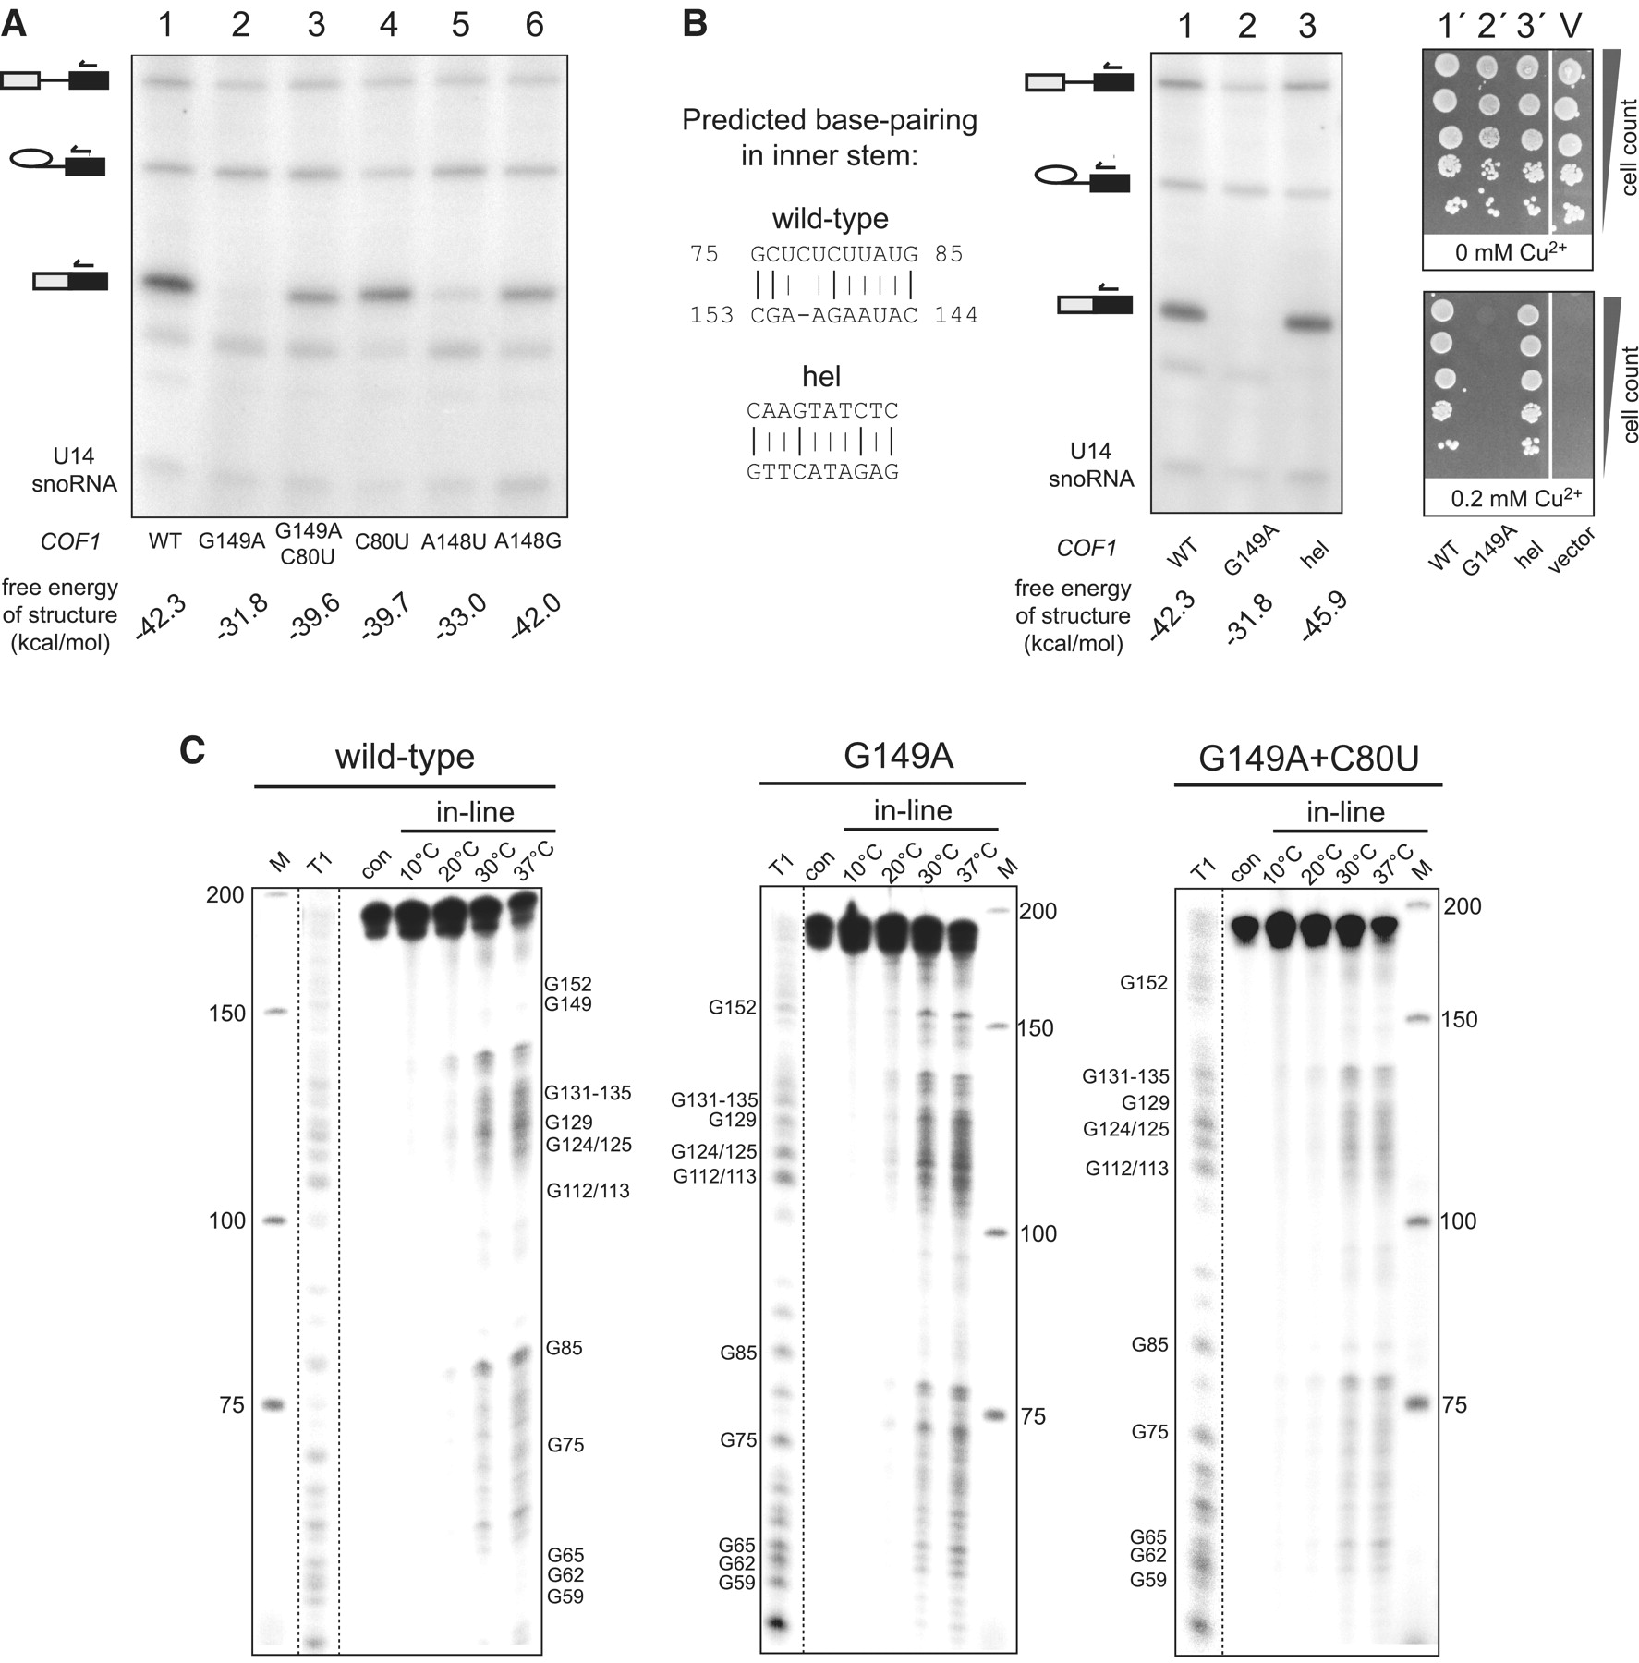
Figure 2. Intramolecular structure between BP and 3′ss is required for efficient splicing of COF1 intron. ( A ) The ...
Notes:
Figure 2. Intramolecular structure between BP and 3′ss is required for efficient splicing of COF1 intron. ( A ) The stability of secondary structure predicted between BP and 3′ss of COF1i correlates with splicing efficiency. RNA from cells expressing the indicated COF1-CUP1 constructs was subjected to primer extension analysis as described in Materials and Methods. The products corresponding to pre-mRNA, mRNA and lariat-exon 2 intermediate are indicated by their icons. U14 snoRNA was assayed as a loading control. Energy values (kcal/mol) for the minimal free energy structures calculated by RNAfold are shown below each lane. Mutation G149A caused severe inhibition of COF1-CUP1 reporter gene splicing. The defect was suppressed by restoring complementarity in the predicted stem (G149A+C80U; lane 3). Destabilization of the predicted structure at a neighboring position likewise decreased splicing efficiency (A148U; lane 5). Substitutions which were predicted to have negligible impact on the stem between BP and 3′ss did not affect splicing (C80U and A148G; lane 4 and 6, respectively). ( B ) Intramolecular stem is indispensable for efficient splicing of COF1i . We completely altered the sequence of the inner stem of COF1i (left panel; see text and Figure 1 B for explanation) such that the structure's predicted stability remained the same. Minimal free energies are indicated below lanes. The variant hel was spliced with the same efficiency as wild-type as shown by primer extension (lane 1 and 3) and by Cu 2+ -resistance of cells expressing the reporter construct (lane 1′ and 3′). ( C ) RNA in-line probing confirms the existence of secondary structure between BP and 3′ss of COF1i . RNAs encompassing wild-type, G149A and G149A+C80U mutant COF1i were subjected to in-line probing analysis as described in Materials and Methods and in Supplementary Data . RNAs were incubated for 45 h at the indicated temperatures and the extent of spontaneous RNA degradation was analyzed by denaturing polyacrylamide gel electrophoresis. The bands were annotated based on guanosine ladders generated by T1 RNase digestion (T1). Untreated RNA and the GeneRuler Ultra Low Range DNA Ladder (Fermentas) were run in the ‘con’ and ‘M’ lanes, respectively. Strong in-line cuts in the regions of A147-A151 and C80 of G149A intron (middle panel), but not of wild-type (left panel) or G149A+C80U mutant (right panel) are visible. They confirm the RNAfold prediction that the stem that forms between G75-G85 and C153-C145 sequences in wild-type or G149A+C80U intron is disrupted in G149 mutant (see Figure 1 B).
Unless provided in the caption above, the following copyright applies to the content of this slide: © The Author(s) 2011. Published by Oxford University Press.This is an Open Access article distributed under the terms of the Creative Commons Attribution Non-Commercial License (http://creativecommons.org/licenses/by-nc/3.0), which permits unrestricted non-commercial use, distribution, and reproduction in any medium, provided the original work is properly cited.

Slide 3
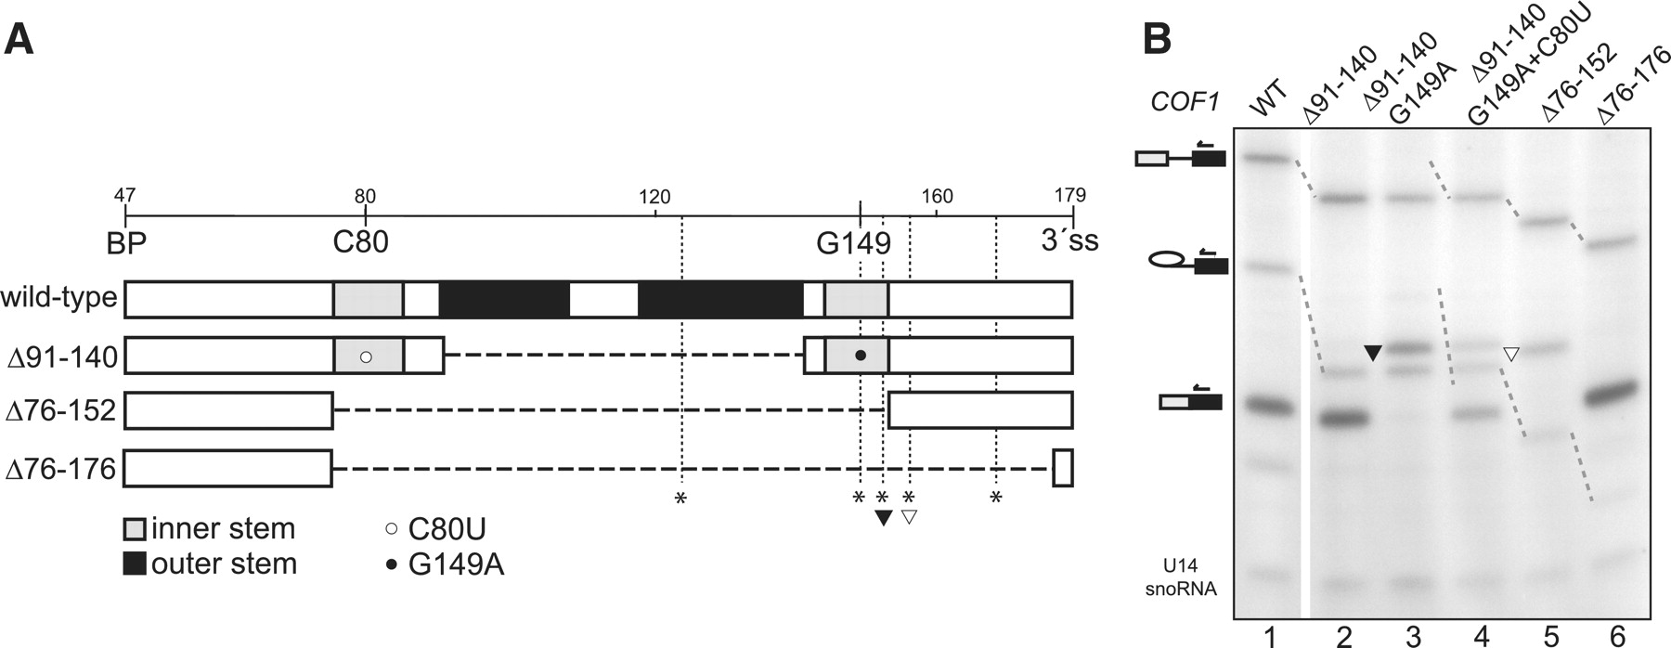
Figure 3. Destabilization of intramolecular stem within COF1 intron unmasks potential 3′ splice sites. ( A ) Summary ...
Notes:
Figure 3. Destabilization of intramolecular stem within COF1 intron unmasks potential 3′ splice sites. ( A ) Summary of COF1i constructs used. Sequences forming inner and outer stem are shaded; deleted regions are represented by dashed lines. Positions of G149 and C80 are marked by empty and filled circle, respectively. Potential 3′ss (all A/C/UAG trinucleotides) are marked by asterisks; acceptor sites used in the mutants, AAG152 and CAG156, are indicated by filled and empty arrowhead, respectively. ( B ) Destabilization or removal of stem within COF1i proves the structure's role in presenting the appropriate portion of the pre-mRNA molecule to spliceosome for 3′ss recognition. Deletion of the outer-stem nucleotides 91–140 did not affect splicing efficiency of COF1i (lane 2). Destabilization of the inner stem in this variant (Δ91-140, G149A) resulted in splicing to AAG152 (lane 3). Mutation of the nucleotide which is supposed to base pair with A149 partially suppressed the phenotype (Δ91-140, G149A+C80U; lane 4). Pre-mRNA with the whole stem-region deleted spliced to the first AG proximal to BP (CAG156; Δ76-152; lane 5). More extensive deletion, which shortened the BP–3′ss distance to 31 nt, resulted in efficient use of the annotated 3′ss (Δ76-176; lane 6). Filled and empty arrowheads indicate bands corresponding to the cryptic splice sites marked in (A). Notably, the cryptic sites of the COF1i mutants were only used when they were not blocked within the secondary structure or when they were brought closer to BP through deletion.
Unless provided in the caption above, the following copyright applies to the content of this slide: © The Author(s) 2011. Published by Oxford University Press.This is an Open Access article distributed under the terms of the Creative Commons Attribution Non-Commercial License (http://creativecommons.org/licenses/by-nc/3.0), which permits unrestricted non-commercial use, distribution, and reproduction in any medium, provided the original work is properly cited.

Slide 4
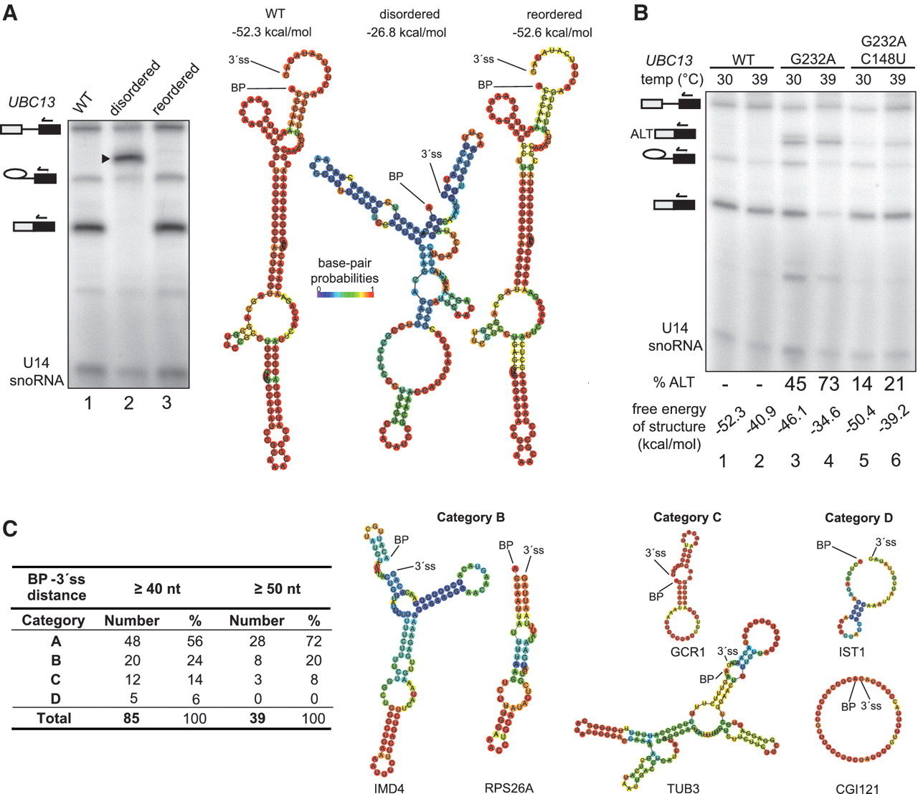
Figure 4. Secondary structure in UBC13 intron is responsible for proper 3′ss selection. ( A ) Mutations of one arm of ...
Notes:
Figure 4. Secondary structure in UBC13 intron is responsible for proper 3′ss selection. ( A ) Mutations of one arm of the predicted stem in UBC13i , which destabilized the structure, resulted in splicing to cryptic CAG located 38 nt downstream of BP (lane 2; band is marked by arrowhead). Introducing mutations to the complementary arm, such that the pairing energy but not the original sequence was restored, repaired the defect (lane 3). Schematic representations of BP to 3′ss regions in wild-type and manipulated UBC13i variants based on RNAfold predictions are shown in the left panel. The values of free energy are indicated for each structure. Summary of wild-type and manipulated UBC13i sequences is provided in Supplementary Figure S1 . ( B ) Use of cryptic 3′ss in a mutant with partially destabilized structure is enhanced at higher temperature. G232A substitution in UBC13i mildly destabilized the secondary structure and led to the use of several 3′ss (lane 3; bands corresponding to mRNA spliced to cryptic 3′ss are marked by ALT + mRNA icon). The defect was exacerbated at 39°C (lane 4). Compensating substitution partially suppressed the defect in temperature dependent manner (G232A+C148U; lanes 5 and 6). Densitometric quantification of alternatively spliced RNA (expressed as percent of total spliced RNA; % ALT) and free energy of structure calculated for a given temperature are indicated below each lane. ( C ) Majority of dBP introns of S. cerevisiae are predicted to form secondary structure between BP and 3′ss. Sequences between BP and 3′ss were analyzed by RNAfold. Predicted structures were sorted into four categories. A—structures with extensive and stable stems; none to small bulge/internal loops. B—structures with less extensive but still stable stems; bulge/internal loops. C—other type of secondary structure. D—unstable structures or unstructured. The relative proportions of the categories are shown. Two examples of predicted structures in each category are depicted in the right panel. Category A is represented by UBC13i and COF1i ( Figure 1 B). Full list of introns together with additional information on sorting the structures is provided in Supplementary Data ( Supplementary Table S1 ).
Unless provided in the caption above, the following copyright applies to the content of this slide: © The Author(s) 2011. Published by Oxford University Press.This is an Open Access article distributed under the terms of the Creative Commons Attribution Non-Commercial License (http://creativecommons.org/licenses/by-nc/3.0), which permits unrestricted non-commercial use, distribution, and reproduction in any medium, provided the original work is properly cited.

