Slide 1
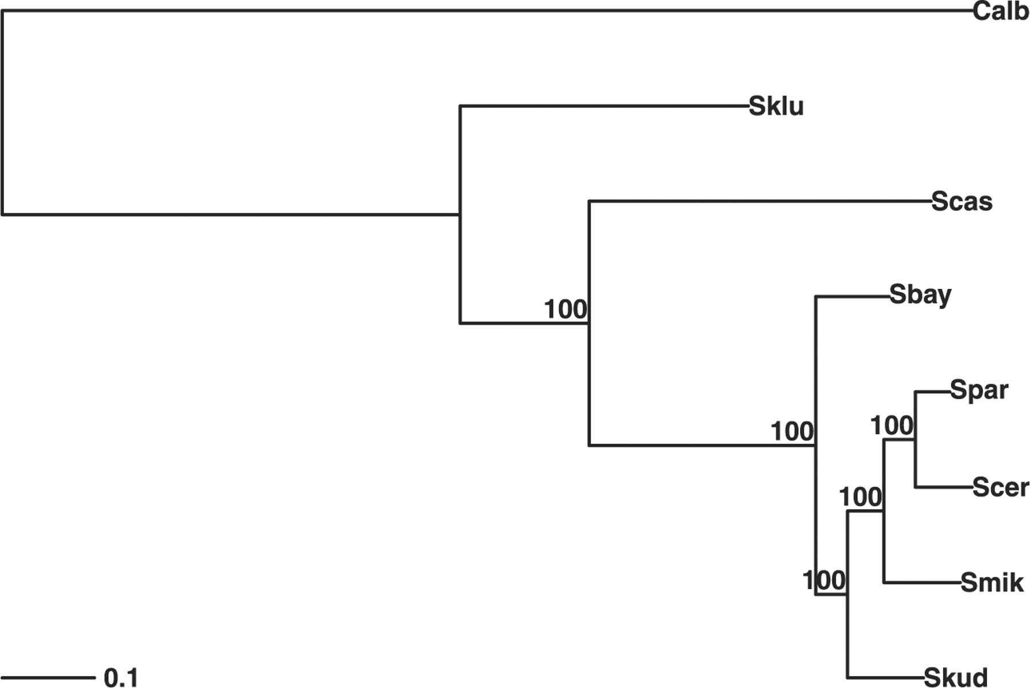
Fig. 1. phylogenetic tree with bootstrap support on the edges for the data of Rokas et al., 2003.
Notes:
Fig. 1. phylogenetic tree with bootstrap support on the edges for the data of Rokas et al., 2003.
Unless provided in the caption above, the following copyright applies to the content of this slide: © The Author(s) 2010. Published by Oxford University Press.This is an Open Access article distributed under the terms of the Creative Commons Attribution Non-Commercial License (http://creativecommons.org/licenses/by-nc/2.5), which permits unrestricted non-commercial use, distribution, and reproduction in any medium, provided the original work is properly cited.

Slide 2
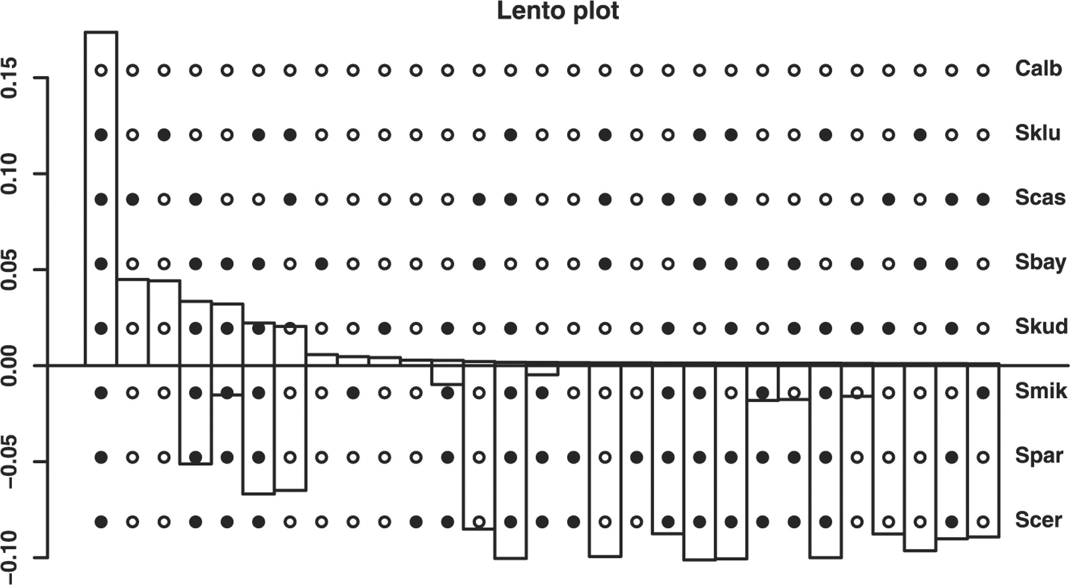
Fig. 2. Lento plot of the edge weights from sequence spectrum for the data of Rokas et al., 2003. On the x-axis the ...
Notes:
Fig. 2. Lento plot of the edge weights from sequence spectrum for the data of Rokas et al., 2003. On the x-axis the splits or edges are represented by the dots overlying the graph. The bars above the axis indicate the edge weights or the support of a split, bars below represent the conflict with this split, i.e. the sum of the edge weights which are incompatible with this split.
Unless provided in the caption above, the following copyright applies to the content of this slide: © The Author(s) 2010. Published by Oxford University Press.This is an Open Access article distributed under the terms of the Creative Commons Attribution Non-Commercial License (http://creativecommons.org/licenses/by-nc/2.5), which permits unrestricted non-commercial use, distribution, and reproduction in any medium, provided the original work is properly cited.

