Slide 1
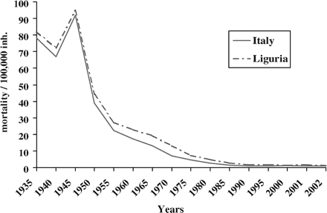
Figure 1 Tb Mortality in Italy and in Liguria
Notes:
Figure 1 Tb Mortality in Italy and in Liguria
Unless provided in the caption above, the following copyright applies to the content of this slide: © The Author 2005. Published by Oxford University Press on behalf of the European Public Health Association. All rights reserved.

Slide 2
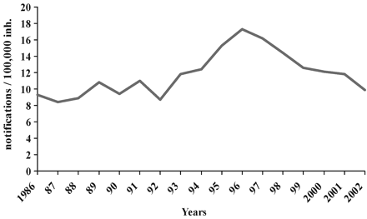
Figure 2 Tb notifications/100 000 inhabitants in Liguria, 1986–2002
Notes:
Figure 2 Tb notifications/100 000 inhabitants in Liguria, 1986–2002
Unless provided in the caption above, the following copyright applies to the content of this slide: © The Author 2005. Published by Oxford University Press on behalf of the European Public Health Association. All rights reserved.

Slide 3
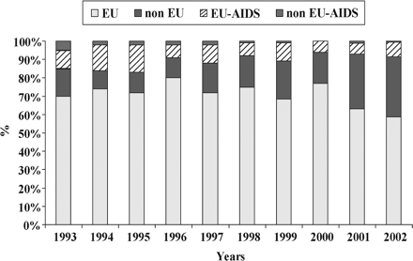
Figure 3 Tb in Liguria: a comparison among European Union citizens, non-European Union citizens and people affected ...
Notes:
Figure 3 Tb in Liguria: a comparison among European Union citizens, non-European Union citizens and people affected with AIDS
Unless provided in the caption above, the following copyright applies to the content of this slide: © The Author 2005. Published by Oxford University Press on behalf of the European Public Health Association. All rights reserved.

Slide 4
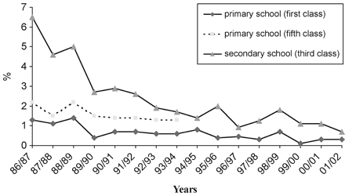
Figure 4 Cutipositivity in Genoan schoolchildren from 1986 to 2002
Notes:
Figure 4 Cutipositivity in Genoan schoolchildren from 1986 to 2002
Unless provided in the caption above, the following copyright applies to the content of this slide: © The Author 2005. Published by Oxford University Press on behalf of the European Public Health Association. All rights reserved.

