Slide 1
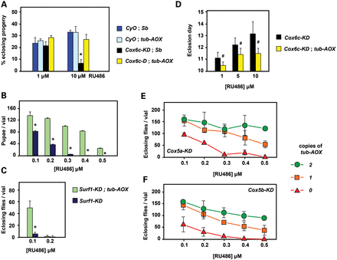
Figure 2. Rescue of COX deficiency by tub-AOX. (A) tub-AOX rescue of developmental lethality and (D) of developmental ...
Notes:
Figure 2. Rescue of COX deficiency by tub-AOX. (A) tub-AOX rescue of developmental lethality and (D) of developmental delay, from partial knockdown of Cox6c (Drosophila gene cyclope) using tub-GS driver. Proportion of eclosing progeny or eclosion day for different genotypes and concentrations of RU486 as shown, means ± SD from 4 or more biological replicates. (B and C) tub-AOX rescue of developmental lethality from partial knockdown of Surf1 using tub-GS driver. The number of pupae or eclosing flies for different genotypes and concentrations of RU486 as shown, means ± SD from 3 or more biological replicates. (E and F) Rescue of developmental lethality from partial knockdown of Cox5a or Cox5b (Drosophila genes CoVa, CoVb) using tub-GS driver, as shown. Number of eclosing progeny at different concentrations of RU486, for the indicated numbers of tub-AOX transgenes. Means ± SD from 3 or more biological replicates. P < 0.01 (*) or < 0.05 (#), Student's t test, two-tailed, unequal variances, comparing flies with and without tub-AOX. See also Supplementary Material, Figure S2. Note that at 0 μm RU486 all knockdown lines tested were indistinguishable from wild-type flies in the assays shown, and that wild-type flies eclose on Days 10 and 11 at 25°C. Two copies of tub-AOX also rescued the lethality of Cox6b knockdown (Supplementary Material, Fig. S2C).
Unless provided in the caption above, the following copyright applies to the content of this slide: © The Author 2013. Published by Oxford University Press.This is an Open Access article distributed under the terms of the Creative Commons Attribution License (http://creativecommons.org/licenses/by/3.0/), which permits unrestricted reuse, distribution, and reproduction in any medium, provided the original work is properly cited.

Slide 2
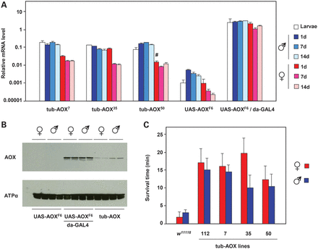
Figure 1. Transgenic expression of tub-AOX. (A) Quantitative real time-polymerase chain reaction (qRT-PCR) analysis of ...
Notes:
Figure 1. Transgenic expression of tub-AOX. (A) Quantitative real time-polymerase chain reaction (qRT-PCR) analysis of AOX mRNA expression (normalized against RpL32) in transgenic adults and larvae, as indicated. Means ± SD of at least three technical replicates of each of at least three biological replicates. Comparing (upstream activating sequence) UAS-AOX expression driven by da-GAL4 (yeast transcription activator protein GAL4) with that of tub-AOX, P < 0.01 for each sex/age analysed; similarly, comparing UAS-AOX expression in the absence of driver with that of tub-AOX, P < 0.01 in each case, except where indicated (#), where P < 0.05 (Student's t test, two-tailed, unequal variances). (B) Western blot of AOX protein and adenosine triphosphate (ATP) synthase subunit α (loading control) in 1-day-old adults of the transgenic strains indicated. tub-AOX denotes flies homozygous for each of tub-AOX7, tub-AOX35 and tub-AOX50 transgenes (males are hemizygous for tub-AOX35). Replicate batches of protein extracts from 30 females or 40 males of each genotype are shown in adjacent lanes. (C) Survival time on cyanide-impregnated agar of flies of the (homozygous) strains indicated. Means ± SD of 80–100 flies of each group, in batches of 10 flies per vial. P < 0.01 in each case, in comparison with w1118 control flies of same sex (Student's t test, two-tailed, unequal variances). See also Supplementary Material, Figure S1.
Unless provided in the caption above, the following copyright applies to the content of this slide: © The Author 2013. Published by Oxford University Press.This is an Open Access article distributed under the terms of the Creative Commons Attribution License (http://creativecommons.org/licenses/by/3.0/), which permits unrestricted reuse, distribution, and reproduction in any medium, provided the original work is properly cited.

Slide 3
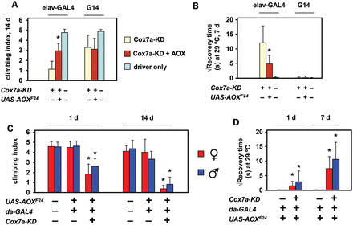
Figure 5. AOX partially rescues neuronal phenotypes resulting from Cox7a knockdown. (A and C) Climbing index and (B and ...
Notes:
Figure 5. AOX partially rescues neuronal phenotypes resulting from Cox7a knockdown. (A and C) Climbing index and (B and D) bang sensitivity at 29°C of flies of the indicated genotypes, ages and sex. Means ± SD generated by analysis of batches of >50 individual flies of each class. Where, indicated, P < 0.001, Student's t test, two-tailed, unequal variances, (A and B) comparing flies knocked down for Cox7a (isogene CG9603) with and without co-expression of AOX or (C and D) comparing flies of a given sex expressing AOX, with or without concomitant knockdown of Cox7a.
Unless provided in the caption above, the following copyright applies to the content of this slide: © The Author 2013. Published by Oxford University Press.This is an Open Access article distributed under the terms of the Creative Commons Attribution License (http://creativecommons.org/licenses/by/3.0/), which permits unrestricted reuse, distribution, and reproduction in any medium, provided the original work is properly cited.

Slide 4
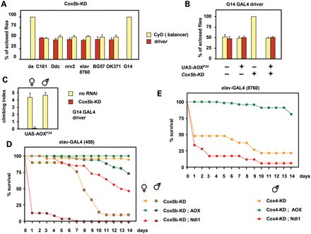
Figure 4. AOX rescue of tissue-restricted cIV knockdown. (A–C) Knockdown of Cox5b (Drosophila gene CoVb) using the ...
Notes:
Figure 4. AOX rescue of tissue-restricted cIV knockdown. (A–C) Knockdown of Cox5b (Drosophila gene CoVb) using the drivers indicated. Flies with the CyO balancer marker are progeny from the same crosses, but without driver. (A and B) Proportion of eclosing progeny of the genotypes indicated, means ± SD for 3 or more biological replicates. (C) Climbing index (defined as in the Materials and methods section) of 1-day-old UAS-AOX transgenic flies bearing the G14 driver, with and without knockdown of Cox5b. Means ± SD of 10 batches of 5 flies, for each sex and genotype. Note that the AOX-rescued Cox5b-knockdown males were unable to climb at all in this experiment. (D and E) Survival curves of flies of the indicated genotypes, following Cox5b or Cox4 (Drosophila gene CoIV) knockdown and transgene expression driven by (D) elav-GAL4 strain 458 or (E) 8760, as shown. Data are means from two independent experiments. See also Supplementary Material, Figure S4.
Unless provided in the caption above, the following copyright applies to the content of this slide: © The Author 2013. Published by Oxford University Press.This is an Open Access article distributed under the terms of the Creative Commons Attribution License (http://creativecommons.org/licenses/by/3.0/), which permits unrestricted reuse, distribution, and reproduction in any medium, provided the original work is properly cited.

Slide 5
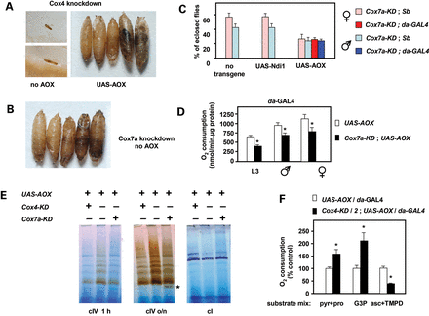
Figure 3. Partial rescue of global COX deficiency by UAS-AOX. (A) Micrographs illustrating typical phenotypes produced ...
Notes:
Figure 3. Partial rescue of global COX deficiency by UAS-AOX. (A) Micrographs illustrating typical phenotypes produced by knockdown of Cox4 (Drosophila gene CoIV) driven by da-GAL4. In the absence of transgenic rescue, progeny arrested as abnormal L1/L2 larvae. Co-expression of UAS-AOX enabled development to proceed as far as late pupa, although few flies eclosed. See also Supplementary Material, Figure S3A. (B) Micrograph illustrating typical pupal-lethal phenotype produced by knockdown of the major Cox7a-encoding isogene CG9603, driven by da-GAL4. (C) AOX rescue of pupal lethality from Cox7a (CG9603) knockdown. Proportion of eclosing progeny for different genotypes as shown, means ± SD from 3 or more biological replicates. Flies with the da-GAL4 driver have normal bristles, distinguishing them from those with the Sb balancer. Expression of UAS-AOX produced a full rescue whereas UAS-Ndi1 expression produced none. (D) Ascorbate/TMPD-driven oxygen consumption of homogenates from UAS-AOX expressing L3 larvae or adult flies, with or without knockdown of Cox7a (CG9603). Means ± SD from 3 or more biological replicates; asterisks indicate significant differences (P < 0.01, Student's t test, two-tailed, unequal variances). (E) BNE gels of mitochondrial extracts (37.5 μg mitochondrial protein per lane) from L3 larvae of the genotypes shown, stained histochemically for cI or cIV activity (cIV activity staining performed for the indicated times). See Ref. 10, Figure 3, for migration of major bands in relation to molecular weight markers on these gels. Asterisk indicates assembly sub-complex S3 (12). (F) Oxygen consumption of homogenates from L3 larvae of the indicated genotypes, driven by different substrate mixes (pyruvate + proline, G3P and ascorbate + TMPD, respectively, as described in the Materials and methods section for cI-, G3PDH- and cIV-linked respiration. For clarity, oxygen consumption is expressed as a percentage of corresponding values for control larvae expressing AOX but without RNAi. Means ± SD, ≥3 biological replicates; asterisks indicate significant differences (P < 0.01, Student's t test, two-tailed, unequal variances).
Unless provided in the caption above, the following copyright applies to the content of this slide: © The Author 2013. Published by Oxford University Press.This is an Open Access article distributed under the terms of the Creative Commons Attribution License (http://creativecommons.org/licenses/by/3.0/), which permits unrestricted reuse, distribution, and reproduction in any medium, provided the original work is properly cited.

Slide 6
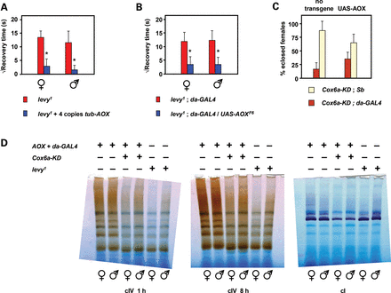
Figure 6. AOX partially rescues Cox6a-dependent neurodegeneration. (A and B) Rescue of seizure sensitivity of 7-day-old ...
Notes:
Figure 6. AOX partially rescues Cox6a-dependent neurodegeneration. (A and B) Rescue of seizure sensitivity of 7-day-old levy1 flies maintained at 29°C. Means ± SD of square root of recovery time from mechanical shock, for batches of 50–100 individual flies of the sex and genotypes indicated. Note that, control flies do not show any such bang sensitivity (∼zero recovery time). (C) UAS-AOX rescue of semi-lethality of Cox6a knockdown (Drosophila gene levy) in female flies. Means ± SD from 3 or more biological replicates. (D) BNE gels (as Fig. 3E) from 1-day-old adults of the genotype and sex shown, stained histochemically for cI or cIV activity (cIV activity staining performed for the indicated times). See also Supplementary Material, Figure S7. Where, indicated, P < 0.001, Student's t test, two-tailed, unequal variances, comparing flies of the given sex, expressing AOX or not. P = 0.051 in (C).
Unless provided in the caption above, the following copyright applies to the content of this slide: © The Author 2013. Published by Oxford University Press.This is an Open Access article distributed under the terms of the Creative Commons Attribution License (http://creativecommons.org/licenses/by/3.0/), which permits unrestricted reuse, distribution, and reproduction in any medium, provided the original work is properly cited.

