Slide 1
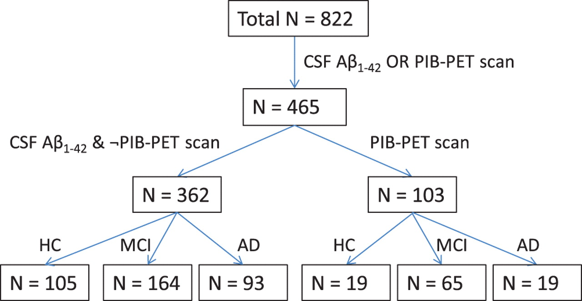
Figure 1. Flow chart of subjects included in the current study.
Notes:
Figure 1. Flow chart of subjects included in the current study.
Unless provided in the caption above, the following copyright applies to the content of this slide: © The Author 2011. Published by Oxford University Press. All rights reserved. For permissions, please e-mail: journals.permissions@oup.com

Slide 2
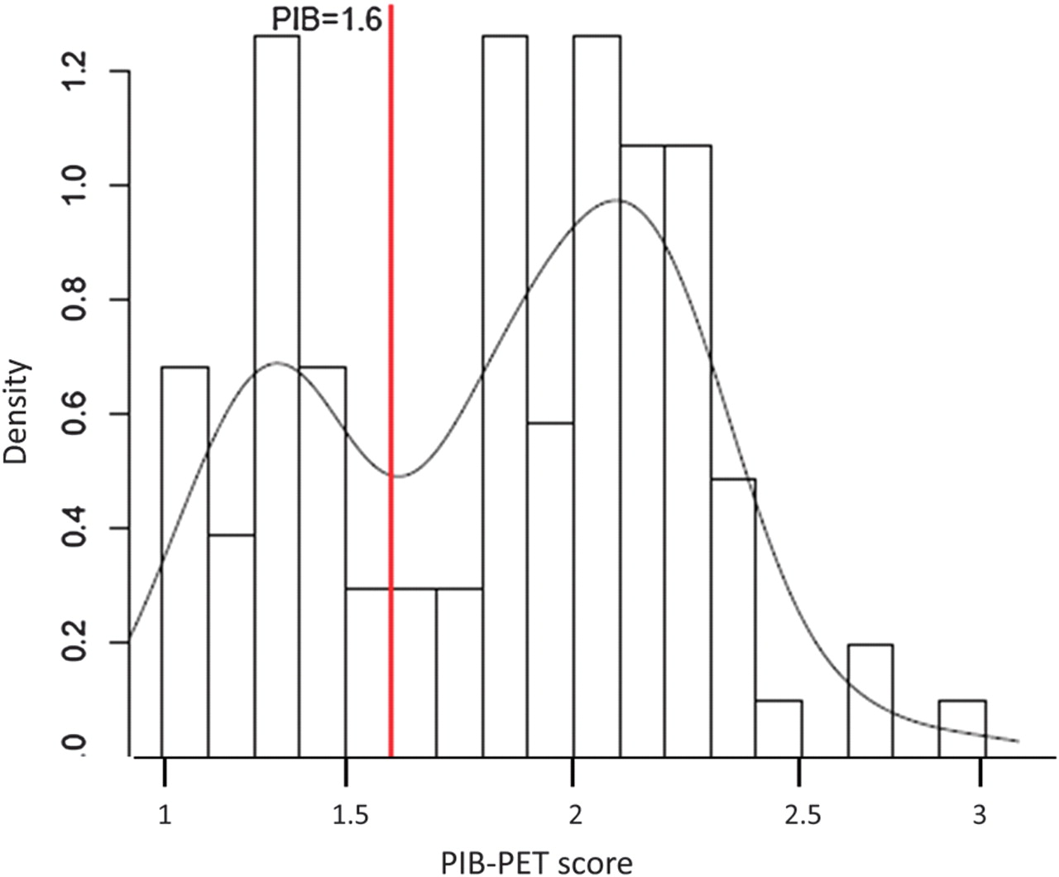
Figure 2. Frequency plot of average PIB-PET scores and a fitted smoothed curve of the distribution. The cutoff point of ...
Notes:
Figure 2. Frequency plot of average PIB-PET scores and a fitted smoothed curve of the distribution. The cutoff point of 1.6 (red vertical line) was derived to optimally separate the data of the bimodal distribution into PIB-PET(+) and PIB-PET(−) groups.
Unless provided in the caption above, the following copyright applies to the content of this slide: © The Author 2011. Published by Oxford University Press. All rights reserved. For permissions, please e-mail: journals.permissions@oup.com

Slide 3
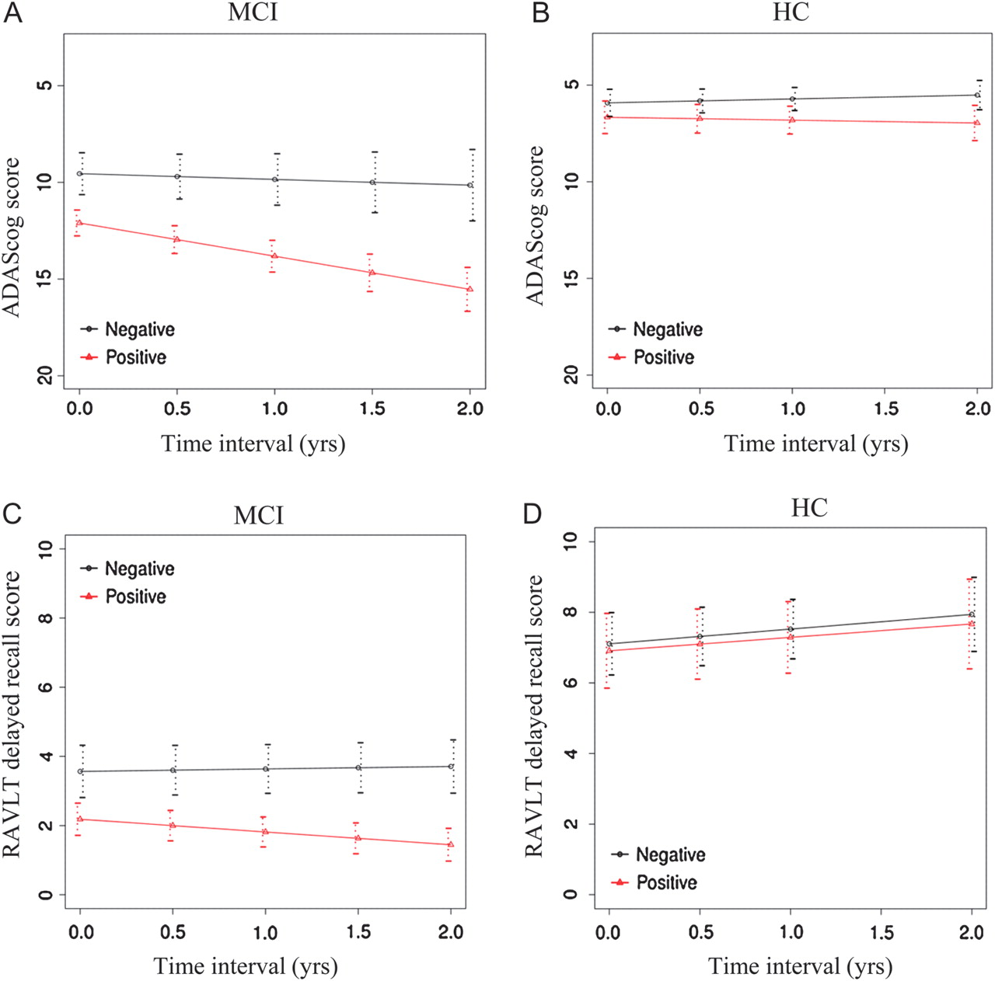
Figure 3. Regression plot of estimated longitudinal decline in the ADAS-cog (A and B) and delayed RAVLT scores (C and ...
Notes:
Figure 3. Regression plot of estimated longitudinal decline in the ADAS-cog (A and B) and delayed RAVLT scores (C and D) over the follow-up period (years) for iPIB-PET(+) subjects (red line) versus iPIB-PET(−) subjects (black line) in MCI (A and C) and HC (B and D). The difference in the rate of decline between iPIB-PET groups was statistically significant for measures, except for ADAS-cog in the HC group (see Results).
Unless provided in the caption above, the following copyright applies to the content of this slide: © The Author 2011. Published by Oxford University Press. All rights reserved. For permissions, please e-mail: journals.permissions@oup.com

Slide 4
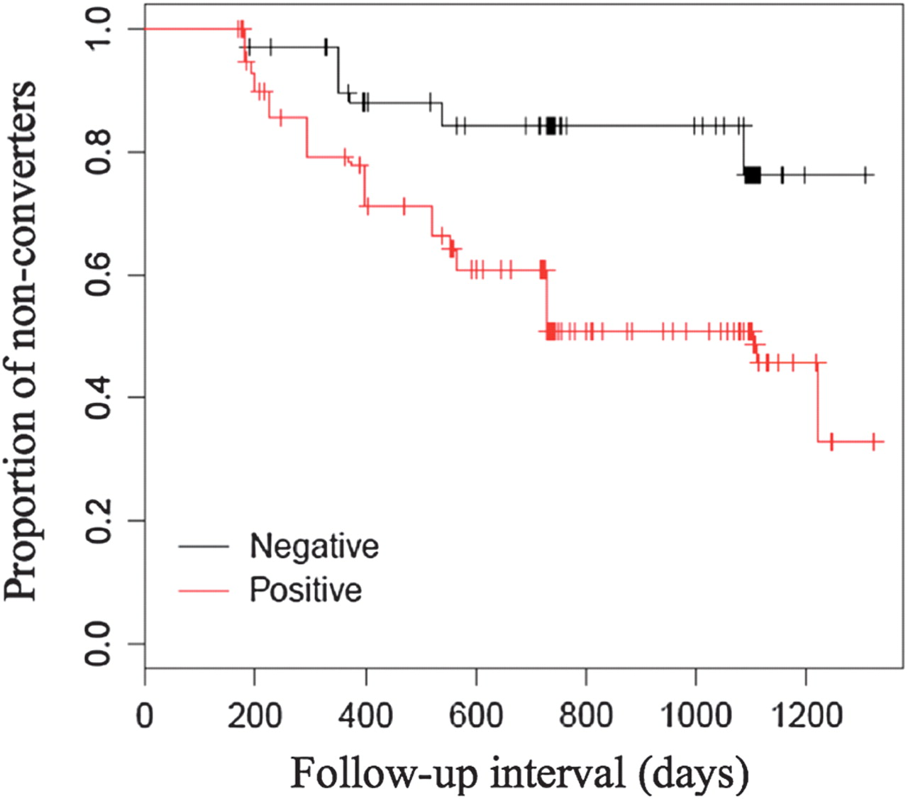
Figure 4. Survival plot for conversion from MCI to AD for iPIB-PET(+) shown in red and iPIB-PET(−) shown in black.
Notes:
Figure 4. Survival plot for conversion from MCI to AD for iPIB-PET(+) shown in red and iPIB-PET(−) shown in black.
Unless provided in the caption above, the following copyright applies to the content of this slide: © The Author 2011. Published by Oxford University Press. All rights reserved. For permissions, please e-mail: journals.permissions@oup.com

Slide 5
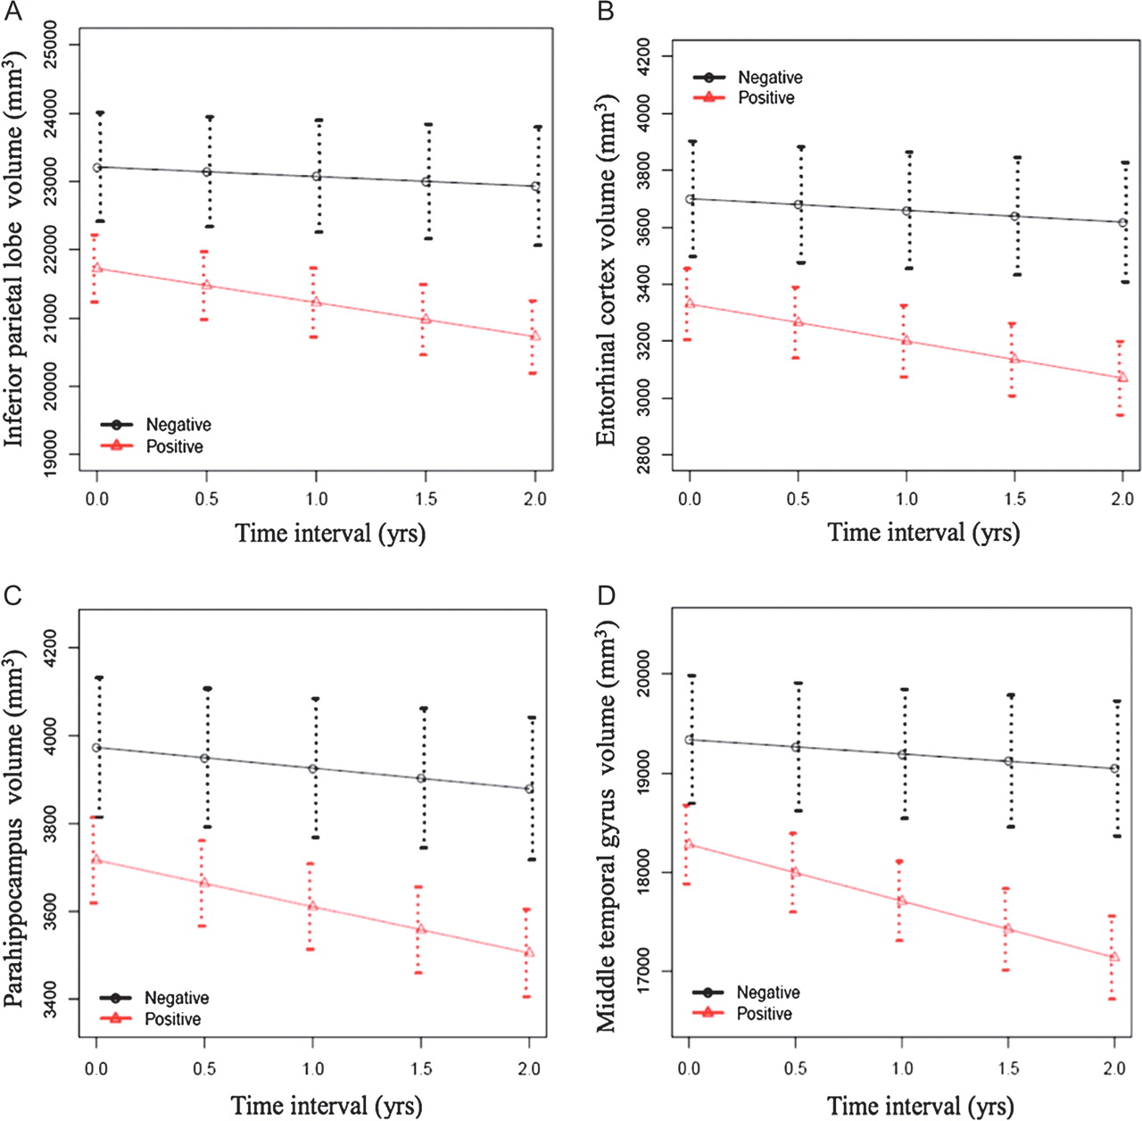
Figure 5. Regression plot of estimated longitudinal decline of gray matter volume in MCI subjects for the inferior ...
Notes:
Figure 5. Regression plot of estimated longitudinal decline of gray matter volume in MCI subjects for the inferior parietal cortex (A), entorhinal cortex (B), parahippocampus (C), and middle temporal gyrus (D). The iPIB-PET(+)–associated acceleration in the decline of each volume was significantly larger in MCI than in HC subjects in whom the iPIB-PET–associated difference was not significant (not shown). Note that the scale of the plots varies due to the different sizes of the brain structures.
Unless provided in the caption above, the following copyright applies to the content of this slide: © The Author 2011. Published by Oxford University Press. All rights reserved. For permissions, please e-mail: journals.permissions@oup.com

