Slide 1
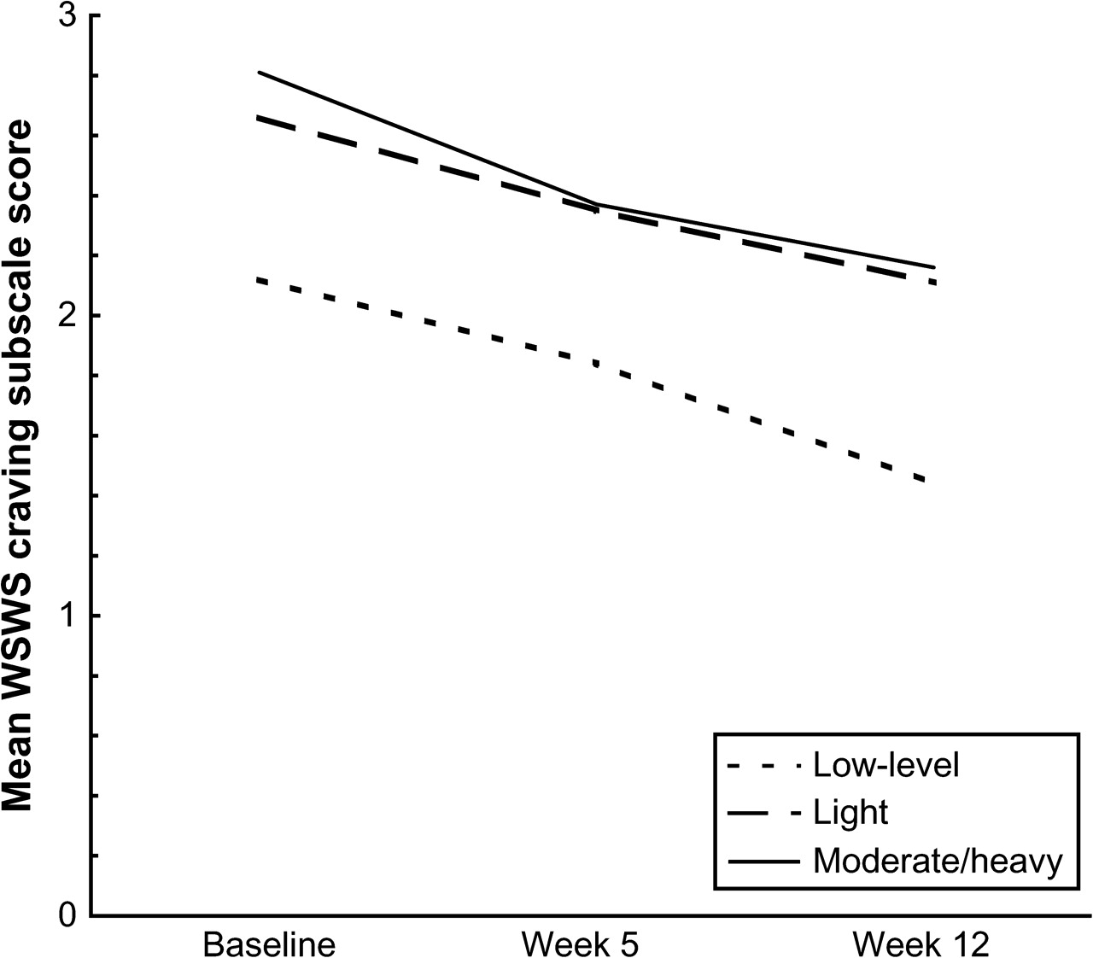
Figure 1. Comparison of unadjusted Wisconsin Smoking Withdrawal Scale craving subscale mean scores by smoking level ...
Notes:
Figure 1. Comparison of unadjusted Wisconsin Smoking Withdrawal Scale craving subscale mean scores by smoking level from baseline through 12 weeks postquit.
Unless provided in the caption above, the following copyright applies to the content of this slide: © The Author 2009. Published by Oxford University Press on behalf of the Society for Research on Nicotine and Tobacco. All rights reserved. For Permissions, please e-mail: journals.Permissions@oxfordjournals.org

Slide 2
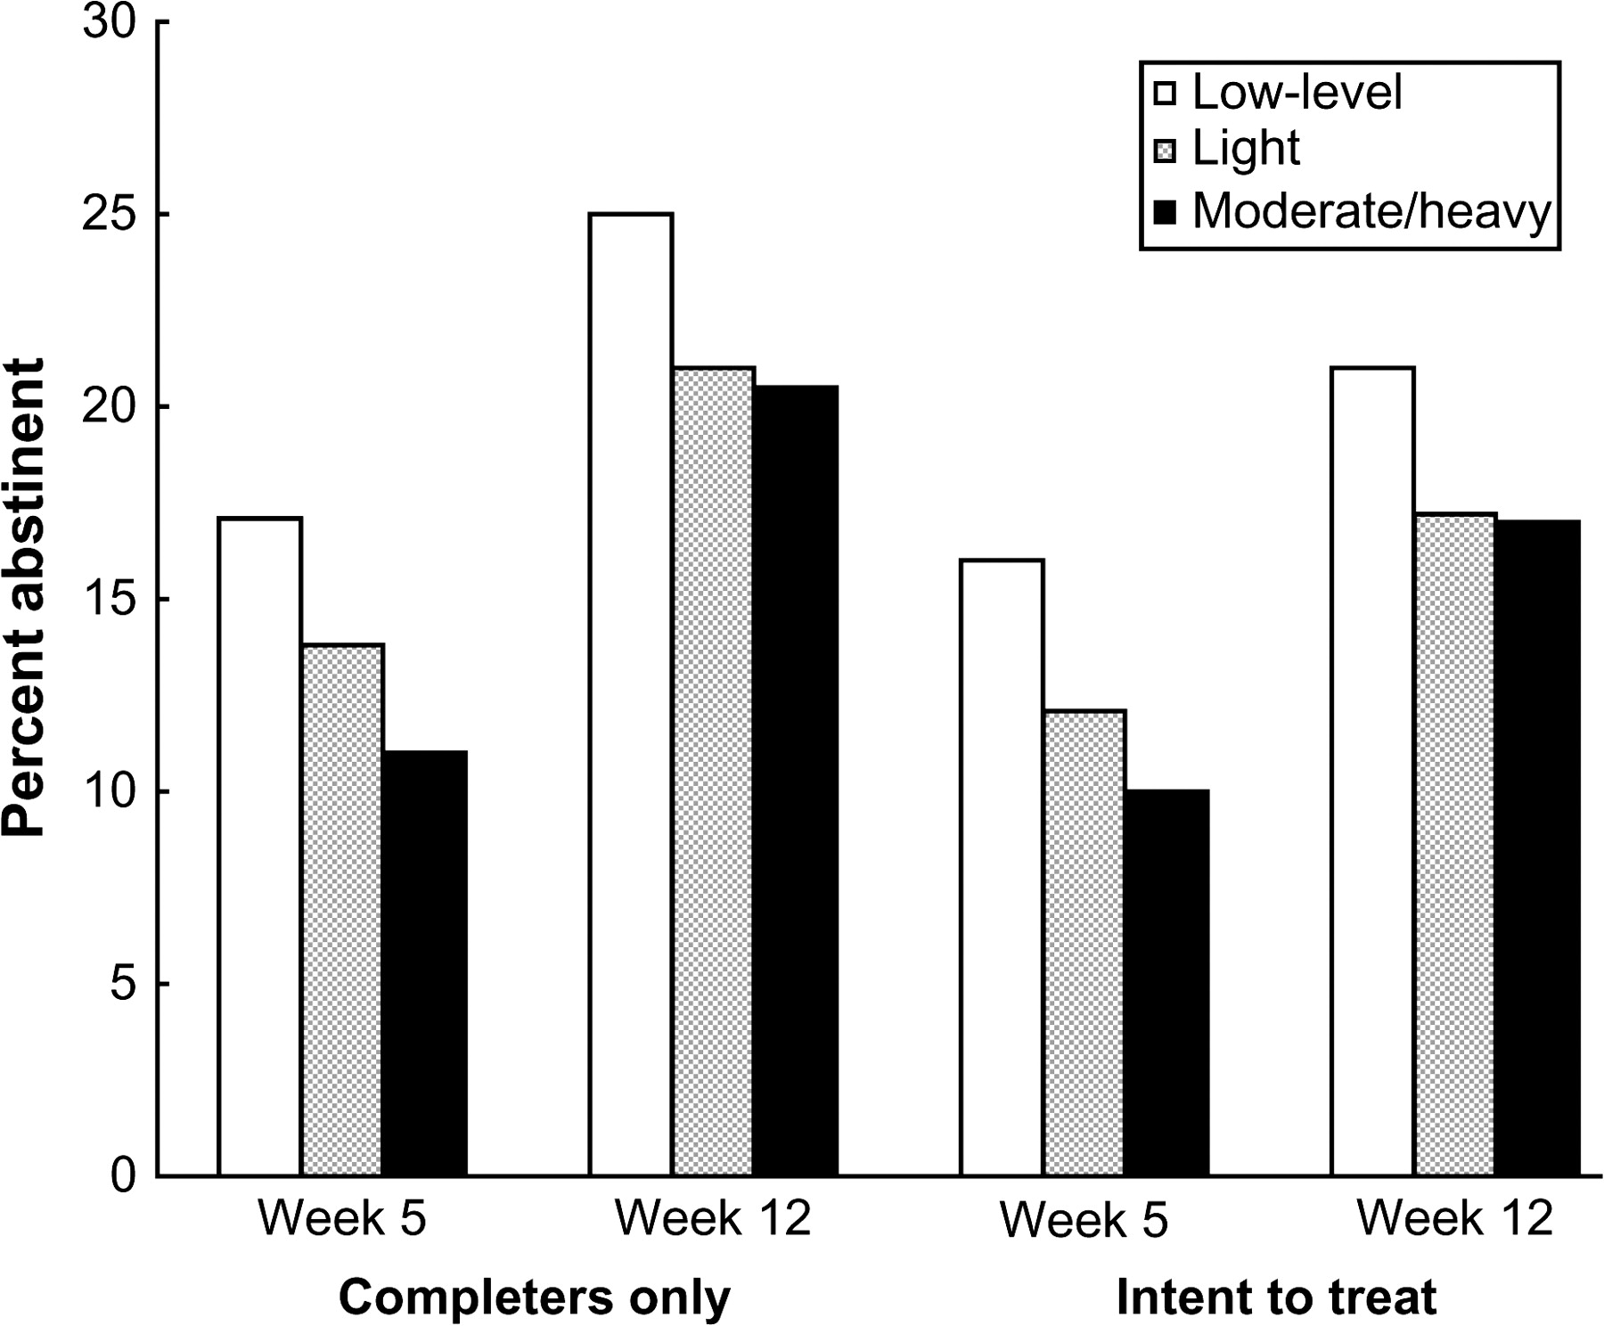
Figure 2. Abstinence by smoking level at 5 and 12 weeks postquit.
Notes:
Figure 2. Abstinence by smoking level at 5 and 12 weeks postquit.
Unless provided in the caption above, the following copyright applies to the content of this slide: © The Author 2009. Published by Oxford University Press on behalf of the Society for Research on Nicotine and Tobacco. All rights reserved. For Permissions, please e-mail: journals.Permissions@oxfordjournals.org

