Slide 1
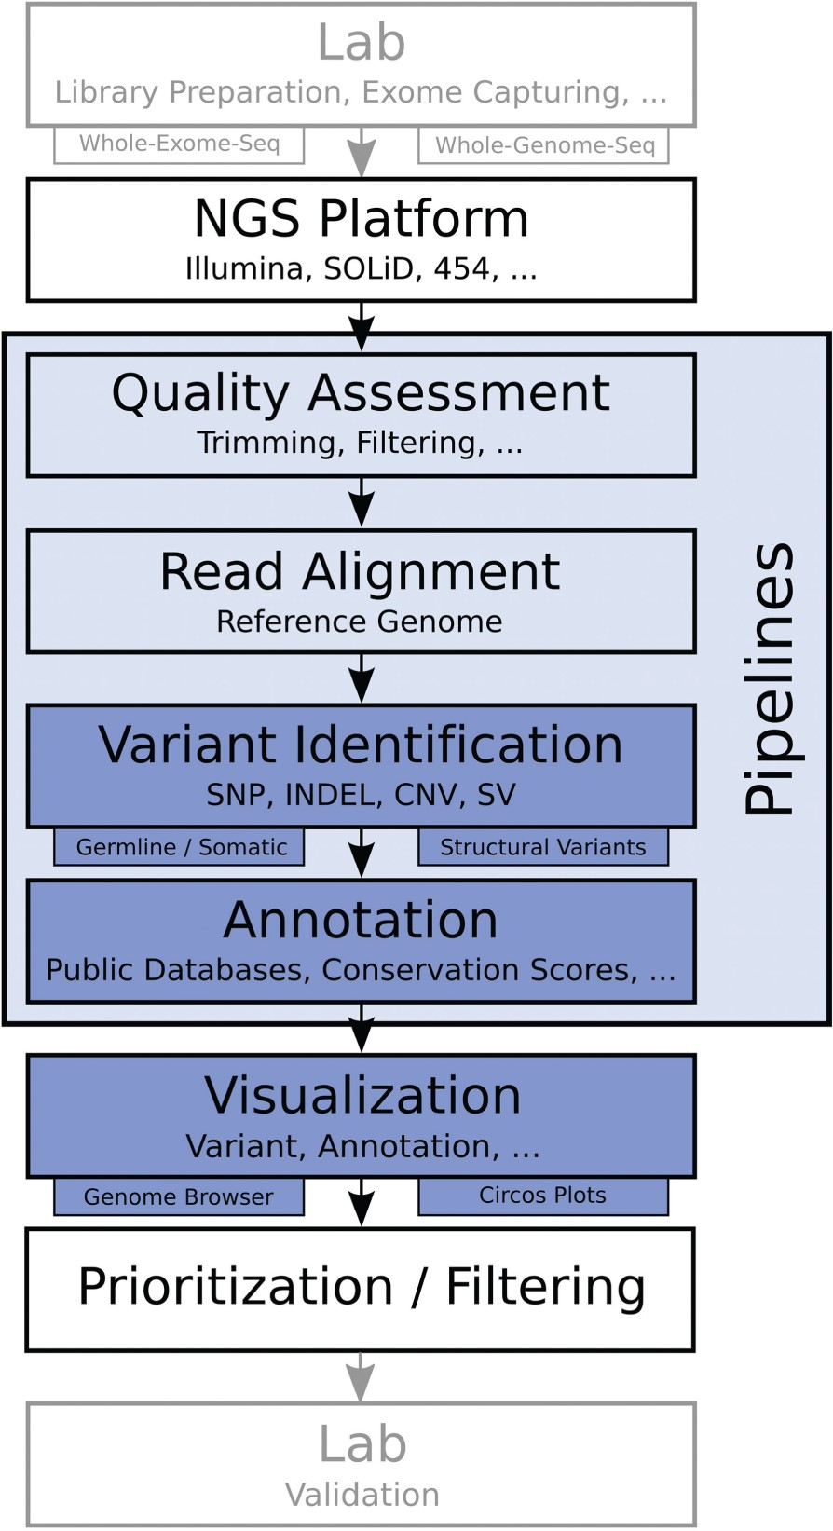
Figure 1: Basic workflow for whole-exome and whole-genome sequencing projects. After library preparation, samples are ...
Notes:
Figure 1: Basic workflow for whole-exome and whole-genome sequencing projects. After library preparation, samples are sequenced on a certain platform. The next steps are quality assessment and read alignment against a reference genome, followed by variant identification. Detected mutations are then annotated to infer the biological relevance and results can be displayed using dedicated tools. The found mutations can further be prioritized and filtered, followed by validation of the generated results in the lab.
Unless provided in the caption above, the following copyright applies to the content of this slide: © The Author 2013. Published by Oxford University Press.This is an Open Access article distributed under the terms of the Creative Commons Attribution Non-Commercial License (http://creativecommons.org/licenses/by-nc/3.0/), which permits unrestricted non-commercial use, distribution, and reproduction in any medium, provided the original work is properly cited.

Slide 2
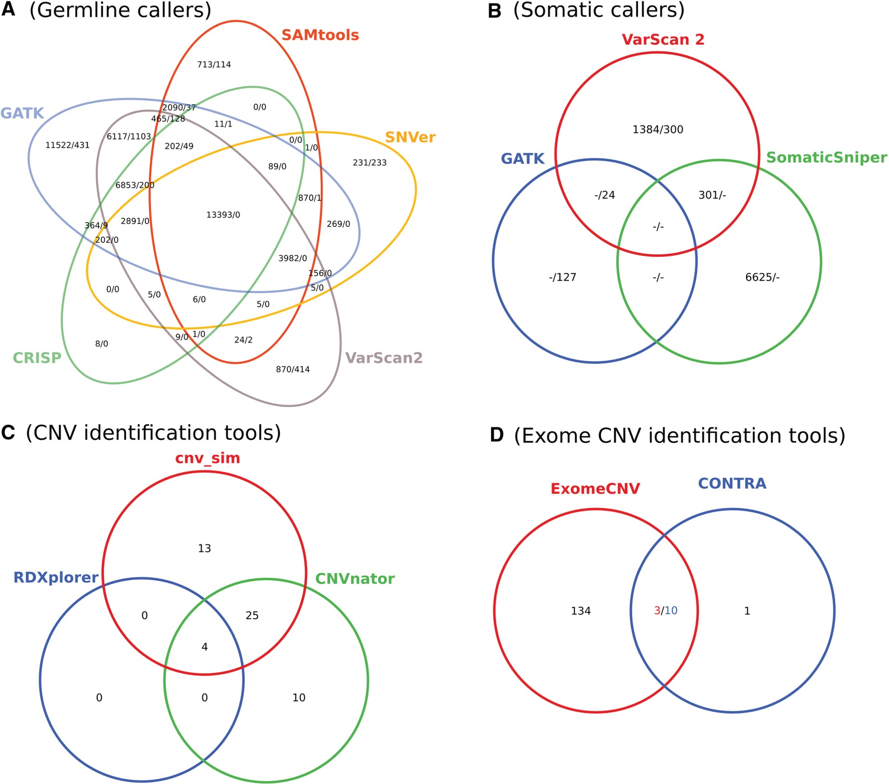
Figure 2: Venn diagrams showing the number of identified variants for tested germline (A), somatic (B), CNV (C) and ...
Notes:
Figure 2: Venn diagrams showing the number of identified variants for tested germline (A), somatic (B), CNV (C) and exome CNV (D) tools. The depicted numbers in (A) and (B) report identified SNPs and INDELs. Venn diagram (C) shows the overlap between known (cnv_sim) and predicted CNVs. Figure (D) illustrates the overlap between CONTRA and ExomeCNV. The intersection numbers were adjusted to reflect that 10 CNVs detected by CONTRA are located within 3 CNVs reported by ExomeCNV.
Unless provided in the caption above, the following copyright applies to the content of this slide: © The Author 2013. Published by Oxford University Press.This is an Open Access article distributed under the terms of the Creative Commons Attribution Non-Commercial License (http://creativecommons.org/licenses/by-nc/3.0/), which permits unrestricted non-commercial use, distribution, and reproduction in any medium, provided the original work is properly cited.

