Slide 1
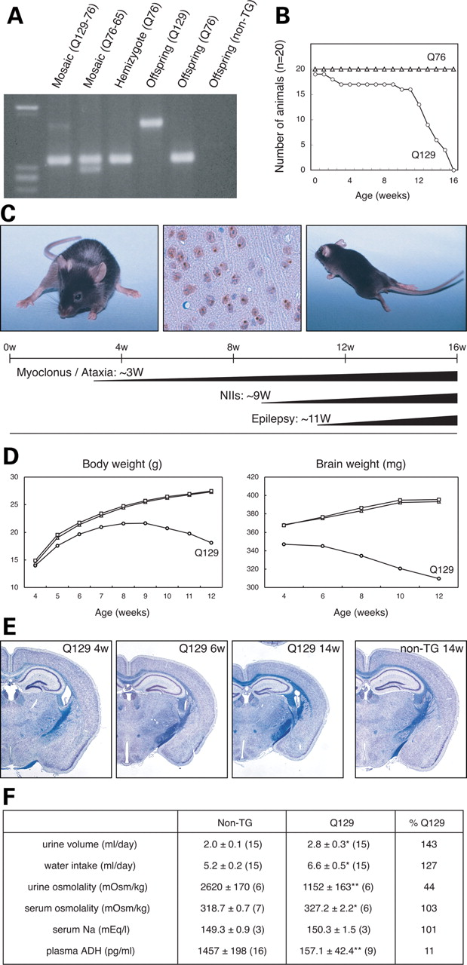
Figure 1. Generation of Q129 transgenic mice and disease phenotypes. (A) PCR analysis of tail DNA revealed two ...
Notes:
Figure 1. Generation of Q129 transgenic mice and disease phenotypes. (A) PCR analysis of tail DNA revealed two hemizygous mosaic mice (Q129-76 and Q76-65), a hemizygous mouse (Q76) and the offspring of the Q129-76 mosaic mouse showing three genotypes (Q129, Q76 and non-TG). The lane for the Q129-76 mosaic mouse showed a faint extra band of a much larger size than the band corresponding to 76 CAG repeats. The large changes in the size of CAG repeats resulted in not only expansion (Q129-76), but also contraction (Q76-65). (B) Kaplan–Meier survival curves of Q76 (triangles) and Q129 (circles) mice, showing premature death of Q129 mice (n = 20). (C) Representative photographs of the Q129 mice at 12 weeks (W), showing ataxic phenotype (left panel), ubiquitinated NIIs (middle panel) and epileptic seizure (right panel). (D) Changes in body and brain weights of the Q129 (circles), Q76 (triangles) and non-TG (rectangles) mice. Each value and number of replicates is shown in Supplementary Material, Tables S1 and S2. (E) Cross-sections of brains of the Q129 mice (4W, 6W and 14W) and non-TG littermate (14W) (Klüver–Barrera staining), showing progressive reduction in brain size of Q129 mice. (F) Results of laboratory tests indicate central diabetes insipidus. Each value indicates mean ± S.E.M. Unpaired t-test, *P < 0.05, **P < 0.01. Numbers of replicates are shown in parentheses.
Unless provided in the caption above, the following copyright applies to the content of this slide: © 2008 The Author(s)This is an Open Access article distributed under the terms of the Creative Commons Attribution Non-Commercial License (http://creativecommons.org/licenses/by-nc/2.0/uk/) which permits unrestricted non-commercial use, distribution, and reproduction in any medium, provided the original work is properly cited.

Slide 2
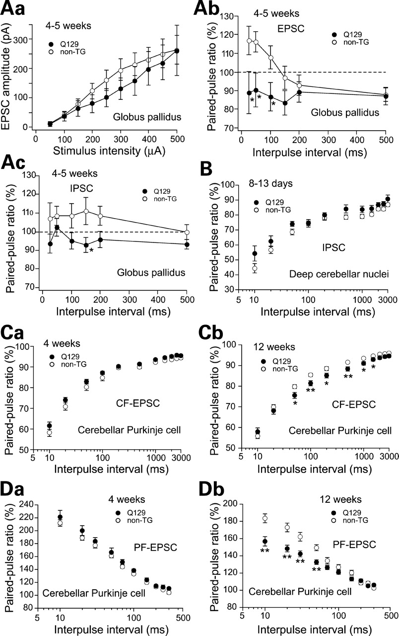
Figure 2. Age-dependent abnormalities of synaptic transmission in GP and cerebellum. Pallidal and cerebellar slices ...
Notes:
Figure 2. Age-dependent abnormalities of synaptic transmission in GP and cerebellum. Pallidal and cerebellar slices were obtained from the Q129 mice (filled circles) and non-TG mice (open circles) at various ages as indicated in each figure. (Aa–Ac) Whole-cell recordings from pallidal neurons of the Q129 and non-TG mice at 4–5 weeks of age. I–O relationship for EPSC (Aa), PPRs for EPSC (Ab) and IPSC (Ac) in GP. EPSCs and IPSCs were evoked by stimulating the sub-thalamopallidal and striatopallidal pathways, respectively, at 0.1 Hz with a bipolar tungsten electrode (100–500 µs, 100–800 µA). IPSCs were recorded at a holding potential of −10 mV in the presence of CNQX and d-AP5. EPSCs of the Q129 mice (n = 14) tended to be smaller than those of the non-TG mice (n = 21), which showed no statistically significant difference (Aa). PPRs for EPSC (Ab) and IPSC (Ac) in the Q129 mice (n = 12 and 11, respectively) decreased as compared with those of the non-TG mice (n = 22 and 15, respectively), resulting in the conversion of PPF to PPD in the Q129 mice at 4–5 weeks of age. (B) PPR for IPSC in FN on postnatal days 8–13. IPSCs were evoked by stimulating bundles of putative PC axons. There was no significant difference between the Q129 mice (n = 12) and the non-TG mice (n = 30). (Ca–Db) Age-dependent changes in PPRs for CF-EPSCs and PF-EPSCs. CF-EPSCs were recorded from PCs at 4 (Ca) and 12 weeks (Cb) of age in the Q129 (n = 19 and 27, respectively) and non-TG mice (n = 20 and 30, respectively). PF-EPSCs were recorded from PCs at 4 (Da) and 12 weeks (Db) of age in the Q129 (n = 14 and 27, respectively) and non-TG mice (n = 22 and 28, respectively). For focal stimulation in the cerebellar slices, we used a bipolar tungsten electrode (for PC axons) and glass pipettes (5–10-μm tip diameter) filled with standard saline (for CFs and PFs), and applied square pulses (duration, 100 µs; amplitude, 0–90 V) at 0.5 Hz. Bundles of putative PC axons were stimulated in the white matter 100–200 µm away from the FN. CFs were stimulated in the granule cell layer 50–100 µm away from the PC soma. PFs were stimulated in the middle of the molecular layer. Each value indicates mean ± S.E.M. Unpaired t-test, *P < 0.05, **P < 0.01. Note that the abscissas of B–Db are shown in the logarithmic scale.
Unless provided in the caption above, the following copyright applies to the content of this slide: © 2008 The Author(s)This is an Open Access article distributed under the terms of the Creative Commons Attribution Non-Commercial License (http://creativecommons.org/licenses/by-nc/2.0/uk/) which permits unrestricted non-commercial use, distribution, and reproduction in any medium, provided the original work is properly cited.

Slide 3
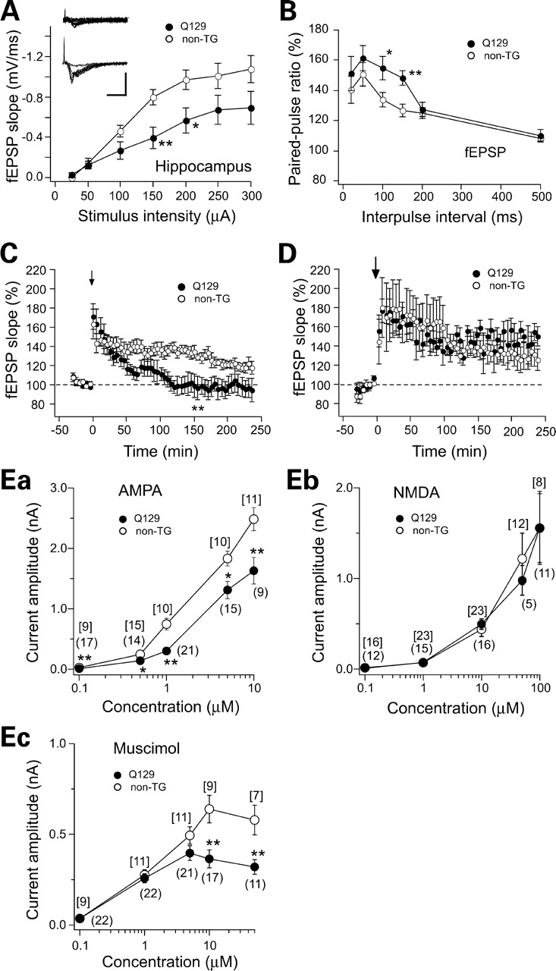
Figure 3. Abnormalities of synaptic transmission and plasticity in hippocampus. Hippocampal slices were obtained from ...
Notes:
Figure 3. Abnormalities of synaptic transmission and plasticity in hippocampus. Hippocampal slices were obtained from the Q129 mice (filled circles) and the non-TG mice (open circles) at 12–15 weeks of age. (A) The I–O relationship showed a significant attenuation of the responsiveness of CA1 pyramidal cells in the Q129 mice (n = 12) as compared with that in the non-TG mice (n = 13). The slopes of fEPSPs evoked by stimulating the Schaffer collateral/commissural pathway are plotted against stimulus intensity. Inset: examples of fEPSPs of the Q129 (upper) mouse and the non-TG (lower) mouse. Scale bars: 2 mV/10 ms. (B) The PPR for the fEPSP slope of CA1 hippocampal cells in the Q129 mice (n = 12) was enhanced as compared with that in the non-TG mice (n = 13) at 13–15 weeks of age. (C) LTP induced by one train of tetanus (a small arrow) subsided within 120 min in the Q129 mice (n = 10), whereas LTP in the non-TG mice (n = 10) lasted much longer. (D) Late-phase LTP induced by four trains of tetanus (a large arrow) was not significantly different between the Q129 mice (n = 5) and the non-TG mice (n = 5). Data in C and D are normalized for each slice with respect to the average slope recorded during the baseline. (Ea–Ec) Pharmacological evidence for functional down-regulation of AMPA and GABAA receptors in hippocampus of Q129 mice at 12–15 weeks of age. AMPA-induced inward current (Ea) was recorded at a holding potential of −60 mV in the presence of 0.1 mm cyclothiazide, which prevents the rapid desensitization of AMPA receptors and 0.5 µM TTX. NMDA-induced inward current (Eb) was recorded at a holding potential of −40 mV in the presence of 20 µm glycine and 0.5 µm TTX in Mg2+-free ACSF. Muscimol-induced outward current (Ec) was recorded at a holding potential of 0 mV. Drug exposure time was 1 min throughout the experiments. The flow rate was 2–3 ml/min. Each value indicates mean ± S.E.M. Unpaired t-test, *P < 0.05, **P < 0.01.
Unless provided in the caption above, the following copyright applies to the content of this slide: © 2008 The Author(s)This is an Open Access article distributed under the terms of the Creative Commons Attribution Non-Commercial License (http://creativecommons.org/licenses/by-nc/2.0/uk/) which permits unrestricted non-commercial use, distribution, and reproduction in any medium, provided the original work is properly cited.

Slide 4
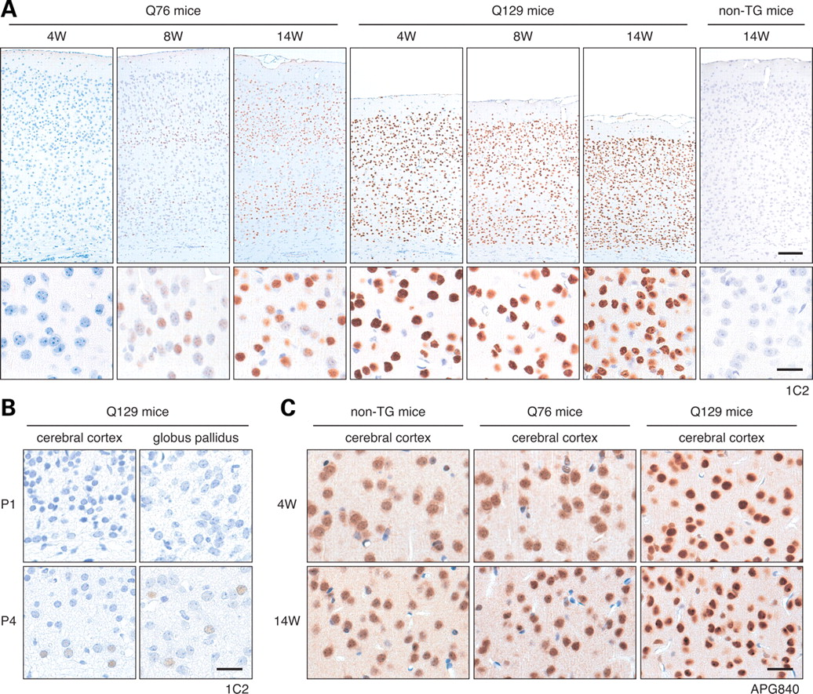
Figure 4. Age- and expanded-polyQ-length-dependent changes in NIA of mutant DRPLA proteins. (A) Immunohistochemical ...
Notes:
Figure 4. Age- and expanded-polyQ-length-dependent changes in NIA of mutant DRPLA proteins. (A) Immunohistochemical analysis of cerebral cortices of the Q76, Q129 and non-TG mice was performed using 1C2. The upper panels show the entire cerebral cortices and the lower panels show cortical layer III. In the Q129 mice (middle panels), the decrease in cortical size was already evident at 4 weeks of age and the cerebral cortex progressively atrophied with age. Neuronal nuclei in all the cortical layers showed intense labeling of expanded polyQ stretches and became gradually packed with age. Age-dependent nuclear atrophy and deformity were also observed (lower panels). There was no obvious neuronal loss in the Q129 mouse brain. In the Q76 mice (left panels), there was no obvious decrease in cortical size. In the lower panels, a gradual increase in the number of neuronal nuclei labeled by 1C2 was observed. Such nuclear labeling became evident particularly in the cortical layers IV and VI. Scale bar = 100 µm for upper panels and 20 µm for lower panels. (B) Immunohistochemical analysis of cerebral cortical layer VI and GP of the Q129 mice using 1C2 revealed faint NIA on P4, but not on P1. Scale bar=20 µm. (C) Immunohistochemical analysis of cerebral cortical layer III using APG840, an anti-DRPLA protein (atrophin-1) antibody, also revealed polyQ-length-dependent and age-dependent intranuclear accumulation of mutant DRPLA proteins. Scale bar = 20 µm.
Unless provided in the caption above, the following copyright applies to the content of this slide: © 2008 The Author(s)This is an Open Access article distributed under the terms of the Creative Commons Attribution Non-Commercial License (http://creativecommons.org/licenses/by-nc/2.0/uk/) which permits unrestricted non-commercial use, distribution, and reproduction in any medium, provided the original work is properly cited.

Slide 5
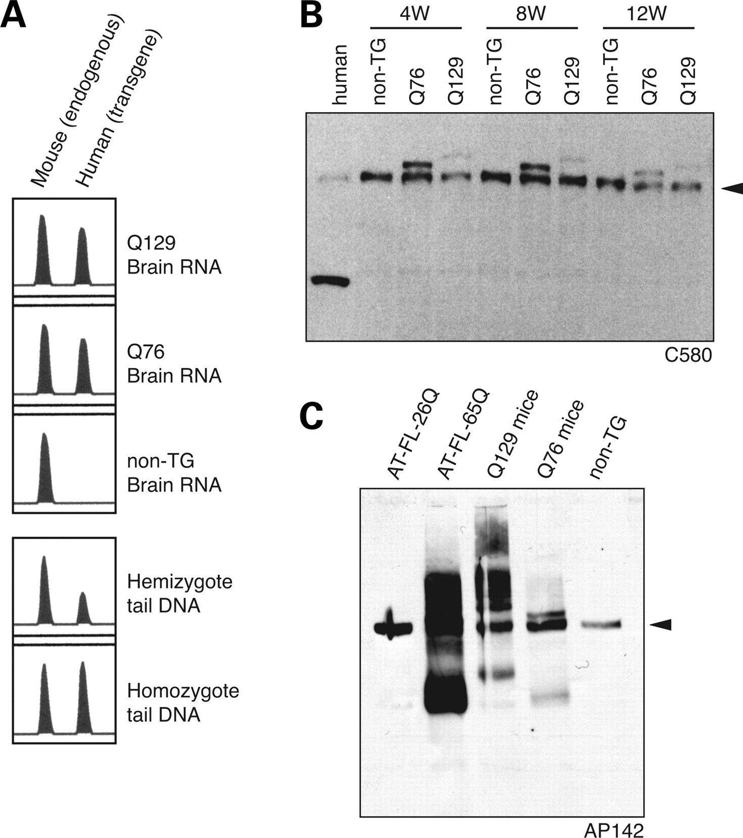
Figure 5. Quantification of mutant DRPLA mRNA levels and western blot analysis of DRPLA proteins in Q129 mouse brains. ...
Notes:
Figure 5. Quantification of mutant DRPLA mRNA levels and western blot analysis of DRPLA proteins in Q129 mouse brains. (A) The expression levels of DRPLA mRNAs derived from the transgene and mouse endogenous DRPLA gene were quantified by competitive RT–PCR. Considering that the length of the homo-serine stretch in the human DRPLA gene is 9 bp longer than that in the mouse DRPLA gene, we amplified a segment of DRPLA genomic DNA or cDNAs using flanking primers that completely match both the human and mouse genomic sequences. The validity of the quantitative analysis was confirmed by gene dosage analysis of human mutant transgenes when compared with endogenous mouse DRPLA genes. The expression levels of human DRPLA gene-derived mRNAs of Q129 and Q76 were determined for each to be 80% of the endogenous mouse DRPLA mRNA level. (B) Western blot analysis of total brain homogenates employing C580 revealed two bands corresponding to mouse endogenous (arrowheads) and transgene derived DRPLA proteins in the Q76 or Q129 mice. The lane for human control brain carrying 13 and 9 CAG repeats (lane 1) showed a weak band corresponding to the full-length human DRPLA protein. The intensities of the full-length protein in autopsied brains have been shown to be variable, possibly due to the intrinsic instability of the DRPLA protein, and the identity of the 100-kDa band detected by C580 remains unknown as previously described (17). (C) Western blot analysis of nuclear fractions using AP142 showed smears migrating between the stacking gel and the full-length bands. The smaller bands, possibly truncated, with polyQ-length-dependent mobility shifts were observed in Q129 and Q76. As a comparison, other DRPLA transgenic mouse models (20; AT-FL-26Q-84 and AT-FL-65Q-150 at 7.5 months of age) were also analyzed. In the lane for AT-FL-65Q mice, a massive amount of smears as well as truncated proteins with a faster mobility than those in the lane for Q129 mice were observed.
Unless provided in the caption above, the following copyright applies to the content of this slide: © 2008 The Author(s)This is an Open Access article distributed under the terms of the Creative Commons Attribution Non-Commercial License (http://creativecommons.org/licenses/by-nc/2.0/uk/) which permits unrestricted non-commercial use, distribution, and reproduction in any medium, provided the original work is properly cited.

Slide 6
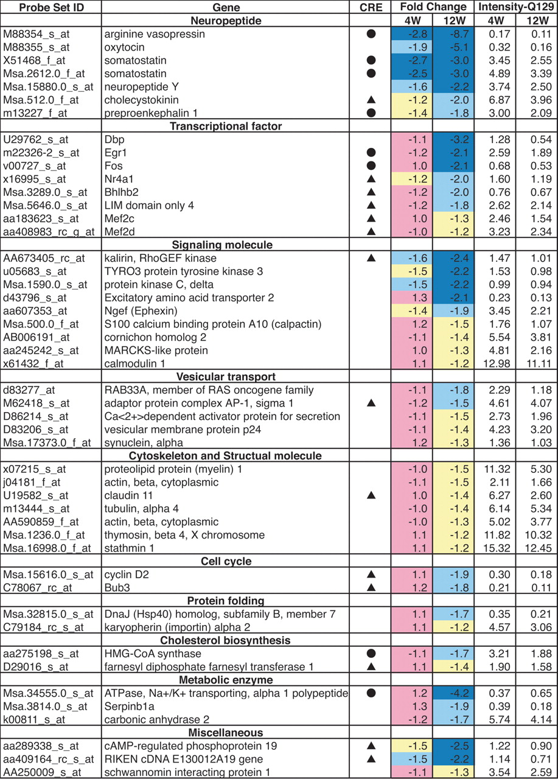
Figure 6. Expression profiles in brains of the Q129 mice compared with those in the non-TG littermates. The fold ...
Notes:
Figure 6. Expression profiles in brains of the Q129 mice compared with those in the non-TG littermates. The fold changes of the genes in the Q129 mice (n = 3) compared with those in the non-TG mice (n = 3) and the intensities in the Q129 mice at 4 or 12 weeks of age are summarized, which were calculated with the Rosetta Resolver (Ratio Experiment) using the Affymetrix-Default Ratio Builder. Fold changes are shown as columns of blue, light blue, yellow and pink indicating fold changes of <−2.0, −1.5, −1.2 and others, respectively. Filled circles: CREB targets described by Mayr and Montminy (21). Filled triangles: putative CREB targets classified as conserved CRE (22). Genes of neuropeptides in the Q129 mice, including vasopressin, oxytocin, somatostatin and neuropeptide Y, were strongly down-regulated even at 4 weeks of age. The latest description of each gene was obtained from the Probe Set at the NetAffx Analysis Center (www.affymetrix.com).
Unless provided in the caption above, the following copyright applies to the content of this slide: © 2008 The Author(s)This is an Open Access article distributed under the terms of the Creative Commons Attribution Non-Commercial License (http://creativecommons.org/licenses/by-nc/2.0/uk/) which permits unrestricted non-commercial use, distribution, and reproduction in any medium, provided the original work is properly cited.

