Slide 1
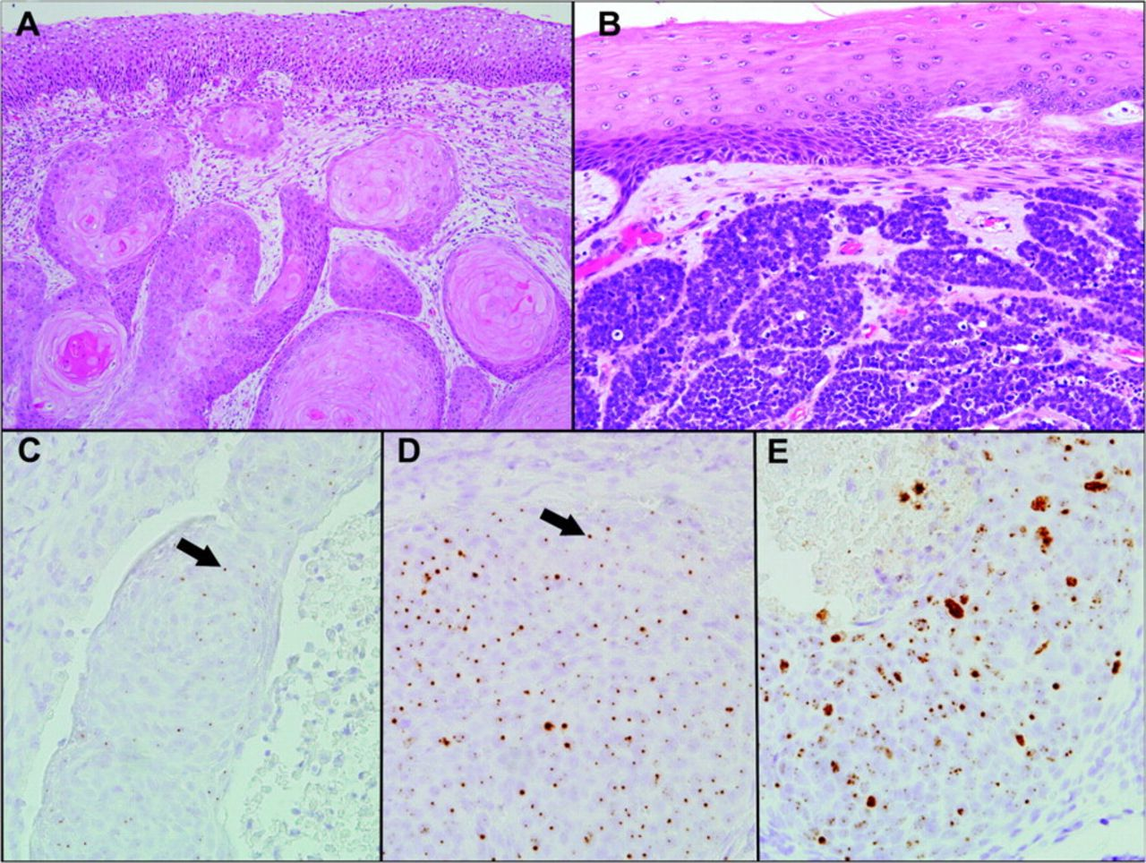
Fig. 1 Histopathologic classification of basaloid features and ordinal scoring for human papillomavirus 16 (HPV16) ...
Notes:
Fig. 1 Histopathologic classification of basaloid features and ordinal scoring for human papillomavirus 16 (HPV16) infections as determined by in situ hybridization. A ) HPV-negative, conventional keratinizing squamous cell carcinoma. The lamina propria is infiltrated by nests of keratinized squamous cells with abundant glassy eosinophilic cytoplasm. B ) HPV-positive basaloid squamous cell carcinoma. Here the carcinoma infiltrates as lobules of basaloid cells characterized by enlarged hyperchromatic nuclei and scant cytoplasm. C , D , and E ) In situ hybridization signal of HPV16-positive squamous cell carcinomas. Tissue sections were probed with a biotinylated type-16 specific probe. In C , D , and E , the in situ hybridization signal was scored as 1+, 2+, and 3+, respectively.
Unless provided in the caption above, the following copyright applies to the content of this slide: © The Author 2008. Published by Oxford University Press.

Slide 2
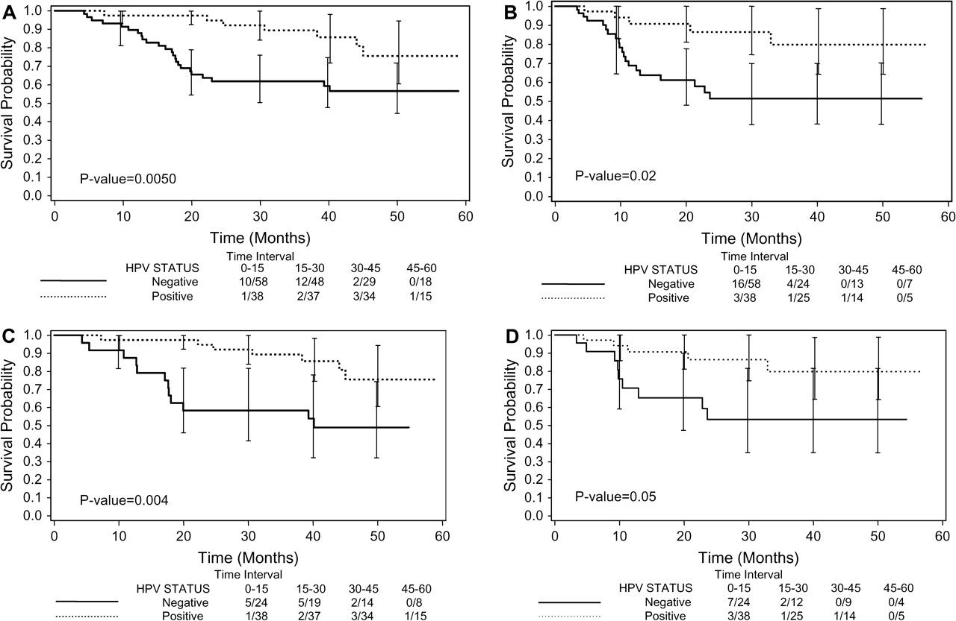
Fig. 2 Kaplan–Meier curves for overall and progression-free survival stratified by tumor human papillomavirus (HPV) ...
Notes:
Fig. 2 Kaplan–Meier curves for overall and progression-free survival stratified by tumor human papillomavirus (HPV) status. A ) Overall survival (OS) for the entire study population. B ) Progression-free survival (PFS) for the entire study population. C ) OS for patients with oropharynx cancer only. D ) PFS for patients with oropharynx cancer only. For all curves, 95% confidence intervals for survival estimates at several time points are shown. Events per patients at risk are indicated for 15-month intervals.
Unless provided in the caption above, the following copyright applies to the content of this slide: © The Author 2008. Published by Oxford University Press.

