Slide 1
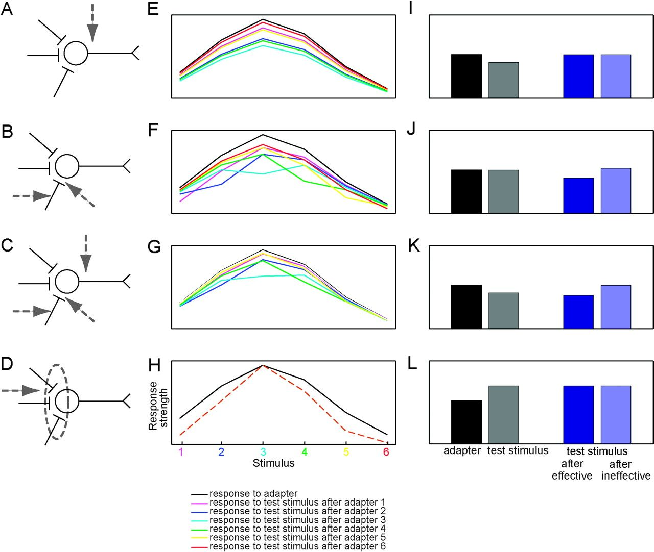
Figure 1. Predicted responses to 6 test stimuli following each of 6 adapter stimuli according to the different ...
Notes:
Figure 1. Predicted responses to 6 test stimuli following each of 6 adapter stimuli according to the different adaptation models. (A,E,I): firing-rate fatigue model; (B,F,J) pure input-fatigue model; (C,G,K) hybrid input-fatigue and firing-rate fatigue model; (D,H,L) sharpening model. (A–D) Schematic illustration of the different adaptation models. The arrows point to the origin of adaptation in each model. Adaptation is assumed to be caused (A) by changes related to action potential generation for the firing-rate fatigue model; (B) by changes at the input or synapses for the pure input-fatigue model; (C) by a combination of A and B; or (D) by changes of the input or synaptic processing that produce a sharpening of the tuning in the sharpening model. (E–H) Tuning curves for the adapter (black solid line) and the test stimuli sorted according to the value of the adapter stimulus. For the sharpening model (H) as modeled here, all tuning curves for the test stimuli overlap completely. These are indicated by the brown dotted curve. (I–L) Predicted selectivity indices, DOS (see Materials and Methods: a larger DOS indicates higher selectivity) for the adapter stimuli (black bars) and the test stimuli (gray bars) when adapter and test stimuli are identical, that is, in the same shape trials, for the test stimuli following the most effective adapter (stimulus 3; dark blue bars) and for the test stimuli following the adapter differing the most from the most effective adapter (stimulus 6; light blue bar).
Unless provided in the caption above, the following copyright applies to the content of this slide: © The Author 2009. Published by Oxford University Press. All rights reserved. For permissions, please e-mail: journals.permissions@oxfordjournals.org

Slide 2
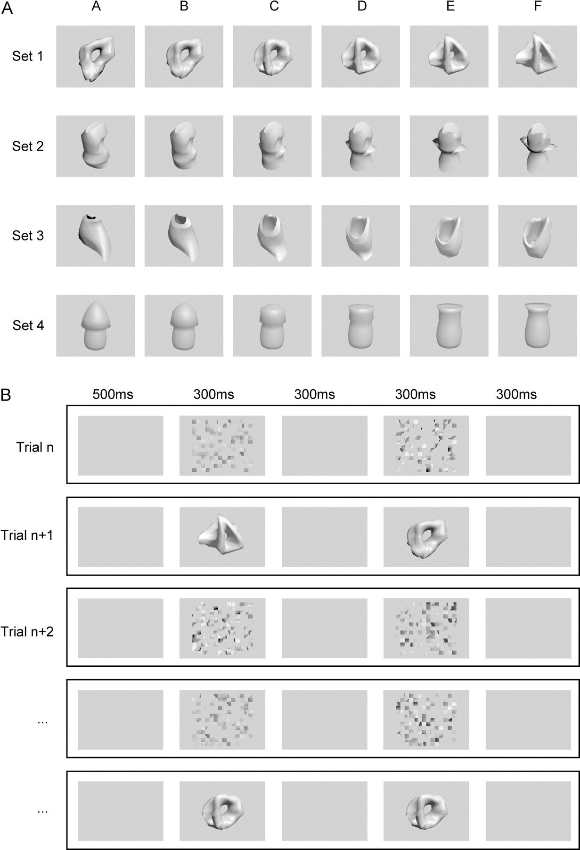
Figure 2. (A) Stimuli, 4 parametric sets of 6 shapes each. The shapes B–E of each set were obtained by morphing between ...
Notes:
Figure 2. (A) Stimuli, 4 parametric sets of 6 shapes each. The shapes B–E of each set were obtained by morphing between shapes A and F of that set. (B) Design of the main passive fixation procedure. The monkey initiated each trial by fixating a red fixation target at the screen center. After 500 ms, a first stimulus appeared at the center of the screen for 300 ms. After an ISI of 300 ms, a second stimulus appeared for 300 ms. After another 300 ms of stable fixation, the monkey was rewarded with a drop of apple juice. The procedure always started with an unadaptation trial, in which 2 scrambled images were presented. Between 2 adaptation trials (in which 2 regular shapes were presented), 2 unaborted unadaptation trials were presented.
Unless provided in the caption above, the following copyright applies to the content of this slide: © The Author 2009. Published by Oxford University Press. All rights reserved. For permissions, please e-mail: journals.permissions@oxfordjournals.org

Slide 3
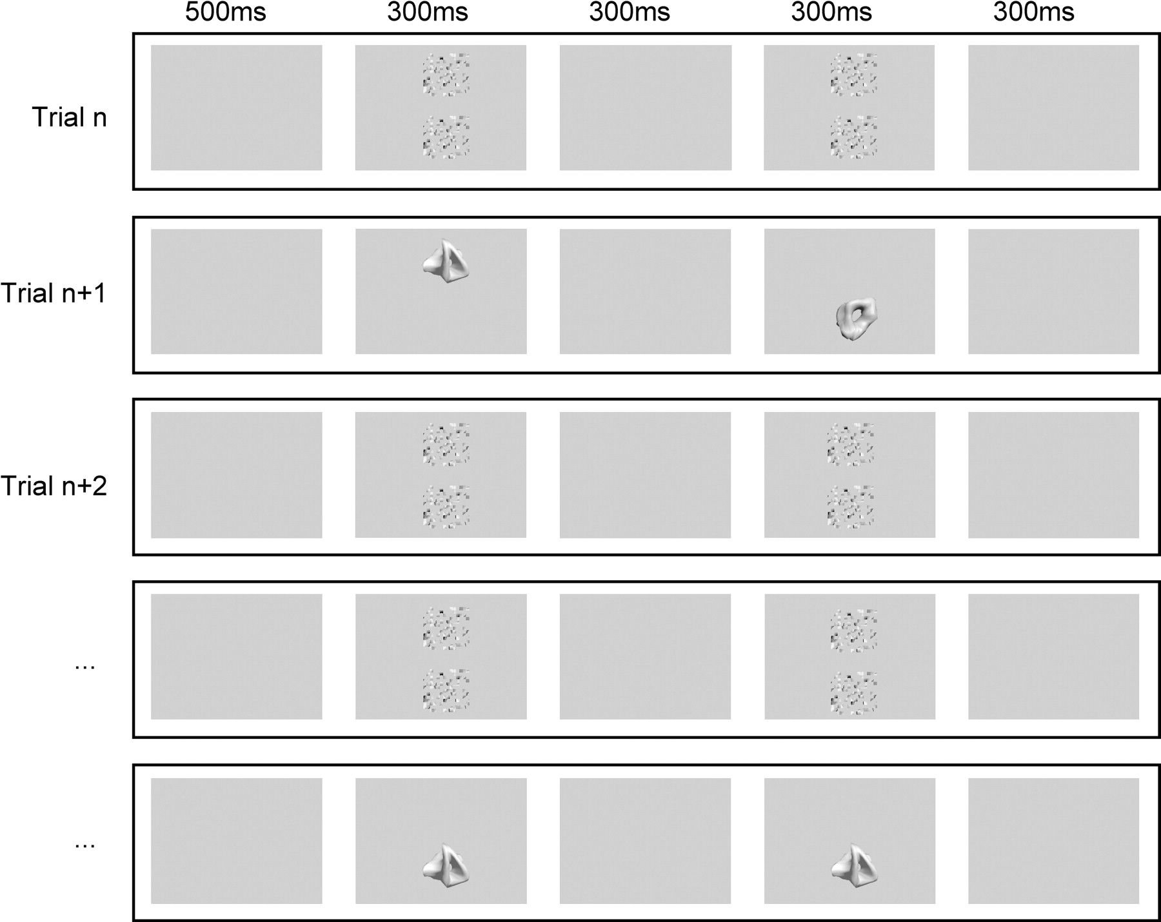
Figure 3. Design of the position procedure. The succession of sequences was identical to that in the main passive ...
Notes:
Figure 3. Design of the position procedure. The succession of sequences was identical to that in the main passive fixation procedure, except that stimuli were presented at 4° eccentricity above or below the fixation target. In the unadaptation trials, 2 scrambled images were presented above and below the fixation target.
Unless provided in the caption above, the following copyright applies to the content of this slide: © The Author 2009. Published by Oxford University Press. All rights reserved. For permissions, please e-mail: journals.permissions@oxfordjournals.org

Slide 4
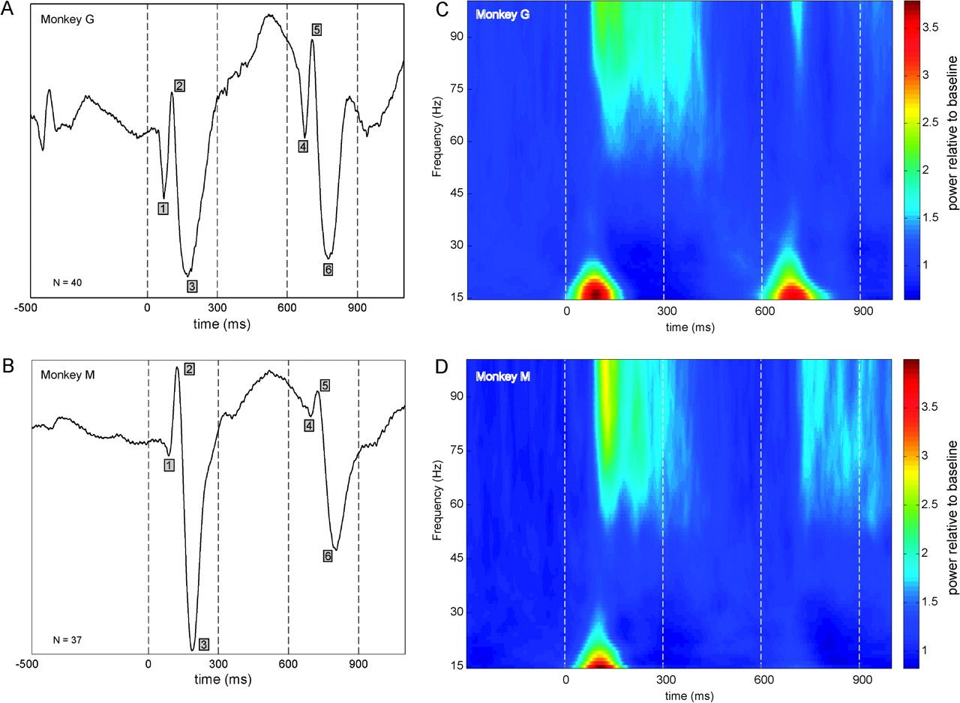
Figure 4. Population LFP data for same trials for each monkey. (A,B) VEPs averaged across sites. The numbers in gray ...
Notes:
Figure 4. Population LFP data for same trials for each monkey. (A,B) VEPs averaged across sites. The numbers in gray squares indicate the peaks used to compute the AI for the different components. (C,D) LFP power spectra. The power at each frequency was divided by the baseline power at that frequency (i.e., mean power in the 300- to 0-ms window prior to adapter onset; for illustration purposes only). The vertical dotted lines indicate the onset and termination of the adapter and test stimuli.
Unless provided in the caption above, the following copyright applies to the content of this slide: © The Author 2009. Published by Oxford University Press. All rights reserved. For permissions, please e-mail: journals.permissions@oxfordjournals.org

Slide 5
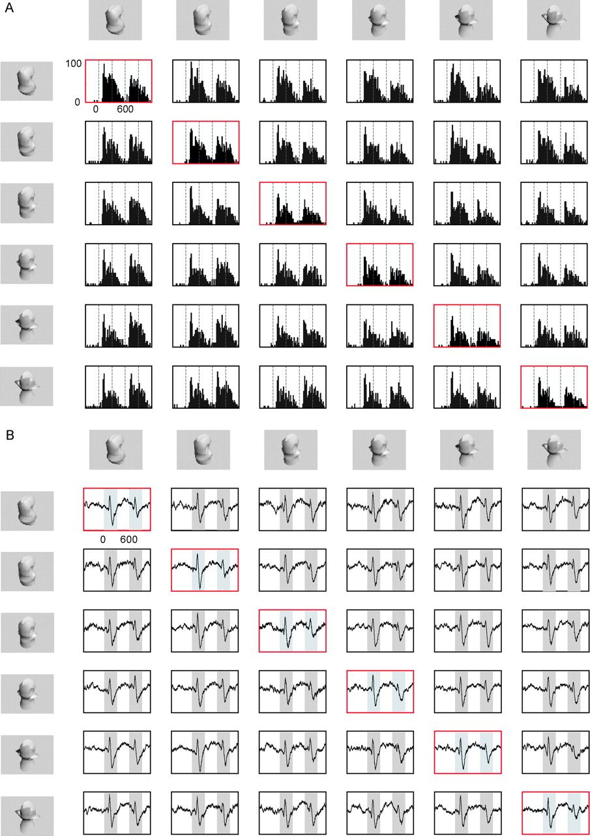
Figure 5. PSTHs (bin width 20 ms; panel A) and VEPs (panel B) recorded simultaneously from the same electrode for a ...
Notes:
Figure 5. PSTHs (bin width 20 ms; panel A) and VEPs (panel B) recorded simultaneously from the same electrode for a single cell and corresponding LFP site in IT cortex for all 36 possible stimulus sequence combinations. The stimulus shown at the left of each row was presented as an adapter in all 6 conditions of this row. The stimulus shown on top of each column was presented as a test stimulus in all 6 conditions of this column. Each combination of a specific row and a specific column represents one of the 36 possible stimulus combinations. The dotted gray lines in panel A and the gray rectangles in panel B depict the onset and termination of both adapter and test stimuli. The red boxes depict the same shape conditions, in which the adapter and test stimuli are identical.
Unless provided in the caption above, the following copyright applies to the content of this slide: © The Author 2009. Published by Oxford University Press. All rights reserved. For permissions, please e-mail: journals.permissions@oxfordjournals.org

Slide 6
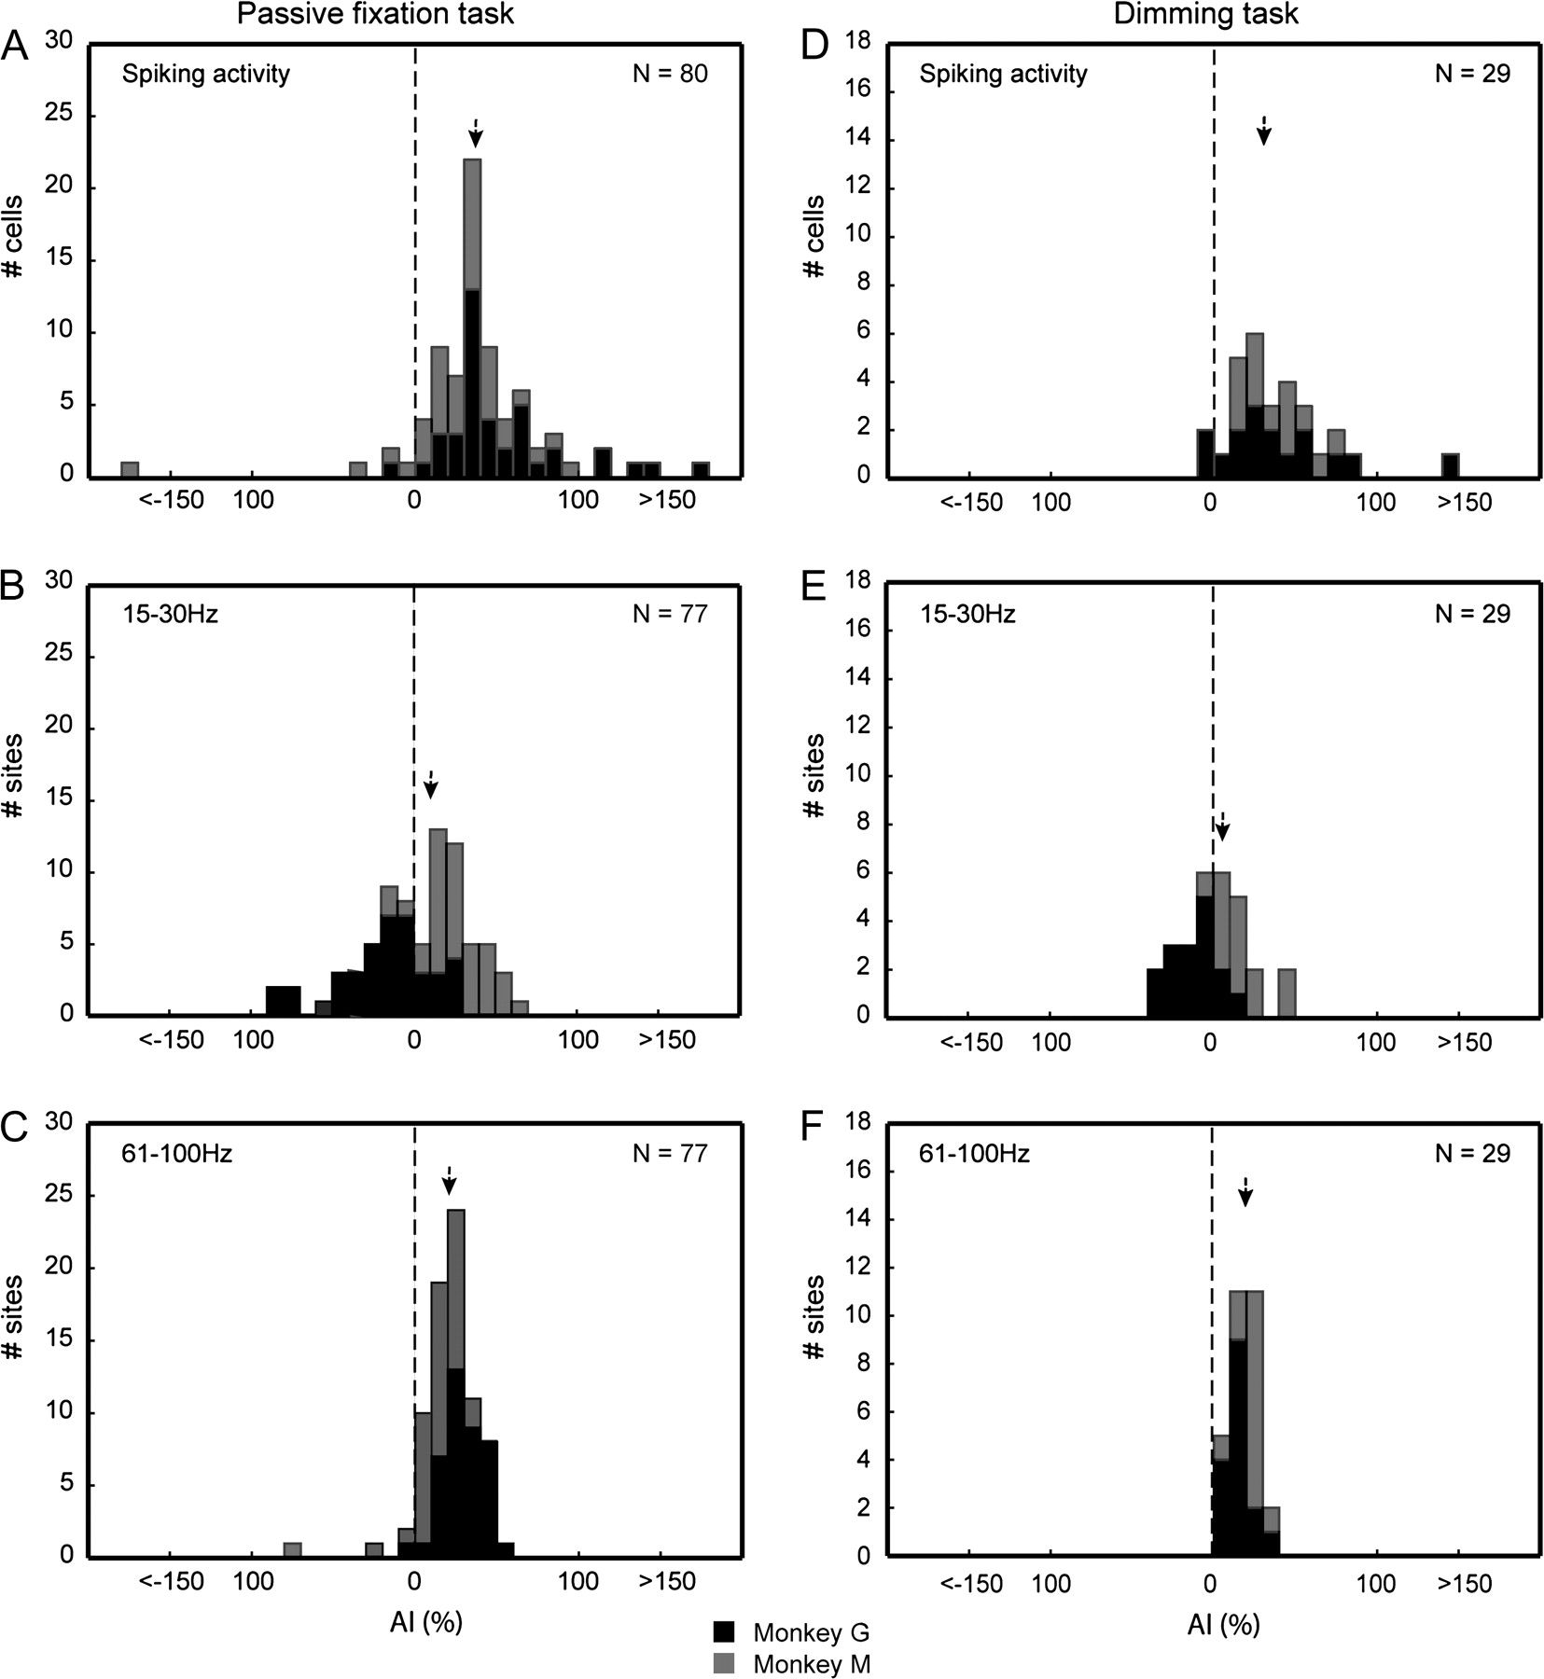
Figure 6. Distributions of AI in “same” trials in the main passive fixation procedure (A–C) and dimming procedure (D–F) ...
Notes:
Figure 6. Distributions of AI in “same” trials in the main passive fixation procedure (A–C) and dimming procedure (D–F) for spiking activity (A,D), low (B,E) and high-frequency (gamma) power (C,F). Arrows indicate the median AIs and data are shown separately for the 2 animals.
Unless provided in the caption above, the following copyright applies to the content of this slide: © The Author 2009. Published by Oxford University Press. All rights reserved. For permissions, please e-mail: journals.permissions@oxfordjournals.org

Slide 7
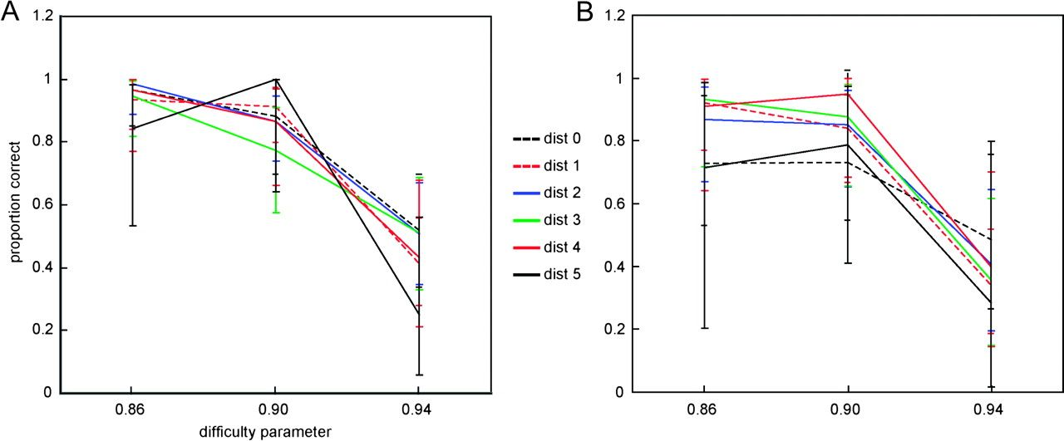
Figure 7. Behavioral results in the dimming task for monkeys G (averaged across 16 sessions, panel A) and M (averaged ...
Notes:
Figure 7. Behavioral results in the dimming task for monkeys G (averaged across 16 sessions, panel A) and M (averaged across 13 sessions, panel B). The mean detection rate of the dimming of the test stimulus is plotted (with standard error [SE]) as a function of the parametric distance between the test stimulus and the preceding adapter stimulus for the 3 difficulty levels of dimming.
Unless provided in the caption above, the following copyright applies to the content of this slide: © The Author 2009. Published by Oxford University Press. All rights reserved. For permissions, please e-mail: journals.permissions@oxfordjournals.org

Slide 8
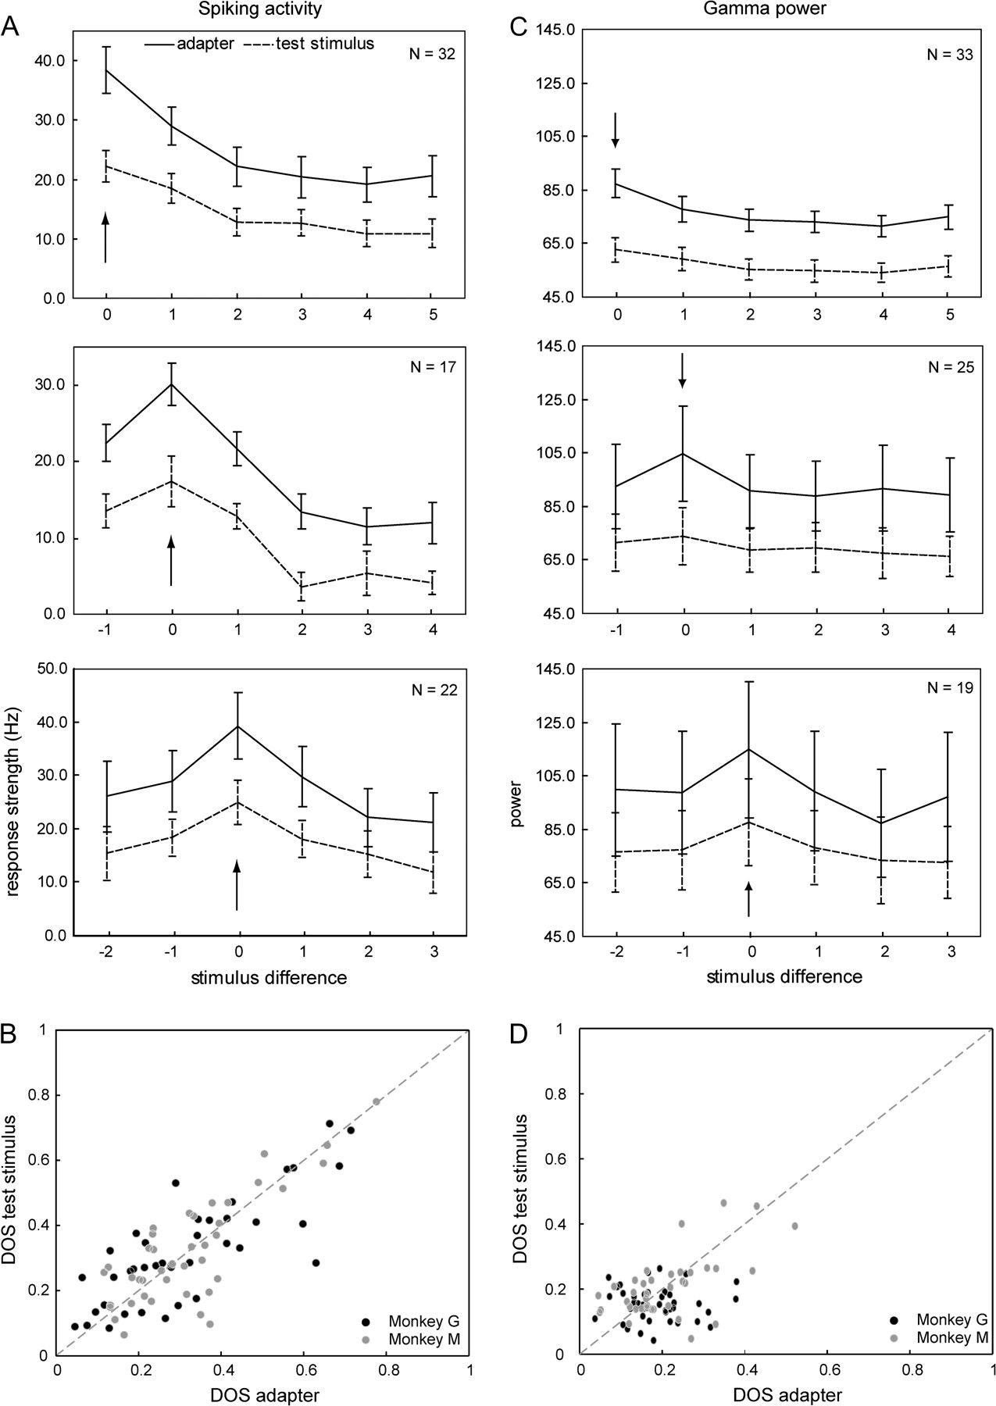
Figure 8. Effect of repetition on IT shape tuning for spiking (A,B) and gamma activity (C,D). (A,C) Tuning curves for ...
Notes:
Figure 8. Effect of repetition on IT shape tuning for spiking (A,B) and gamma activity (C,D). (A,C) Tuning curves for the adapter (solid line) and the test stimuli (dotted line) in the “same” trials (with SEs) of 3 groups of neurons/sites (see Results). Responses are plotted as a function of the difference between the stimulus value and the preferred shape. (B,D) DOS indices for the test stimuli plotted against the DOS indices for the adapters. Each dot represents the values of a single neuron/site and gray levels indicate the different animals. The arrows indicate the most effective stimulus for each group of neurons/sites.
Unless provided in the caption above, the following copyright applies to the content of this slide: © The Author 2009. Published by Oxford University Press. All rights reserved. For permissions, please e-mail: journals.permissions@oxfordjournals.org

Slide 9
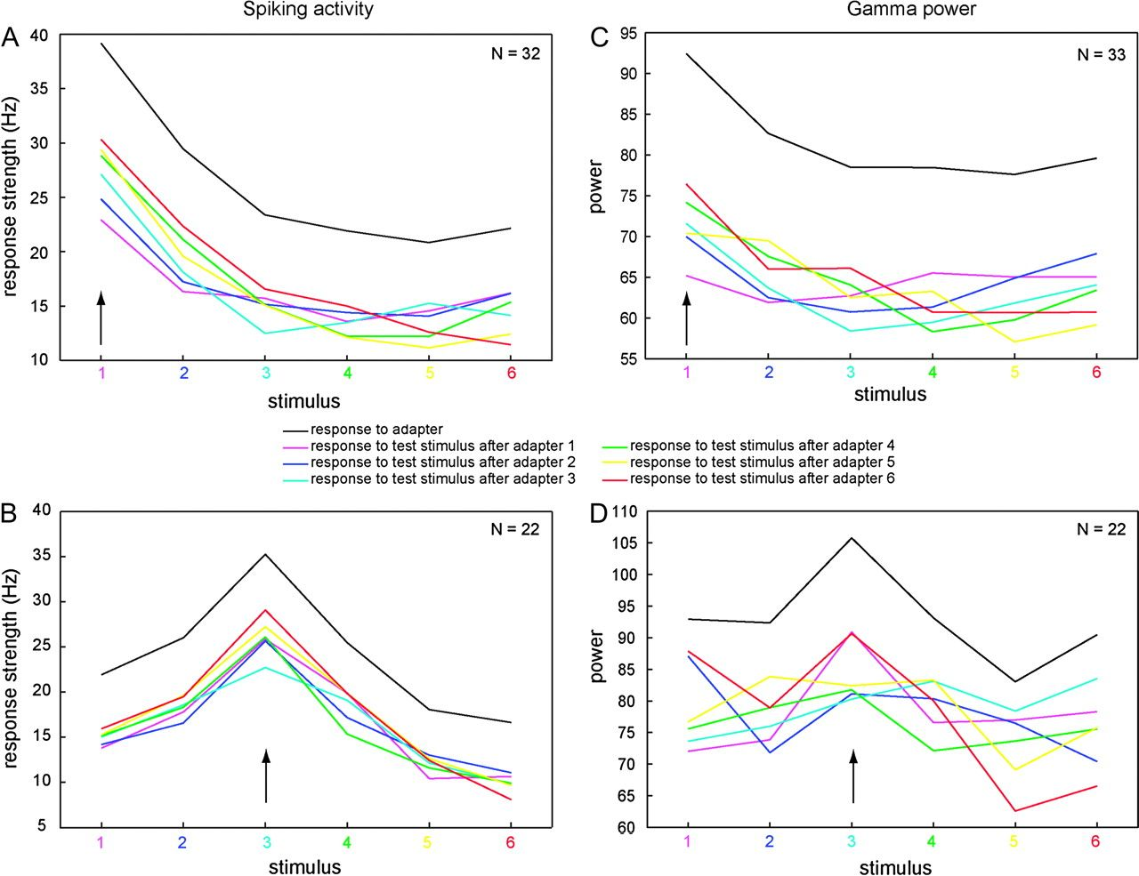
Figure 9. Effect of adapter and test stimulus value on adaptation for spiking (A,B) and gamma activity (C,D). Tuning ...
Notes:
Figure 9. Effect of adapter and test stimulus value on adaptation for spiking (A,B) and gamma activity (C,D). Tuning curves of neurons/sites for the adapter (black solid line) and the test stimuli as a function of the difference between the stimulus value and the preferred shape. The tuning curves for the test stimuli are sorted according to the value of the preceding adapter stimulus (see inset). (A,C) neurons/sites showing maximum responses to one of the extremes of the shape set when presented as an adapter (i.e., monotonic tuning). (B,D) neurons/sites showing a maximum adapter response for shape C or D (as labeled in Fig. 2). The arrows indicate the most effective stimulus for each group of neurons/sites.
Unless provided in the caption above, the following copyright applies to the content of this slide: © The Author 2009. Published by Oxford University Press. All rights reserved. For permissions, please e-mail: journals.permissions@oxfordjournals.org

Slide 10
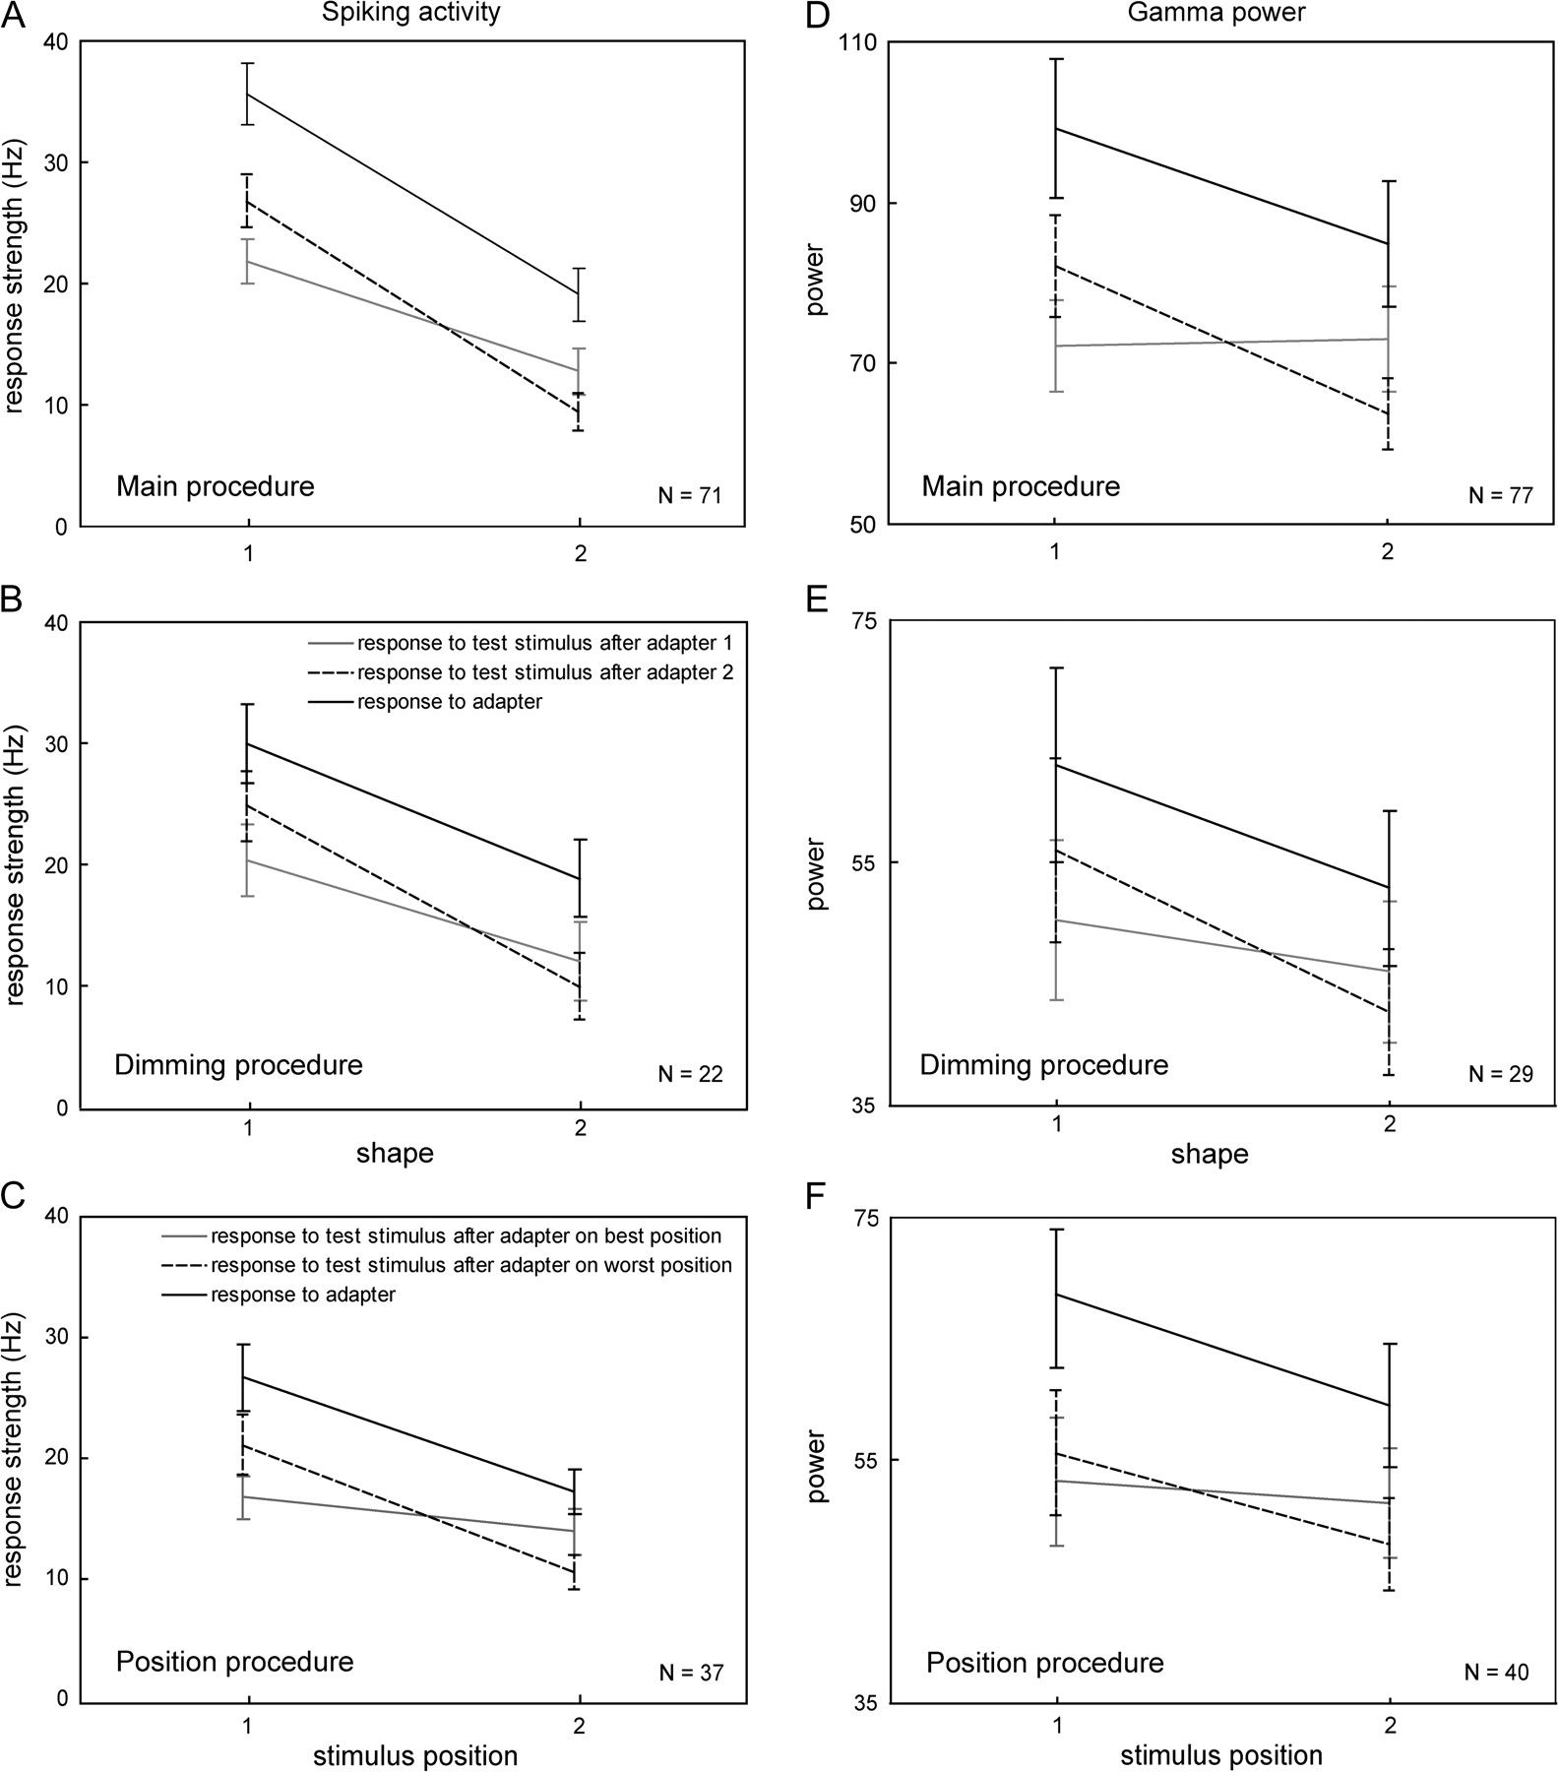
Figure 10. Effect of adapter and test stimulus values on adaptation for spiking (A–C) and gamma (D–F) activity in the ...
Notes:
Figure 10. Effect of adapter and test stimulus values on adaptation for spiking (A–C) and gamma (D–F) activity in the main procedure (A,D), dimming procedure (B,E) and position procedure (C,F). Black, solid lines show responses (with SEs) to 2 shapes/positions of the adapter stimulus. Shape 1 is the most effective, whereas shape 2 differed parametrically the most from shape 1. Positions 1 and 2 are the most and least effective positions, respectively. The stippled and gray lines show the test stimulus responses (with SEs) for shapes/positions 1 and 2 following shapes/positions 2 and 1 as adapter stimuli, respectively.
Unless provided in the caption above, the following copyright applies to the content of this slide: © The Author 2009. Published by Oxford University Press. All rights reserved. For permissions, please e-mail: journals.permissions@oxfordjournals.org

Slide 11
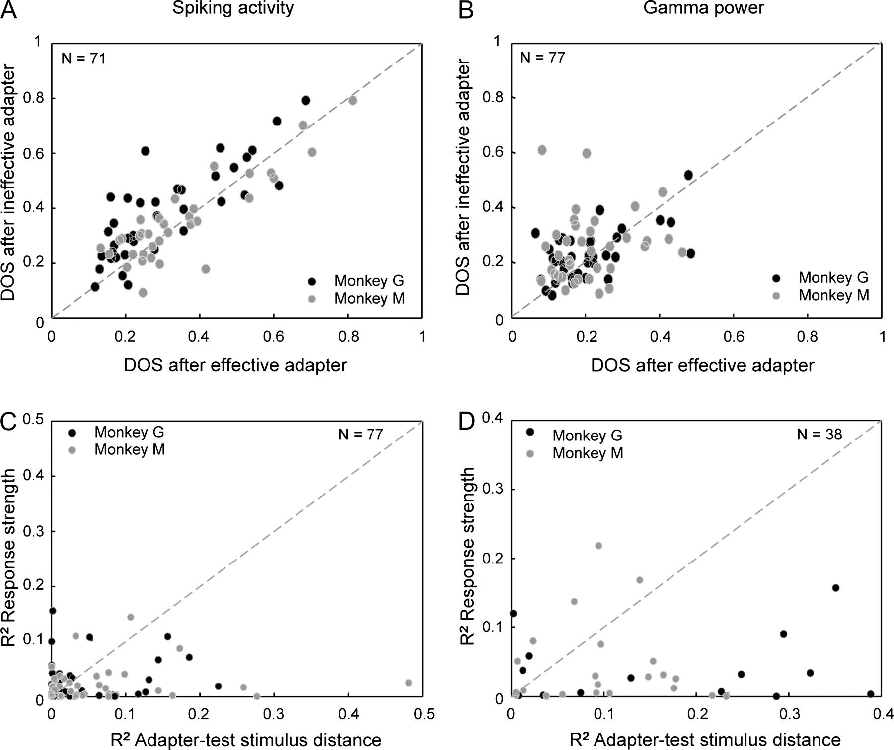
Figure 11. Effect of adaptation on the degree of selectivity, and the contributions of response strength and ...
Notes:
Figure 11. Effect of adaptation on the degree of selectivity, and the contributions of response strength and adapter–test stimulus distance to adaptation. In the top panels, the effect of adapter stimulus value (effective vs. ineffective stimulus) on selectivity for the test stimuli with respect to the spiking (A) and gamma (B) activity is shown. DOS indices for the test stimuli following the ineffective stimulus are plotted against the DOS indices for the test stimuli following the effective stimulus. In the bottom panels, the proportion of variance (squared semipartial correlations; see Results) explained by the response strength variable is plotted against the proportion of variance explained by the adapter–test stimulus distance variable for spiking (C) and gamma (D) activity. In all panels, each dot represents the values of a single neuron/site and gray levels indicate the different animals.
Unless provided in the caption above, the following copyright applies to the content of this slide: © The Author 2009. Published by Oxford University Press. All rights reserved. For permissions, please e-mail: journals.permissions@oxfordjournals.org

Slide 12
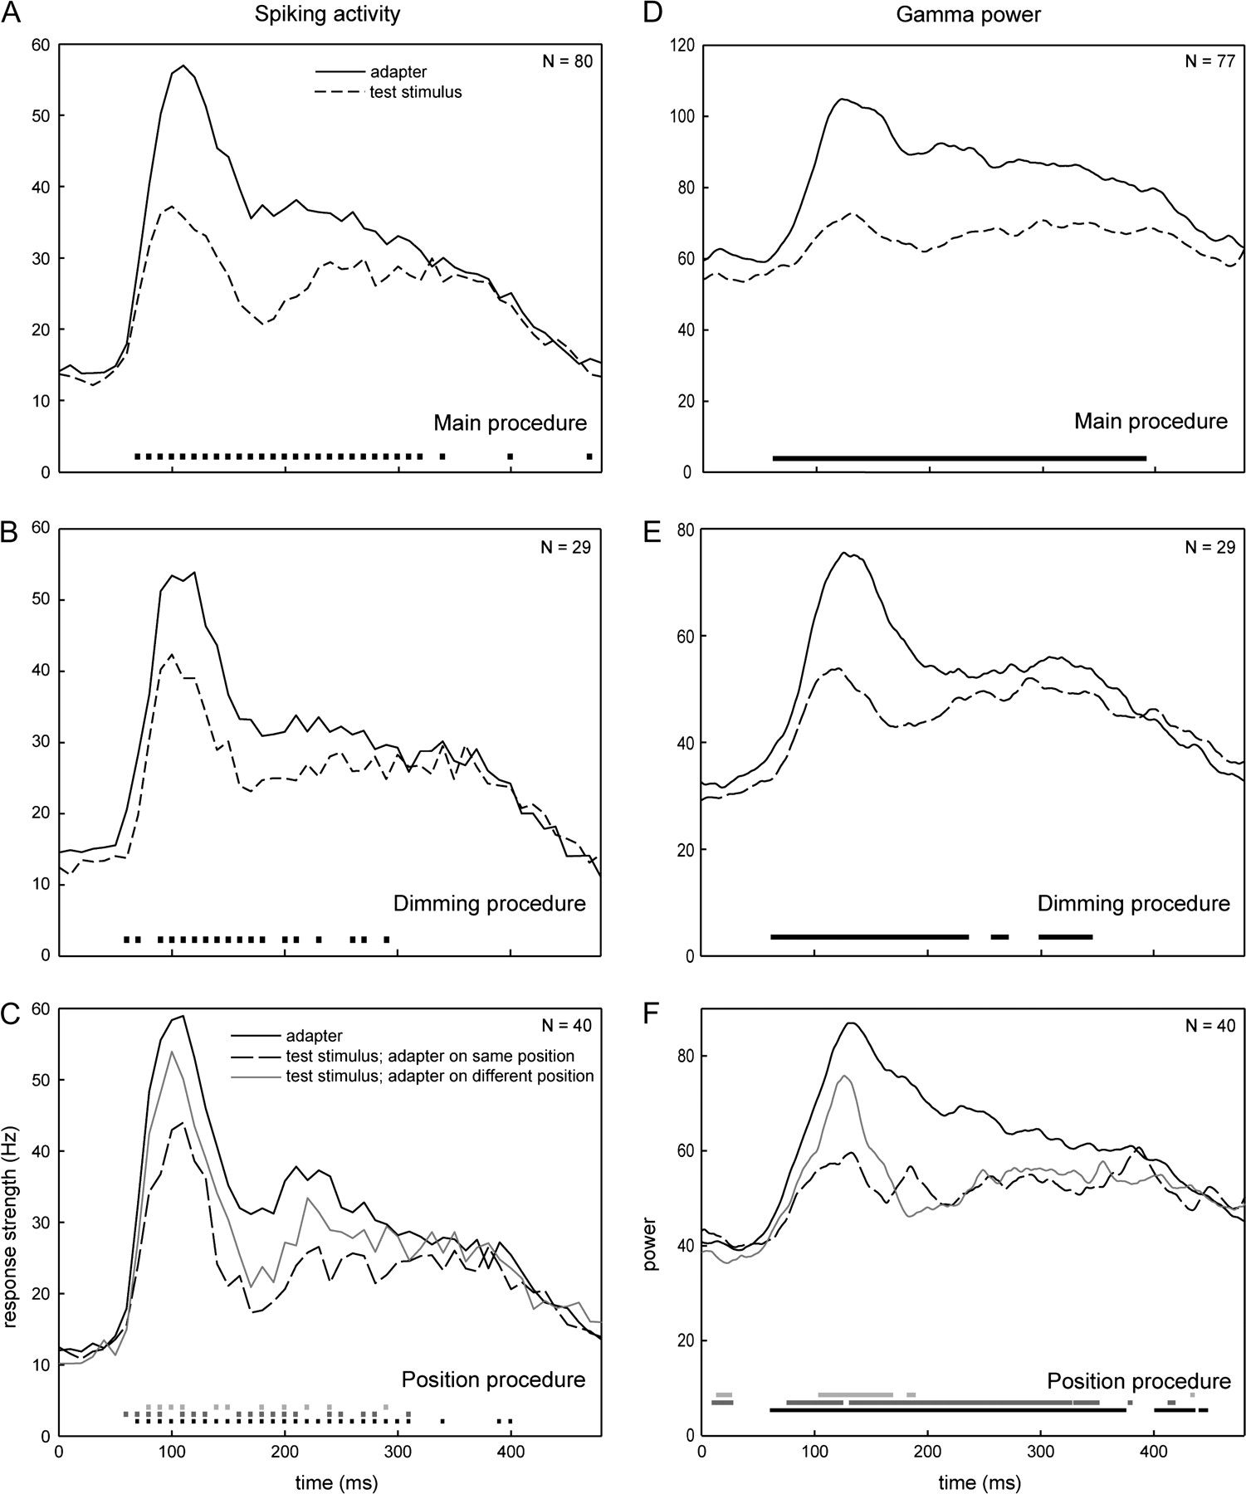
Figure 12. Time courses of adaptation for the spiking activity (A–C) and the gamma power (D–F). Population responses are ...
Notes:
Figure 12. Time courses of adaptation for the spiking activity (A–C) and the gamma power (D–F). Population responses are shown for the adapter and test stimuli in the same trials of the main (A,D) and dimming procedures (B,E) and for the adapter and test stimuli following the same shape at the same or a different position in the position procedure (C,F). Zero indicates the onset of the first or second stimulus. For the spiking activity, shown as population PSTHs, responses were computed in 10-ms bins and are plotted as a function of the centers of the bins (e.g., response between 5 and 14 ms plotted at 10 ms). Gamma powers are plotted per ms. The black dots on the bottoms of panels A, B, D, and E indicate the bins/ms for which the responses of the adapter and test stimulus differed significantly (Wilcoxon test; P < 0.05). The dots along the bottom in panels C and F indicate the bins/ms for which responses to the adapter and the test stimuli presented at the same (black) or at the other position (dark gray) as the adapter differed significantly. In light gray, significant differences for the test shape shown at same and different adapter–test stimulus positions (i.e., between stippled and gray curves) are indicated.
Unless provided in the caption above, the following copyright applies to the content of this slide: © The Author 2009. Published by Oxford University Press. All rights reserved. For permissions, please e-mail: journals.permissions@oxfordjournals.org

