Slide 1
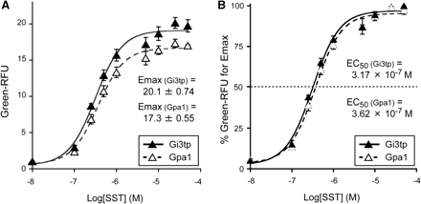
Fig. 1 Dose–response curves for SST-specific SSTR5 signalling activities of recombinant yeast cells expressing ...
Notes:
Fig. 1 Dose–response curves for SST-specific SSTR5 signalling activities of recombinant yeast cells expressing different types of intracellular peripheral G-protein α-subunits. As Gα-subunits for the functional SST-specific SSTR5 signalling, yeast endogenous Gpa1 and yeast–human chimeric Gi3tp were compared using the GFP reporter gene. The signalling activities of recombinant strains MI-170-1 (Gpa1, open symbol) and MI-170-2 (Gi3tp, closed symbol) were evaluated as described in ‘Materials and methods’ section. (A) Pharmacological efficacies of yeast transformants were represented by green-RFU normalized with the green fluorescent intensities of the SST-untreated yeast cells as the reference values, respectively. (B) Pharmacological potencies of yeast transformants were represented by relative green-RFU normalized with the values of maximal effects of SST-specific dose–responses as the reference values, respectively. Data points represent the mean of triplicate independent experiments and error bars represent the standard deviation. EC50 values were determined using KaleidaGraph4.0 fits to a dosersplgst model.
Unless provided in the caption above, the following copyright applies to the content of this slide: © The Authors 2010. Published by Oxford University Press on behalf of the Japanese Biochemical Society. All rights reserved

Slide 2
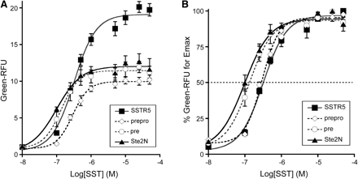
Fig. 2 Dose–response curves for SST-specific signalling activities of SSTR5 with or without additional SS in yeast ...
Notes:
Fig. 2 Dose–response curves for SST-specific signalling activities of SSTR5 with or without additional SS in yeast cells. To examine the effects of SS for the SST-specific SSTR5 signalling, prepro-SSTR5, pre-SSTR5 and Ste2N-SSTR5 were prepared. The signalling activities of recombinant strains MI-170-3 (prepro), MI-170-4 (pre) and MI-170-5 (Ste2N) were evaluated using the GFP reporter gene as described in ‘Materials and methods’ section. (A) Pharmacological efficacies of yeast transformants were represented by green-RFU normalized with the green fluorescent intensities of the SST-untreated yeast cells as the reference values, respectively. (B) Pharmacological potencies of yeast transformants were represented by relative green-RFU normalized with the values of maximal effects of SST-specific dose responses as the reference values, respectively. MI-170-2 data shown in Fig. 1 are displayed for comparison. Data points represent the mean of triplicate independent experiments and error bars represent the standard deviation.
Unless provided in the caption above, the following copyright applies to the content of this slide: © The Authors 2010. Published by Oxford University Press on behalf of the Japanese Biochemical Society. All rights reserved

Slide 3
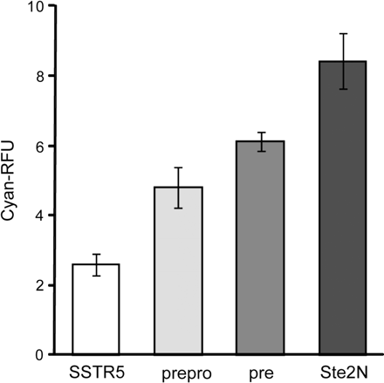
Fig. 3 Estimation of expression levels of CFP-fluorescent tagged SSTR5 receptors with or without additional SS ...
Notes:
Fig. 3 Estimation of expression levels of CFP-fluorescent tagged SSTR5 receptors with or without additional SS sequences. Four CFP-fluorescent tagged SSTR5 constructs—SSTR5-CFP, prepro-SSTR5-CFP, pre-SSTR5-CFP and Ste2N-SSTR5-CFP—were prepared to generate recombinant strains MI-170-6 (SSTR5), MI-170-7 (prepro), MI-170-8 (pre) and MI-170-9 (Ste2N), respectively. Cellular cyan-RFU was calculated as described in ‘Materials and methods’ section. Data represent the mean of triplicate independent experiments and error bars represent the standard deviation.
Unless provided in the caption above, the following copyright applies to the content of this slide: © The Authors 2010. Published by Oxford University Press on behalf of the Japanese Biochemical Society. All rights reserved

Slide 4
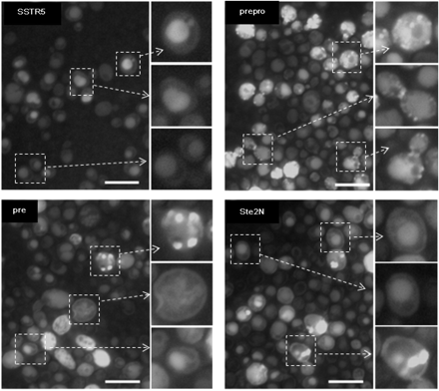
Fig. 4 Observation of localisation patterns of CFP-fluorescent tagged SSTR5 receptors with or without additional SS. ...
Notes:
Fig. 4 Observation of localisation patterns of CFP-fluorescent tagged SSTR5 receptors with or without additional SS. The yeast strain MI-170 was used as the host strain to introduce CFP-fluorescent tagged SSTR5 receptors without or with additional SS. Four CFP-fluorescent tagged SSTR5 constructs—SSTR5-CFP, prepro-SSTR5-CFP, pre-SSTR5-CFP and Ste2N-SSTR5-CFP—were prepared to generate recombinant strains MI-170-6 (SSTR5), MI-170-7 (prepro), MI-170-8 (pre) and MI-170-9 (Ste2N), respectively. The cellular cyan fluorescence was observed with the fluorescence microscope as described in ‘Materials and methods’ section. White bars represent 10 μm.
Unless provided in the caption above, the following copyright applies to the content of this slide: © The Authors 2010. Published by Oxford University Press on behalf of the Japanese Biochemical Society. All rights reserved

