Slide 1
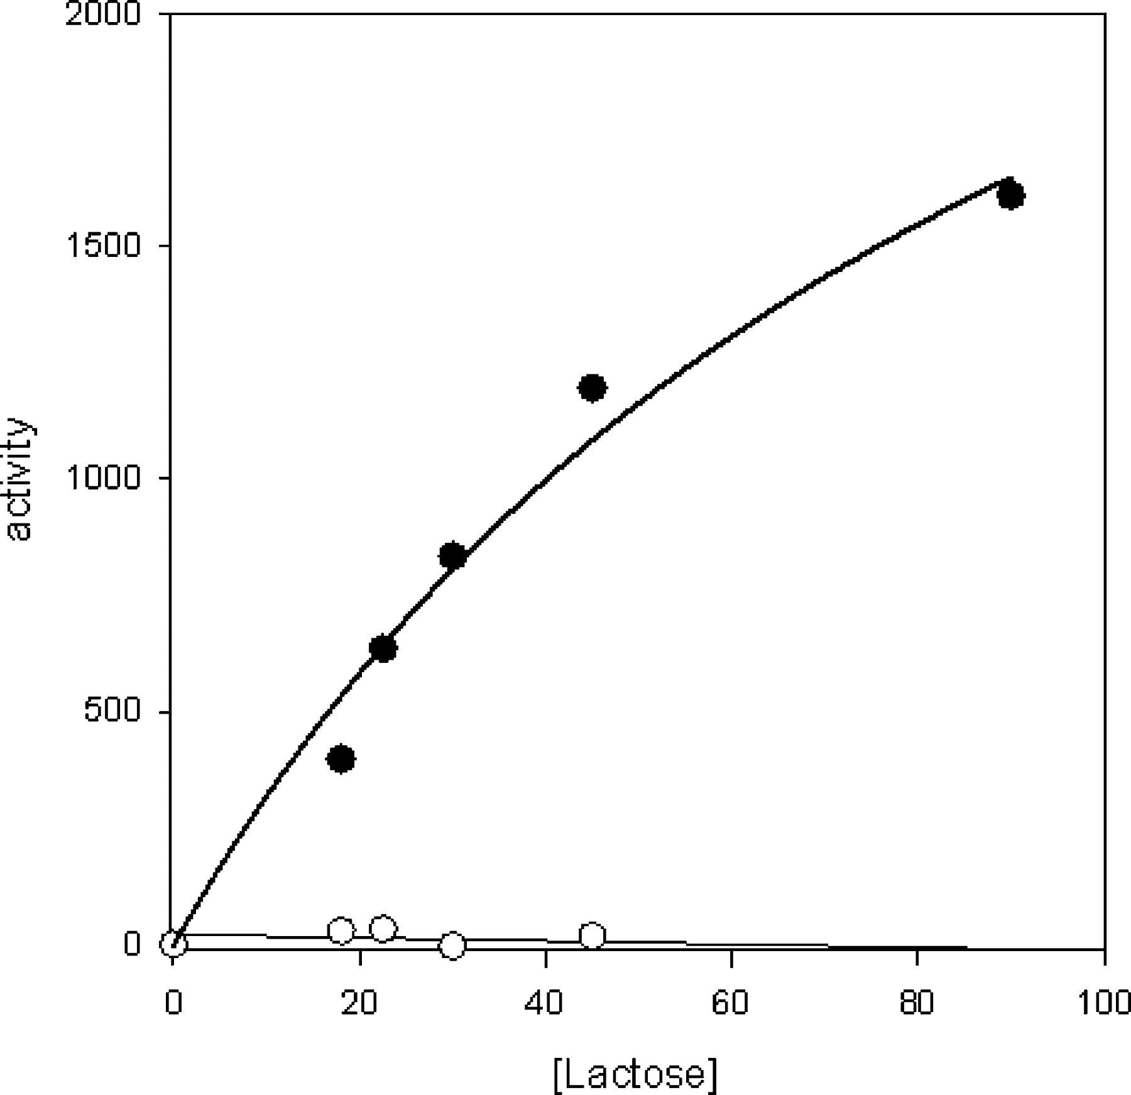
Fig. 1 Comparison of the activities of the AGGL mutant and wild-type α3GT with UDP-GalNAc as a donor substrate at ...
Notes:
Fig. 1 Comparison of the activities of the AGGL mutant and wild-type α3GT with UDP-GalNAc as a donor substrate at different concentrations of lactose. Symbols: , AGGL mutant; ◯, wild-type α3GT. Each assay contained 3.6 μg of enzyme and was carried out as described in Material and methods.
Unless provided in the caption above, the following copyright applies to the content of this slide: © Oxford University Press 2008

Slide 2
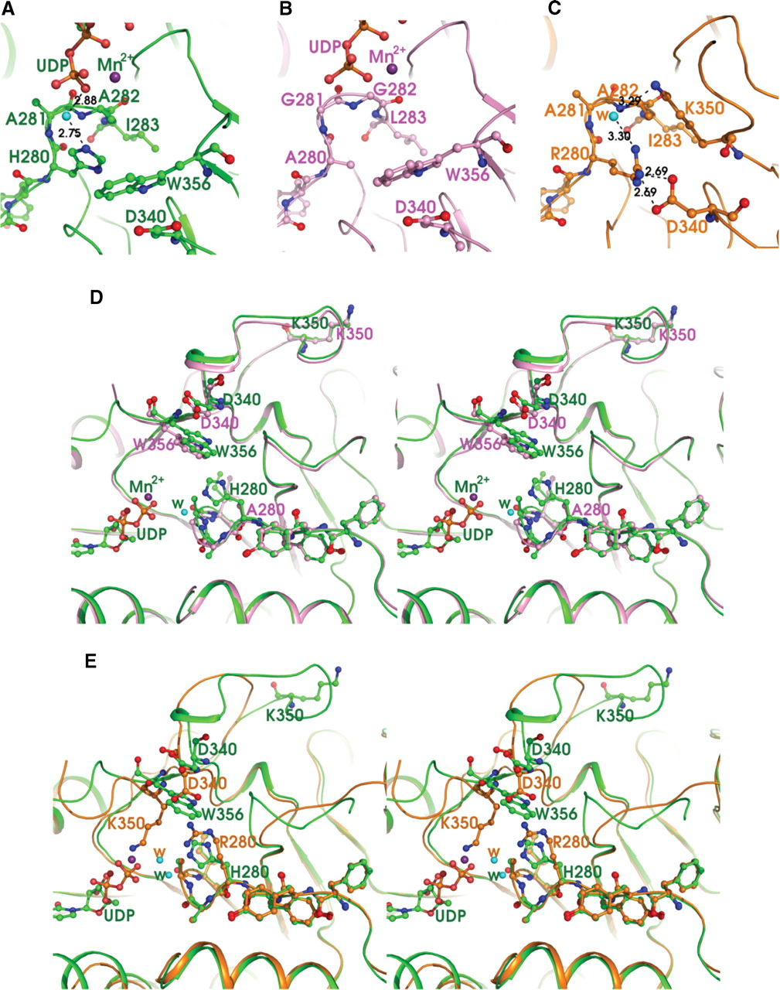
Fig. 2 Comparison of the structures of AGGL and RAAI mutants with wild-type α3GT. (A) The interaction of H280 with ...
Notes:
Fig. 2 Comparison of the structures of AGGL and RAAI mutants with wild-type α3GT. (A) The interaction of H280 with UDP in native α3GT. The neighboring residues A281, A282, I283, and W356 are shown as ball-and-stick models. Hydrogen bonds are displayed as black dotted lines and the distances are shown. The bound manganese ion and UDP are labeled. (B) Residues 280–283 (AGGL) and the adjacent residues D340 and W356 in the structure of the AGGL mutant of α3GT are shown as ball-and-stick models. The bound manganese ion and UDP are labeled. (C) Residues 280–283 (RAAI) and the surrounding residues D340 and K350 in the structure of the RAAI mutant of the α3GT structure are shown. The interaction of R280 with D340 is represented by black dotted lines. Note: because of the H280R mutation, a significant rearrangement of C-terminal region was observed in the mutant enzyme and no bound UDP or manganese ion are present. (D) Stereo representation of the superposition of the structures of the 280HAAI283 region of wild-type α3GT and the corresponding region of the AGGL mutant. Wild-type α3GT is represented in green, and the AGGL mutant is in pink. The bound manganese ion and UDP are labeled. (E) Stereo figure representation of superposition of the structures of wild-type α3GT and H280R from the structure of the RAAI mutant. The H280R mutant is represented in orange, and wild-type α3GT is colored green. The UDP and manganese ion (purple sphere) from wild-type α3GT are shown. A drastic rearrangement of the C-terminal region is evident in the RAAI-α3GT mutant, as compared with the wild-type enzyme.
Unless provided in the caption above, the following copyright applies to the content of this slide: © Oxford University Press 2008

