Slide 1
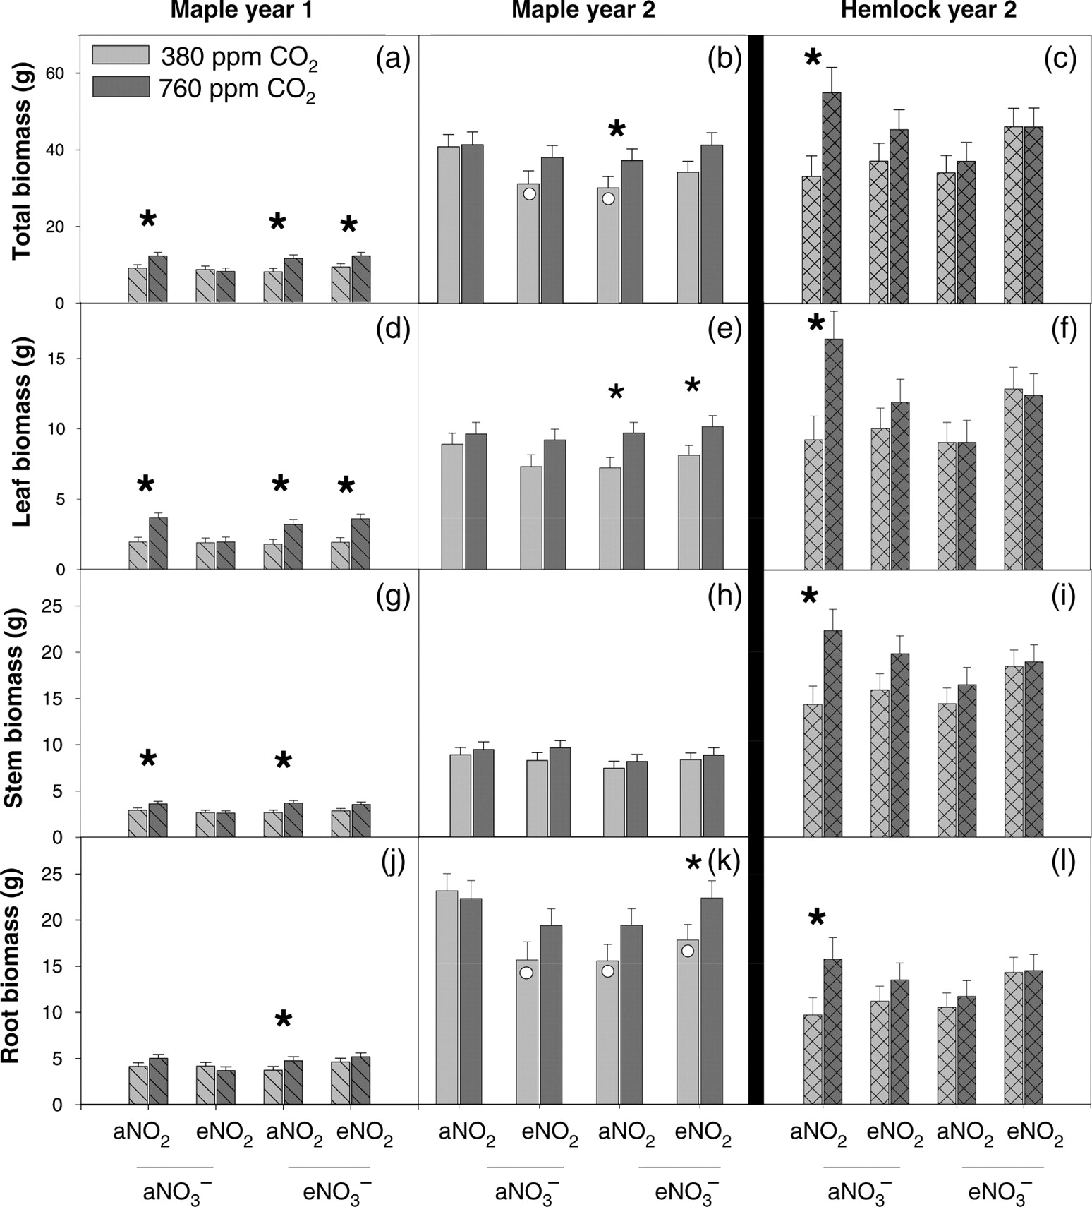
Figure 1. Mean total, leaf, stem and root dry mass (g) with error bars indicating ±SE. Diagonal lines, open bars and ...
Notes:
Figure 1. Mean total, leaf, stem and root dry mass (g) with error bars indicating ±SE. Diagonal lines, open bars and cross-hatch bars indicate maple seedlings after 1 year of treatment, maple seedlings after 2 years of treatment and hemlock seedlings after 2 years of treatment, respectively. aNO3− = ambient NO3− deposition, eNO3− = 30 kg ha−1 year−1 NO3− deposition (high NO3−), aNO2 = ambient NO2 and eNO2 = 40 ppb NO2. Asterisks indicate a significant difference between the ambient and elevated CO2 pairs (α = 0.05). Open circles indicate a significant difference between that treatment and the control.
Unless provided in the caption above, the following copyright applies to the content of this slide: © The Author 2011. Published by Oxford University Press. All rights reserved. For Permissions, please email: journals.permissions@oup.com

Slide 2
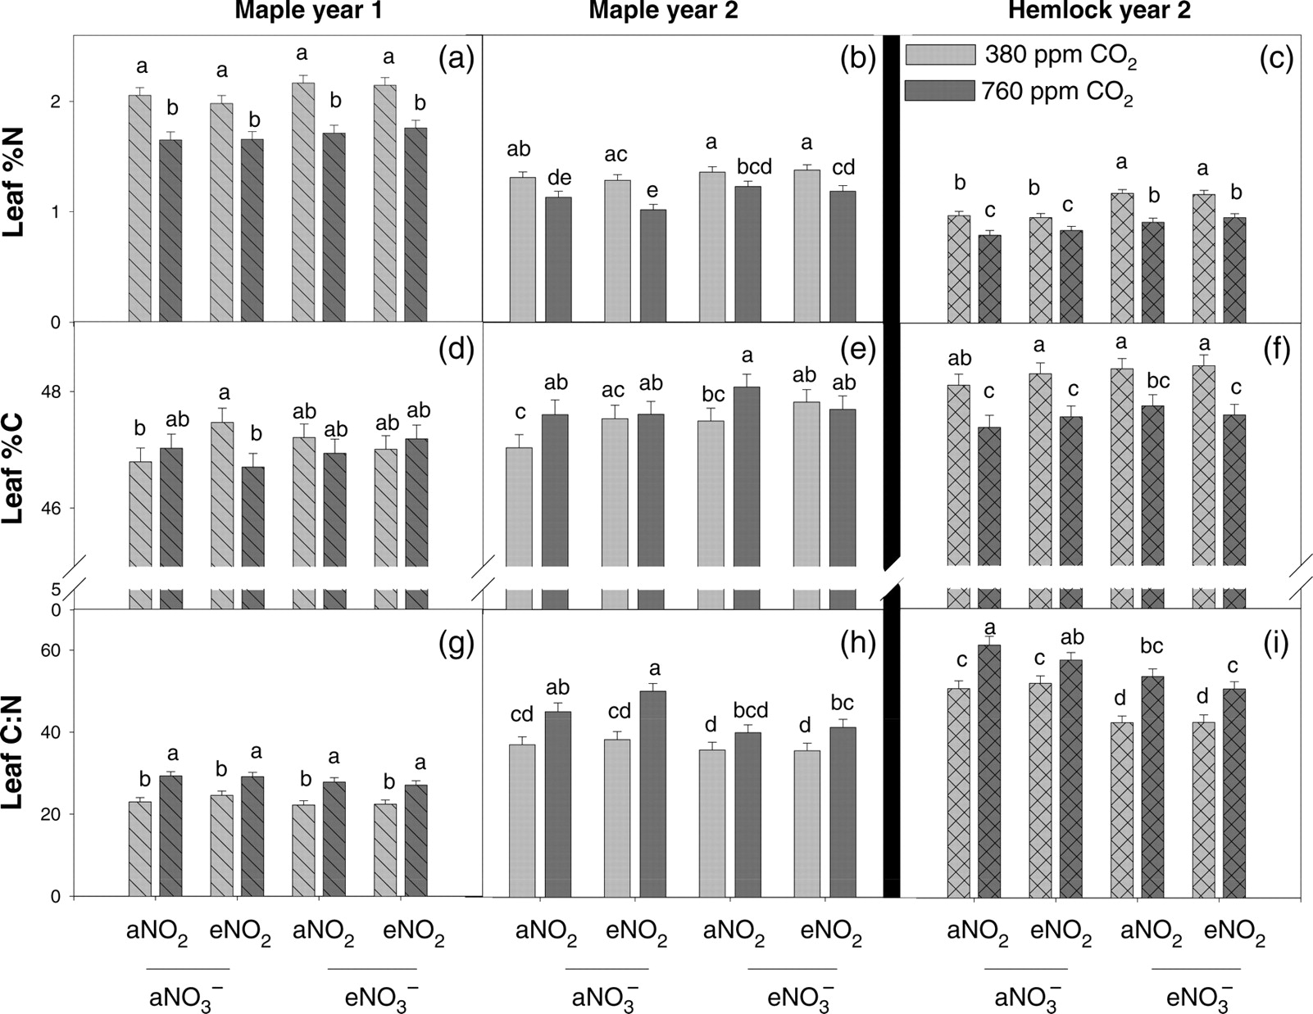
Figure 2. Total leaf area (cm²) and SLA (cm² g⁻¹). Error bars indicate ±SE. ...
Notes:
Figure 2. Total leaf area (cm2) and SLA (cm2 g−1). Error bars indicate ±SE. Diagonal lines, open bars and cross-hatch bars indicate sugar maple seedlings after 1 and 2 years of treatment and hemlock seedlings after 2 years of treatment, respectively. aNO3− = ambient NO3− deposition, eNO3− = 30 kg ha−1 year−1 NO3− deposition (high NO3−), aNO2 = ambient NO2 and eNO2 = 40 ppb NO2. Asterisks indicate a significant difference between ambient and elevated CO2 pairs and circles indicate a significant difference between that treatment and the control.
Unless provided in the caption above, the following copyright applies to the content of this slide: © The Author 2011. Published by Oxford University Press. All rights reserved. For Permissions, please email: journals.permissions@oup.com

Slide 3
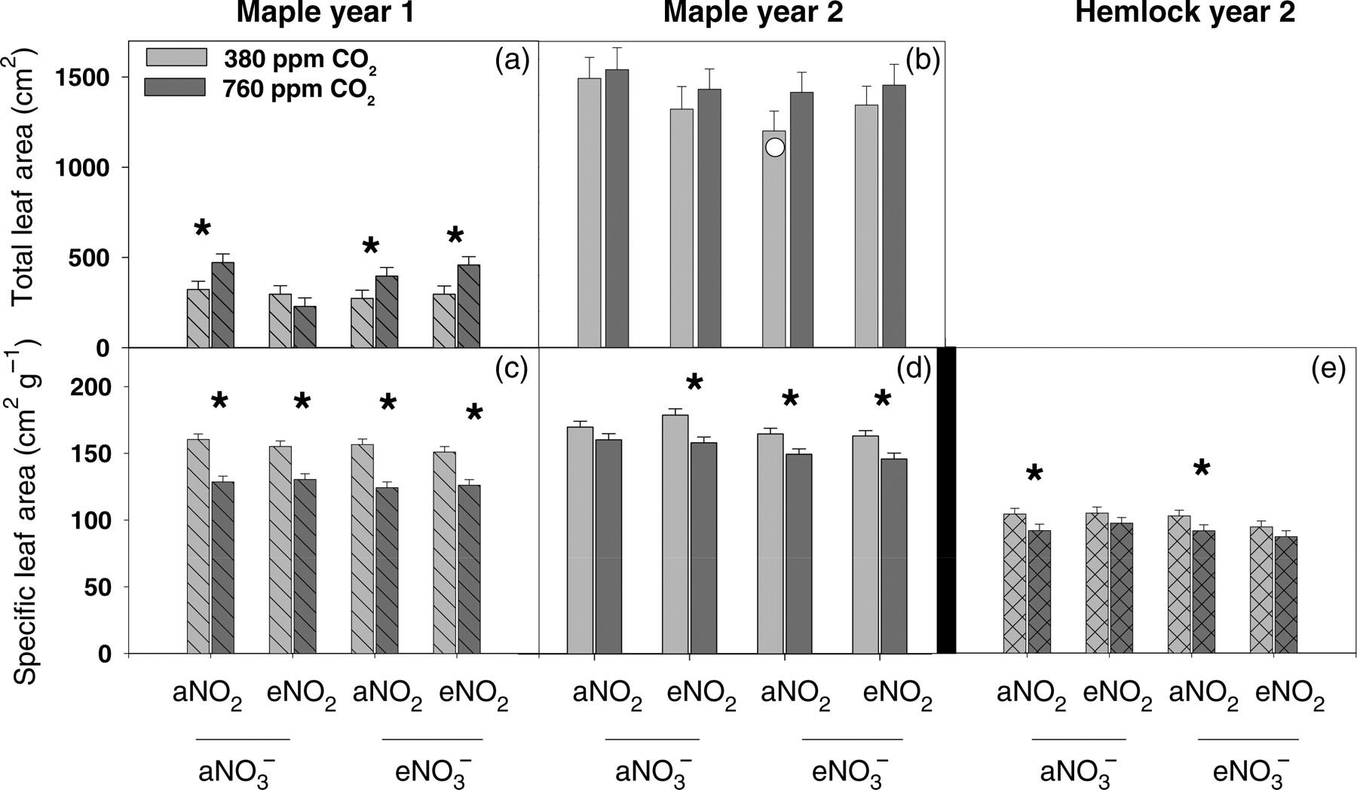
Figure 3. Elemental analysis of leaf tissue including %N, %C and leaf C:N with error bars indicating ±SE. Diagonal ...
Notes:
Figure 3. Elemental analysis of leaf tissue including %N, %C and leaf C:N with error bars indicating ±SE. Diagonal lines, open bars and cross-hatch bars indicate sugar maple seedlings after 1 and 2 years of treatment and hemlock seedlings after 2 years of treatment, respectively. aNO3− = ambient NO3− deposition and eNO3− = 30 kg ha−1 year−1 NO3− deposition (high NO3−), aNO2 = ambient NO2 and eNO2 = 40 ppb NO2. Different letters indicate a significant difference between means (α = 0.05).
Unless provided in the caption above, the following copyright applies to the content of this slide: © The Author 2011. Published by Oxford University Press. All rights reserved. For Permissions, please email: journals.permissions@oup.com

