Slide 1
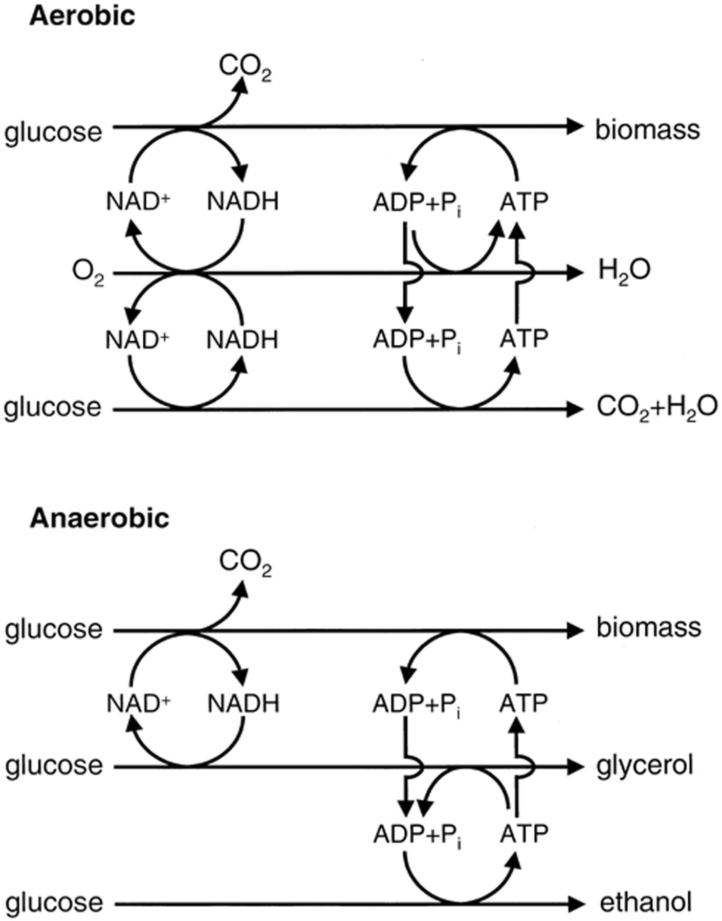
Figure 1 Schematic overview of NAD⁺/NADH turnover in respiring (top) and fermentative (bottom) cultures of ...
Notes:
Figure 1 Schematic overview of NAD+/NADH turnover in respiring (top) and fermentative (bottom) cultures of Saccharomyces cerevisiae. Depending on the concentrations of sugar and oxygen, intermediate situations are possible. In addition to biomass formation, production of low-molecular-mass metabolites, such as acetate, pyruvate, acetaldehyde or succinate, may affect turn-over of NAD+/NADH.
Unless provided in the caption above, the following copyright applies to the content of this slide: © 2001 Federation of European Microbiological Societies.

Slide 2
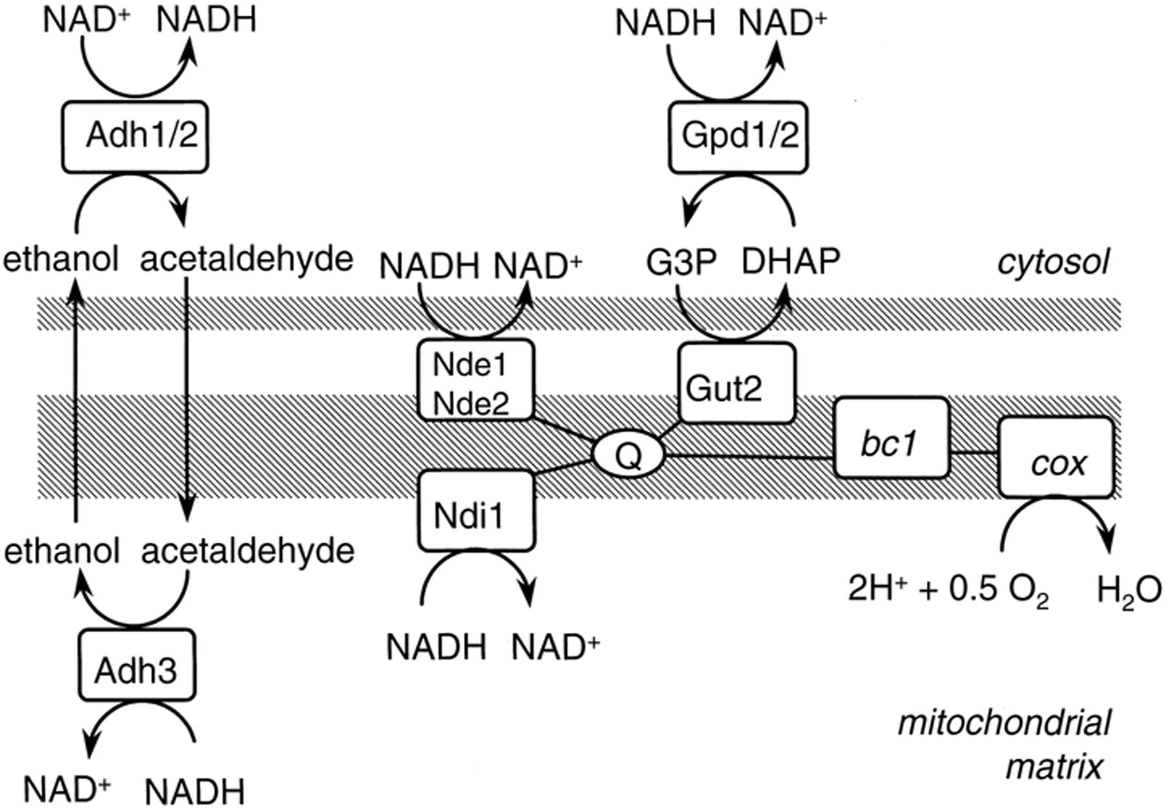
Figure 3 A scheme of the respiratory chain of Saccharomyces cerevisiae. Adh, alcohol dehydrogenase; bc1, ...
Notes:
Figure 3 A scheme of the respiratory chain of Saccharomyces cerevisiae. Adh, alcohol dehydrogenase; bc1, bc1 complex; cox, cytochrome c oxidase; Gpd, soluble glycerol-3-phosphate dehydrogenase; Gut2, membrane-bound glycerol-3-phosphate dehydrogenase; Nde, external NADH dehydrogenase; Ndi1, internal NADH dehydrogenase; Q:ubiquinone. Note that the ethanol–acetaldehyde shuttle is reversible in principle.
Unless provided in the caption above, the following copyright applies to the content of this slide: © 2001 Federation of European Microbiological Societies.

Slide 3
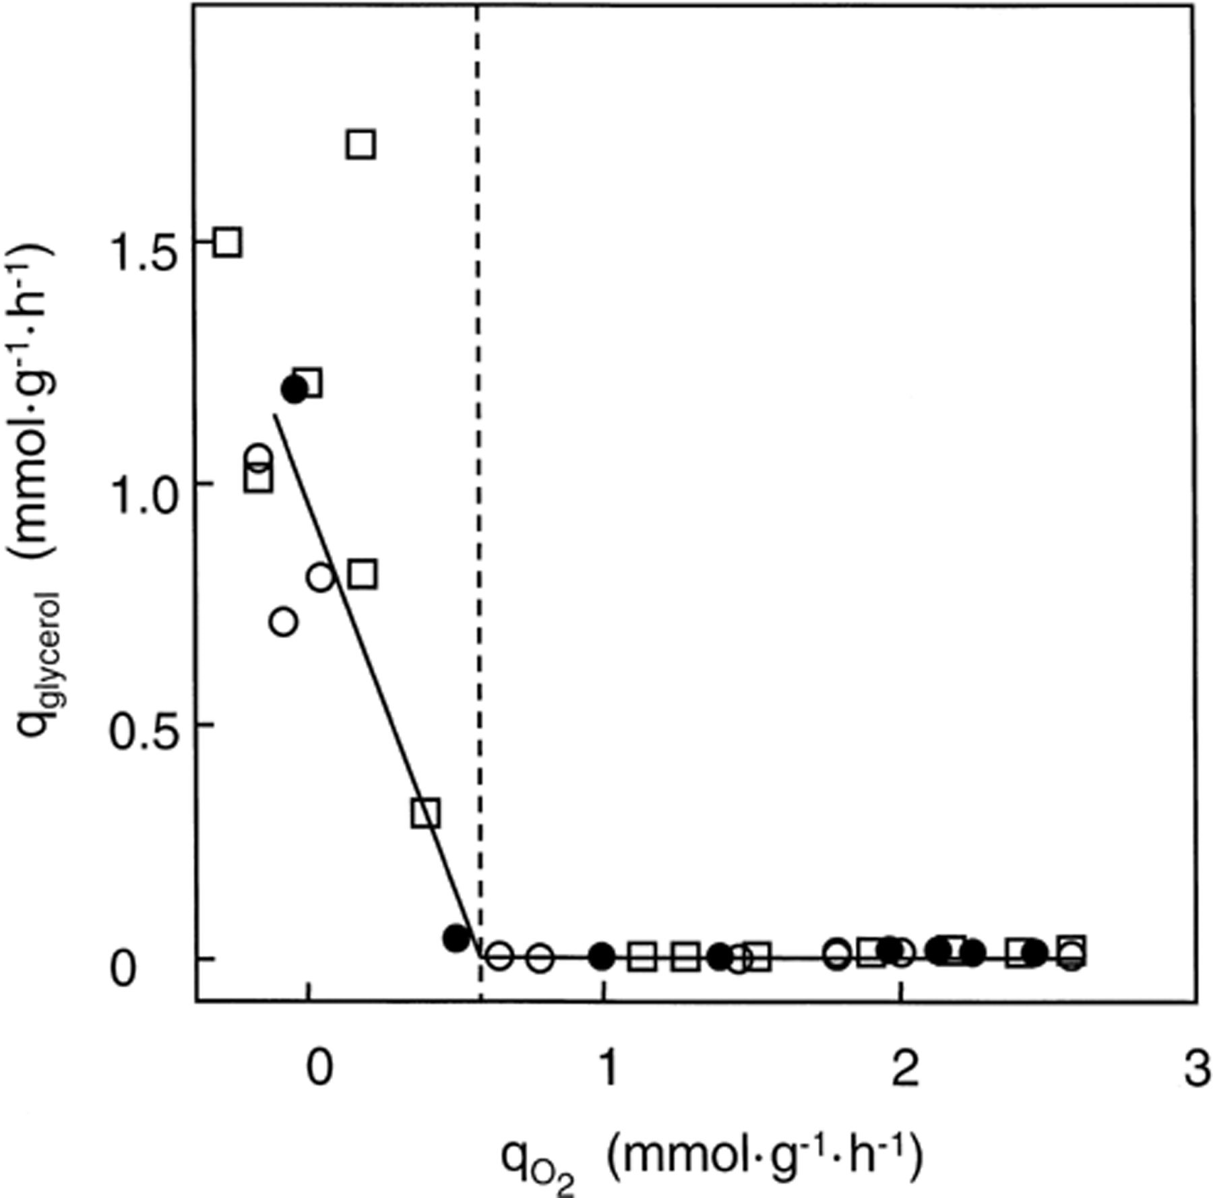
Figure 2 Effect of specific oxygen uptake rate by oxygen-limited chemostat cultures (D=0.10 h⁻¹) of S. ...
Notes:
Figure 2 Effect of specific oxygen uptake rate by oxygen-limited chemostat cultures (D=0.10 h−1) of S. cerevisiae (circles) and Candida utilis (squares) on the production of glycerol, with glucose (open symbols) or maltose (closed symbols) as the source of carbon and free energy. The fact that the specific oxygen consumption rate seems to drop below zero is due to inaccuracy of the measurements at these extremely low rates. As glycerol formation only occurs when the specific rate of oxygen uptake is too low to reoxidize all NADH formed in assimilatory reactions (dashed line), accurate control of the oxygen feed may be applied to prevent glycerol formation. Reproduced from [83].
Unless provided in the caption above, the following copyright applies to the content of this slide: © 2001 Federation of European Microbiological Societies.

Slide 4
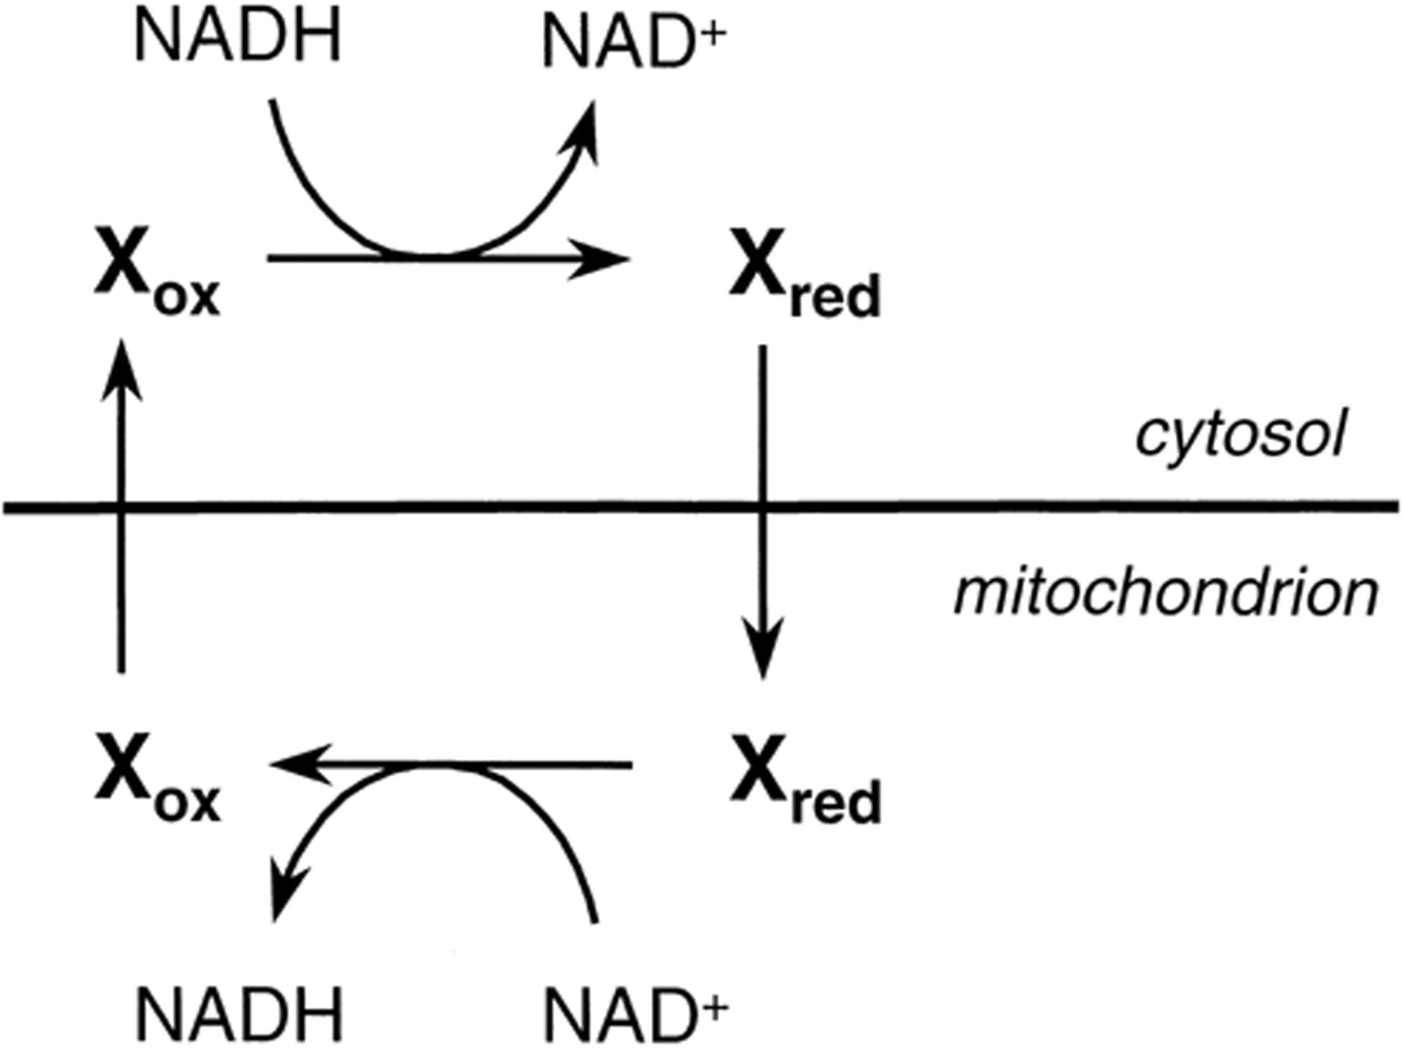
Figure 5 A general scheme of an NADH shuttle. X_{ox} and X_{red} represent an oxidized and a reduced ...
Notes:
Figure 5 A general scheme of an NADH shuttle. Xox and Xred represent an oxidized and a reduced organic compound, respectively, that are interconverted by a dehydrogenase. If, for example, Xox is an aldehyde or ketone, then Xred is the corresponding alcohol. In this scheme, net import of NADH into the mitochondrion occurs in exchange for NAD+.
Unless provided in the caption above, the following copyright applies to the content of this slide: © 2001 Federation of European Microbiological Societies.

Slide 5
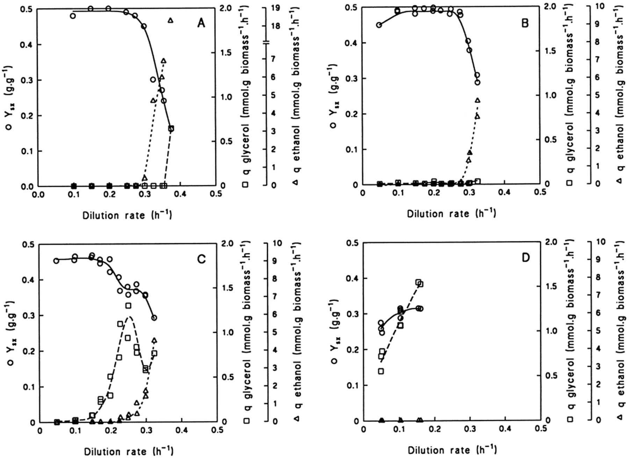
Figure 4 Effects of dilution rate in an aerobic, glucose-limited chemostat culture on biomass yield (Y_{sx}) ...
Notes:
Figure 4 Effects of dilution rate in an aerobic, glucose-limited chemostat culture on biomass yield (Ysx) and specific production rate of ethanol and glycerol (respectively qethanol and qglycerol) for (A) wild-type S. cerevisiae CEN.PK 113-7D, (B) gut2Δ mutant, (C) nde1Δ nde2Δ mutant and (D) gut2Δ nde1Δ nde2Δ mutant. Data reproduced from [80].
Unless provided in the caption above, the following copyright applies to the content of this slide: © 2001 Federation of European Microbiological Societies.

Slide 6
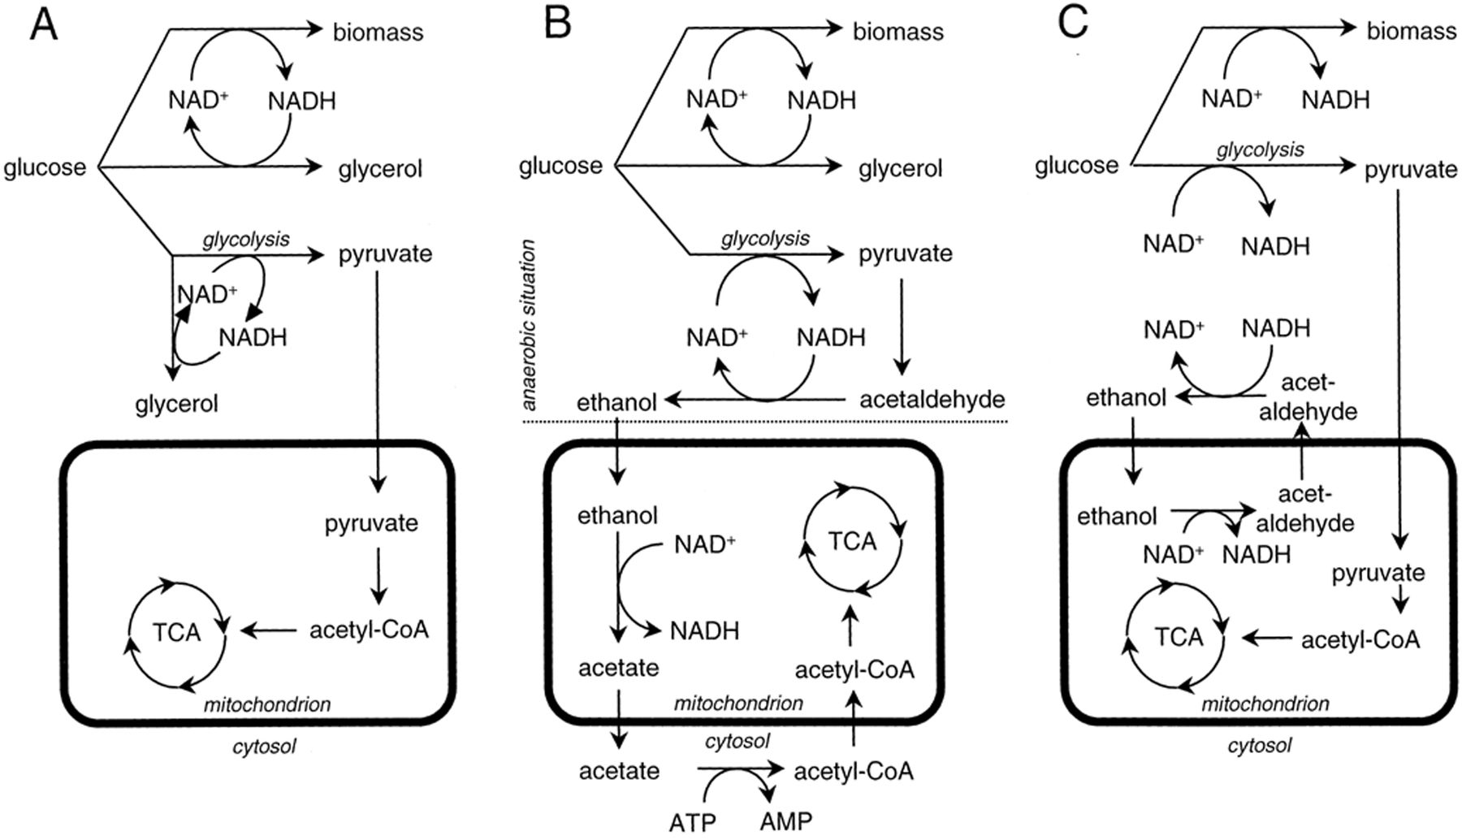
Figure 6 Schematic representation of the proposed metabolic pathways for the oxidation of cytosolic NADH in an S. ...
Notes:
Figure 6 Schematic representation of the proposed metabolic pathways for the oxidation of cytosolic NADH in an S. cerevisiae gut2Δ nde1Δ nde2Δ mutant, grown in an aerobic, glucose-limited chemostat culture at a low dilution rate. (A) Conversion of dissimilatory glucose into equimolar amounts of pyruvate and glycerol. (B) The ethanol produced in the cytosol is consumed by the mitochondria. (C) Ethanol–acetaldehyde shuttle.
Unless provided in the caption above, the following copyright applies to the content of this slide: © 2001 Federation of European Microbiological Societies.

Slide 7
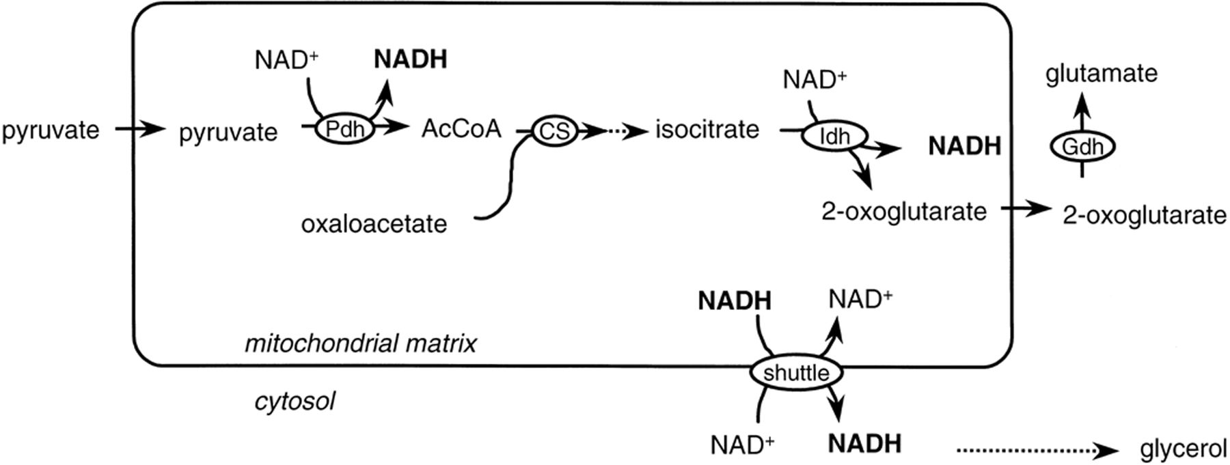
Figure 7 Proposed physiological role of the ethanol–acetaldehyde redox shuttle under anaerobic conditions [41]. In the ...
Notes:
Figure 7 Proposed physiological role of the ethanol–acetaldehyde redox shuttle under anaerobic conditions [41]. In the biosynthesis of amino acids, mitochondrial NADH is generated. Under anaerobic conditions this NADH may be reoxidized via formation of glycerol, after being shuttled to the cytosol. Pdh, pyruvate dehydrogenase complex; CS, citrate synthase; Idh, isocitrate dehydrogenase; Gdh, glutamate dehydrogenase.
Unless provided in the caption above, the following copyright applies to the content of this slide: © 2001 Federation of European Microbiological Societies.

Slide 8
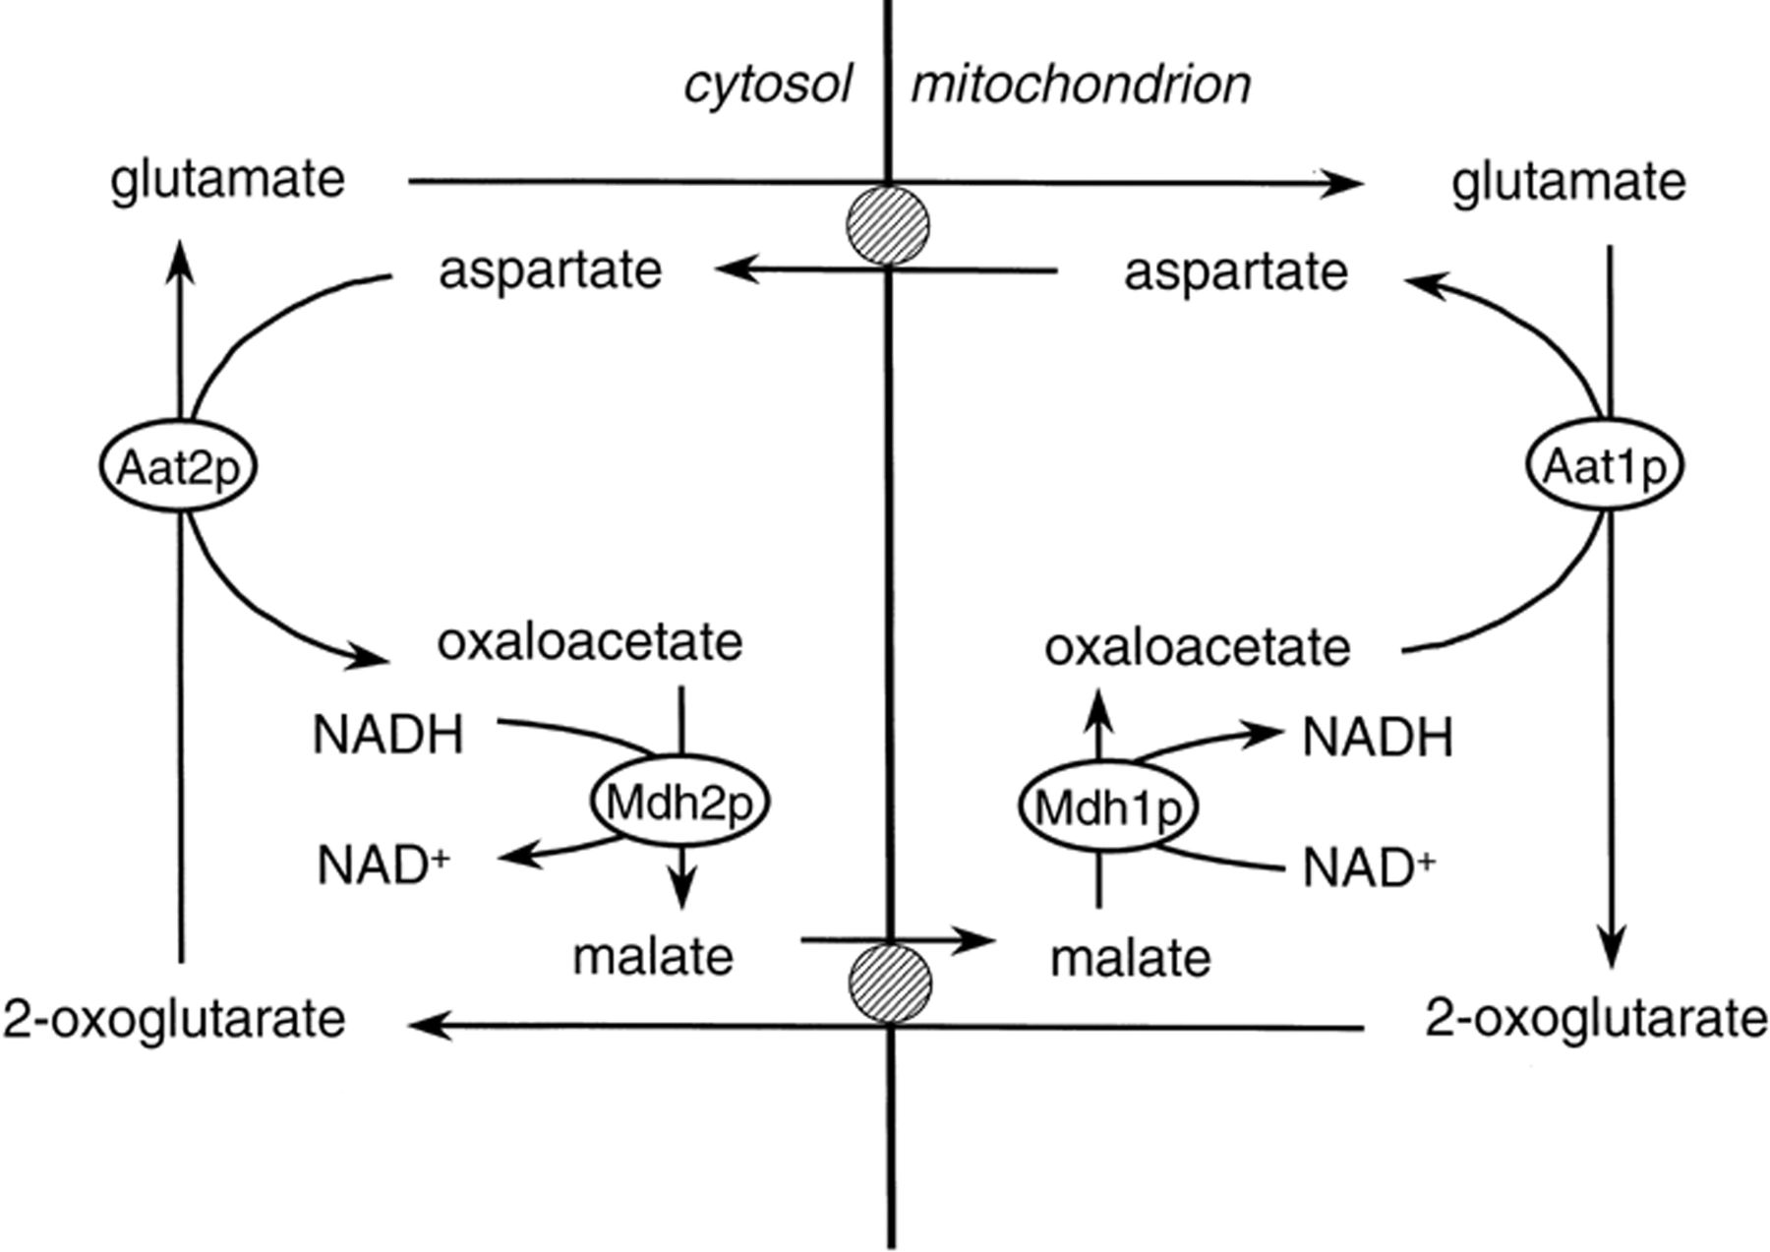
Figure 9 The malate–aspartate shuttle, exchanging cytosolic NADH for mitochondrial NAD⁺.
Notes:
Figure 9 The malate–aspartate shuttle, exchanging cytosolic NADH for mitochondrial NAD+.
Unless provided in the caption above, the following copyright applies to the content of this slide: © 2001 Federation of European Microbiological Societies.

Slide 9
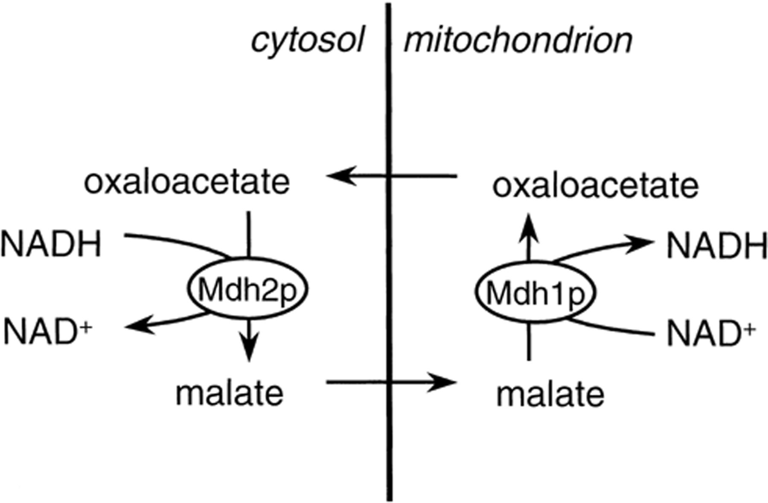
Figure 8 The malate–oxaloacetate shuttle, exchanging cytosolic NADH for mitochondrial NAD⁺.
Notes:
Figure 8 The malate–oxaloacetate shuttle, exchanging cytosolic NADH for mitochondrial NAD+.
Unless provided in the caption above, the following copyright applies to the content of this slide: © 2001 Federation of European Microbiological Societies.

Slide 10
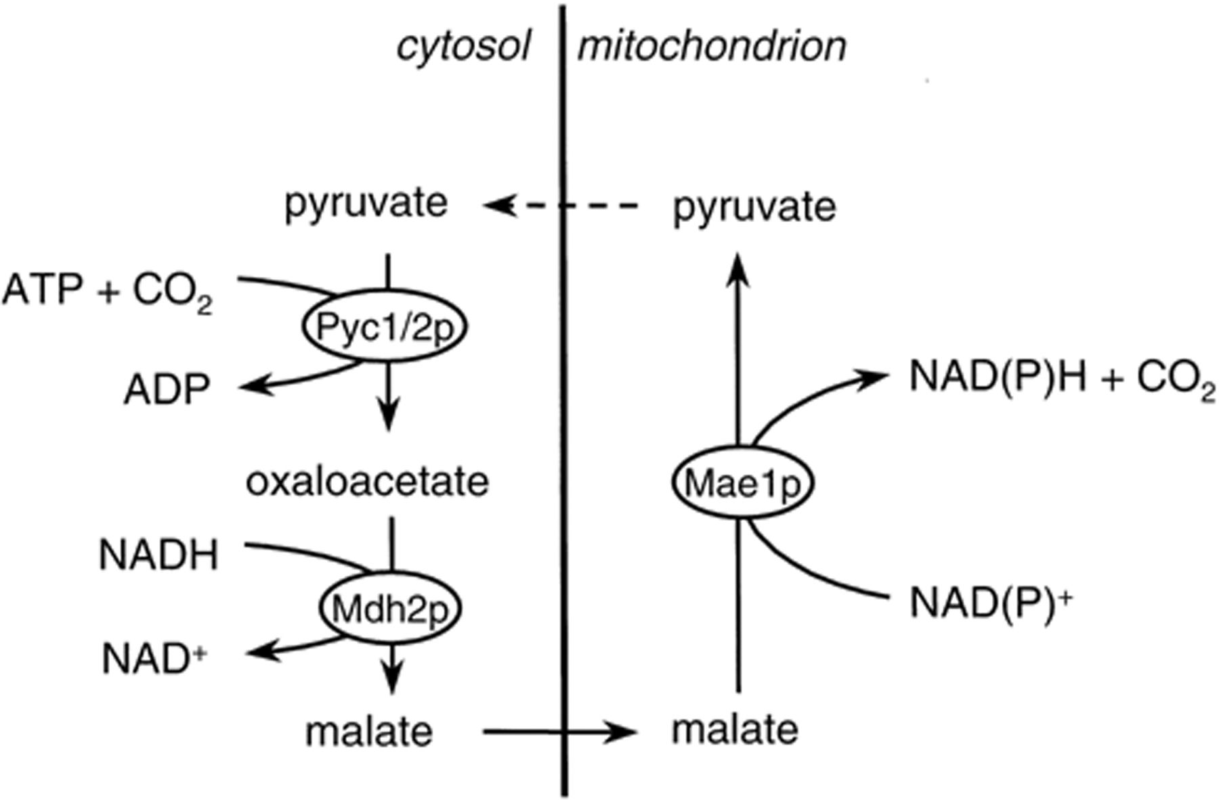
Figure 10 A hypothetical malate–pyruvate shuttle as it might work in S. cerevisiae, transferring electrons from ...
Notes:
Figure 10 A hypothetical malate–pyruvate shuttle as it might work in S. cerevisiae, transferring electrons from cytosolic NADH to mitochondrial NAD(P)H. The dashed line indicates that transport of pyruvate from the mitochondrial matrix to the cytosol is highly unlikely. Therefore, this shuttle is probably not closed, if it works at all (see text).
Unless provided in the caption above, the following copyright applies to the content of this slide: © 2001 Federation of European Microbiological Societies.

