Slide 1
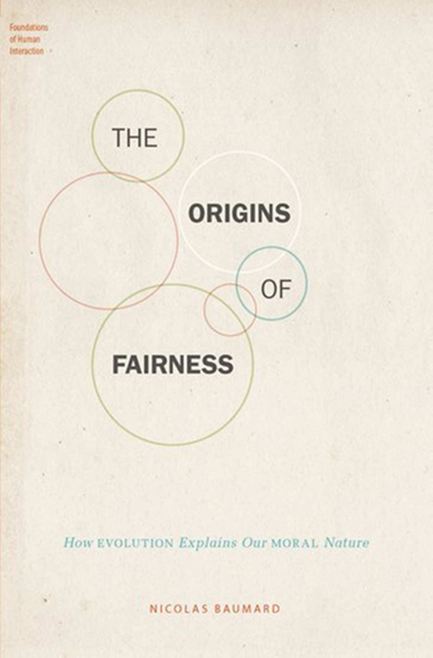
Notes:
Unless provided in the caption above, the following copyright applies to the content of this slide: © The Author(s) 2017. Published by Oxford University Press on behalf of the American Institute of Biological Sciences. All rights reserved. For permissions, please e-mail: journals.permissions@oup.com

