Slide 1
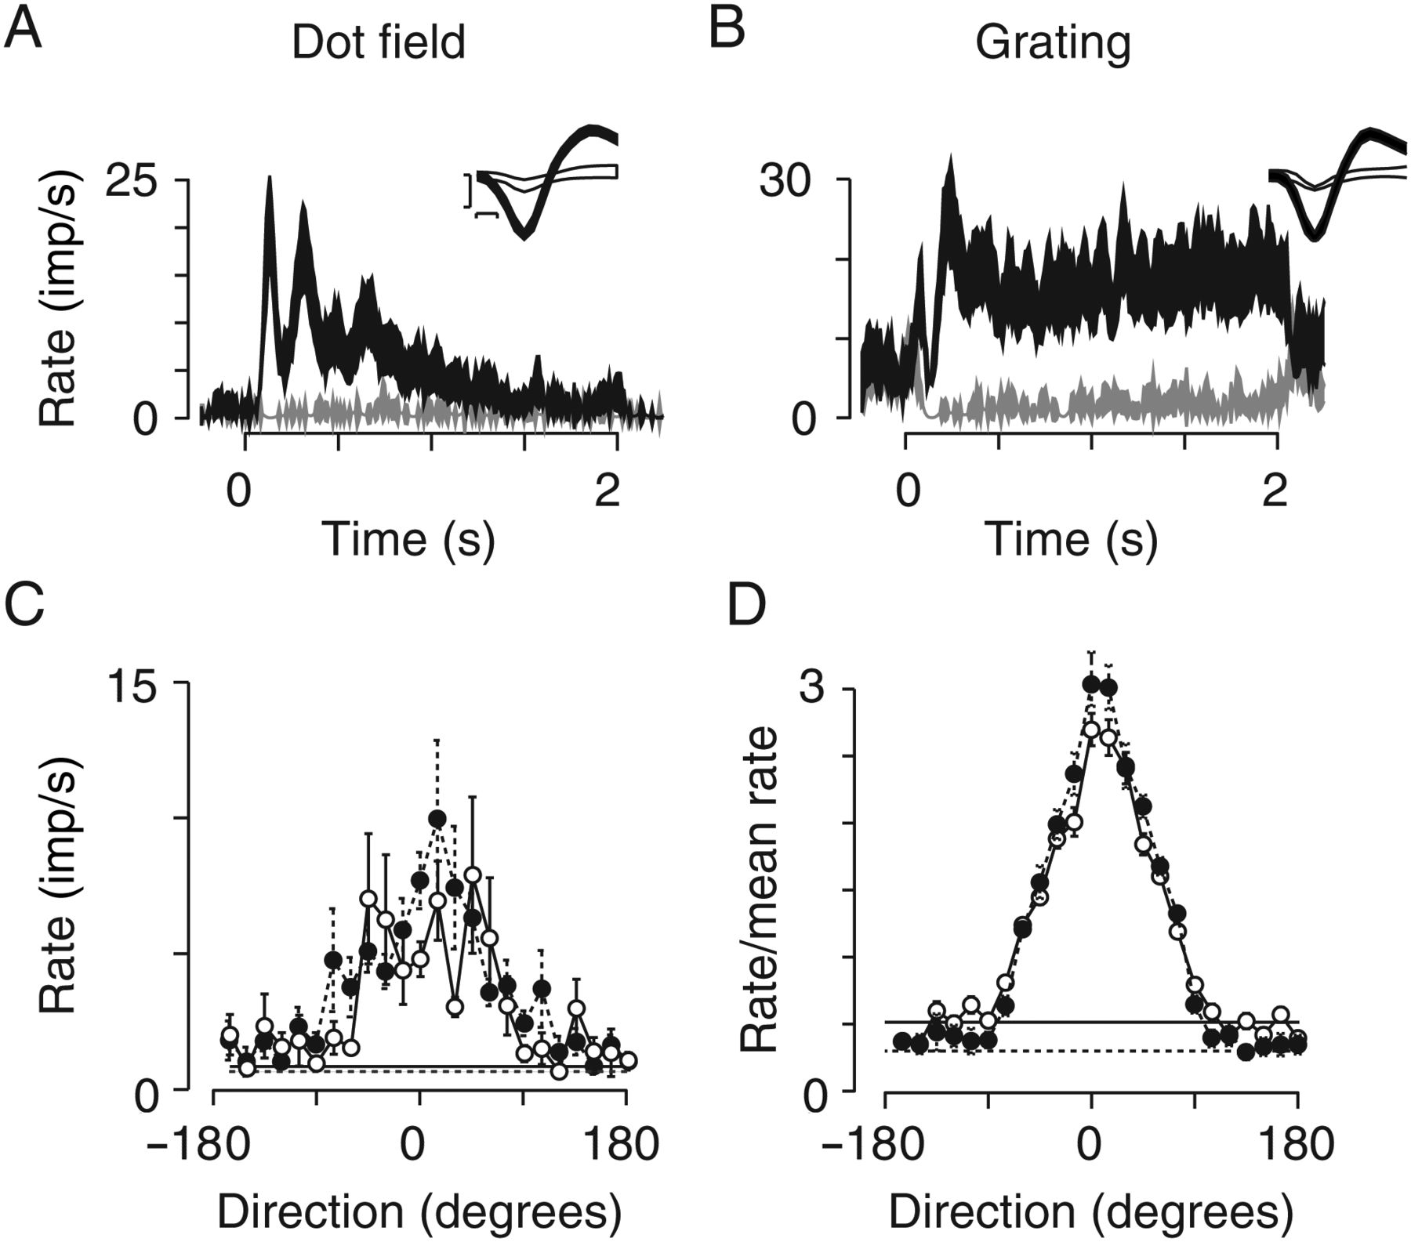
Figure 1. Visual responses of neurons in area MT of marmoset recorded with 10 × 10 electrode array. (A) Peri-stimulus ...
Notes:
Figure 1. Visual responses of neurons in area MT of marmoset recorded with 10 × 10 electrode array. (A) Peri-stimulus time histograms (PSTHs; bin width 10 ms) of response of representative neuron to moving dot fields (20 degree/s; dot diameter 0.4 degrees). Dark-filled trace shows average ±1 SEM of response to preferred stimulus over 100 trials. Light-filled trace shows same but for response to the opposite direction. Inset shows the average ±1 SD of spike waveform of the neuron (filled trace) and "multi-unit" activity on the same electrode (open trace). SNR of this waveform was 4.9. Scale bars are 0.1 ms (abscissa) and 0.1 mV (ordinate). (B) Response of another neuron to drifting gratings (0.2 cycles/degree, 4 Hz). Conventions as in (A) SNR of this waveform was 4.4. (C) Average response of MT neurons to moving dot fields (filled symbols; n = 114) and moving gratings (open symbols; n = 151). Responses are aligned such that the preferred direction is 0 degrees. Horizontal lines show average maintained discharge, obtained during measurements with dot fields (dashed line) or gratings (solid line). Error bars show ±1 SEM. (D) Average response of MT neurons to moving dot fields and moving gratings, when normalized to the mean response of each neuron across directions. Neurons and conventions as in (C).
Unless provided in the caption above, the following copyright applies to the content of this slide: © The Author 2014. Published by Oxford University Press. All rights reserved. For Permissions, please e-mail: journals.permissions@oup.com

Slide 2
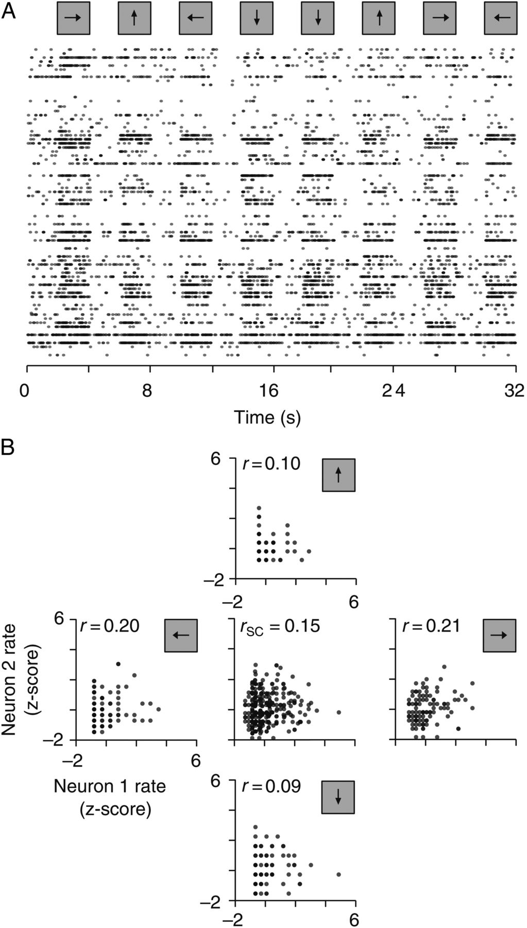
Figure 2. Illustrative data set and calculation of spike count correlations. (A) Raster plot of activity during ...
Notes:
Figure 2. Illustrative data set and calculation of spike count correlations. (A) Raster plot of activity during presentation of a moving dot field, for 60 neurons obtained from 1 implantation of a 10 × 10 array into area MT of 1 animal (case MY147). Each row shows 1 single-unit, and each dot 1 spike from that neuron. Every 4 s a field of white dots moved over a background of the mean luminance for 2 s. Otherwise, the screen was held at the mean luminance. Arrows at the top indicate the motion direction of the dot field on each trial. (B) Calculation of spike count correlation. Response of each neuron to each motion direction was transformed into z-scores. The 4 marginal plots compare the z-scored response for 2 neurons, for each of 4 directions of motion as indicated by the arrows. The associated Pearson's correlation is shown in each plot. The center plot compares z-scored responses for the same 2 neurons, collapsed over all directions: the associated Pearson's correlation is the spike count correlation, rSC.
Unless provided in the caption above, the following copyright applies to the content of this slide: © The Author 2014. Published by Oxford University Press. All rights reserved. For Permissions, please e-mail: journals.permissions@oup.com

Slide 3
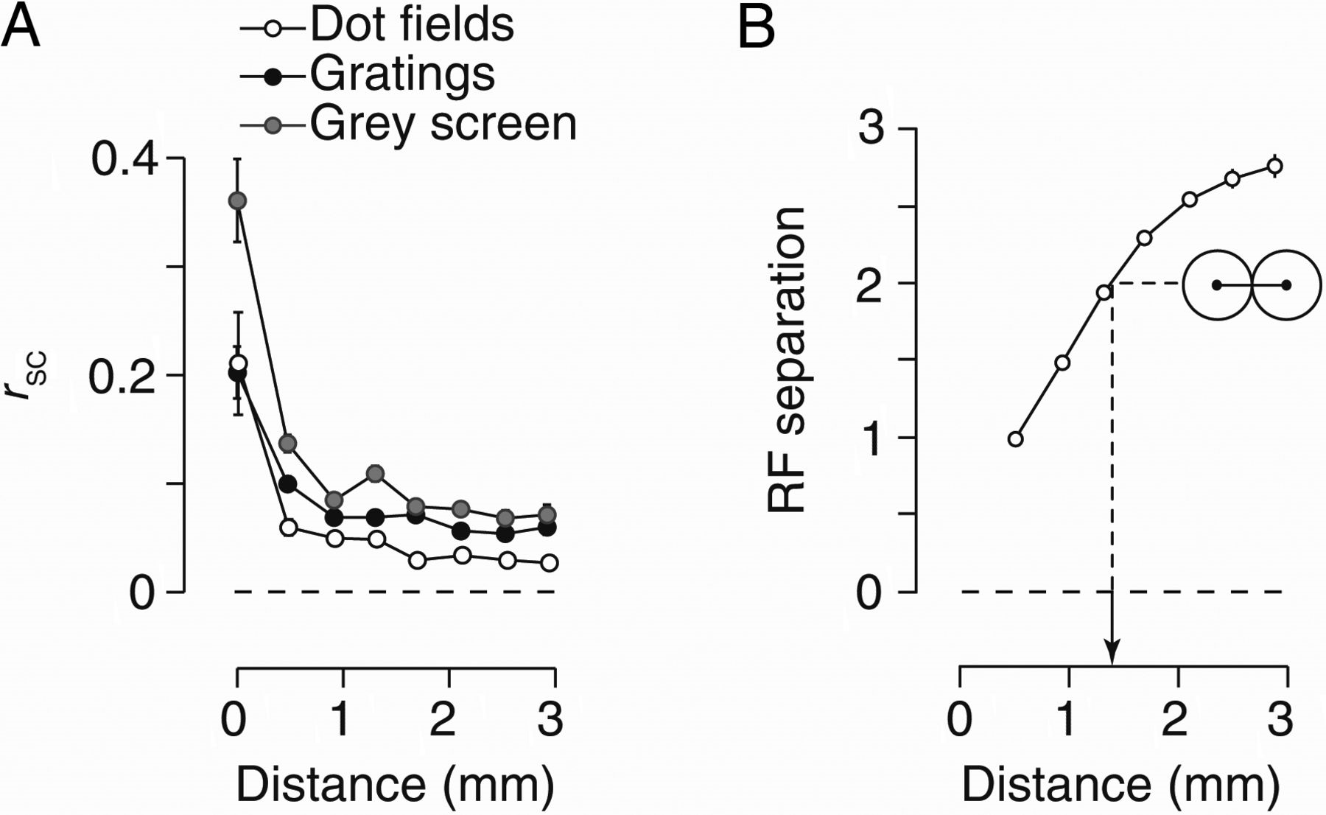
Figure 3. Spike count correlation (r_{SC}) decreases with distance. (A) Mean r_{SC} as a function of ...
Notes:
Figure 3. Spike count correlation (rSC) decreases with distance. (A) Mean rSC as a function of the cortical distance between neurons, during responses to a moving dot field (open circles; n = 1738), moving grating (filled black circles; n = 1858), or a gray screen presented between trials of moving gratings (filled gray circles). Error bars show ±1 SEM and are often smaller than the symbols. We were conservative when isolating single-units and identified 18 (dot fields) or 43 (gratings) pairs of neurons from a single electrode. Values at cortical distances greater than 0 are obtained from an average of 253 pairs (range 110–360). (B) Mean receptive field (RF) separation between pairs of electrodes (n = 12 528), as a function of cortical distance. Calculation of RF separation is described in Materials and Methods. Inset shows representation of a pair of receptive fields that are circular and equal in diameter, which touch but do not overlap.
Unless provided in the caption above, the following copyright applies to the content of this slide: © The Author 2014. Published by Oxford University Press. All rights reserved. For Permissions, please e-mail: journals.permissions@oup.com

Slide 4
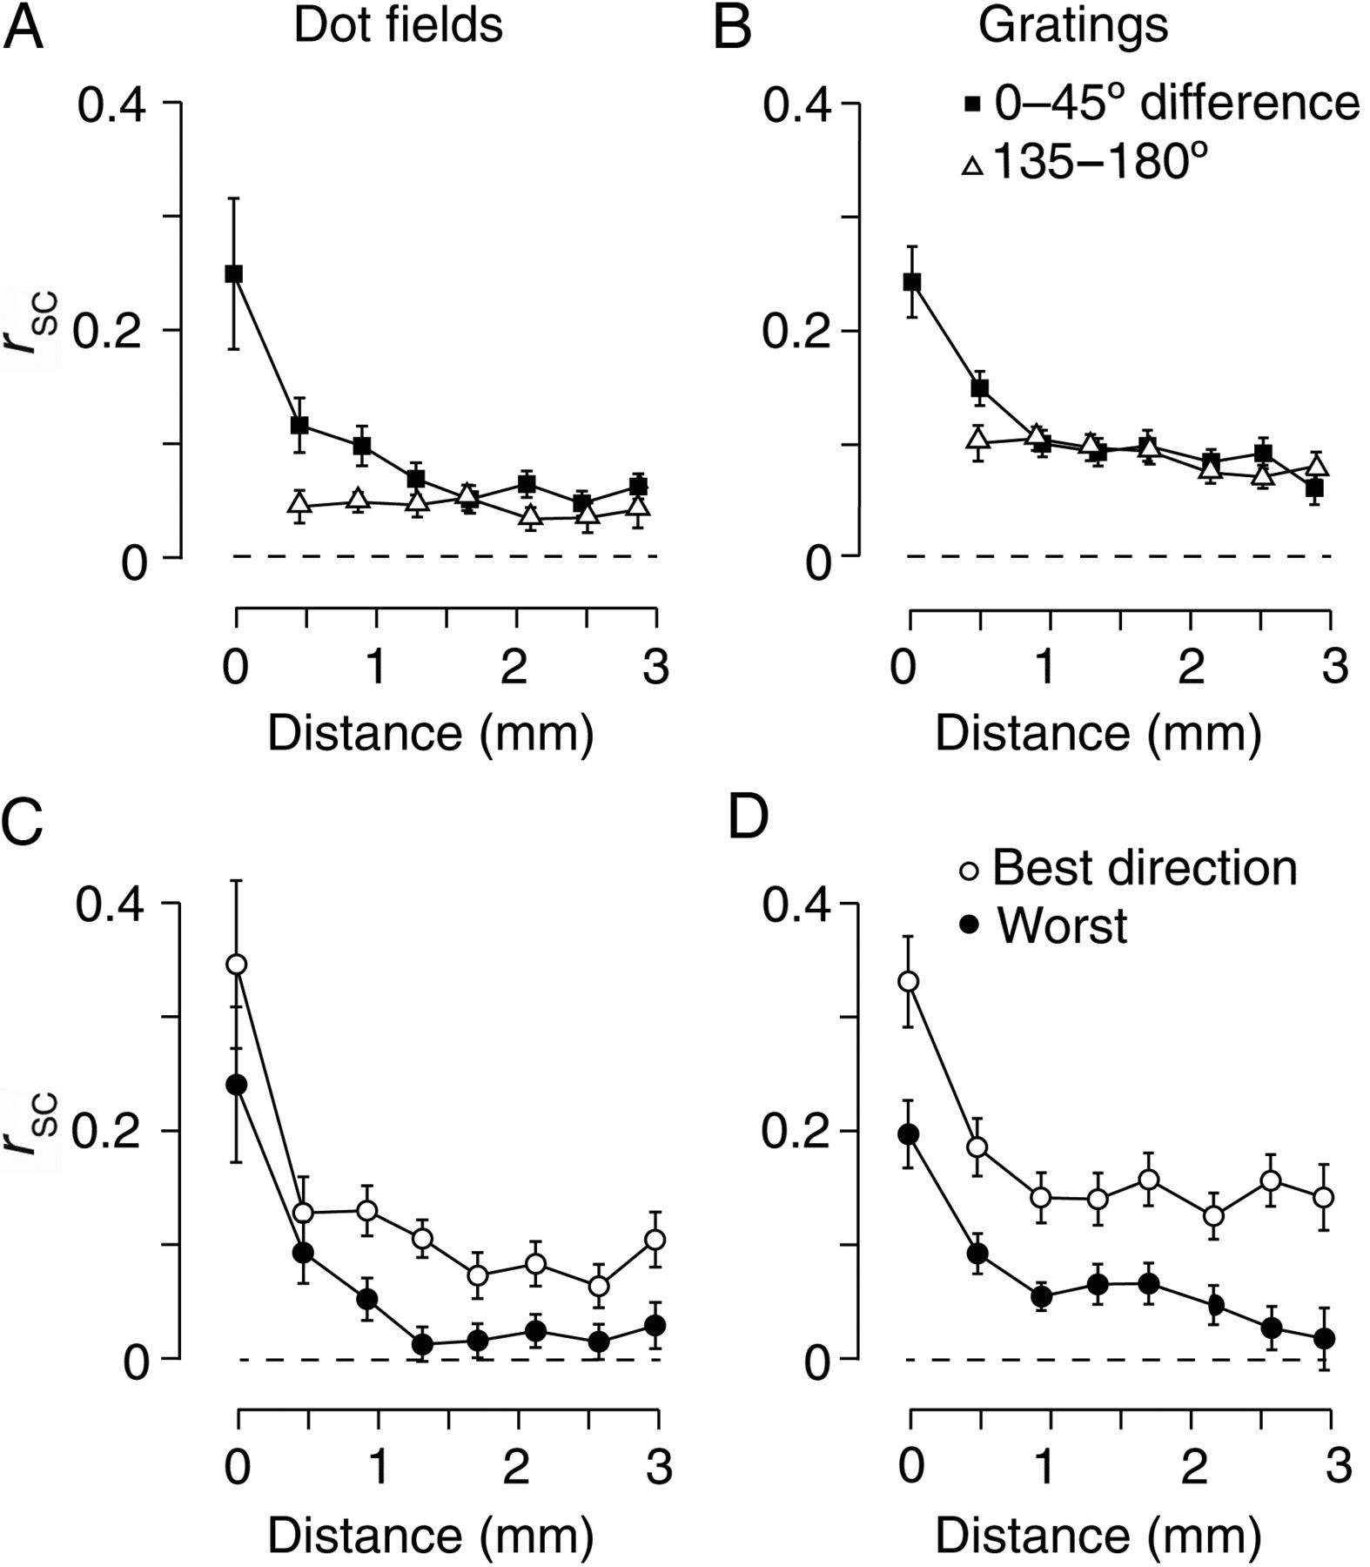
Figure 4. Spike count correlation depends on preferred motion direction and stimulus direction. (A) Mean r_{SC} ...
Notes:
Figure 4. Spike count correlation depends on preferred motion direction and stimulus direction. (A) Mean rSC during presentation of moving dot fields, for pairs of neurons with similar direction preference (squares, n = 434) and different direction preference (triangles, n = 417). Error bars show ±1 SEM. (B) Mean rSC during presentation of a moving grating (similar direction preference, n = 476; different direction preferences n = 470). Conventions as in (A). (C) Mean rSC during presentation of moving dot fields, for pairs of neurons with similar preferred motion direction (<45 degrees apart; n = 434). Open symbols show rSC for the most effective motion direction; closed symbols show rSC for the least effective motion direction. Error bars show ±1 SEM. (D) Same as (C) but during presentation of a moving grating (n = 476). Conventions as in (C).
Unless provided in the caption above, the following copyright applies to the content of this slide: © The Author 2014. Published by Oxford University Press. All rights reserved. For Permissions, please e-mail: journals.permissions@oup.com

Slide 5
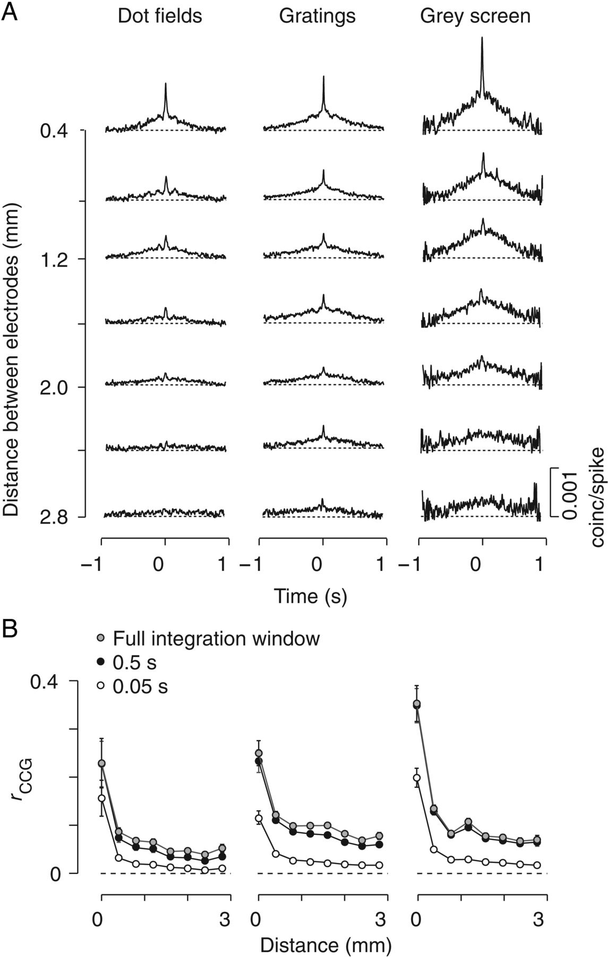
Figure 5. Correlations at all timescales decay with distance. (A) Shuffle-corrected cross-correlograms (CCGs) as a ...
Notes:
Figure 5. Correlations at all timescales decay with distance. (A) Shuffle-corrected cross-correlograms (CCGs) as a function of distance. CCGs were computed over 2 s during presentation of moving dot fields (left, n = 1858), or moving gratings (middle, n = 1738). CCGs in the right column were computed over the 1 s of gray screen presented between successive trials of moving gratings (n = 1738). For display purposes, CCGs were smoothed with a Gaussian filter (SD 0.005 s). (B) Mean rCCG as a function of distance, for integration windows of 0.05 s (open circles), 0.5 s (black circles) or the maximum achievable integration window (gray circles). This was 2 s for dot fields (left) or gratings (middle) and 1 s for the gray screen (right). Same neurons as (A). Error bars show ±1 SEM.
Unless provided in the caption above, the following copyright applies to the content of this slide: © The Author 2014. Published by Oxford University Press. All rights reserved. For Permissions, please e-mail: journals.permissions@oup.com

Slide 6
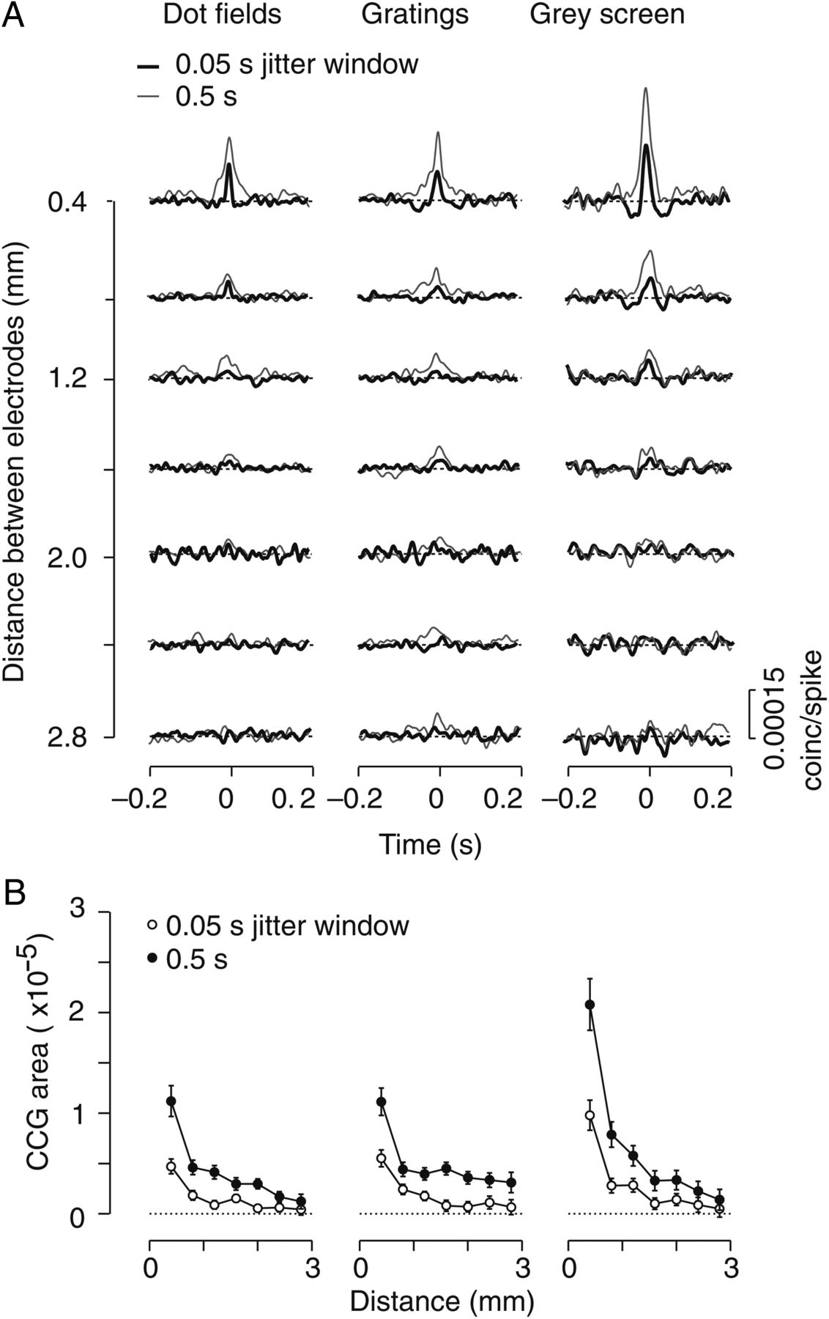
Figure 6. Near-synchronous activity is confined to nearby neurons. (A) Mean jitter-corrected CCGs, for jitter windows ...
Notes:
Figure 6. Near-synchronous activity is confined to nearby neurons. (A) Mean jitter-corrected CCGs, for jitter windows of 0.05 s (black) and 0.5 s (gray) during presentations of moving dot fields (left), moving gratings (middle), or a gray screen (right column). Same neurons as Figure 5A. (B) Mean of area under the jitter-corrected CCGs (±0.01 s), for jitter windows of 0.05 s (open circles) and 0.5 s (filled circles). Same neurons as (A). Error bars show ±1 SEM.
Unless provided in the caption above, the following copyright applies to the content of this slide: © The Author 2014. Published by Oxford University Press. All rights reserved. For Permissions, please e-mail: journals.permissions@oup.com

Slide 7
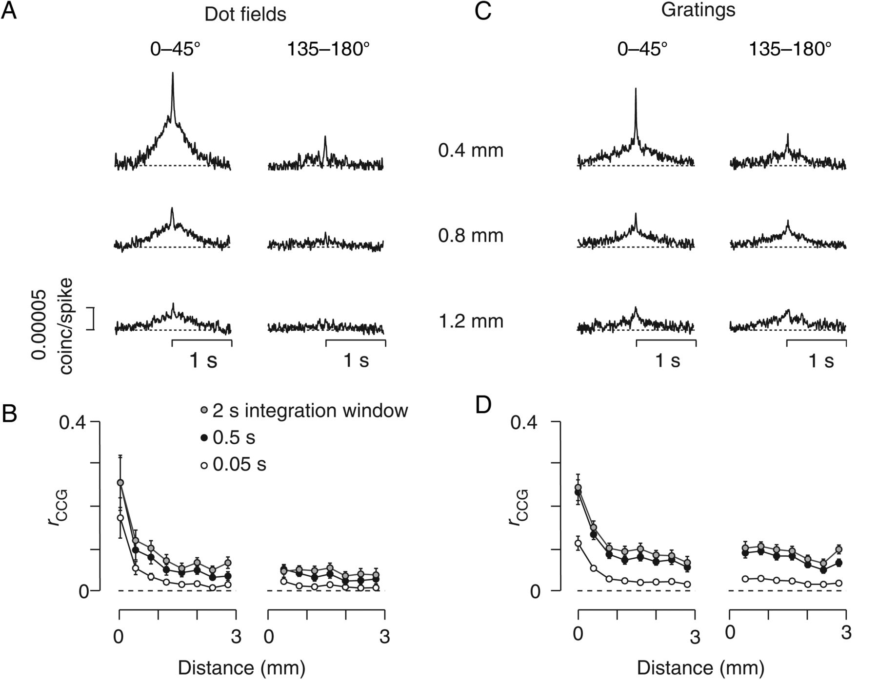
Figure 7. Dependence of correlations on preferred motion direction. (A,B) During presentations of moving dot fields. ...
Notes:
Figure 7. Dependence of correlations on preferred motion direction. (A,B) During presentations of moving dot fields. (A) Mean shuffle-corrected CCGs for pairs of neurons grouped according to the cortical distance between them (0.4, 0.8, or 1.2 mm) and by the difference in the preferred motion direction. (B) Mean rCCG for integrating time windows of 0.05, 0.5, and 2 s as a function of cortical distance. Error bars show ±1 SEM. Same neurons as (A). (C,D) Same as (A) and (B) but during presentations of drifting gratings.
Unless provided in the caption above, the following copyright applies to the content of this slide: © The Author 2014. Published by Oxford University Press. All rights reserved. For Permissions, please e-mail: journals.permissions@oup.com

Slide 8
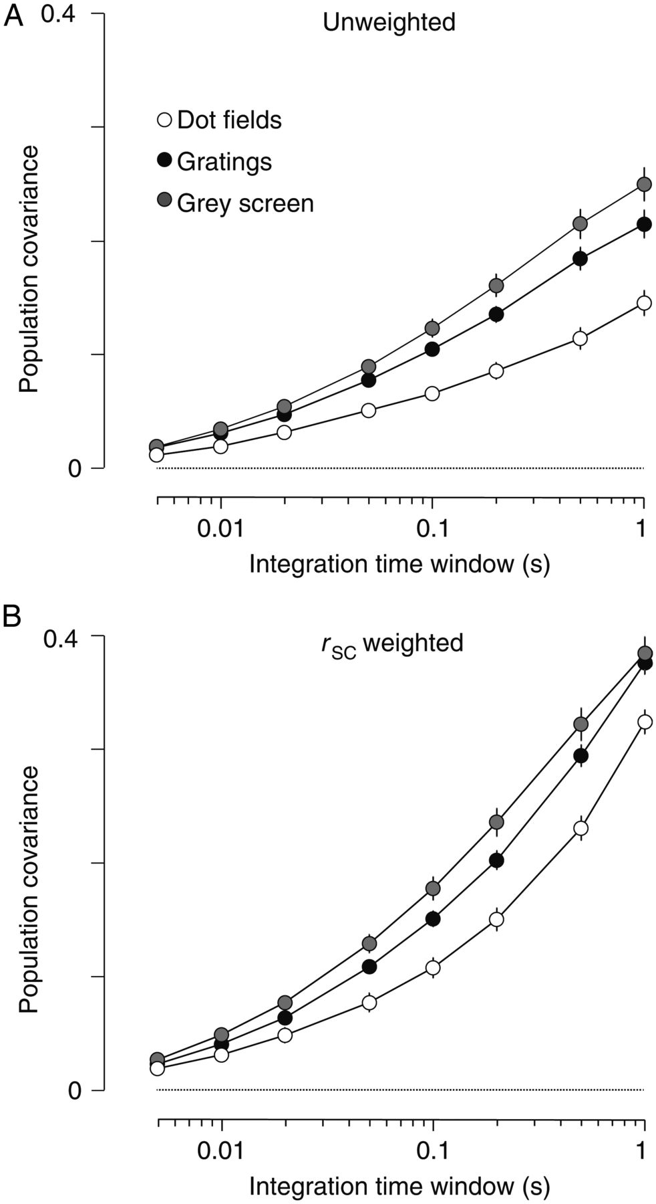
Figure 8. Visual modulation of population covariance. (A) Mean population covariance as a function of integration time ...
Notes:
Figure 8. Visual modulation of population covariance. (A) Mean population covariance as a function of integration time window, when all neurons in the population were given equal weights, during presentation of moving dot fields (open circles, n = 151), moving gratings (black circles, n = 114), and a gray screen presented between trials of moving gratings (gray circle, n = 114). (B) Same as (A) but when neural contributions to population response were weighted by the pair-wise noise correlation with the target neuron, rSC. Same neurons as in (A).
Unless provided in the caption above, the following copyright applies to the content of this slide: © The Author 2014. Published by Oxford University Press. All rights reserved. For Permissions, please e-mail: journals.permissions@oup.com

Slide 9
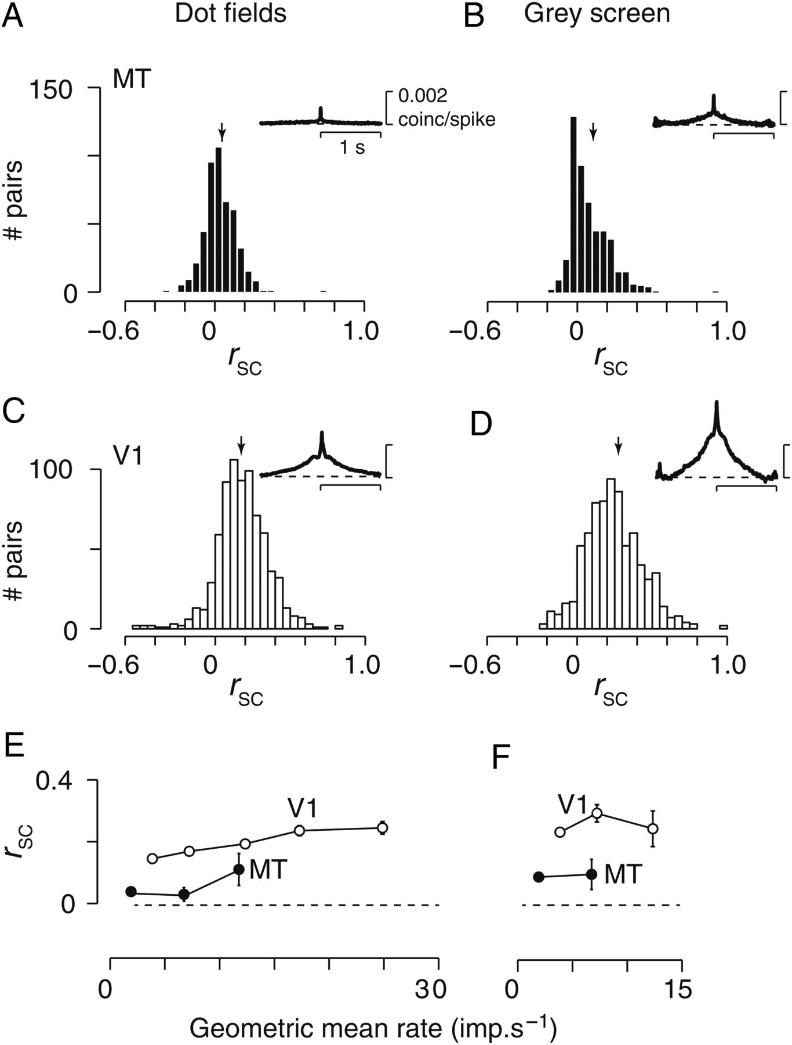
Figure 9. Correlations are lower in area MT than in area V1. (A) Distribution of spike count correlation ...
Notes:
Figure 9. Correlations are lower in area MT than in area V1. (A) Distribution of spike count correlation (rSC) in area MT during presentation of a moving dot field. Recordings were obtained with laminar probes and include all neurons that passed response criterion. Arrow shows mean rSC across all pairs (n = 483). The inset shows the mean CCG across the same neurons. Scale bars are 1 s (abscissa) and 0.002 coincidences/spike (ordinate). For display purposes, CCGs were smoothed with a Gaussian filter (SD 0.005 s). (B) Same as (A) but during presentation of a gray screen. Same neurons as (A). (C,D) Same as (A,B) but for pairs of neurons (n = 756) obtained from laminar probes implanted into area V1. (E) Mean rSC as a function of geometric mean spike rate for pairs of neurons in area V1 (open circles) and area MT (filled circles). The stimulus was a moving dot field. (F) Same as (E) but during presentation of a gray screen.
Unless provided in the caption above, the following copyright applies to the content of this slide: © The Author 2014. Published by Oxford University Press. All rights reserved. For Permissions, please e-mail: journals.permissions@oup.com

