Slide 1
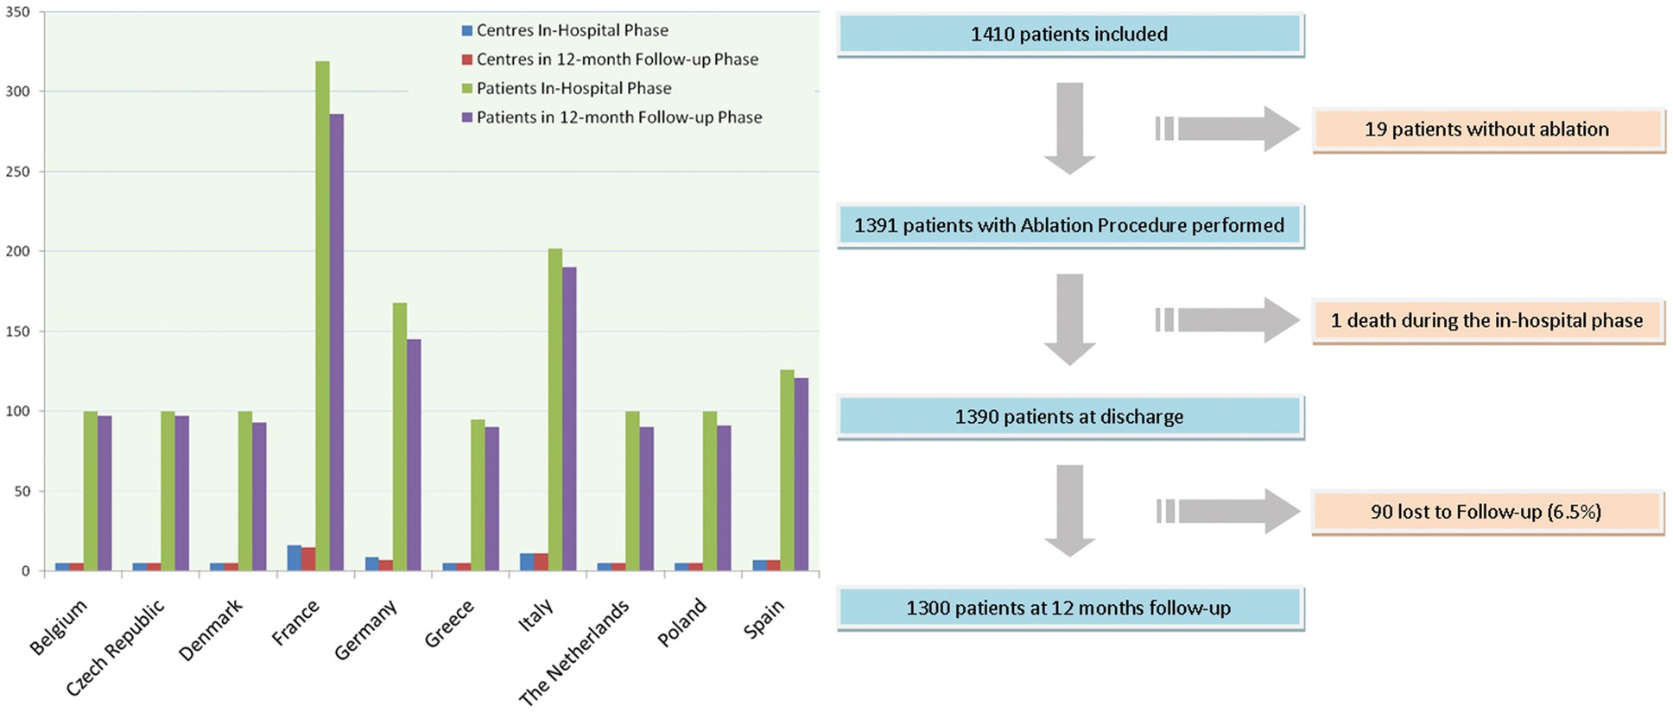
Figure 1 Distribution of centres and patients included in the Atrial Fibrillation Ablation Pilot by country.
Notes:
Figure 1 Distribution of centres and patients included in the Atrial Fibrillation Ablation Pilot by country.
Unless provided in the caption above, the following copyright applies to the content of this slide: Published on behalf of the European Society of Cardiology. All rights reserved. © The Author 2014. For permissions please email: journals.permissions@oup.com.

Slide 2
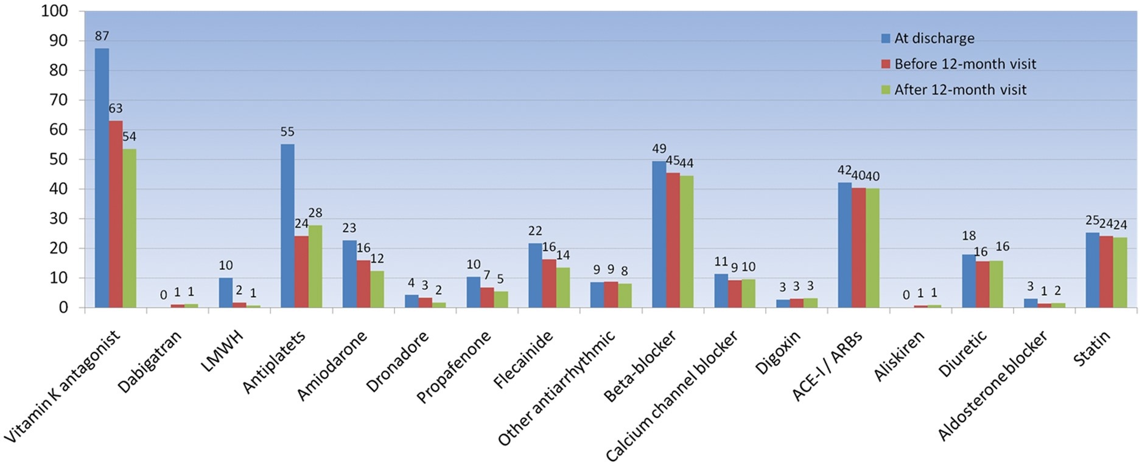
Figure 2 Rate of use of pharmacological treatment at discharge and at the 12-month follow-up.
Notes:
Figure 2 Rate of use of pharmacological treatment at discharge and at the 12-month follow-up.
Unless provided in the caption above, the following copyright applies to the content of this slide: Published on behalf of the European Society of Cardiology. All rights reserved. © The Author 2014. For permissions please email: journals.permissions@oup.com.

Slide 3
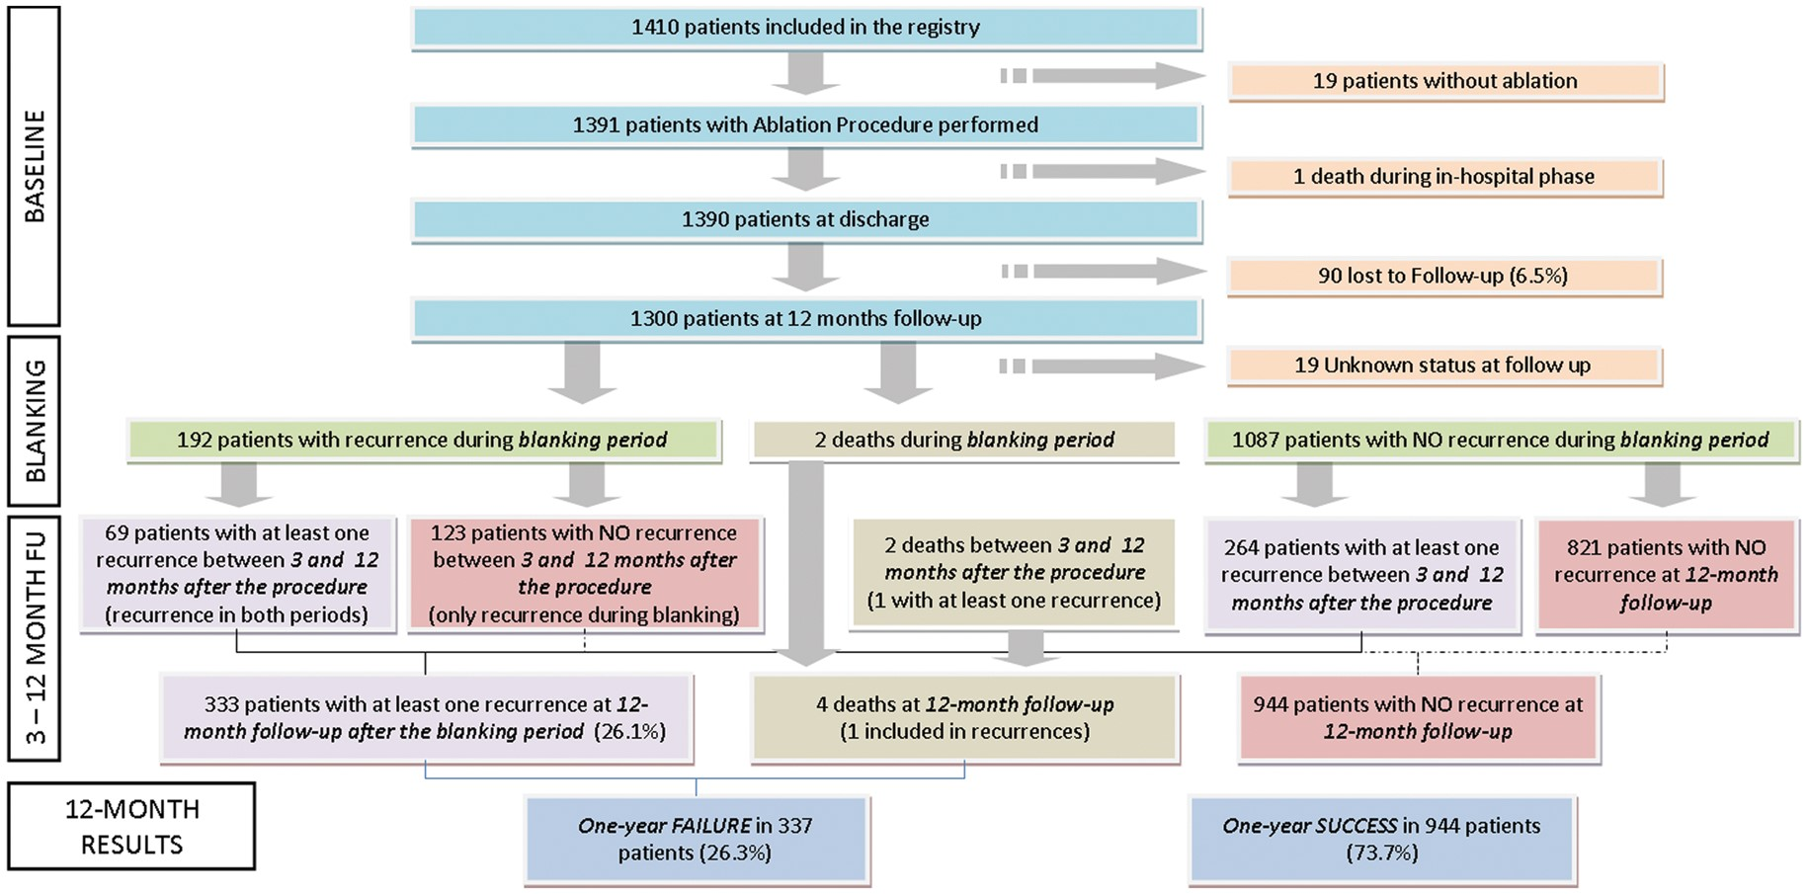
Figure 3 Flowchart representing numbers of individuals at each stage of the study.
Notes:
Figure 3 Flowchart representing numbers of individuals at each stage of the study.
Unless provided in the caption above, the following copyright applies to the content of this slide: Published on behalf of the European Society of Cardiology. All rights reserved. © The Author 2014. For permissions please email: journals.permissions@oup.com.

Slide 4
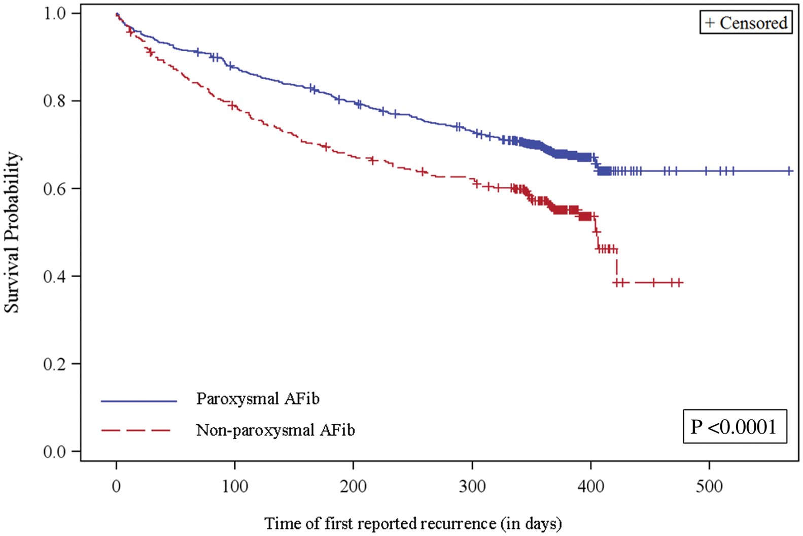
Figure 4 Kaplan– Meier arrhythmia-free survival curve by type of atrial fibrillation.
Notes:
Figure 4 Kaplan– Meier arrhythmia-free survival curve by type of atrial fibrillation.
Unless provided in the caption above, the following copyright applies to the content of this slide: Published on behalf of the European Society of Cardiology. All rights reserved. © The Author 2014. For permissions please email: journals.permissions@oup.com.

