Slide 1
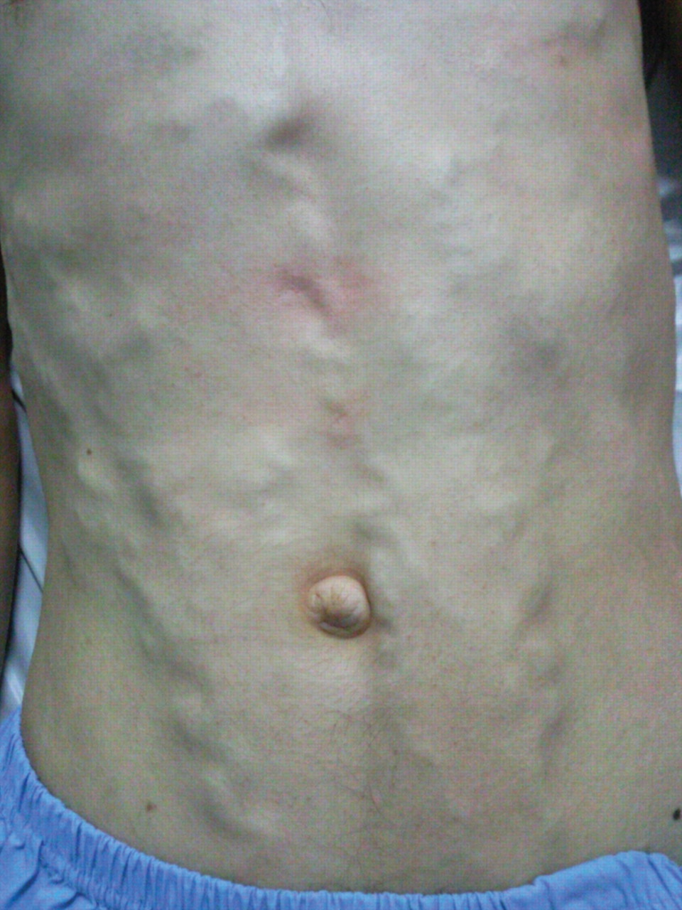
Figure 1 The venous distention seen over chest and abdomen.
Notes:
Figure 1 The venous distention seen over chest and abdomen.
Unless provided in the caption above, the following copyright applies to the content of this slide: Published on behalf of the European Society of Cardiology. All rights reserved. © The Author 2011. For permissions please email: journals.permissions@oup.com

Slide 2
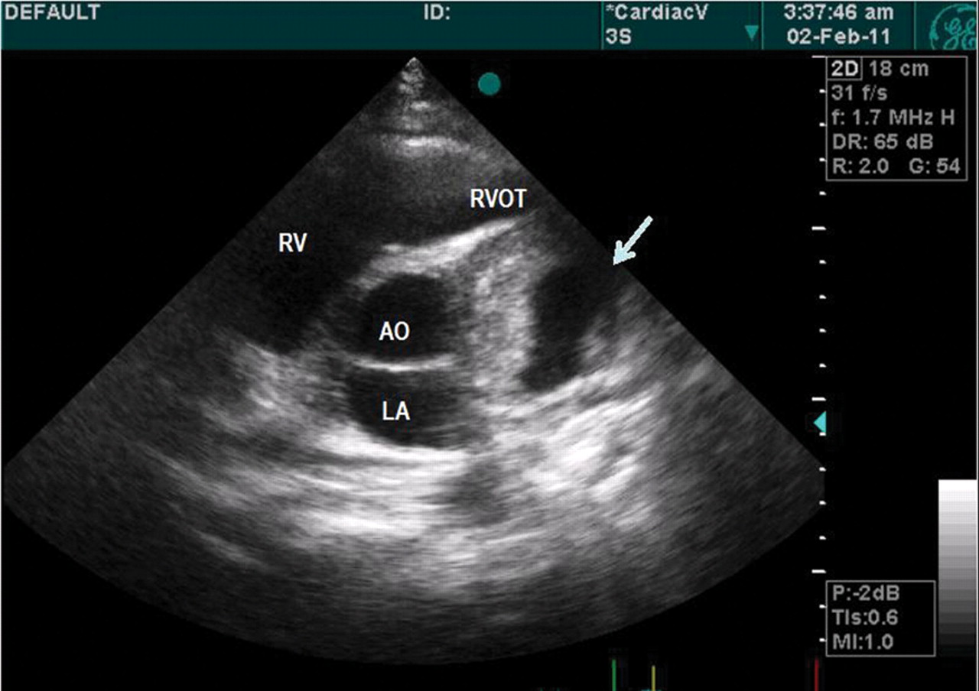
Figure 2 Transthoracic echocardiographic appearance of the mass. It should be noted that the mass is surrounded by ...
Notes:
Figure 2 Transthoracic echocardiographic appearance of the mass. It should be noted that the mass is surrounded by aorta, left atrium, and pulmonary artery. Different positions of the transducer also revealed that the mass is anterolateral to the left ventricle. LA, left atrium; Ao, aortic valve; RVOT, right ventricular outflow tract; RV, right ventricle.
Unless provided in the caption above, the following copyright applies to the content of this slide: Published on behalf of the European Society of Cardiology. All rights reserved. © The Author 2011. For permissions please email: journals.permissions@oup.com

Slide 3
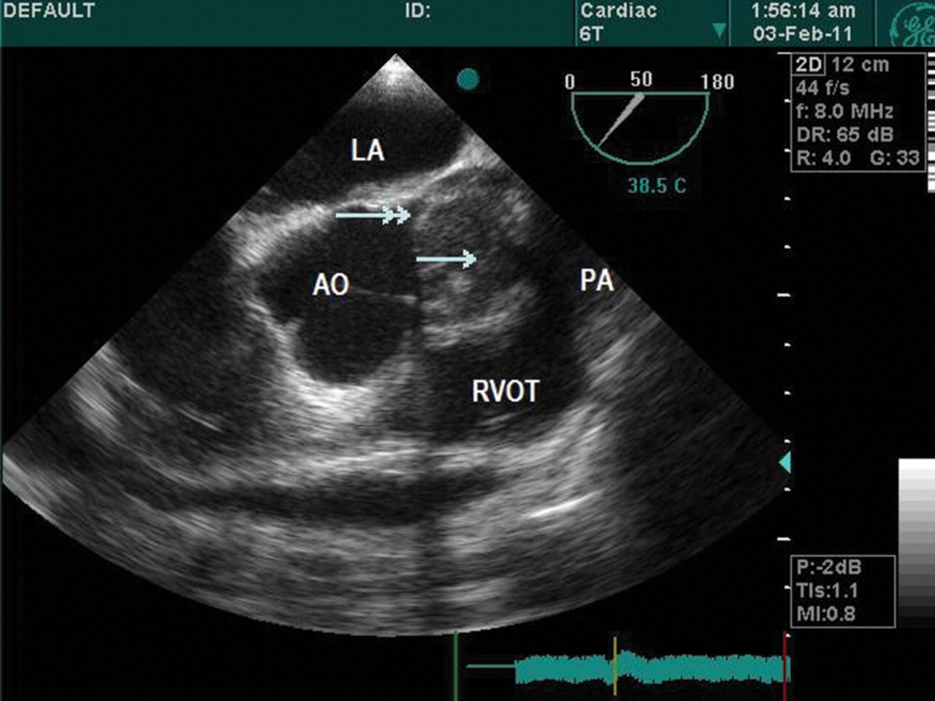
Figure 3 Transoesophageal echocardiographic appearance of the mass. Single-headed arrow indicates the mass, while ...
Notes:
Figure 3 Transoesophageal echocardiographic appearance of the mass. Single-headed arrow indicates the mass, while double-headed arrow indicates the left main coronary artery. LA, left atrium; Ao, aortic valve; RVOT, right ventricular outflow tract; PA, pulmonary artery.
Unless provided in the caption above, the following copyright applies to the content of this slide: Published on behalf of the European Society of Cardiology. All rights reserved. © The Author 2011. For permissions please email: journals.permissions@oup.com

Slide 4
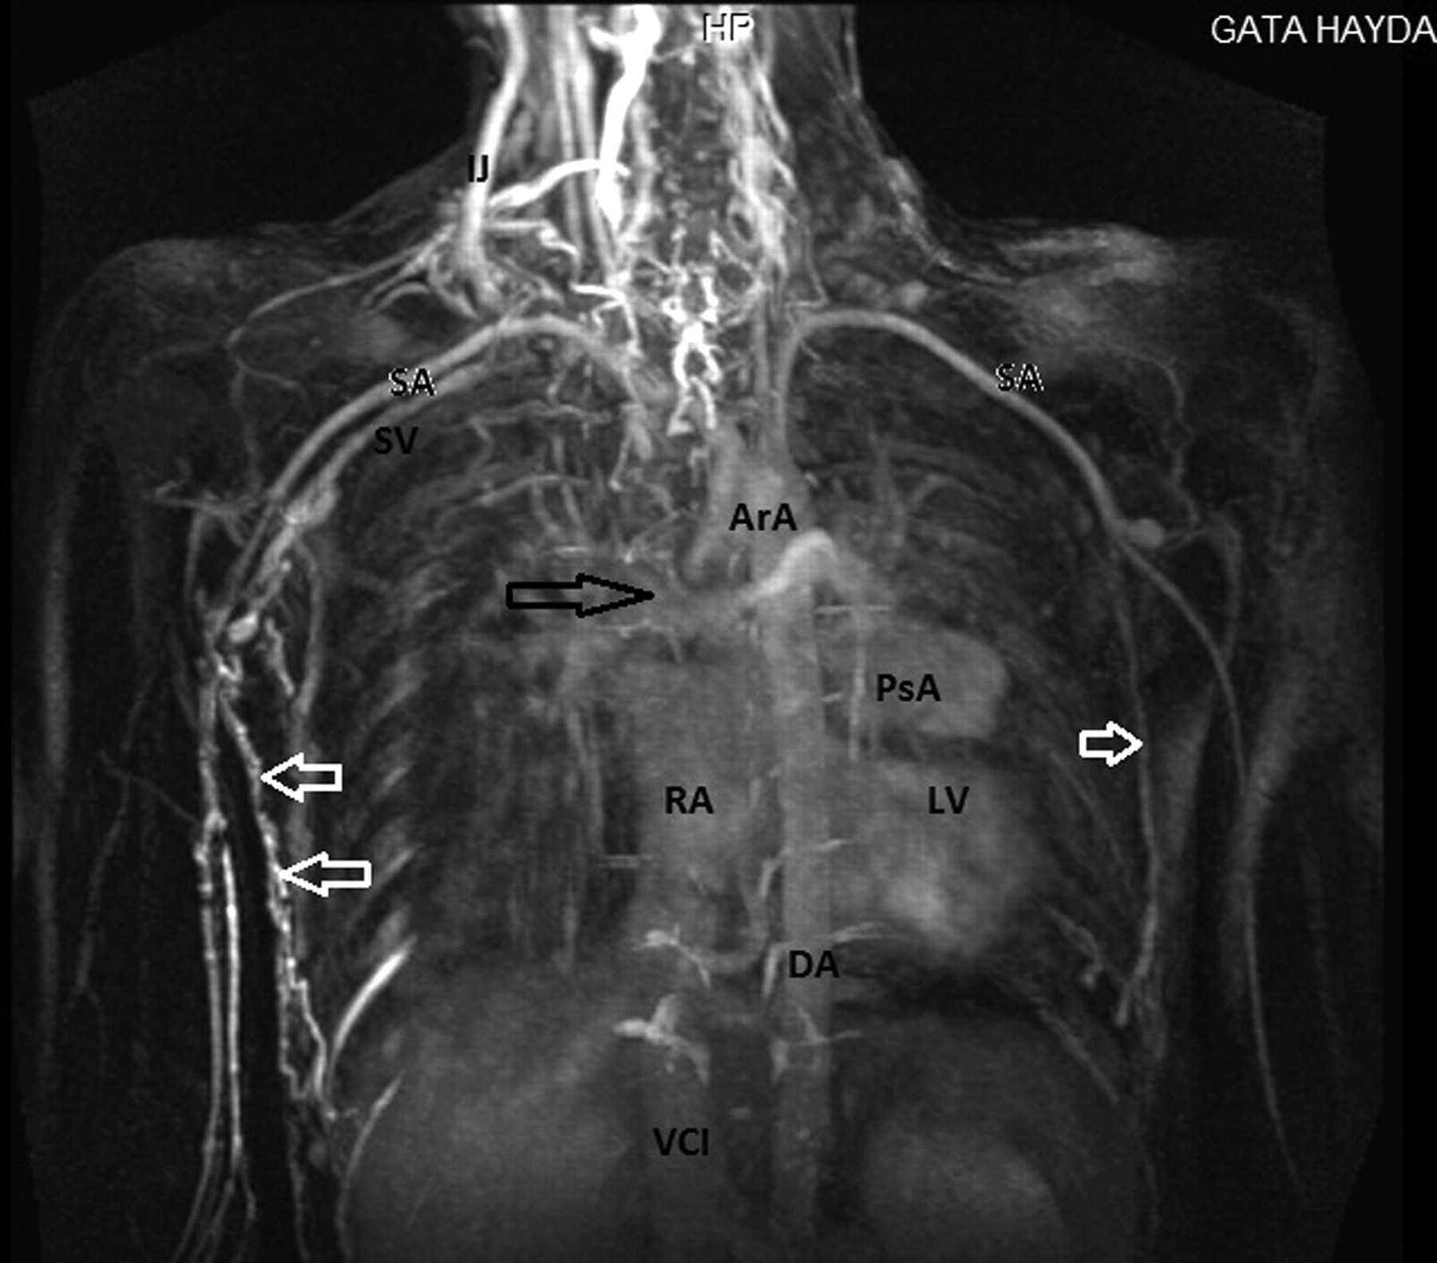
Figure 4 In the magnetic resonance imaging of the venous system, the superior vena cava could not be imaged. The black ...
Notes:
Figure 4 In the magnetic resonance imaging of the venous system, the superior vena cava could not be imaged. The black arrow shows where vena cava superior should have been. The white arrows indicate the collateral veins. It should be noted that the left subclavian vein is also occluded. SA, subclavian artery; SV, subclavian vein; ArA, arcus aorta; RA, right atrium; DA, descending aorta; VCI, vena cava inferior; LV, left ventricle; PsA, coronary pseudoaneurysm; IJ, internal jugular vein.
Unless provided in the caption above, the following copyright applies to the content of this slide: Published on behalf of the European Society of Cardiology. All rights reserved. © The Author 2011. For permissions please email: journals.permissions@oup.com

Slide 5
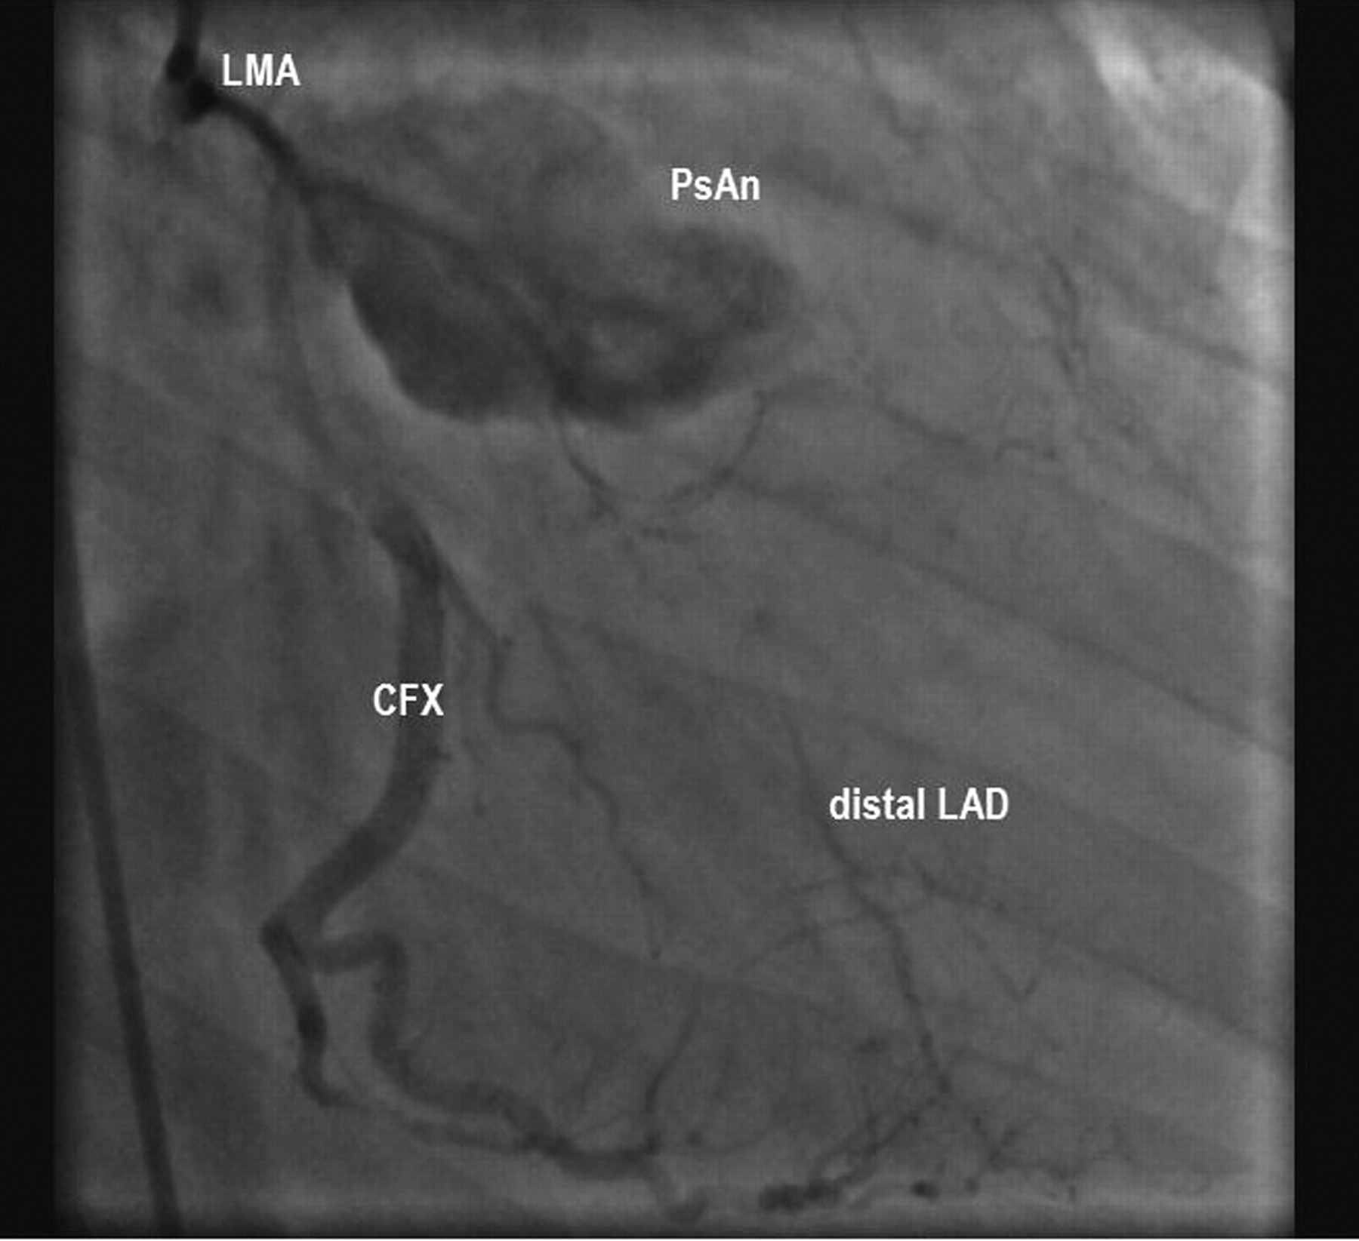
Figure 5 Coronary angiographic image of the coronary pseudoaneurysm. LMA, left main coronary artery; CFX, circumflex ...
Notes:
Figure 5 Coronary angiographic image of the coronary pseudoaneurysm. LMA, left main coronary artery; CFX, circumflex artery; LAD, left anterior descending artery; PsAn, coronary pseudoaneurysm.
Unless provided in the caption above, the following copyright applies to the content of this slide: Published on behalf of the European Society of Cardiology. All rights reserved. © The Author 2011. For permissions please email: journals.permissions@oup.com

Slide 6
Figure 6 Histological view of the lymph node. (A) Small follicles with hyalinized germinal centres; (B) a follicle ...
Notes:
Figure 6 Histological view of the lymph node. (A) Small follicles with hyalinized germinal centres; (B) a follicle with targetoid appearance; (C) penetrating vessels through germinal centres causing so-called ‘lollipop’ appearance.
Unless provided in the caption above, the following copyright applies to the content of this slide: Published on behalf of the European Society of Cardiology. All rights reserved. © The Author 2011. For permissions please email: journals.permissions@oup.com

