Slide 1
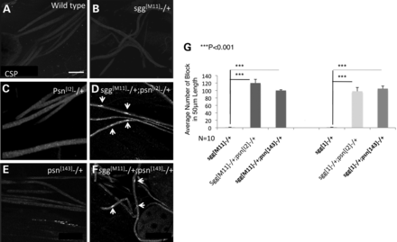
Figure 1. PS genetically interacts with GSK-3β. Heterozygous sgg^{[M11]}−/+ (B), psn^{[I2]}−/+ (C) or ...
Notes:
Figure 1. PS genetically interacts with GSK-3β. Heterozygous sgg[M11]−/+ (B), psn[I2]−/+ (C) or psn[143]−/+ (E) larvae do not show axonal blockages and were comparable with WT larvae (A). Fifty percentage reduction of SGG with 50% reduction of PS (sgg[M11]−/+; psn[I2]−/+, (D), or sgg[M11]−/+; psn[143]−/+, (F) showed a significant amount of axonal blockages (arrows). (G) Quantification analysis indicated a statistically significant increase in the amount of axonal blockages with 50% reduction of PS (sgg[M11]−/+; psn[I2]−/+ or sgg[M11]−/+; psn[143]−/+, P < 0.001) compared with sgg[M11]−/+, or psn[I2]−/+ or psn[143] −/+ alone. Similar results were seen in sgg[1]−/+; psn[I2]−/+ or sgg[1]−/+; psn[143]−/+ larvae (P < 0.001). N = 10 for each genotype. Bar = 10 µm.
Unless provided in the caption above, the following copyright applies to the content of this slide: © The Author 2013. Published by Oxford University Press. All rights reserved. For Permissions, please email: journals.permissions@oup.com

Slide 2
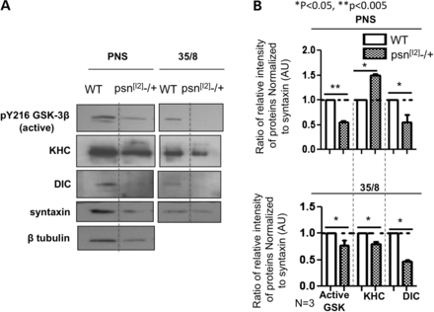
Figure 2. Reduction of PS decreases membrane binding of active GSK-3β. (A) Subcellular fractionation of third instar ...
Notes:
Figure 2. Reduction of PS decreases membrane binding of active GSK-3β. (A) Subcellular fractionation of third instar larval brain membranes on sucrose step gradients indicated that reduction of PS (psn[I2]−/+) decreased the level of active GSK-3β that was associated with light membranes (membrane fraction, 35/8) compared with WT brains. The antibody against active GSK-3β (pY216 GSK-3β) was used. Note that this observation was similar to what was seen with reduction of sgg (sgg[M11]−/+, Fig. 4F). The levels of KHC and DIC were also decreased in the membrane fraction from psn[I2]−/+ brains compared with WT brains. (B) Quantification analysis indicated that the extent of the decrease seen in active GSK-3β, KHC or DIC in the 35/8 fraction was statistically significant (*P < 0.05, **P < 0.005). The ratio of relative intensity of proteins normalized to syntaxin is shown from three independent experiments. For quantification analysis of the PNS fraction, the ratio between the intensity of active GSK-3β and the intensity of syntaxin was determined and normalized to WT, and the level of intensity in WT was set at 1. For quantification analysis of the 35/8 membrane fraction, the ratio between the intensity of KHC/DLC/active GSK-3β and the intensity of syntaxin was determined and normalized to WT. Y-axis depicts the intensity in arbitrary units (AUs). N = 3.
Unless provided in the caption above, the following copyright applies to the content of this slide: © The Author 2013. Published by Oxford University Press. All rights reserved. For Permissions, please email: journals.permissions@oup.com

Slide 3
Figure 3. Active GSK-3β is necessary for axonal transport. Larval segmental nerves from larvae expressing WT SGG ...
Notes:
Figure 3. Active GSK-3β is necessary for axonal transport. Larval segmental nerves from larvae expressing WT SGG (SGGWT, (A) or active SGG (SGGACTIVE, (B) showed many axonal blockages (arrows) in contrast to larvae expressing a non-functional form of SGG (SGGN, C). (D) Quantification analysis indicated that the extent of axonal blockages in larvae expressing SGGWT and SGGACTIVE was statistically significant compared with larvae expressing a non-functional form of SGG (P < 0.05, N = 10 larvae for each genotype). Bar = 10 µm.
Unless provided in the caption above, the following copyright applies to the content of this slide: © The Author 2013. Published by Oxford University Press. All rights reserved. For Permissions, please email: journals.permissions@oup.com

Slide 4
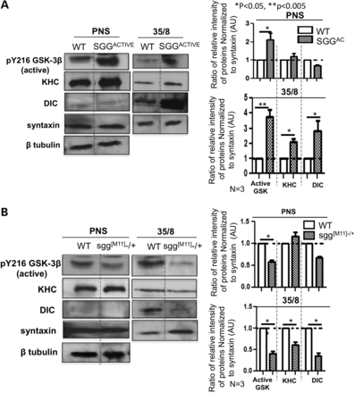
Figure 4. Active GSK-3β influences kinesin-1 and dynein binding to membranes. (A) Subcellular fractionation of third ...
Notes:
Figure 4. Active GSK-3β influences kinesin-1 and dynein binding to membranes. (A) Subcellular fractionation of third instar larval brain membranes on sucrose step gradients indicated that expression of SGGACTIVE increased the level of active GSK-3β that is associated with light membranes (membrane fraction, 35/8) compared with WT brains. Note that the levels of KHC and DIC were also increased in the membrane fraction from brains expressing SGGACTIVE compared with WT brains. Quantification analysis indicated that the extent of the increase seen in active GSK-3β, KHC or DIC in the 35/8 fraction was statistically significant (*P < 0.05, **P < 0.005, N = 2-3). Y-axis depicts the intensity in AUs. (B) In contrast, reduction of SGG (sgg[M11]−/+) decreased the level of active GSK-3β that is associated with light membranes compared with WT. The levels of KHC and DIC were also decreased in sgg[M11]−/+ membranes. Quantification analysis indicated the decrease seen in active GSK-3β, KHC or DIC in the 35/8 fraction was statistically significant (*P < 0.05, **P < 0.005, N = 3).
Unless provided in the caption above, the following copyright applies to the content of this slide: © The Author 2013. Published by Oxford University Press. All rights reserved. For Permissions, please email: journals.permissions@oup.com

Slide 5
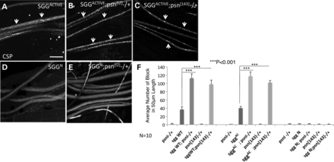
Figure 5. PS influences GSK-3β activity-dependent motor protein function during axonal transport. (A) Excess of ...
Notes:
Figure 5. PS influences GSK-3β activity-dependent motor protein function during axonal transport. (A) Excess of SGGACTIVE alone caused axonal defects, but excess of a non-functional SGGN (D) does not. Fifty percent reduction of PS increased axonal blockages mediated by excess of SGGACTIVE (B, SGGACTIVE; psn[I2]−/+, arrows), while expression of the non-functional SGG with 50% reduction of PS had no effect (E, SGGN; psn[I2]−/+). Increased axonal blockages were also seen in SGGACTIVE; psn[143]−/+ (C). (F) Quantification analysis indicated that 50% reduction of PS significantly increased the number of GSK-3β-mediated blockages in SGGACTIVE; psn[I2]−/+, SGGACTIVE; psn[143]−/+, SGGWT; psn[I2]−/+ or SGGWT; psn[143]−/+ larvae compared with SGGACTIVE or SGGWT larvae (P < 0.001). No effect was seen in SGGN; psn[I2]−/+ or SGGN; psn[143]−/+) larvae. N = 10 for each genotype. Bar = 10 µm.
Unless provided in the caption above, the following copyright applies to the content of this slide: © The Author 2013. Published by Oxford University Press. All rights reserved. For Permissions, please email: journals.permissions@oup.com

Slide 6
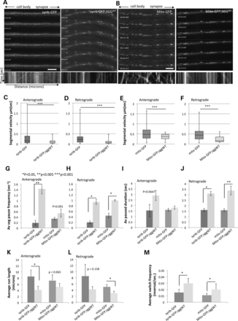
Figure 6. Excess of GSK-3β activity perturbs the movement of synaptobrevin vesicles and mitochondria in vivo. (A) A ...
Notes:
Figure 6. Excess of GSK-3β activity perturbs the movement of synaptobrevin vesicles and mitochondria in vivo. (A) A montage from a representative movie (Supplementary Material, movie S1) shows diffused synb-GFP with faint bidirectionally moving vesicles from a larvae expressing synb-GFP. The representative kymograph shows robust bidirectional movement with synb-GFP vesicles (red line = anterograde, green line = retrograde). Cell bodies are toward the left and the synapse is toward the right as depicted by the arrows at the top. In contrast, expression of SGGWT perturbed the movement of synb-GFP causing synb-GFP blocks (Supplementary Material, Movie S2). The kymograph shows stalled blockages. On the kymograph, the Y-axis depicts the time and the X-axis depicts the distance. (B) A montage from a representative movie shows bidirectional movement of mitochondria in a larvae expressing Mito-GFP (Supplementary Material, Movie S3). In contrast, expression of SGGWT caused decreased movement of mitochondria, which are stalled in the representative kymograph (Supplementary Material, Movie S4). For each genotype, a total of five animals were imaged for data analysis; four time-lapsed movies were collected for each animal; a total of 20 movies were analyzed. Bar = 20 µm. (C and D) Box plots of duration-weighted segmental velocities of synaptobrevin-GFP (synb-GFP) in larvae with normal SGG compared with larvae with excess SGGWT showed that excess SGG significantly perturbed both anterograde (P < 0.001) and retrograde (P < 0.001) velocities of synb-GFP vesicle movement. Box plots outline the distribution of duration-weighted segmental velocities for each genotype. The horizontal bar represents the median. The upper and lower box edges represent 75% percentile (i.e. upper quartile) and 25% percentile (i.e. lower quartile), respectively. (E and F) Box plots of duration-weighted segmental velocities of mitochrondria-GFP (Mito-GFP) in larvae with normal SGG compared with larvae with excess SGGWT also showed that excess SGG significantly perturbed both anterograde (P < 0.001) and retrograde (P < 0.001) velocities of Mito-GFP. Data were analyzed from five larvae and a total of 20 movies, 4 movies from each larvae were used (Anterograde synb-GFP tracks/vesicles n = 149; synb-GFP;SGGWTn = 90; retrograde synb-GFP tracks/vesicles n = 114; synb-GFP;SGGWTn = 53. Anterograde Mito-GFP tracks/vesicles n = 120; Mito-GFP;SGGWTn = 30; retrograde Mito-GFP tracks/vesicles n = 123; Mito-GFP;SGGWTn = 30.). (G, H) Significant increases were observed in the average segmental pause frequencies for both anterograde and retrograde vesicles from synb-GFP;SGGWT larvae compared with synb-GFP larvae (P < 0.05-P < 0.005), while significant increases were seen in retrograde vesicles from Mito-GFP;SGGWT compared with Mito-GFP larvae (P < 0.05). (I and J) Significant increases in pause durations were seen in retrograde vesicles from synb-GFP;SGGWT or Mito-GFP;SGGWT larvae compared with synb-GFP or Mito-GFP larvae (P < 0.05-P < 0.005). (K and L) Significant decreases in the average run lengths were seen for anterograde vesicles from synb-GFP;SGGWT larvae compared with synb-GFP larvae (P < 0.05), while significant decreases were seen for retrograde vesicles from Mito-GFP;SGGWT compared with Mito-GFP larvae (P < 0.05). The run length reports the distance a vesicle travels without pausing in microns (Y-axis). (M) Significant decreases in the average switch frequencies were seen for both synaptobrevin vesicles and mitochondria under excess SGG (P < 0.05). Switch frequency is defined as the number of reversals per second (times/s, Y-axis). Supplementary Material, Table S1 contains the summary of all in vivo measurements.
Unless provided in the caption above, the following copyright applies to the content of this slide: © The Author 2013. Published by Oxford University Press. All rights reserved. For Permissions, please email: journals.permissions@oup.com

