Slide 1
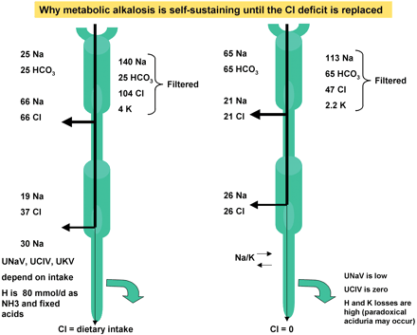
Fig. 1. Left is the normal situation with normal serum electrolytes; right the diseased state. A filtrate with Na ...
Notes:
Fig. 1. Left is the normal situation with normal serum electrolytes; right the diseased state. A filtrate with Na 140, K 4, Cl 104 and HCO3 25 mmol/l is filtered. The sodium amount is 28 000 mmol/day. Per litre, 104 mmol of Na can be resorbed with the ‘resorbable’ anion Cl. The rest is resorbed via bicarbonate reclamation (sodium/proton exchanger) and in the cortical collecting duct via potassium and/or hydrogen ion excretion. When the resorbable Cl ion is reduced to 47 mmol/l, only 47 mmol/l Na can be resorbed via the ‘resorbable’ anion. The rest requires an increased bicarbonate threshold (in this case 65 mmol/day) and increased distal K and H ion excretion.
Unless provided in the caption above, the following copyright applies to the content of this slide: European Renal Association–European Dialysis and Transplant Association

