Slide 1
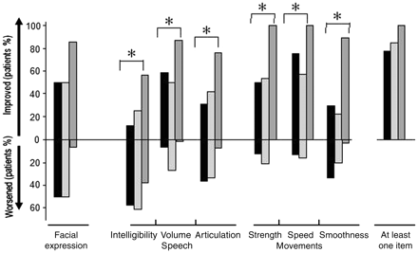
Figure 1 The level of improvement and worsening in movement (strength, speed and smoothness), speech (intelligibility, ...
Notes:
Figure 1 The level of improvement and worsening in movement (strength, speed and smoothness), speech (intelligibility, high volume and articulation) and facial expression during sleep in 31 patients with MSA (black columns: MSA-C, n = 18; light grey columns: MSA-P, n = 13) and 31 age- and gender-matched patients with Parkinson’s disease (dark grey columns), as assessed by their bed partners. No significant differences were observed between MSA-C and MSA-P, but more patients with Parkinson’s disease than with MSA showed improvement for all individual items except facial expression. *P < 0.05 for a difference between patients with MSA and Parkinson’s disease.
Unless provided in the caption above, the following copyright applies to the content of this slide: © The Author (2011). Published by Oxford University Press on behalf of the Guarantors of Brain. All rights reserved. For Permissions, please email: journals.permissions@oup.com

