Slide 1
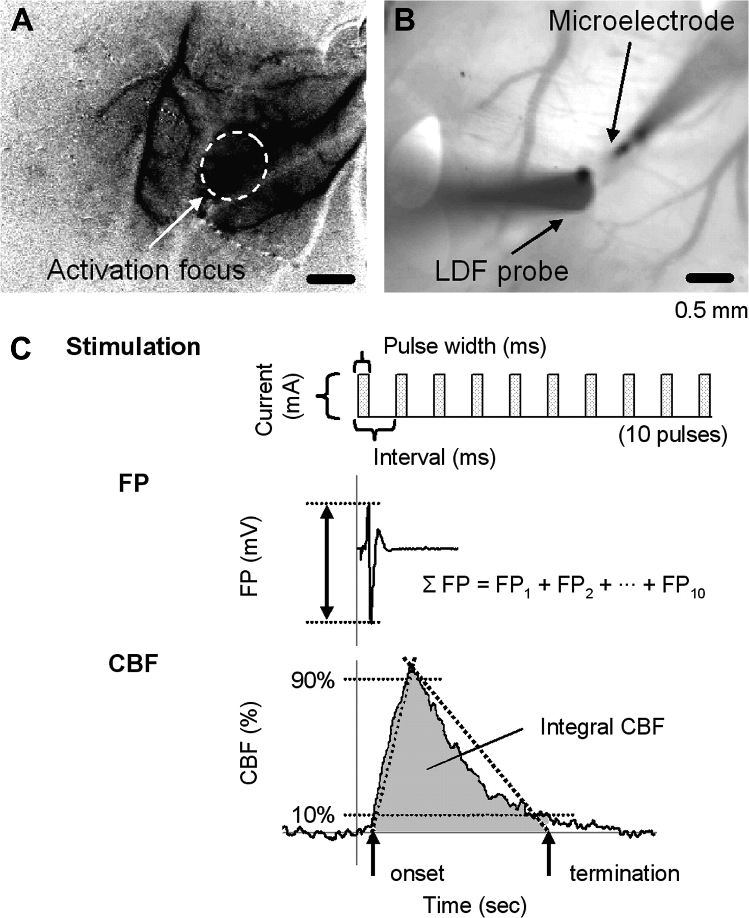
Figure 1. (A) Optical imaging map. The darkened area shows the decrease in light reflectance (620-nm wavelength) from ...
Notes:
Figure 1. (A) Optical imaging map. The darkened area shows the decrease in light reflectance (620-nm wavelength) from prestimulation level in response to electrical forepaw stimulation. The white circle with a dashed line represents activation focus (∼1-mm diameter). The localized activation focus was consistently observed in all animals. The stimulation-induced reflectance change (ΔR/R) in the activation focus was ∼0.2%. (B) Probe locations for recording of evoked FP and CBF at the activation focus. The distance between the microelectrode insertion and LDF probe was ∼0.5 mm. (C) Definition of stimulation parameters and calculation of evoked FP and CBF. Ten rectangular pulses of electrical stimulation were induced with varying 1) pulse width, 2) current, and 3) onset-to-onset interval. The amplitude of the evoked FP was measured from minimal peak to maximal peak. The summation of evoked FP (∑FP) was then calculated to sum all amplitudes of 10 consecutive evoked FPs (FP1 + FP2 + … + FP10). The evoked CBF (integral CBF) was calculated to integrate the area of mean CBF response curve bounded from the time-to-onset to the time-to-termination of mean CBF curves (See text in detail).
Unless provided in the caption above, the following copyright applies to the content of this slide: © The Author 2006. Published by Oxford University Press. All rights reserved. For permissions, please e-mail: journals.permissions@oxfordjournals.org

Slide 2
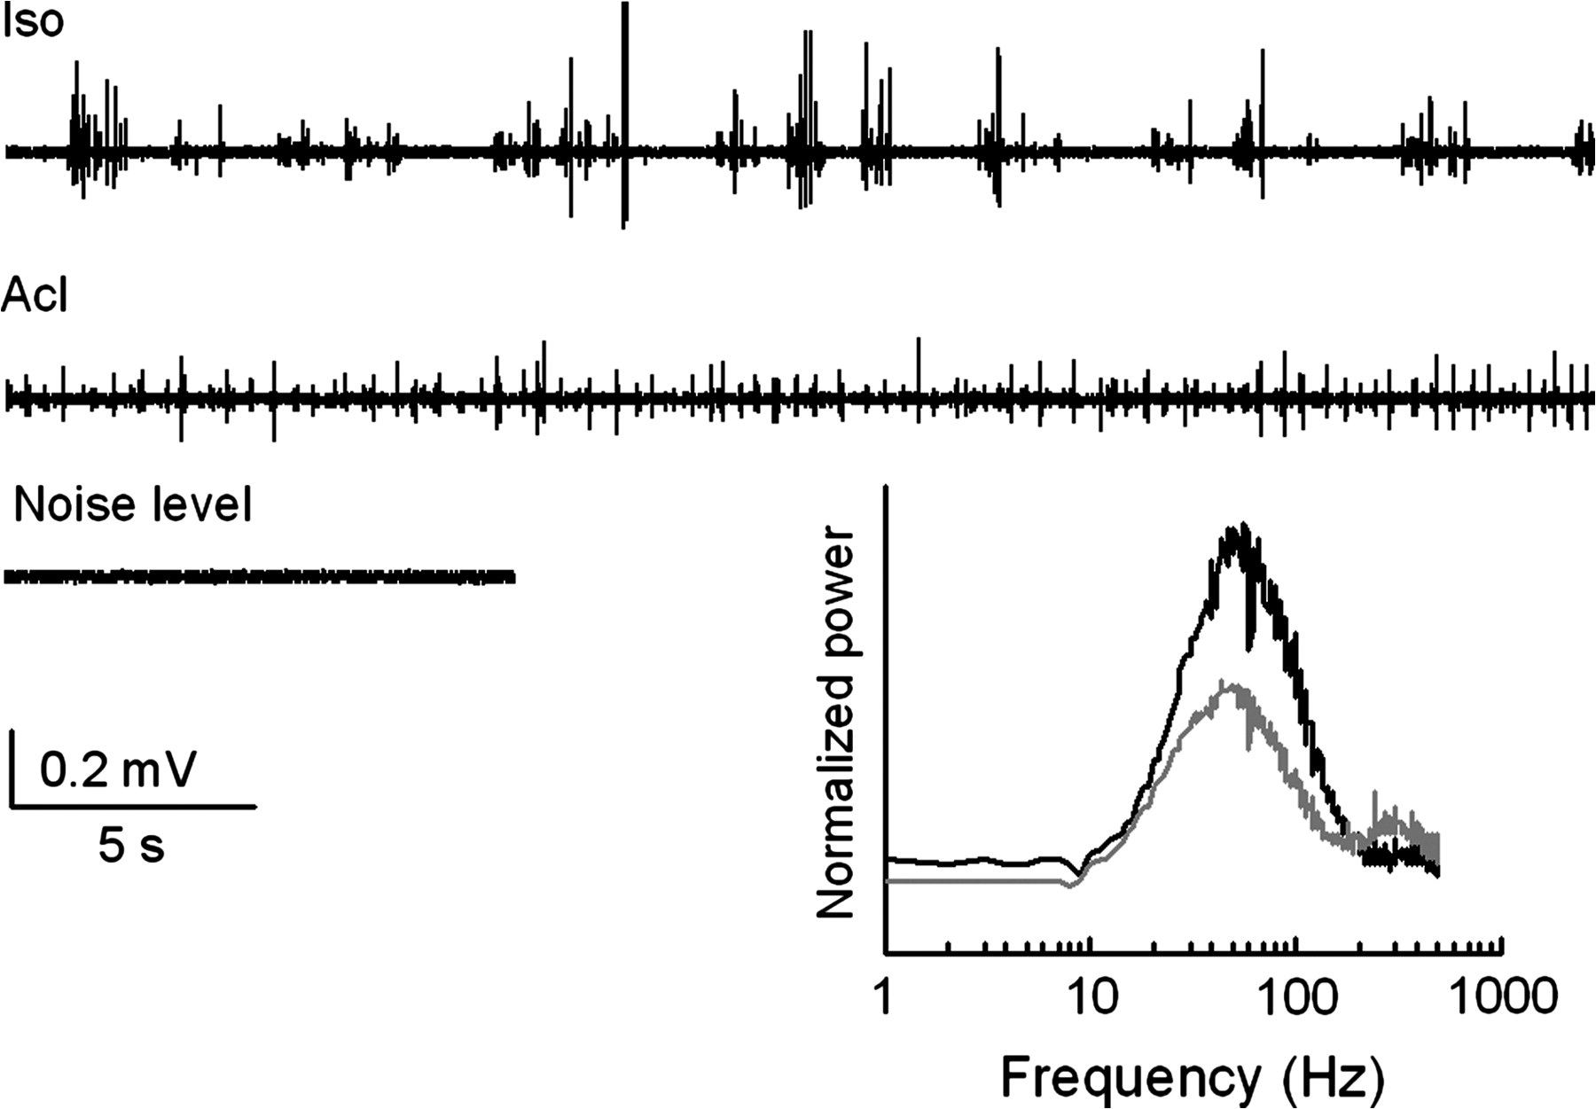
Figure 2. Baseline FP activity. The pattern of baseline FP activity differed depending on the anesthetics. Under ISO ...
Notes:
Figure 2. Baseline FP activity. The pattern of baseline FP activity differed depending on the anesthetics. Under ISO (Iso), burst-suppression pattern (i.e., depressed background activity alternating with high voltage activity) was typically observed, whereas α-chloralose (Acl) caused frequent activity with small amplitude. Consequently, frequency composition of the baseline FP was different between ISO (black) and α-chloralose (gray). The representative raw data of baseline FP were obtained from the same animal and compared with system noise level obtained after the animal was euthanized. The fast Fourier transform data was normalized by the noise level and averaged from all 5 animals.
Unless provided in the caption above, the following copyright applies to the content of this slide: © The Author 2006. Published by Oxford University Press. All rights reserved. For permissions, please e-mail: journals.permissions@oxfordjournals.org

Slide 3
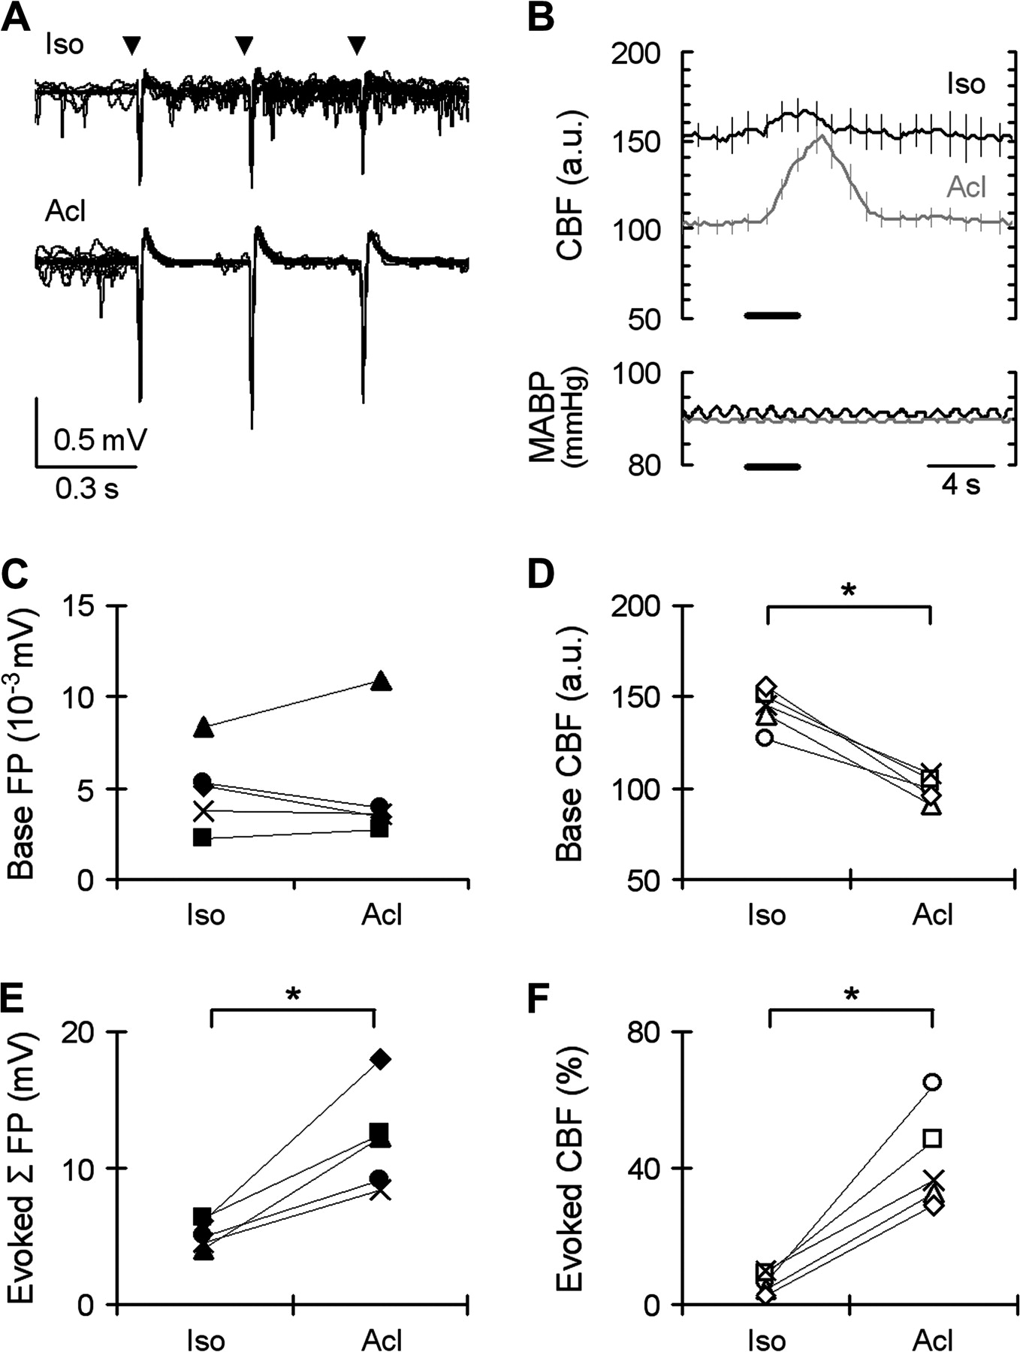
Figure 3. Evoked FP and CBF under α-chloralose versus ISO. Evoked FP and CBF were compared under ISO (Iso) and ...
Notes:
Figure 3. Evoked FP and CBF under α-chloralose versus ISO. Evoked FP and CBF were compared under ISO (Iso) and α-chloralose (Acl) in the same animal. The 10-pulse stimulation with 0.3 ms width, 1.2 mA current, and 333-ms interval was applied as previously shown under α-chloralose (Silva and others 1999). (A) Typical FP traces including baseline activity (300 ms before stimulus onset) and initial 3 evoked responses (out of 10) to stimulation (arrowheads). Note that the poststimulus neural activity (i.e., after each stimulation pulse) was relatively active (noisy) under ISO but suppressed under α-chloralose. The higher amplitude of evoked FP was evident in α-chloralose compared with that in ISO. (B) Corresponding CBF responses under ISO (black) and α-chloralose (gray) obtained from the same animal shown in panel (A). The evoked CBF was averaged across all 20 trials. Under ISO, the baseline CBF level was higher but evoked CBF was lower compared with α-chloralose. Horizontal lines indicate the stimulation duration. Error bar indicates 1 SD for 20 trials. No observable changes in MABP during stimulation were confirmed. (C, D) Baseline FP (C) and baseline CBF (D) data from all 5 animals. Each symbol indicates the individual animal data. The baseline FP was not significantly different between ISO and α-chloralose, whereas the baseline CBF was significantly higher under ISO than α-chloralose. The baseline CBF under ISO was 145 ± 8% of that under α-chloralose. *P < 0.05. (E, F) Individual animal's data of ∑FP (E) and CBF peak response (F). The ∑FP and CBF peak were significantly higher in α-chloralose (12 ± 4 mV and 42 ± 14%) than ISO (5 ± 1 mV and 7 ± 3%).
Unless provided in the caption above, the following copyright applies to the content of this slide: © The Author 2006. Published by Oxford University Press. All rights reserved. For permissions, please e-mail: journals.permissions@oxfordjournals.org

Slide 4
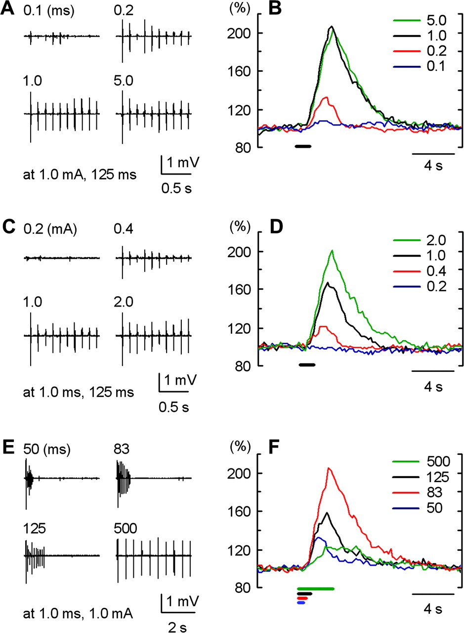
Figure 4. One animal's evoked FP and CBF data during variations of stimulation parameters under ISO. FP traces (A, C, ...
Notes:
Figure 4. One animal's evoked FP and CBF data during variations of stimulation parameters under ISO. FP traces (A, C, and E) and corresponding CBF time courses (B, D, and F) induced by varied width (A, B), current (C, D), and onset-to-onset interval (E, F) in one representative animal were plotted. For each variation, only 4 data points (out of 9, 10, and 9 for width, current, and interval variations, respectively) were shown. The CBF response was normalized by the prestimulation baseline level. The horizontal lines in (B, D, and F) represent the stimulation durations. (A, B) Width (0.1, 0.2, 1.0, 5.0 ms) was varied with 1.0 mA current and 125-ms interval. The evoked FP and CBF similarly increased and reached a plateau with an increase in width. (C, D) Current (0.2, 0.4, 1.0, 2.0 mA) was varied with 1.0 ms width and 125-ms interval. The evoked FP and CBF monotonically increased with an increase in current. Note that 0.2 mA current was not enough to induce detectable FP and CBF changes. (E, F) Interval (50, 83, 125, 500 ms) was varied with 1.0 ms width and 1.0 mA current. Whereas the first evoked FP (out of 10) was relatively constant, the remaining evoked FPs (second to tenth) were preferentially affected by the intervals; a longer interval maintained a higher amplitude. In contrast, the highest peak CBF was observed at 83-ms interval.
Unless provided in the caption above, the following copyright applies to the content of this slide: © The Author 2006. Published by Oxford University Press. All rights reserved. For permissions, please e-mail: journals.permissions@oxfordjournals.org

Slide 5
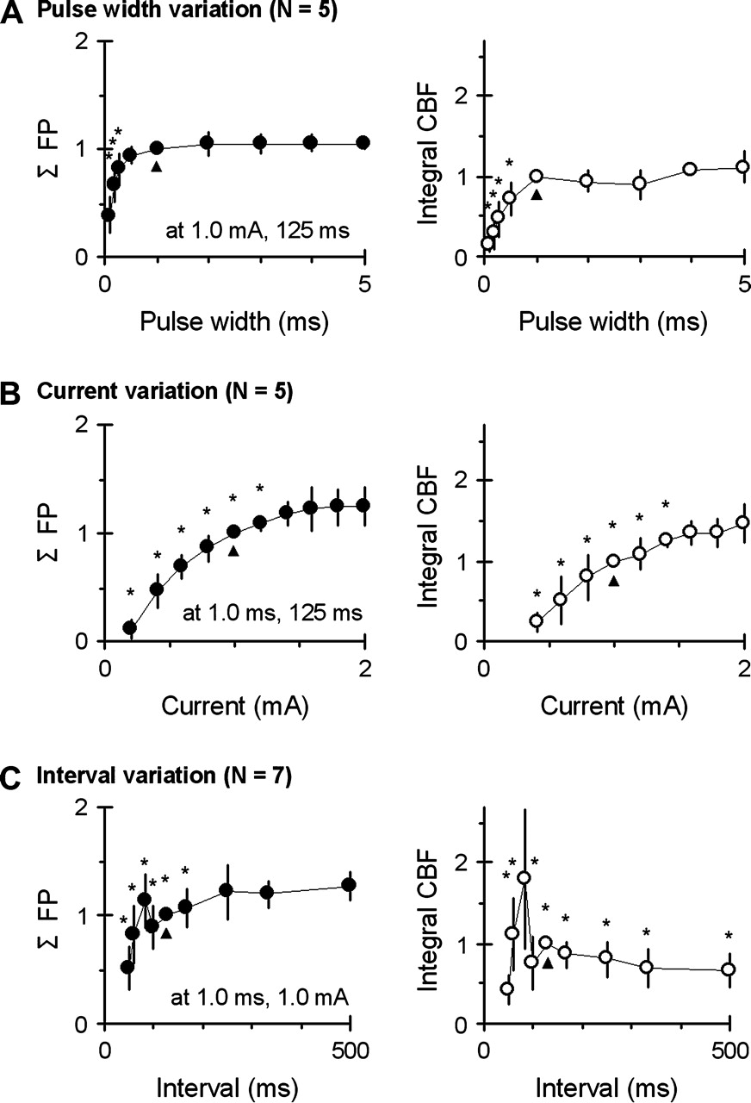
Figure 5. Parameter dependence of ∑FP and integral CBF. Normalized ∑FP (left) and integral CBF (right column) of all ...
Notes:
Figure 5. Parameter dependence of ∑FP and integral CBF. Normalized ∑FP (left) and integral CBF (right column) of all animals were plotted as a function of stimulation width (A) (with fixed current of 1.0 mA and interval of 125 ms, N = 5), current (B) (with fixed width of 1.0 ms and interval of 125 ms, N = 5), and interval (C) (with fixed width of 1.0 ms and current of 1.0 mA, N = 7). The ∑FP and integral CBF were normalized by the values at the common stimulation (arrowhead; 1.0 ms width, 1.0 mA current, 125-ms interval) in each group. Note that the ∑FP and integral CBF reached a plateau for widths of 1.0–5.0 ms and for currents of 1.4–2.0 mA. For the interval variations, the ∑FP reached a plateau for interval of 250–500 ms, but the peak of integral CBF was consistently observed at the interval of 83 ms. Significant difference (*P < 0.05) was shown by comparing the observed peak of ∑FP (5.0 ms width, 2.0 mA current, 500-ms interval) or peak of integral CBF (5.0 ms width, 2.0 mA current, 83-ms interval) within each variations groups. Error bar: 1 SD.
Unless provided in the caption above, the following copyright applies to the content of this slide: © The Author 2006. Published by Oxford University Press. All rights reserved. For permissions, please e-mail: journals.permissions@oxfordjournals.org

Slide 6
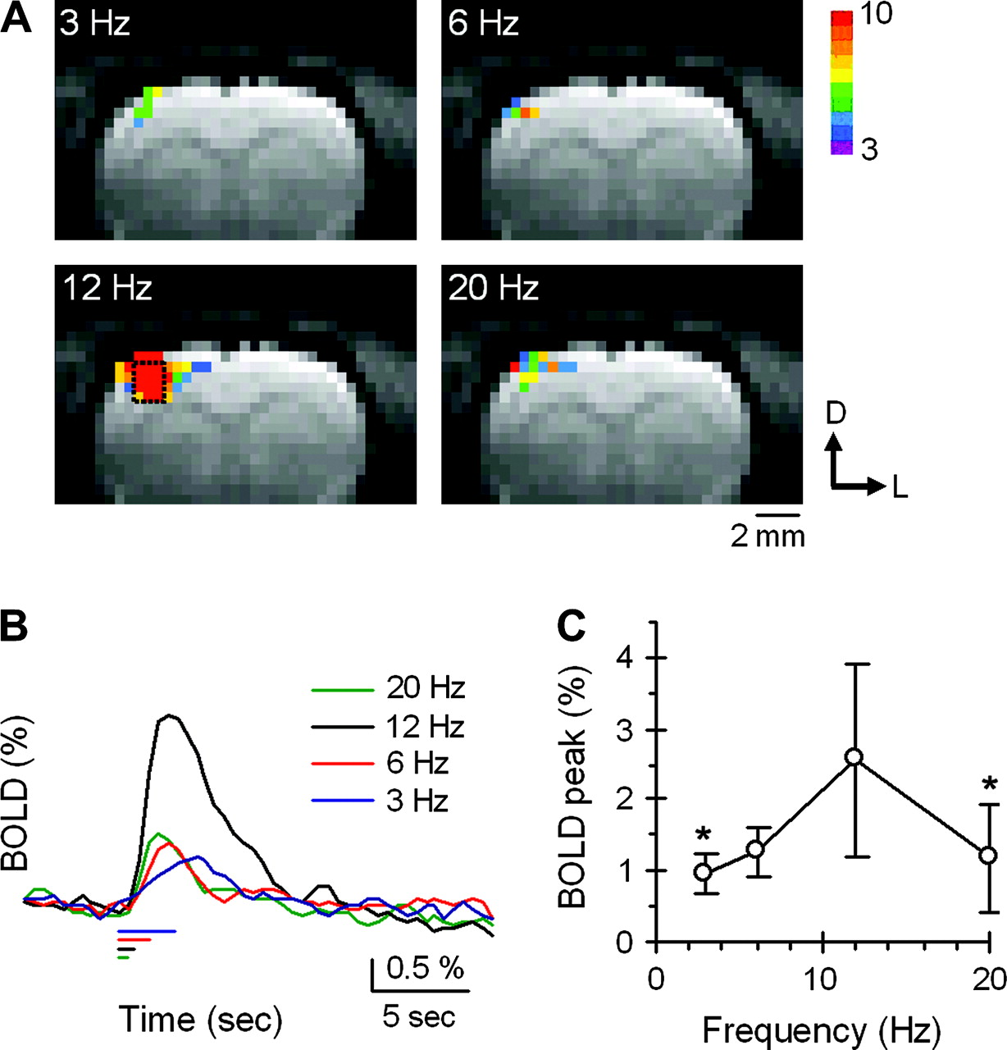
Figure 6. BOLD fMRI under ISO. (A) BOLD fMRI map obtained for various frequencies (3, 6, 12, 20 Hz) with refined ...
Notes:
Figure 6. BOLD fMRI under ISO. (A) BOLD fMRI map obtained for various frequencies (3, 6, 12, 20 Hz) with refined parameters (1.0 ms width and 1.4 mA current) of 10-pulse stimulation in one representative animal. The color scale bar indicates t-values that were compared between baseline periods (10 images) and activation periods (4 images). The significant signal change was observed at the well-localized activity focus in contralateral forepaw area of the primary somatosensory cortex for all stimulation frequencies, but the robust activation area was obtained only for 12 Hz frequency (∼83-ms interval) stimulation. The rectangle in the image for 12-Hz stimulation indicates the position of 3 × 4 pixels ROI. The same ROI was chosen for all stimulation conditions. D, dorsal; L, lateral. (B) Time courses of BOLD signal changes were calculated within the ROI shown in panel (A). The clear signal change was achieved at 12 Hz frequency. The horizontal bars show the stimulation duration corresponding to each stimulation frequency. (C) Population data on BOLD peak obtained from all 5 animals. Note that the 12-Hz frequency consistently evoked the highest BOLD signal change. Error bar: 1 SD. *P < 0.05 (vs. 12-Hz stimulation).
Unless provided in the caption above, the following copyright applies to the content of this slide: © The Author 2006. Published by Oxford University Press. All rights reserved. For permissions, please e-mail: journals.permissions@oxfordjournals.org

