Slide 1
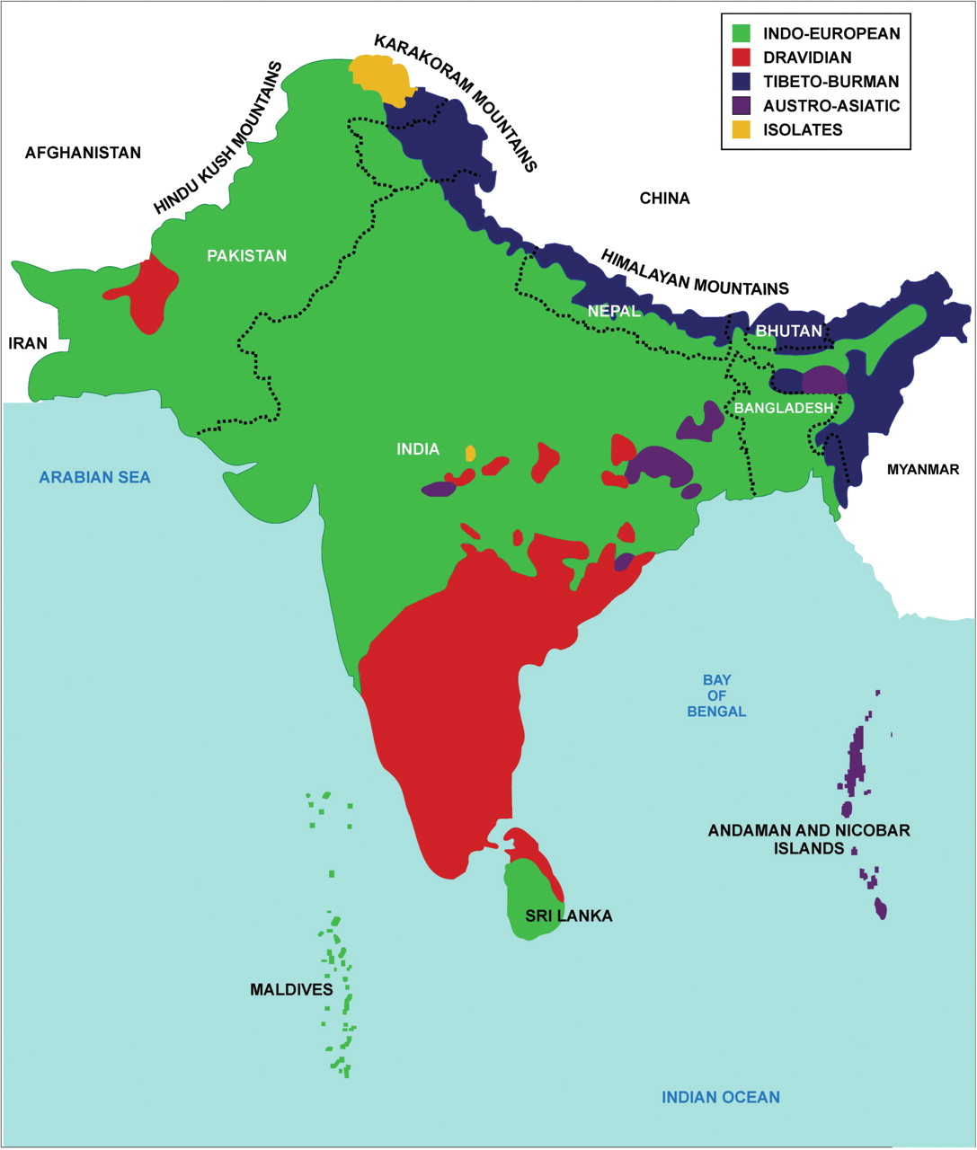
Figure 1: Linguistic boundaries in South Asia.
Notes:
Figure 1: Linguistic boundaries in South Asia.
Unless provided in the caption above, the following copyright applies to the content of this slide: © The Author 2009. Published by Oxford University Press. For permissions, please email: journals.permissions@oxfordjournals.org

