Slide 1
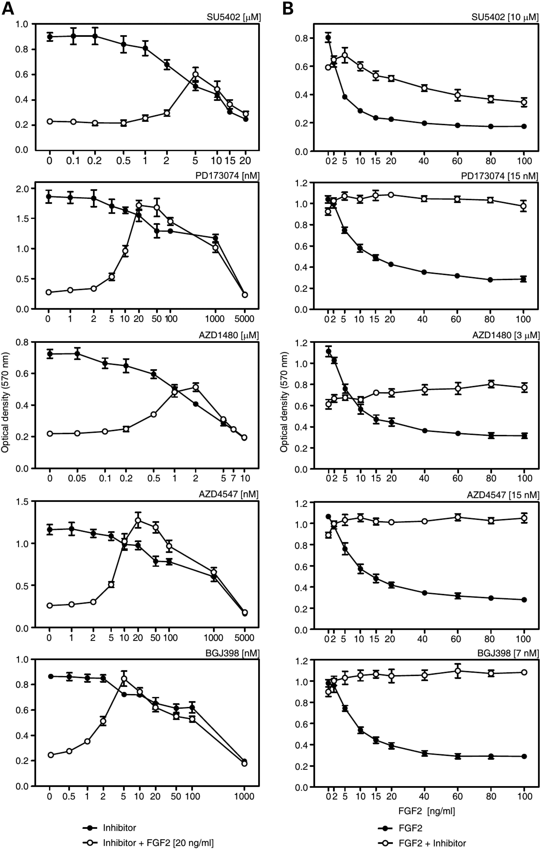
Figure 1. TKIs rescue FGF2-mediated inhibition of chondrocyte proliferation. (A) RCS chondrocytes were treated with ...
Notes:
Figure 1. TKIs rescue FGF2-mediated inhibition of chondrocyte proliferation. (A) RCS chondrocytes were treated with FGF2 and FGFR TKIs SU5402, PD173074, AZD1480, AZD4547 and BGJ398 as indicated, and cell numbers were determined by crystal violet staining 96 h later. Data represent averages for six wells. Results are representative of three independent experiments. Note the potent FGF2-mediated growth arrest, which is completely relieved by each of the FGFR TKIs at different concentrations. Also note that all TKIs show toxicity (growth inhibition in FGF2-naïve cells) at higher concentrations. (B) The optimal TKI concentrations determined in the experiments presented in (A) were applied to RCS cells treated with >40 ng/ml of FGF2, which induces the strongest possible level of FGF2-mediated growth arrest. All TKIs rescue this maximal growth arrest phenotype.
Unless provided in the caption above, the following copyright applies to the content of this slide: © The Author 2015. Published by Oxford University Press. All rights reserved. For Permissions, please email: journals.permissions@oup.com

Slide 2
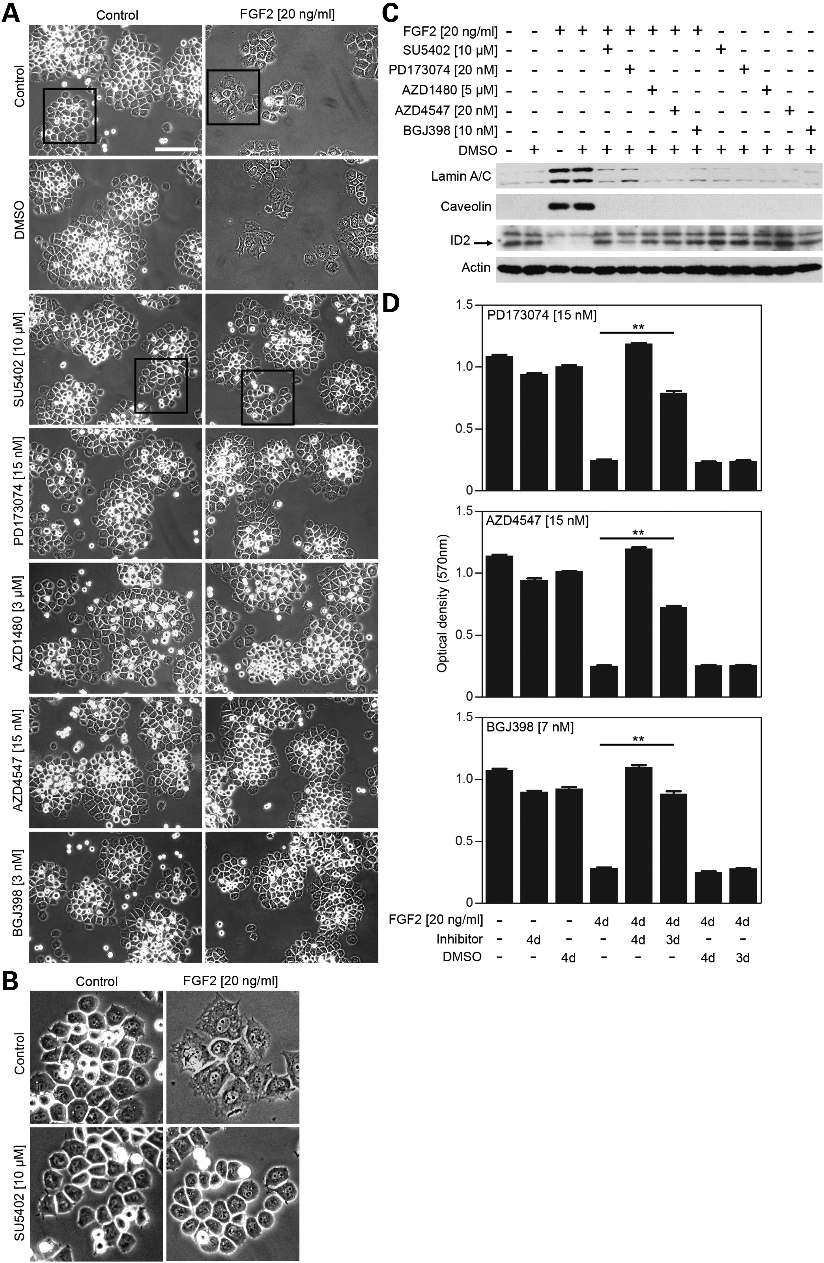
Figure 2. TKIs rescue FGF2-mediated senescence in chondrocytes. (A) RCS chondrocytes were treated as indicated for 96 h ...
Notes:
Figure 2. TKIs rescue FGF2-mediated senescence in chondrocytes. (A) RCS chondrocytes were treated as indicated for 96 h and photographed (scale bar 200 µm). Note the FGF2-mediated effect on RCS colony sizes, which is rescued by TKIs. (B) Higher magnification of regions highlighted with black boxes in (A) demonstrating enlargement and flattening of cells treated with FGF2, which is rescued by SU5402. (C) FGF2-mediated premature senescence in RCS cells (26) is accompanied by induction of lamin A/C and caveolin, and suppression of ID2, as detected by WB. Actin was used as a loading control. (D) RCS cells were treated with FGF2 for 4 days, and cell numbers were determined by crystal violet staining. In some samples (3 days), TKIs were added after FGF2-mediated growth arrest was fully established in 24 h of incubation with FGF2 (28). Note that all of the tested TKIs reversed the established growth arrest. Data represent averages for six wells with indicated standard deviations. Results are representative of three independent experiments. Statistically significant differences are indicated (ANOVA, **P < 0.001).
Unless provided in the caption above, the following copyright applies to the content of this slide: © The Author 2015. Published by Oxford University Press. All rights reserved. For Permissions, please email: journals.permissions@oup.com

Slide 3
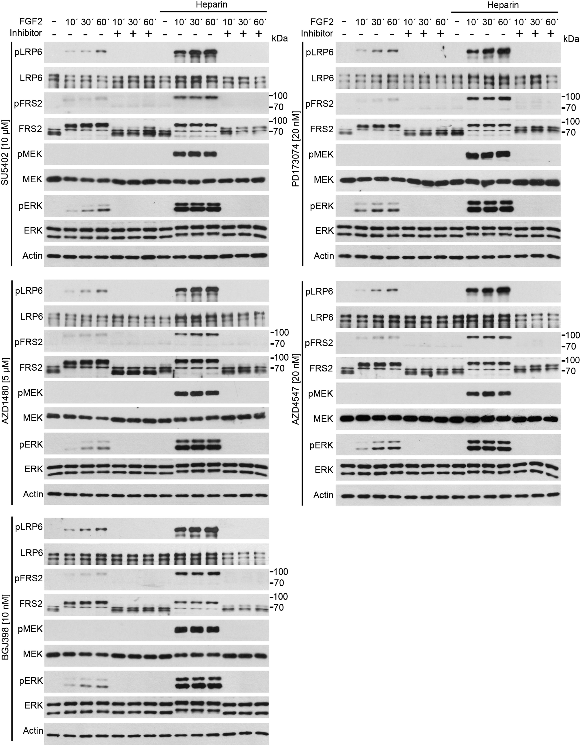
Figure 3. TKIs suppress FGF2-mediated activation of FGFR signal transduction. FGFR signaling was activated in RCS ...
Notes:
Figure 3. TKIs suppress FGF2-mediated activation of FGFR signal transduction. FGFR signaling was activated in RCS chondrocytes by addition of exogenous FGF2 (20 ng/ml), and the cells were analyzed for activating phosphorylation (p) of the LRP6 WNT co-receptor, FRS2 adapter, and MEK and ERK kinases. As loading controls, the levels of actin and the total levels of the targeted kinases (irrespective of their phosphorylation status) were also determined. The electrophoretic mobility shift on FRS2 (total FRS2 blot) corresponds to the ERK-mediated feedback phosphorylation described previously (30). Exogenous heparin (1 µg/ml) was added to FGF2 since it potently enhances the RCS response to FGF2 stimulus (28). All TKIs completely abolish the FGF2-mediated activation of FGFR signal transduction.
Unless provided in the caption above, the following copyright applies to the content of this slide: © The Author 2015. Published by Oxford University Press. All rights reserved. For Permissions, please email: journals.permissions@oup.com

Slide 4
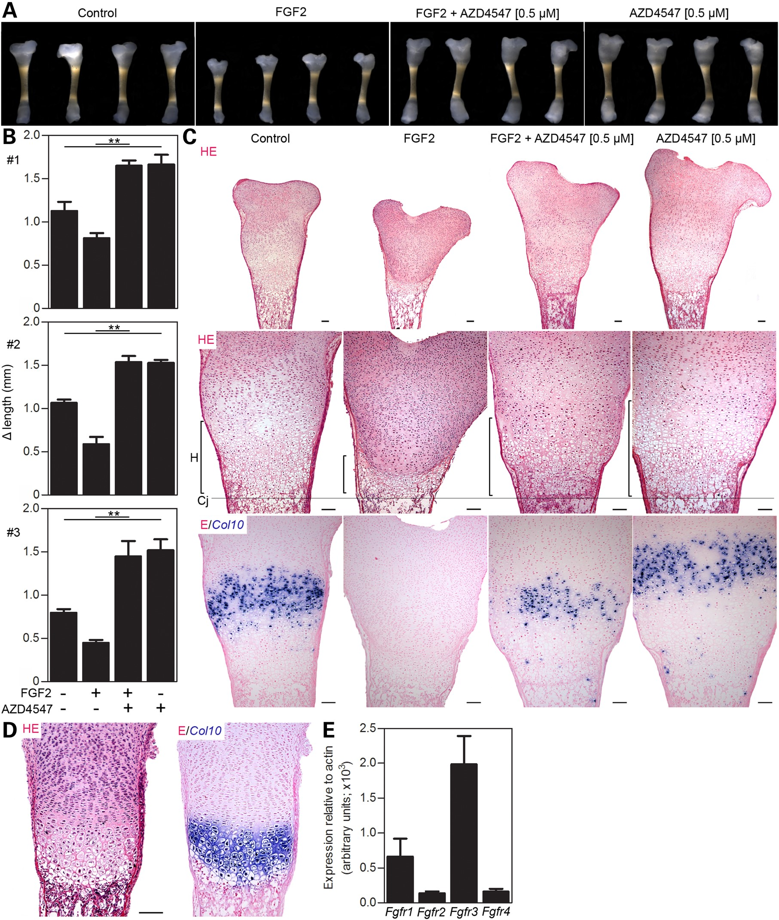
Figure 4. AZD4547 inhibits FGFR signaling in mouse tibia culture. (A) Tibias isolated from E18 embryos were cultured in ...
Notes:
Figure 4. AZD4547 inhibits FGFR signaling in mouse tibia culture. (A) Tibias isolated from E18 embryos were cultured in media supplemented with FGF2 (100 ng/ml) and/or AZD4547 for 8 days, and their length was measured after extraction from the embryo and after 8 days of incubation. (B) Graphs representing differences between both time points (Δ length) in three independent experiments (four tibias for each treatment) are shown (1–3). Statistically significant differences are highlighted (ANOVA, **p < 0.001). Note the FGF2-mediated growth inhibition that is rescued by AZD4547. Also note the significant increase in lengths of tibias treated with AZD4547 alone in contrast to untreated controls, which reflects the inhibition of endogenous FGFR3 signaling. (C) Histological sections of representative tibias were stained with HE. Note the marked reduction of hypertrophic cartilage (H) in tibias treated with FGF2, with corresponding loss of Col10a1 expression (bottom panel, Col10a1 in situ hybridization counterstained with eosin). This phenotype is rescued by AZD4547. Cj, chondro-osseous junction. Scale bars 100 µM. Note the Col10a1 expression domain matching the zone of enlarged hypertrophic chondrocytes. Also note a band of hypertrophic cartilage at the end of the control growth plates negative for Col10a1 mRNA, which represents cartilage matrix lacunae containing apoptotic chondrocytes, which would normally be eliminated by invading bone; these accumulate here due to the disruption of bone growth in the tibia cultures. (D) Confirmation of the function of the Col10a1 in situ hybridization protocol on freshly isolated tibias; the signal corresponds to the zone of hypertrophic chondrocytes adjacent to the bone tissue. (E) Relative levels of FGFR1–4 expression in growth plates isolated from E18 tibias, determined by quantitative reverse transcriptase-polymerase chain reaction (qRT-PCR).
Unless provided in the caption above, the following copyright applies to the content of this slide: © The Author 2015. Published by Oxford University Press. All rights reserved. For Permissions, please email: journals.permissions@oup.com

Slide 5
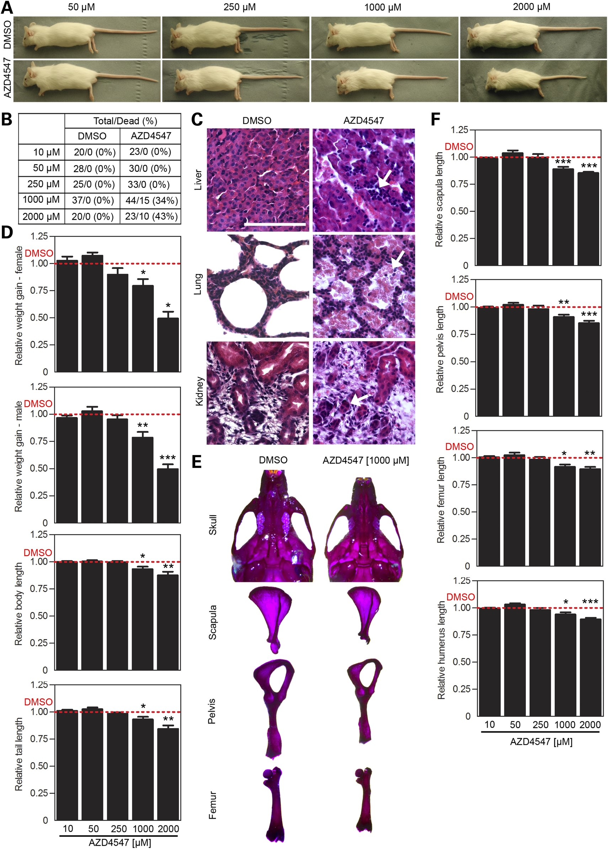
Figure 5. AZD4547 causes toxicity in mouse. (A–F) Newborn mice were injected intraperitoneally with 50 µl of AZD4547 or ...
Notes:
Figure 5. AZD4547 causes toxicity in mouse. (A–F) Newborn mice were injected intraperitoneally with 50 µl of AZD4547 or its vehicle DMSO (red lines in D and F) at indicated concentrations. (A) The overall appearance of animals after 28 days of AZD4547 application. Note the significantly shorter size in mice treated with 1000 and 2000 µM AZD4547. (B and C) Lethality in animals treated with higher AZD4547 concentrations, affecting the liver (necrotic areas, lymphocyte accumulation), lungs (alveolar hemorrhage) and kidneys (reduction of renal tubules). Scale bar 100 µm. (D) Body weight determined at the time of injection (every week) up to day 28. The length of body (from snout to tip of the tail) and tail (from radix to tip of the tail) was measured at the end of experiment at day 28 and plotted. Note the inhibitory effect of higher AZD4547 concentrations on body weight and length of body and tail (t-test; *P < 0.05, **P < 0.01, ***P < 0.001). (E and F) The skeleton was stained with alizarin red and alcian blue, and the lengths of each animal's scapula, pelvis, femur and humerus were measured. (E) A representative skull, scapula, pelvis and femur of mice treated either with DMSO or 1000 µM AZD4547. (F) Relative quantification of the scapula, pelvis, femur and humerus length reveals significant shortening following treatment with 1000 and 2000 µM AZD4547 (t-test).
Unless provided in the caption above, the following copyright applies to the content of this slide: © The Author 2015. Published by Oxford University Press. All rights reserved. For Permissions, please email: journals.permissions@oup.com

Slide 6
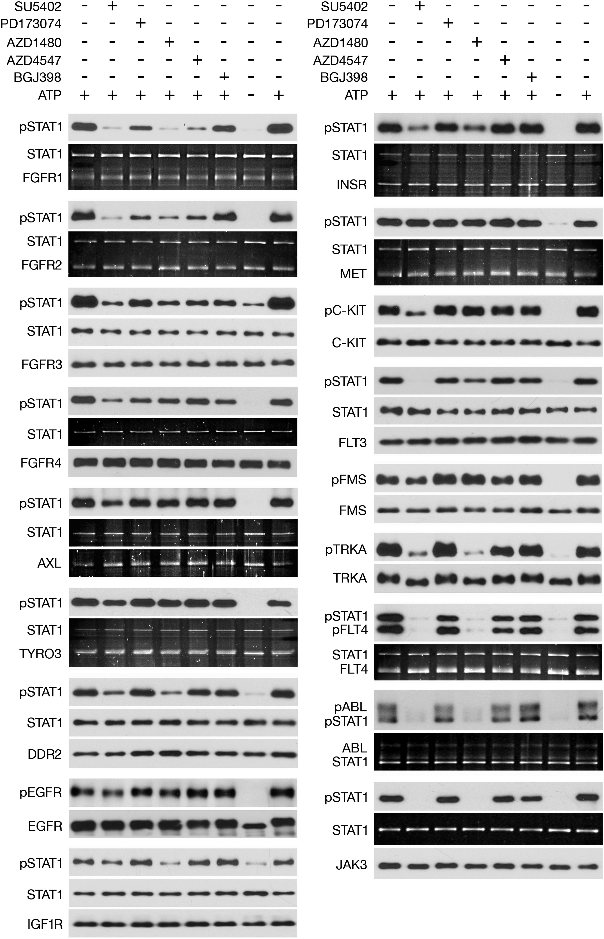
Figure 6. TKI activity against FGFR1–4 and 14 other unrelated tyrosine kinases. Cell-free kinase assays were conducted ...
Notes:
Figure 6. TKI activity against FGFR1–4 and 14 other unrelated tyrosine kinases. Cell-free kinase assays were conducted using selected recombinant tyrosine kinases and recombinant STAT1 as the substrate, with TKIs added directly to the reaction mixtures. Kinase activity was determined by monitoring STAT1 phosphorylation (p) at Y701. EGFR, cKIT, FMS and TRKA activity was determined by detecting the levels of their autophosphorylation with an antibody specific to the phosphorylated form of the given kinase. Each experiment contains two controls (no inhibitor) and a sample with omitted ATP as a negative control. Quantities of total kinase and STAT1 serve as loading controls; in some samples, the amounts of recombinant proteins were determined by Sypro Ruby staining of acrylamide gels. The results are representative of three independent experiments, as listed in Table 1. TKIs were used at 20 nM (BGJ398), 50 nM (AZD4547, PD173074), 5 µM (AZD1480) and 10 µM (SU5402).
Unless provided in the caption above, the following copyright applies to the content of this slide: © The Author 2015. Published by Oxford University Press. All rights reserved. For Permissions, please email: journals.permissions@oup.com

Slide 7
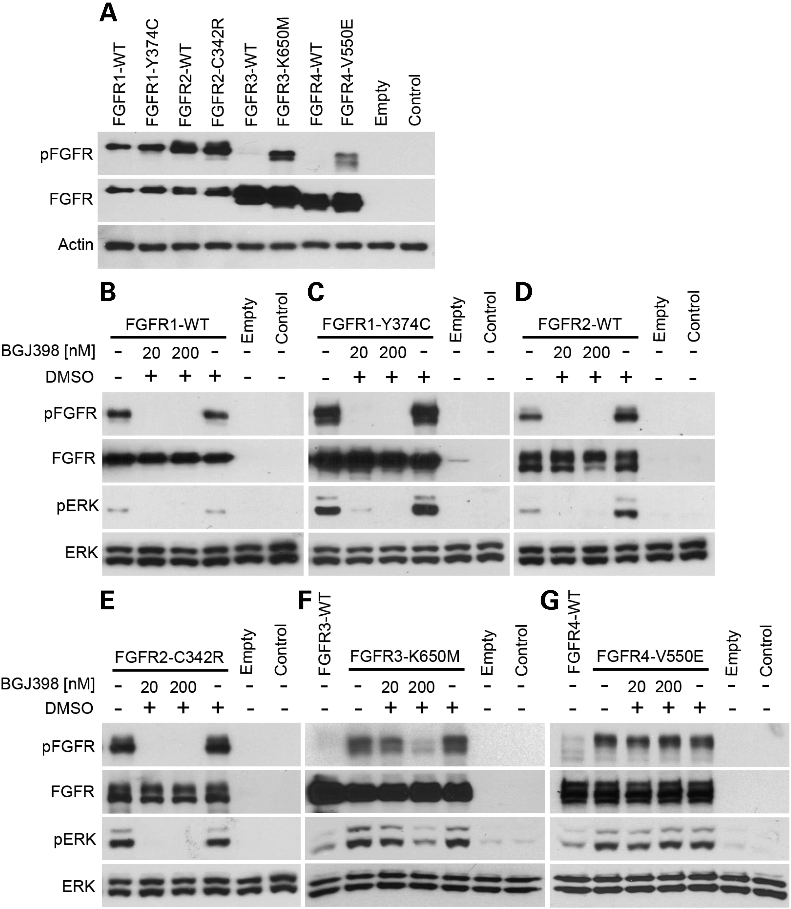
Figure 7. BGJ398 activity against FGFR1–4 and their activating mutants. (A) 293T cells were transfected with vectors ...
Notes:
Figure 7. BGJ398 activity against FGFR1–4 and their activating mutants. (A) 293T cells were transfected with vectors carrying C-terminally V5-tagged wt FGFR1–4 or their activated mutants, and the levels of FGFR activation were determined by WB with antibody that binds to FGFRs autophosphorylated (p) at Y653/Y654. The levels of total FGFRs and actin serve as loading controls. Note the spontaneous, ligand-independent activation of wt FGFR1 and FGFR2 in contrast to FGFR3 and FGFR4. (B–G) FGFRs were expressed in 293T cells that had been treated with BGJ398 for 18 h, and the levels of FGFR and ERK phosphorylation (p) were determined. Total FGFR and ERK levels are used as loading controls. Note the suppression of wt and mutant FGFR1 and FGFR2 activation by 20 nM BGJ398 (B–E) in contrast to full FGFR3-K650E inhibition, which required 200 nM BGJ398 (F); the activity of FGFR4-V550E was insensitive to BGJ398 (G).
Unless provided in the caption above, the following copyright applies to the content of this slide: © The Author 2015. Published by Oxford University Press. All rights reserved. For Permissions, please email: journals.permissions@oup.com

Slide 8
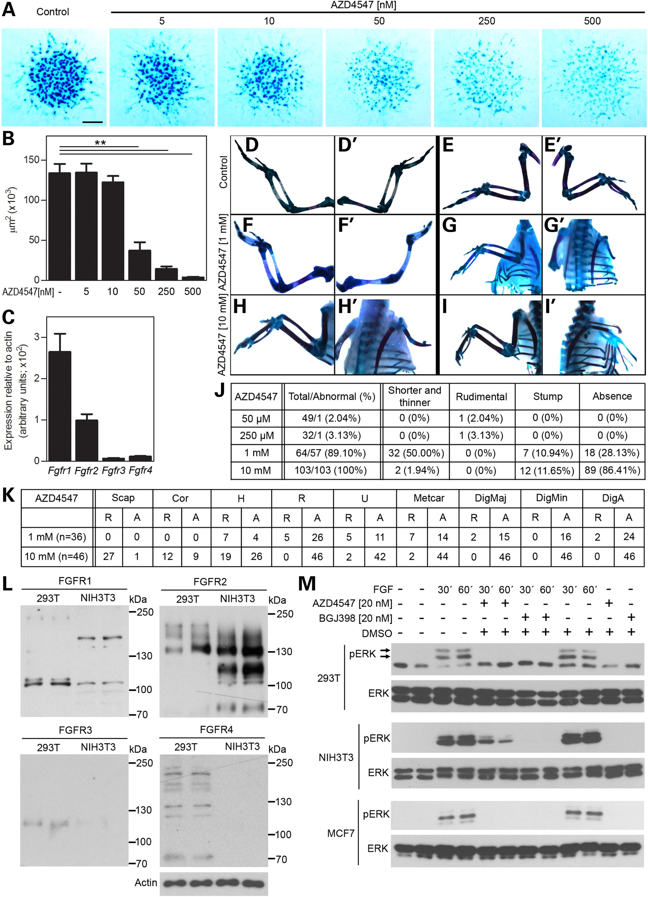
Figure 8. TKIs inhibit FGFR signaling in different in vitro and in vivo models irrespectively of their FGFR outfit. (A) ...
Notes:
Figure 8. TKIs inhibit FGFR signaling in different in vitro and in vivo models irrespectively of their FGFR outfit. (A) Micromass cultures established from E12 mouse limb buds were treated with AZD4547 for 7 days and stained with alcian blue to visualize cartilaginous nodules. Signal intensity is quantified and graphed (B). Scale bar 1 mm, statistically significant differences are highlighted (t-test, **P < 0.01). (C) Expression of Fgfr1–4 in mouse micromasses was quantified by qRT-PCR. (D–I) Limb buds of chicken embryos were injected with AZD4547 and analyzed for external (J) and skeletal (K) morphology 10–12 days later. Right wings (D, E) and left wings (D′,E′) of embryos treated with DMSO alone exhibited normal morphology. 1 mm AZD4547 caused the abolition of radii (F′) or a reduction in the sizes of all distal structures (G′). 10 mm AZD4547 abolished either distal structures (H′) or the entire wing skeleton (I′). (J) Treatment with 1 or 10 mm AZD4547 caused most of the embryo's limbs to develop abnormally, with the external phenotype ranging from shortening to a complete absence of the limb. (K) Detailed skeletal analysis revealed major morphological changes to the zeugopod and autopod bones of limb buds injected with 1 mm AZD4547 and total reduction of distal skeleton with significant changes on proximal wing bones at 10 mm AZD4547 (R, reduced; A, absent). (L) 293T and NIH3T3 cells were analyzed for FGFR1–4 expression by WB. Note the expression of FGFR1 and FGFR2 in NIH3T3 cells and FGFR1–4 in 293T cells. Actin is used as a loading control. (M) Treatment with AZD4547 or BGJ398 suppresses FGF2- (NIH3T3, 293T) or FGF22-mediated (MCF7) activation of ERK MAP kinase, detected by WB using an antibody against ERK phosphorylated at the activating T202/Y204 residues (pERK). Total ERK levels are used as a loading control.
Unless provided in the caption above, the following copyright applies to the content of this slide: © The Author 2015. Published by Oxford University Press. All rights reserved. For Permissions, please email: journals.permissions@oup.com

