Slide 1
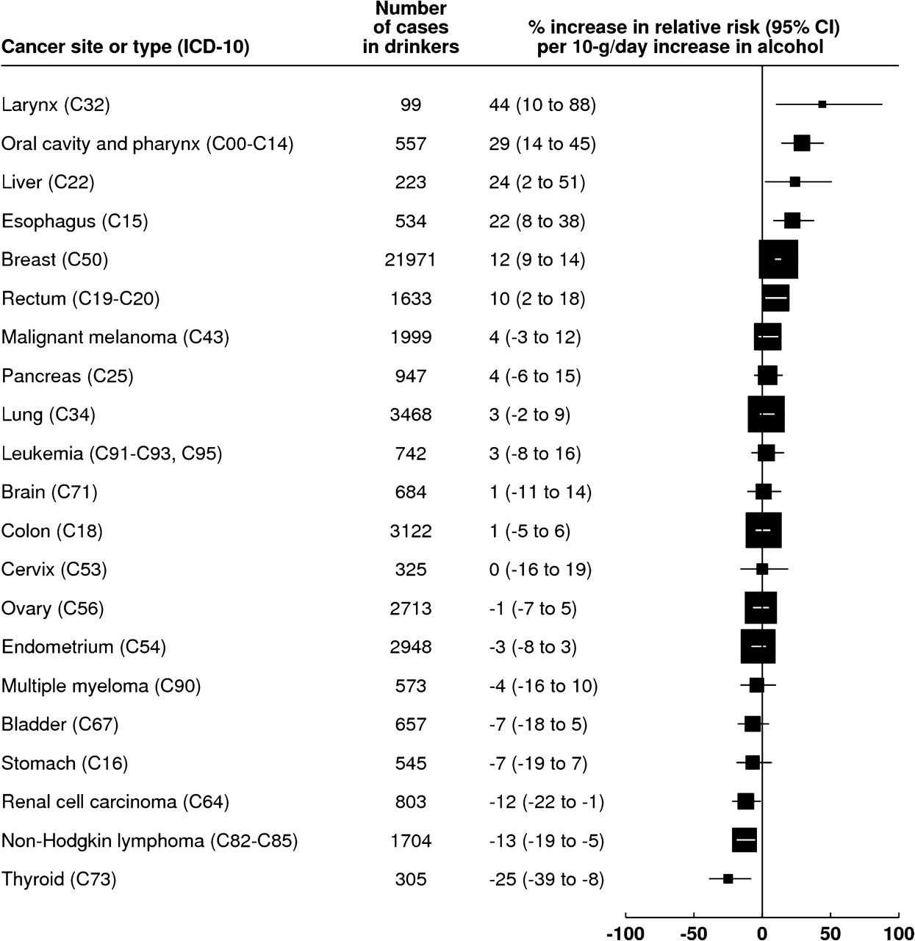
Figure 1 Estimated increase in the relative risk (95% confidence interval) of incident cancer per 10-g/d increase in ...
Notes:
Figure 1 Estimated increase in the relative risk (95% confidence interval) of incident cancer per 10-g/d increase in alcohol intake (drinkers only). Analyses are adjusted for age, region of residence, socioeconomic status, body mass index, smoking, physical activity, use of oral contraceptives and hormone replacement therapy. CI = confidence interval. ICD-10 = International Classification of Diseases, 10th Revision (the C00-C97 codes refer to malignant neoplasm codes as defined in ICD-10).
Unless provided in the caption above, the following copyright applies to the content of this slide: © The Author 2009. Published by Oxford University Press.

Slide 2
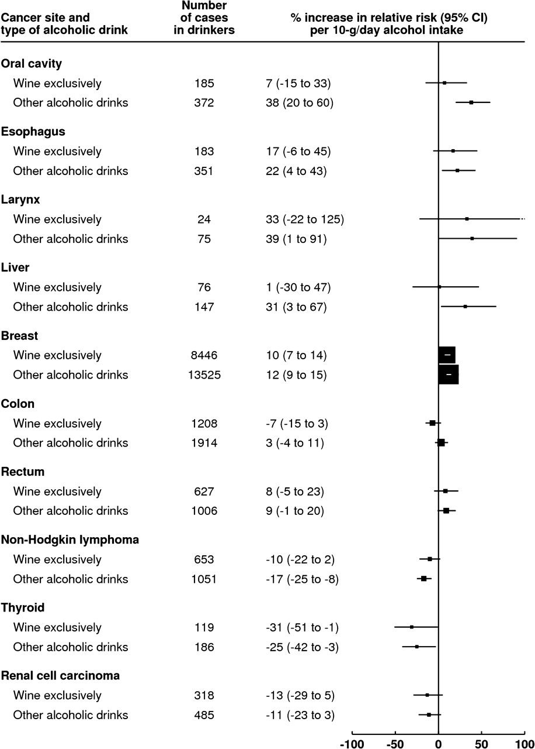
Figure 2 Estimated increase in relative risk (95% confidence interval) for selected cancer sites per 10-g/d increase ...
Notes:
Figure 2 Estimated increase in relative risk (95% confidence interval) for selected cancer sites per 10-g/d increase in alcohol intake and by type of alcohol consumed (drinkers only). Analyses are adjusted for age, region of residence, socioeconomic status, body mass index, smoking, physical activity, use of oral contraceptives, and hormone replacement therapy. CI = confidence interval. “Other alcoholic drinks” is defined as drinkers of beer and/or spirits exclusively or a mixture of wine, beer, and/or spirits.
Unless provided in the caption above, the following copyright applies to the content of this slide: © The Author 2009. Published by Oxford University Press.

Slide 3
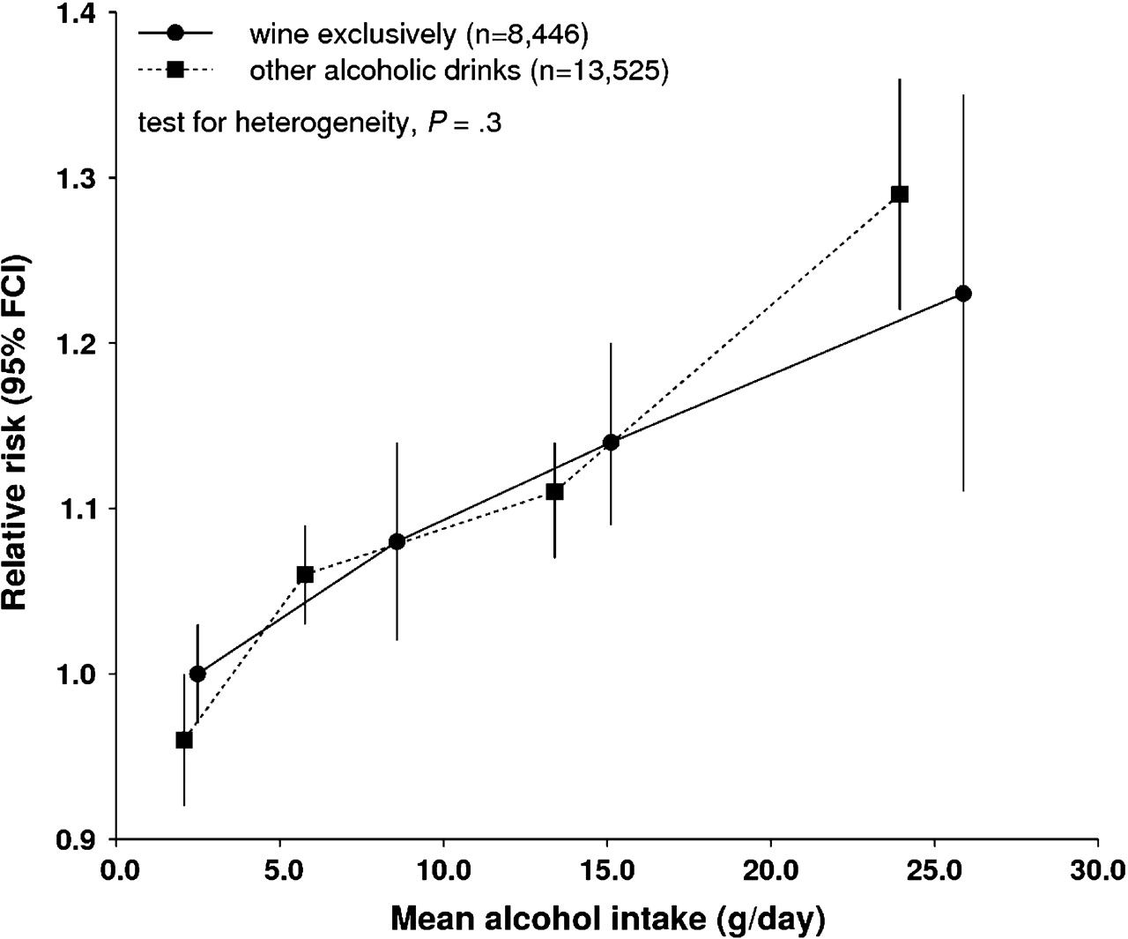
Figure 3 Relative risk (95% floated confidence interval) of breast cancer by amount and type of alcohol consumed ...
Notes:
Figure 3 Relative risk (95% floated confidence interval) of breast cancer by amount and type of alcohol consumed (drinkers only). The relative risk is plotted against the mean remeasured value of alcohol intake (g/d) in each category. Analyses are adjusted for age, region of residence, socioeconomic status, body mass index, smoking, physical activity, use of oral contraceptives and hormone replacement therapy. FCI = floated confidence interval. “Other alcoholic drinks” is defined as drinkers of beer and/or spirits exclusively or a mixture of wine, beer, and/or spirits.
Unless provided in the caption above, the following copyright applies to the content of this slide: © The Author 2009. Published by Oxford University Press.

Slide 4
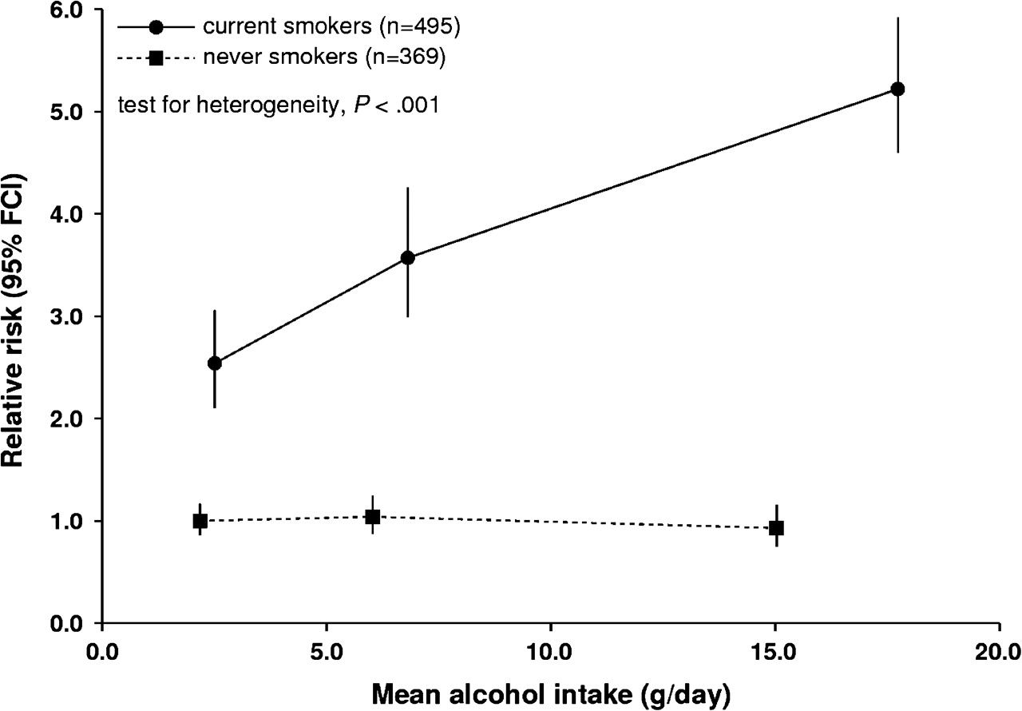
Figure 4 Relative risk (95% floated confidence interval) of cancers of the upper aerodigestive tract (cancer of the ...
Notes:
Figure 4 Relative risk (95% floated confidence interval) of cancers of the upper aerodigestive tract (cancer of the oral cavity and pharynx, lanynx and esophagus by alcohol intake and smoking (drinkers only). The relative risk is plotted against the mean remeasured value of alcohol intake (g/d) in each category. Analyses are adjusted for age, region of residence, socioeconomic status, body mass index, smoking, physical activity, use of oral contraceptives, and hormone replacement therapy. FCI = floated confidence interval.
Unless provided in the caption above, the following copyright applies to the content of this slide: © The Author 2009. Published by Oxford University Press.

