Slide 1
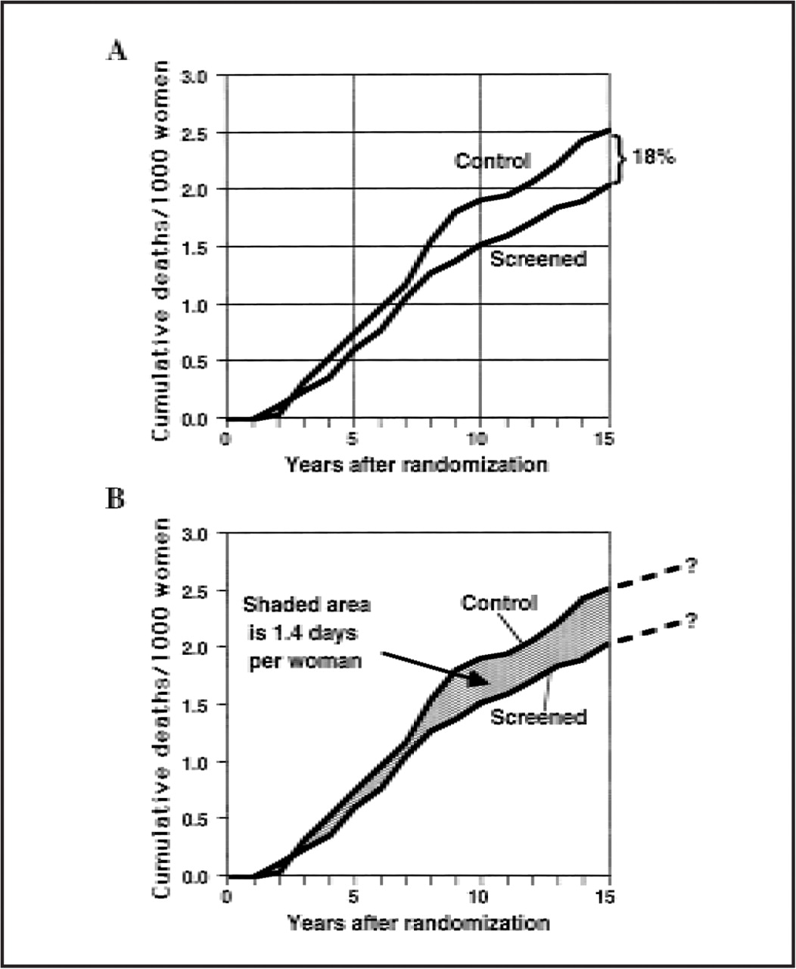
Fig. 3 Breast cancer mortality per 1000 women, all eight trials of screening mammography (6–12). A) Estimated from ...
Notes:
Fig. 3 Breast cancer mortality per 1000 women, all eight trials of screening mammography (6–12). A) Estimated from Larsson et al. (20), Miller et al. (7), Alexander et al. (12), and Shapiro et al. ((6), with updated overall mortality as reported by Hendrick et al. (13). Larsson et al. contains an older version of the Swedish trial results than does Hendrick et al., and, in particular, Larsson et al. includes only Malmo" Mammography Screening Trial I. Therefore, the mortality curves in this figure incorporate updated results of the Swedish trials to include Malmo" Mammography Screening Trial II (11). For trials with less than 15 years of follow-up, mortality rates from the end of follow-up out to 15 years were estimated using parallel straight lines. The observed 15-year reduction in mortality for screened women compared with control women is 18%. B) The shaded area is equivalent to 3.76 years/1000 women or 1.37 days per woman. This is the estimated increase in life expectancy out to 15 years after the initiation of screening. The text gives estimates of increases in overall life expectancy by assuming that the reduction of 18% applies at 15 years and that it is maintained indefinitely.
Unless provided in the caption above, the following copyright applies to the content of this slide: © 1998 Oxford University Press

Slide 2
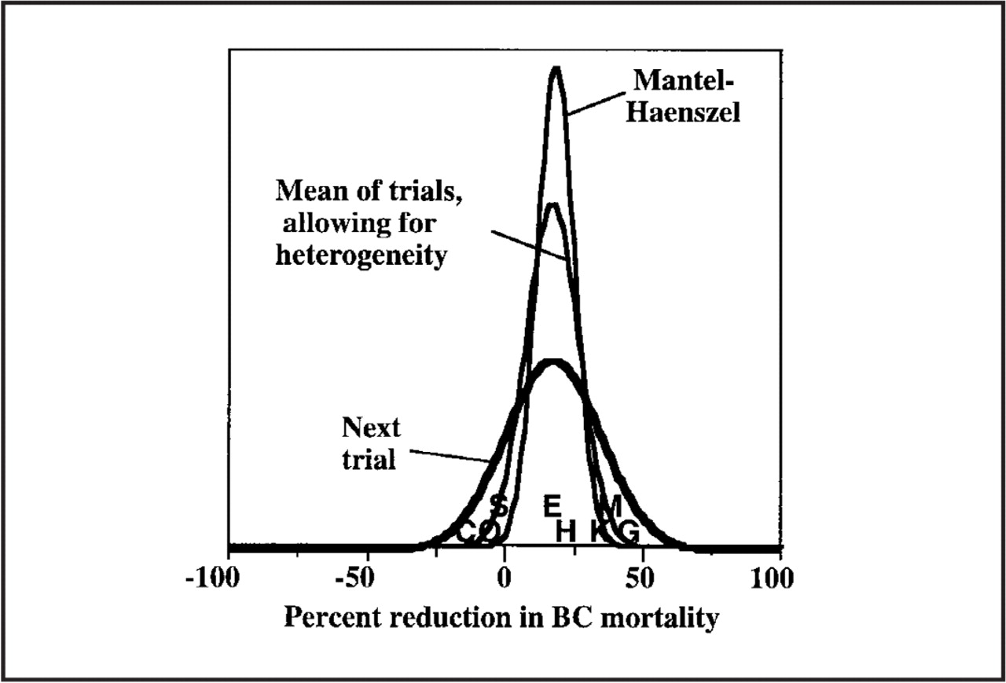
Fig. 2 Distribution of reduction in breast cancer (BC) mortality. The Mantel- Haenszel likelihood function assumes ...
Notes:
Fig. 2 Distribution of reduction in breast cancer (BC) mortality. The Mantel- Haenszel likelihood function assumes homogeneity in the eight trials of screening mammography [H4Health Insurance Plan of New York; K4Kopparberg; O 4 O " stergo"tland; M 4 Malmo"; E 4 Edinburgh; G 4 Gothenburg; S 4 Stockholm; and C 4 Canada National Breast Screening Study I] (6-12). The other two curves are from a Bayesian analysis, which allows for trial heterogeneity. The areas under the curves are the same. Allowing for heterogeneity, the posterior distribution of the population mean exhibits greater variability than that observed with the Mantel-Haenszel likelihood function. The predictive distribution of the next observation (trial) from the population of trials-including that of a particular woman choosing screening-has much greater variability than that observed with the Mantel-Haenszel function.
Unless provided in the caption above, the following copyright applies to the content of this slide: © 1998 Oxford University Press

Slide 3
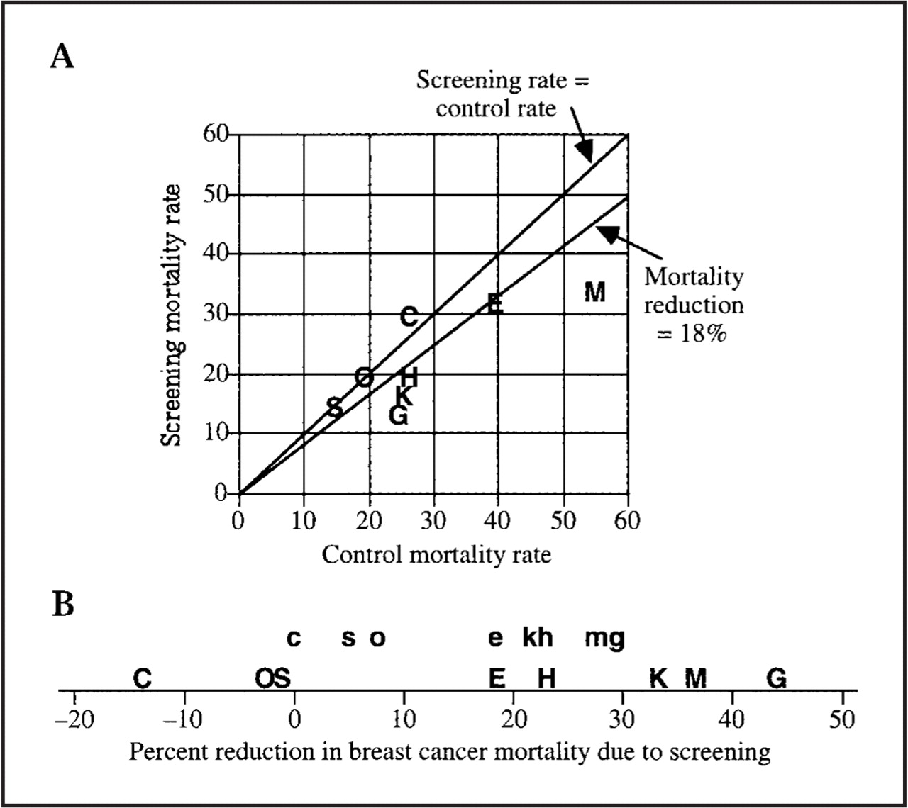
Fig. 1 Plots of results of the eight randomized trials of screening mammography (6-12). Data points are labeled by ...
Notes:
Fig. 1 Plots of results of the eight randomized trials of screening mammography (6-12). Data points are labeled by use of trial symbols as follows: H 4 Health Insurance Plan of New York; K 4 Kopparberg; O 4 O " stergo"tland; M 4 Malmo"; E 4 Edinburgh; G 4 Gothenburg; S 4 Stockholm; and C 4 Canada National Breast Screening Study I. A) Breast cancer mortality rates per 100 000 life-years by group. The upper line would be obtained if mortality rates in screening groups and control groups were the same. The lower line reflects the 18% reduction in mortality observed in the eight trials combined. B) Estimated reduction in breast cancer mortality-screening over control. Positive reductions indicate an observed benefit for the screening group. Upper-case symbols show the estimated reductions in the trials [see penultimate column of Table 2], and lower-case symbols show the adjusted or regressed estimates as described in the text and as indicated in the last column of Table 2. Trial results further from the overall mean estimate of 18% are regressed more than are those closer to the mean, and smaller trials are regressed more than larger trials.
Unless provided in the caption above, the following copyright applies to the content of this slide: © 1998 Oxford University Press

Slide 4
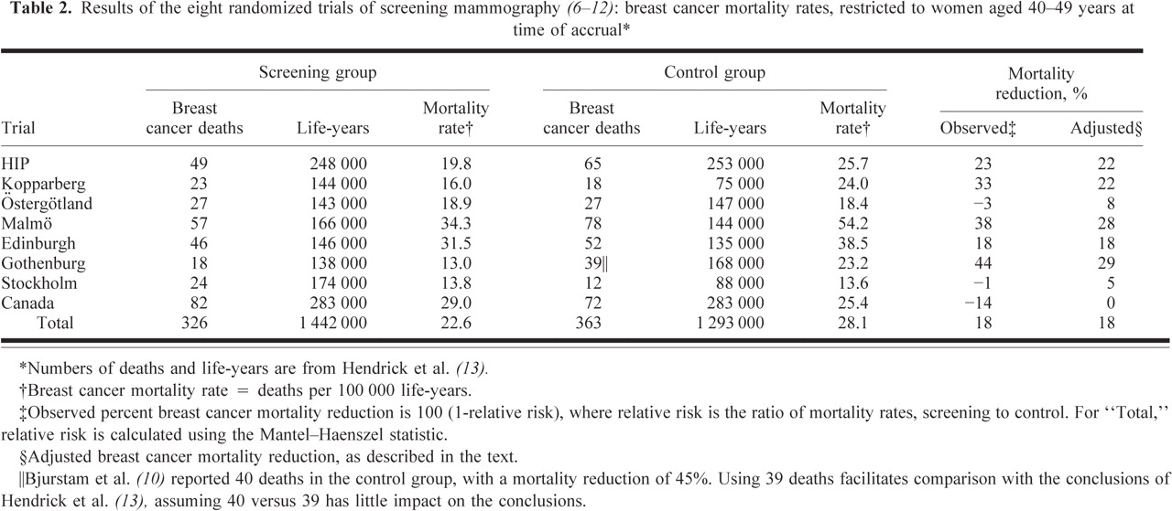
Notes:
Unless provided in the caption above, the following copyright applies to the content of this slide: © 1998 Oxford University Press

Slide 5
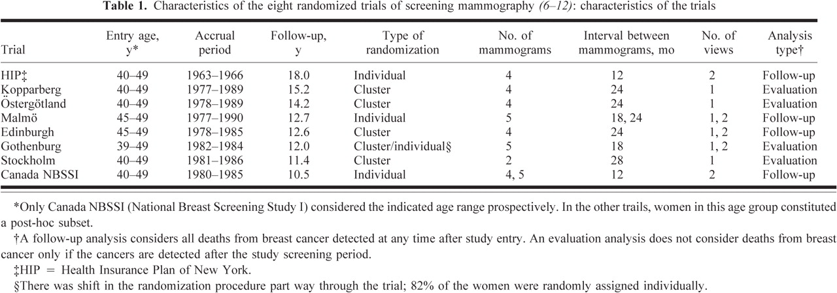
Notes:
Unless provided in the caption above, the following copyright applies to the content of this slide: © 1998 Oxford University Press

