Slide 1
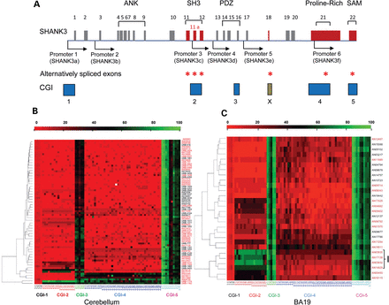
Figure 1. Increased DNA methylation in SHANK3 intragenic CGIs in ASD postmortem brain tissues. (A) The alternatively ...
Notes:
Figure 1. Increased DNA methylation in SHANK3 intragenic CGIs in ASD postmortem brain tissues. (A) The alternatively spliced exons are marked in red and by asterisks. SHANK3a–f transcripts initiated from six promoters as described in text are shown by arrows (see also Supplementary Material, Fig. S10). The CGIs are shown by solid bars in blue. CGI-X is displayed in Ensembl but not in the UCSC genome browser, probably due to the use of slightly different computational programs for the prediction of CGIs. We were not able to design primers to analyze CGI-X. (B) Heat map of the percentage of methylation of CGIs in ASD cerebellum (all available samples were analyzed but only cases with data for all CGIs are shown in the heat map). The heat map was generated using the calculated percentage of methylation from the data of bisulfite genomic sequencing for each CGI. The color bar indicates the level of methylation from lowest (red) to highest (green). The ASD case numbers are in red and the controls are in black on the Y-axis. ASD cerebellum samples AN17777 (14), AN16115 (17), AN07948 (14), UMB1174 (17), UMB1182 (17) (the number in parenthesis indicates the hypermethylated sites out of a total of 17 CG sites covered) were significantly hypermethylated in CGI-2 and ASD samples AN03345 (29), AN19511 (30), AN09730 (31), UMB1174 (32), UMB1182 (33) and AN11989 (33) were significantly hypermethylated in CGI-4 (a total of 40 CG sites analyzed). (C) Heat map of the methylation percentage of SHANK3 CGIs in BA19 tissues. ASD samples AN03632 (16), AN03935 (17), AN14829 (17) and AN17138 (17) have a significantly higher percentage of methylation compared with controls and other ASD samples (Cluster I). (D and E) Representative methylation plots for control and ASD cerebellum with significantly increased methylation in CGI-2 (D) and CGI-4 (E). (F and G) Representative methylation plots for control and ASD BA19 samples with significantly increased methylation in CGI-2 (F) and CGI-4 (G). The closed circles indicate methylated CG sites and open circles indicate unmethylated CG sites. The ASD cases with significantly increased methylation of CGI-3 are shown in Supplementary Material, Dataset D1 (y, year; M, male; F, female).
Unless provided in the caption above, the following copyright applies to the content of this slide: © The Author 2013. Published by Oxford University Press. All rights reserved. For Permissions, please email: journals.permissions@oup.com

Slide 2
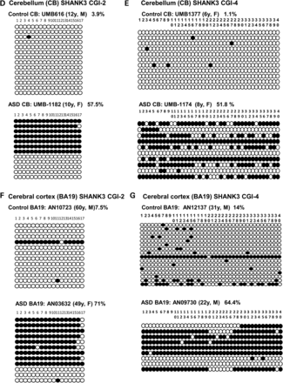
Figure 1. Increased DNA methylation in SHANK3 intragenic CGIs in ASD postmortem brain tissues. (A) The alternatively ...
Notes:
Figure 1. Increased DNA methylation in SHANK3 intragenic CGIs in ASD postmortem brain tissues. (A) The alternatively spliced exons are marked in red and by asterisks. SHANK3a–f transcripts initiated from six promoters as described in text are shown by arrows (see also Supplementary Material, Fig. S10). The CGIs are shown by solid bars in blue. CGI-X is displayed in Ensembl but not in the UCSC genome browser, probably due to the use of slightly different computational programs for the prediction of CGIs. We were not able to design primers to analyze CGI-X. (B) Heat map of the percentage of methylation of CGIs in ASD cerebellum (all available samples were analyzed but only cases with data for all CGIs are shown in the heat map). The heat map was generated using the calculated percentage of methylation from the data of bisulfite genomic sequencing for each CGI. The color bar indicates the level of methylation from lowest (red) to highest (green). The ASD case numbers are in red and the controls are in black on the Y-axis. ASD cerebellum samples AN17777 (14), AN16115 (17), AN07948 (14), UMB1174 (17), UMB1182 (17) (the number in parenthesis indicates the hypermethylated sites out of a total of 17 CG sites covered) were significantly hypermethylated in CGI-2 and ASD samples AN03345 (29), AN19511 (30), AN09730 (31), UMB1174 (32), UMB1182 (33) and AN11989 (33) were significantly hypermethylated in CGI-4 (a total of 40 CG sites analyzed). (C) Heat map of the methylation percentage of SHANK3 CGIs in BA19 tissues. ASD samples AN03632 (16), AN03935 (17), AN14829 (17) and AN17138 (17) have a significantly higher percentage of methylation compared with controls and other ASD samples (Cluster I). (D and E) Representative methylation plots for control and ASD cerebellum with significantly increased methylation in CGI-2 (D) and CGI-4 (E). (F and G) Representative methylation plots for control and ASD BA19 samples with significantly increased methylation in CGI-2 (F) and CGI-4 (G). The closed circles indicate methylated CG sites and open circles indicate unmethylated CG sites. The ASD cases with significantly increased methylation of CGI-3 are shown in Supplementary Material, Dataset D1 (y, year; M, male; F, female).
Unless provided in the caption above, the following copyright applies to the content of this slide: © The Author 2013. Published by Oxford University Press. All rights reserved. For Permissions, please email: journals.permissions@oup.com

Slide 3
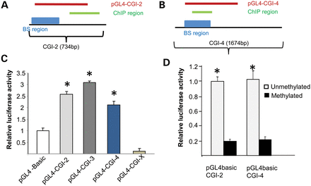
Figure 2. SHANK3 promoter activity and intragenic CGIs. (A and B) Diagram of CGI-2 and CGI-4 regions analyzed for ...
Notes:
Figure 2. SHANK3 promoter activity and intragenic CGIs. (A and B) Diagram of CGI-2 and CGI-4 regions analyzed for luciferase reporter assay (red), ChIP (green) and bisulfite sequencing (BS, blue). (C) Luciferase reporter assay revealed that the fragments from CGI-2, CGI-3 and CGI-4, but not CGI-X, have promoter activity in HEK293 cells (*P < 0.0001 versus pGL4 basic). (D) The promoter activity of CGI-2 and CGI-4 was inhibited by in vitro DNA methylation in HEK293 cells (*P < 0.0002 methylated versus unmethylated).
Unless provided in the caption above, the following copyright applies to the content of this slide: © The Author 2013. Published by Oxford University Press. All rights reserved. For Permissions, please email: journals.permissions@oup.com

Slide 4
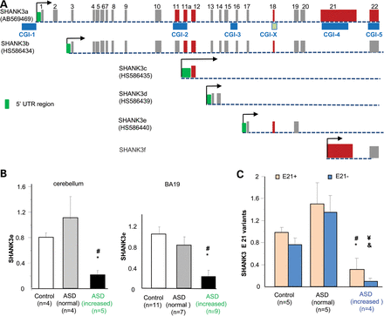
Figure 3. Altered isoform-specific expression of SHANK3 in ASD brain tissues with increased DNA methylation. (A) ...
Notes:
Figure 3. Altered isoform-specific expression of SHANK3 in ASD brain tissues with increased DNA methylation. (A) Diagram of multiple intragenic promoters and promoter specific isoforms of SHANK3a–f. SHANK3b–e are transcribed from intronic regions as diagramed. These transcripts were confirmed by RT–PCR using isoform-specific primers in human brains. The full-length mRNA for each isoform have not been characterized. The exons highlighted in red are alternatively spliced exons. (B) The expression of the SHANK3e in ASD cerebellum with increased methylation was significantly lower than in controls (#P = 0.0006) and ASD with normal methylation (*P = 0.02). Expression of SHANK3e was also reduced in ASD BA19 with increased methylation compared with ASD with low methylation (#P = 0.004) and controls (*P = 0.001). (C) The expression of both E21+ and E21− variants was decreased in ASD tissues with increased methylation (n = 4) compared with controls (n = 5) and ASD with normal methylation (n = 5). For the E21+ variant, #P < 0.01 for ASD samples with increased methylation versus controls, and *P < 0.03 for increased methylation versus normal methylation. For the E21− variant, ¥P < 0.001 for ASD samples with increased methylation versus controls, &P 3 kb. Primer pair P1 and P2 was used to detect E21+ variant. The information of age and gender for brain tissues used for RT–PCR are listed in the Supplementary Material, Table S5.
Unless provided in the caption above, the following copyright applies to the content of this slide: © The Author 2013. Published by Oxford University Press. All rights reserved. For Permissions, please email: journals.permissions@oup.com

Slide 5
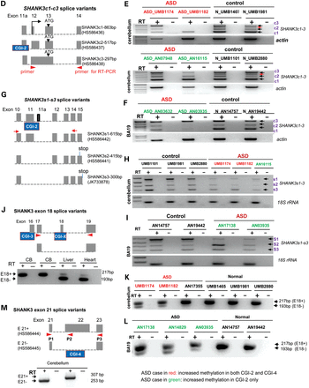
Figure 3. Altered isoform-specific expression of SHANK3 in ASD brain tissues with increased DNA methylation. (A) ...
Notes:
Figure 3. Altered isoform-specific expression of SHANK3 in ASD brain tissues with increased DNA methylation. (A) Diagram of multiple intragenic promoters and promoter specific isoforms of SHANK3a–f. SHANK3b–e are transcribed from intronic regions as diagramed. These transcripts were confirmed by RT–PCR using isoform-specific primers in human brains. The full-length mRNA for each isoform have not been characterized. The exons highlighted in red are alternatively spliced exons. (B) The expression of the SHANK3e in ASD cerebellum with increased methylation was significantly lower than in controls (#P = 0.0006) and ASD with normal methylation (*P = 0.02). Expression of SHANK3e was also reduced in ASD BA19 with increased methylation compared with ASD with low methylation (#P = 0.004) and controls (*P = 0.001). (C) The expression of both E21+ and E21− variants was decreased in ASD tissues with increased methylation (n = 4) compared with controls (n = 5) and ASD with normal methylation (n = 5). For the E21+ variant, #P < 0.01 for ASD samples with increased methylation versus controls, and *P < 0.03 for increased methylation versus normal methylation. For the E21− variant, ¥P < 0.001 for ASD samples with increased methylation versus controls, &P 3 kb. Primer pair P1 and P2 was used to detect E21+ variant. The information of age and gender for brain tissues used for RT–PCR are listed in the Supplementary Material, Table S5.
Unless provided in the caption above, the following copyright applies to the content of this slide: © The Author 2013. Published by Oxford University Press. All rights reserved. For Permissions, please email: journals.permissions@oup.com

Slide 6
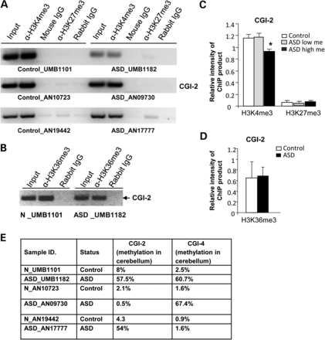
Figure 4. Chromatin histone modifications were altered in CGI-4 of ASD brain tissues with increased DNA methylation. ...
Notes:
Figure 4. Chromatin histone modifications were altered in CGI-4 of ASD brain tissues with increased DNA methylation. Chromatin immunoprecipitation (ChIP) assays were performed in cerebellum of ASD cases and controls (N) using antibodies against different histone modifications including H3K4me3, H3K27me3 and H3K36me3. (A) The images of ChIP-PCR product for H3K4me3 in CGI-2 of cerebellar tissues. The level of H3K4me3 in CGI-4 was significantly reduced in ASD cerebellum samples with significantly increased methylation compared with controls. The level of H3K27me3 was low in brain tissues. (B) The semi-quantitative analysis of intensity of ChIP products for H3K4me3 and H3K27m3 in CGI-2 of ASD brains with increased methylation (high me), ASD with low methylation (low me) and controls. *P < 0.001 ASD with increased methylation versus controls (n = 3 for controls, n = 4 for ASD with low methylation, n = 3 for ASD with high methylation. (C) The images of ChIP-PCR product for H3K36me3 in CGI-2 of cerebellar tissues. (D) The semi-quantitative analysis of intensity of ChIP products for H3K36me3 in CGI-2 of ASD brains with increased methylation and controls. (E) Summary of percentage of methylation for ASD and control brain tissues used in the ChIP assay. The age and gender information for each case is listed in Supplementary Material, Table S5.
Unless provided in the caption above, the following copyright applies to the content of this slide: © The Author 2013. Published by Oxford University Press. All rights reserved. For Permissions, please email: journals.permissions@oup.com

Slide 7
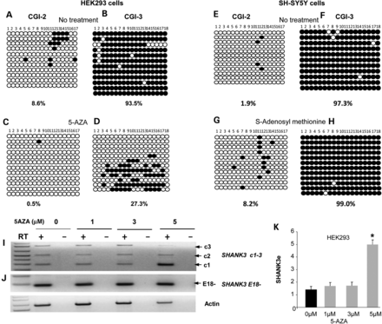
Figure 5. A DNA methylation inhibitor and methyl donor modified methylation of CGIs and altered the isoform-specific ...
Notes:
Figure 5. A DNA methylation inhibitor and methyl donor modified methylation of CGIs and altered the isoform-specific expression of SHANK3 in cultured cells. (A–D) The methylation level of CGI-2 and CGI-3 SHANK3 in HEK293 cells with or without 5-AZA treatment (5 µm) for 14 days. (E–H) The methylation level in CGI-2 and CGI-3 of SHANK3 in SH-SY5Y neuronal cells with or without treatment of S-adenosyl methionine (100 µm). The methylation of CG site 11 and 12 of CGI-2 were more affected by the treatment. (I) SHANK3c1 is increased in HEK293 cells treated with 5 µm 5-AZA. (J) The ratio of exon 18 splice variants was not altered after 5-AZA treatment and only E18− variant was present. No change for SHANK3s1–s3. (K) The significantly increased expression of SHANK3e from CGI-3 promoter in HEK293 cells after 5-AZA treatment by real-time PCR analysis (n = 3 for each concentration; *P< 0.001 treated versus not treated) (see also Supplementary Material, Fig. S13).
Unless provided in the caption above, the following copyright applies to the content of this slide: © The Author 2013. Published by Oxford University Press. All rights reserved. For Permissions, please email: journals.permissions@oup.com

