Slide 1
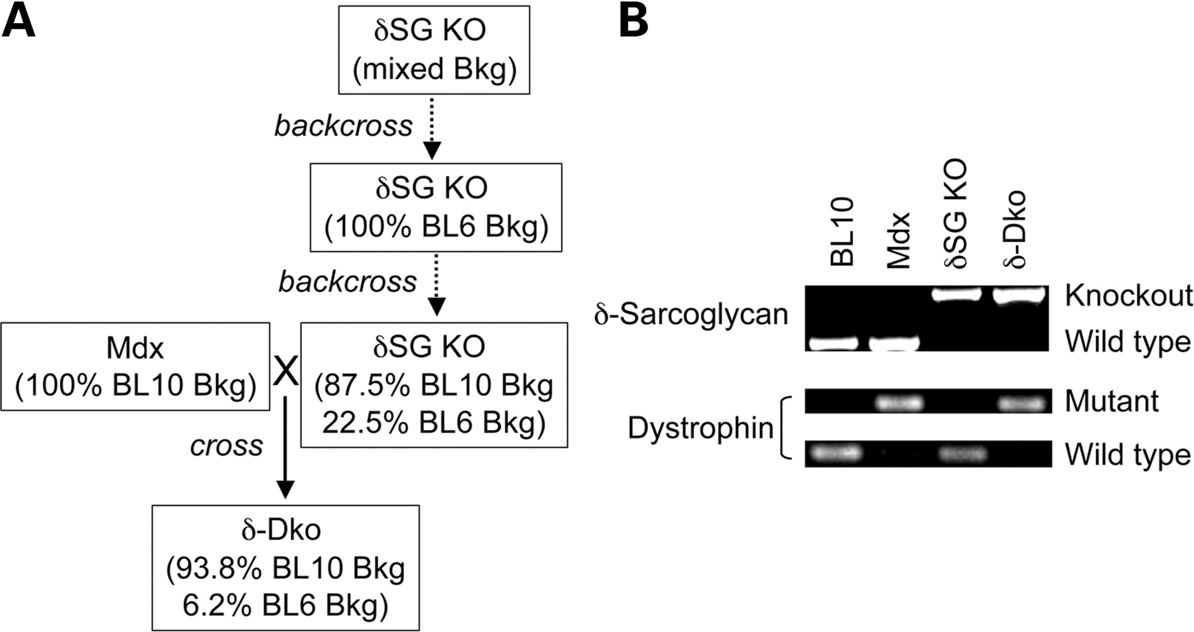
Figure 1. Generation of dystrophin/δ-sarcoglycan double mutant mice. (A) The breeding scheme. (B) Representative PCR ...
Notes:
Figure 1. Generation of dystrophin/δ-sarcoglycan double mutant mice. (A) The breeding scheme. (B) Representative PCR genotyping results. Bkg, background; δSG KO, δ-sarcoglycan deficient mice; δ-Dko, δ-sarcoglycan/dystrophin double deficient mice.
Unless provided in the caption above, the following copyright applies to the content of this slide: © The Author 2009. Published by Oxford University Press. All rights reserved. For Permissions, please email: journals.permissions@oxfordjournals.org

Slide 2
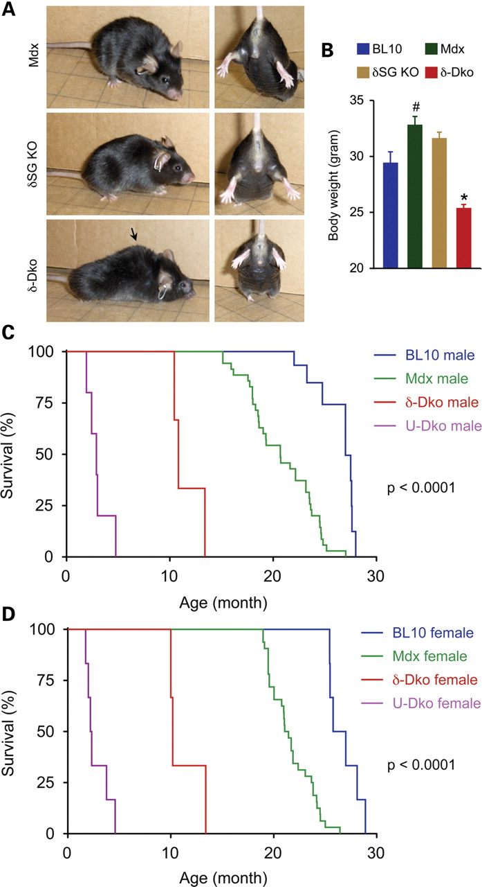
Figure 2. Dystrophin/δ-sarcoglycan double knockout mice display a severer clinical phenotype. (A) Kyphosis (arrow) and ...
Notes:
Figure 2. Dystrophin/δ-sarcoglycan double knockout mice display a severer clinical phenotype. (A) Kyphosis (arrow) and hind limb joint contracture were apparent in δ-Dko mice. (B) Body weights of 3-month-old male BL10, mdx, δSG KO and δ-Dko mice. n = 11 for BL10 mice, n = 13 for mdx mice, n = 7 for δSG KO mice and n = 10 for δ-Dko mice. Asterisk, the body weight of δ-Dko mice was significantly lower than that of other strains (P ≤ 0.004); Pound sign, mdx mice were significantly heavier than BL10 and δ-Dko mice (P ≤ 0.012). (C and D) Kaplan–Meier survival curves for male and female mice, respectively. U-Dko, utrophin/dystrophin double knockout mice. See Table 1 for sample size.
Unless provided in the caption above, the following copyright applies to the content of this slide: © The Author 2009. Published by Oxford University Press. All rights reserved. For Permissions, please email: journals.permissions@oxfordjournals.org

Slide 3
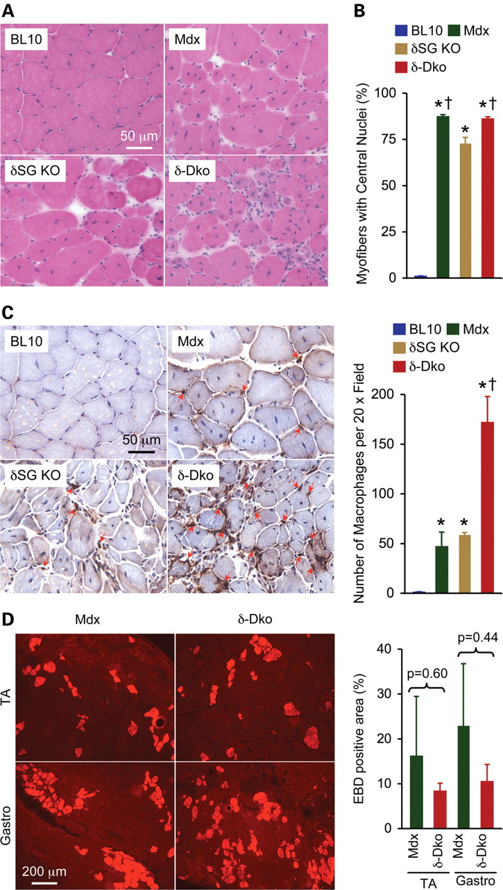
Figure 3. Skeletal muscle histopathology is severe in δ-Dko mice. (A) Representative skeletal muscle HE staining from ...
Notes:
Figure 3. Skeletal muscle histopathology is severe in δ-Dko mice. (A) Representative skeletal muscle HE staining from 4-month-old male BL10, single mutant and double mutant mice. (B) Quantification of central nucleation. n = 4 for BL10 mice, n = 7 for mdx mice, n = 6 for δSG KO mice and n = 7 for δ-Dko mice. Asterisk, significantly higher than that of BL10 muscle (P ≤ 0.0004); Cross, significantly higher than that of δSG KO muscle (P ≤ 0.0004). There is no significant difference between mdx muscle and δ-Dko muscle (P = 0.968). (C) Representative photomicrographs of macrophage infiltration in muscle. Arrow, macrophages (Note, some macrophages are not marked). n = 4 for BL10 mice, n = 7 for mdx mice, n = 8 for δSG KO mice and n = 6 for δ-Dko mice. Asterisk, significantly higher than that of BL10 muscle (P ≤ 0.004); Cross, significantly higher than that of δSG KO muscle (P ≤ 0.004). (D) Representative photomicrographs of EBD uptake in mdx and δ-Dko muscle. TA, tibialis anterior muscle; Gastro, gastrocnemius muscle.
Unless provided in the caption above, the following copyright applies to the content of this slide: © The Author 2009. Published by Oxford University Press. All rights reserved. For Permissions, please email: journals.permissions@oxfordjournals.org

Slide 4
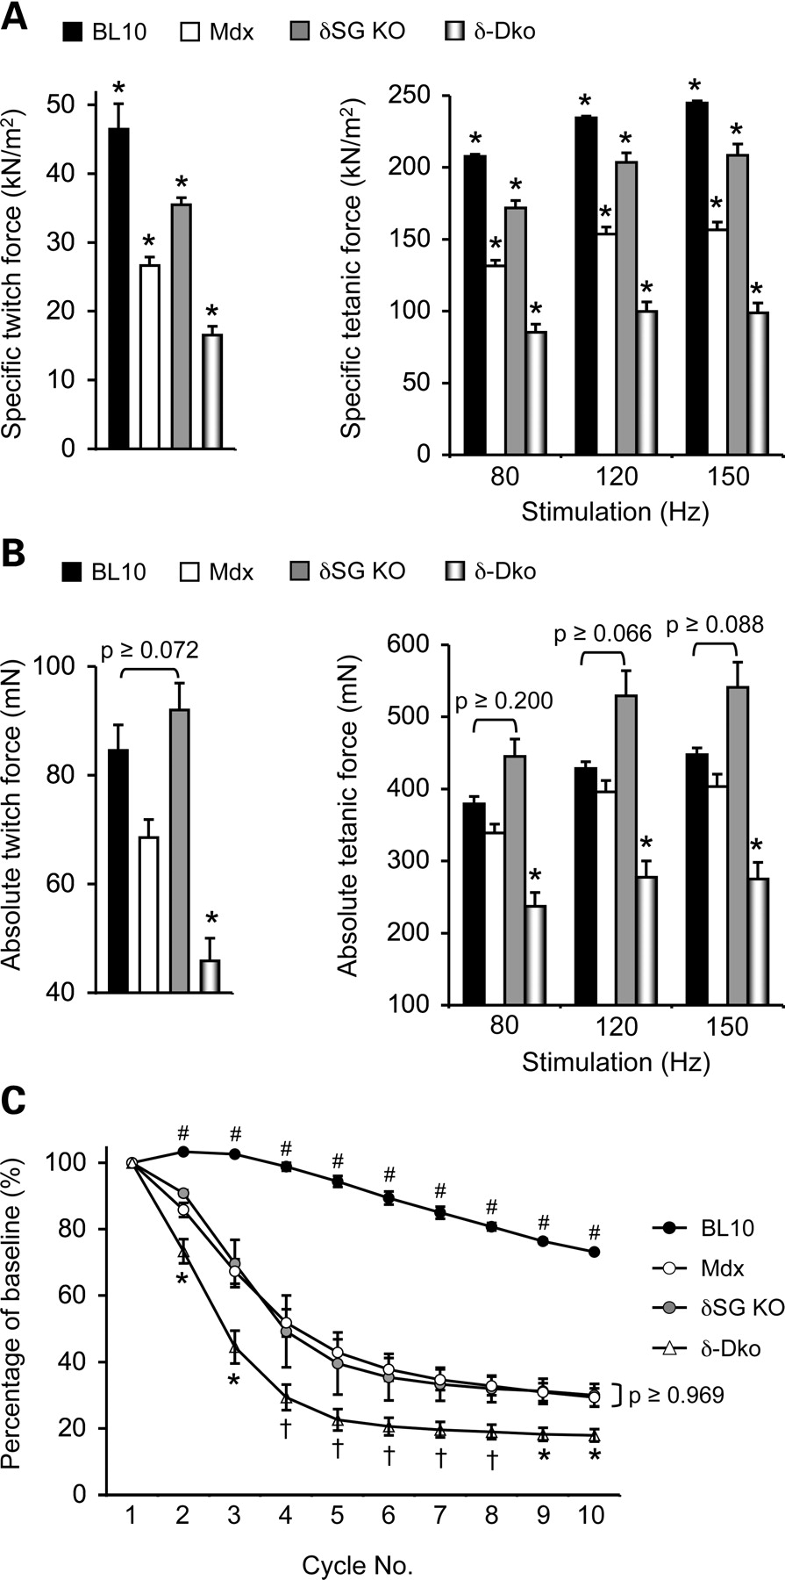
Figure 4. Double knockout mouse skeletal muscle generates much less force and it is also more sensitive to eccentric ...
Notes:
Figure 4. Double knockout mouse skeletal muscle generates much less force and it is also more sensitive to eccentric contraction-induced injury. Muscle force measurements from 4-month-old male BL10, single mutant and double mutant mice. (A) Cross-sectional area normalized twitch and tetanic forces. Asterisk, significantly different from other groups. (B) Absolute twitch and tetanic muscle forces. Asterisk, significantly lower than other groups. (C) Profiles of muscle force drop during 10 continuous rounds of eccentric contraction. Asterisk, significantly lower than other groups; Cross, significantly lower than that of BL10 and mdx muscles; Pound sign, significantly higher than other groups. n = 4 for BL10 mice, n = 9 for mdx mice, n = 4 for δSG KO mice and n = 11 for δ-Dko mice.
Unless provided in the caption above, the following copyright applies to the content of this slide: © The Author 2009. Published by Oxford University Press. All rights reserved. For Permissions, please email: journals.permissions@oxfordjournals.org

Slide 5
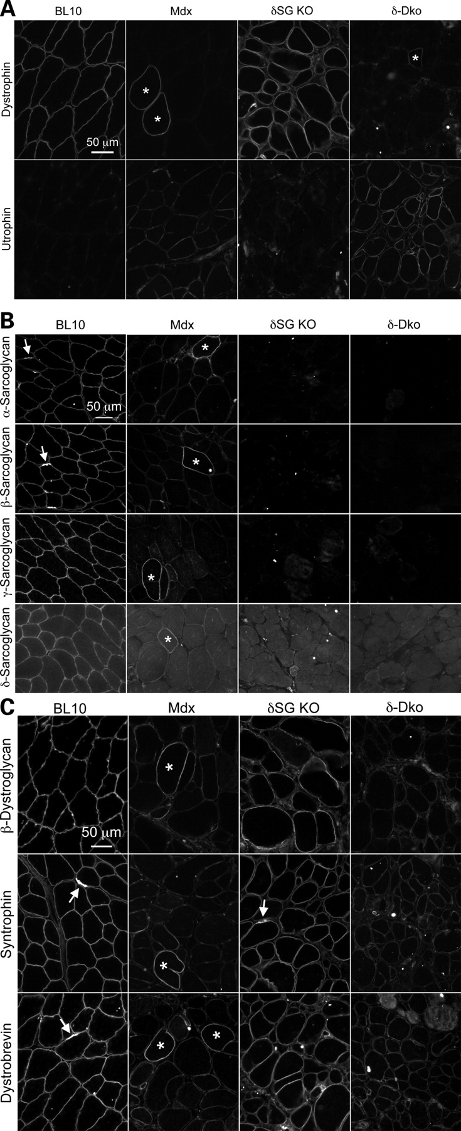
Figure 6. Evaluating sarcolemmal expression of dystrophin, utrophin and their associated proteins by immunofluorescence ...
Notes:
Figure 6. Evaluating sarcolemmal expression of dystrophin, utrophin and their associated proteins by immunofluorescence staining. (A) Representative immunostaining photomicrographs of dystrophin and utrophin. (B) Representative immunostaining photomicrographs of the SGC. (C) Representative immunostaining photomicrographs of β-dystroglycan, syntrophin and dystrobrevin. Asterisk, revertant fiber; Arrow, neuromuscular junction.
Unless provided in the caption above, the following copyright applies to the content of this slide: © The Author 2009. Published by Oxford University Press. All rights reserved. For Permissions, please email: journals.permissions@oxfordjournals.org

Slide 6
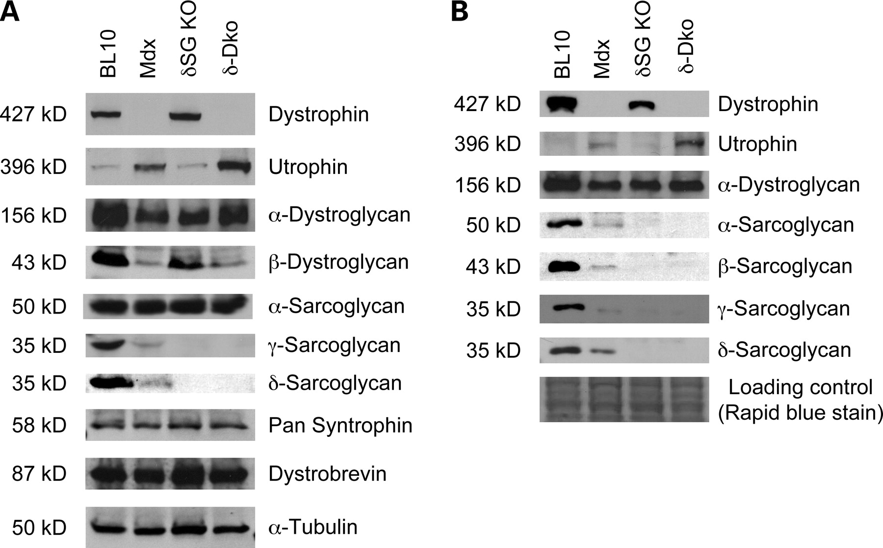
Figure 5. Western blot analysis of dystrophin, utrophin and their associated proteins in skeletal muscle lysate. (A) ...
Notes:
Figure 5. Western blot analysis of dystrophin, utrophin and their associated proteins in skeletal muscle lysate. (A) Representative western blot results from whole muscle lysate. (B) Representative microsomal preparation western blot results.
Unless provided in the caption above, the following copyright applies to the content of this slide: © The Author 2009. Published by Oxford University Press. All rights reserved. For Permissions, please email: journals.permissions@oxfordjournals.org

