Slide 1
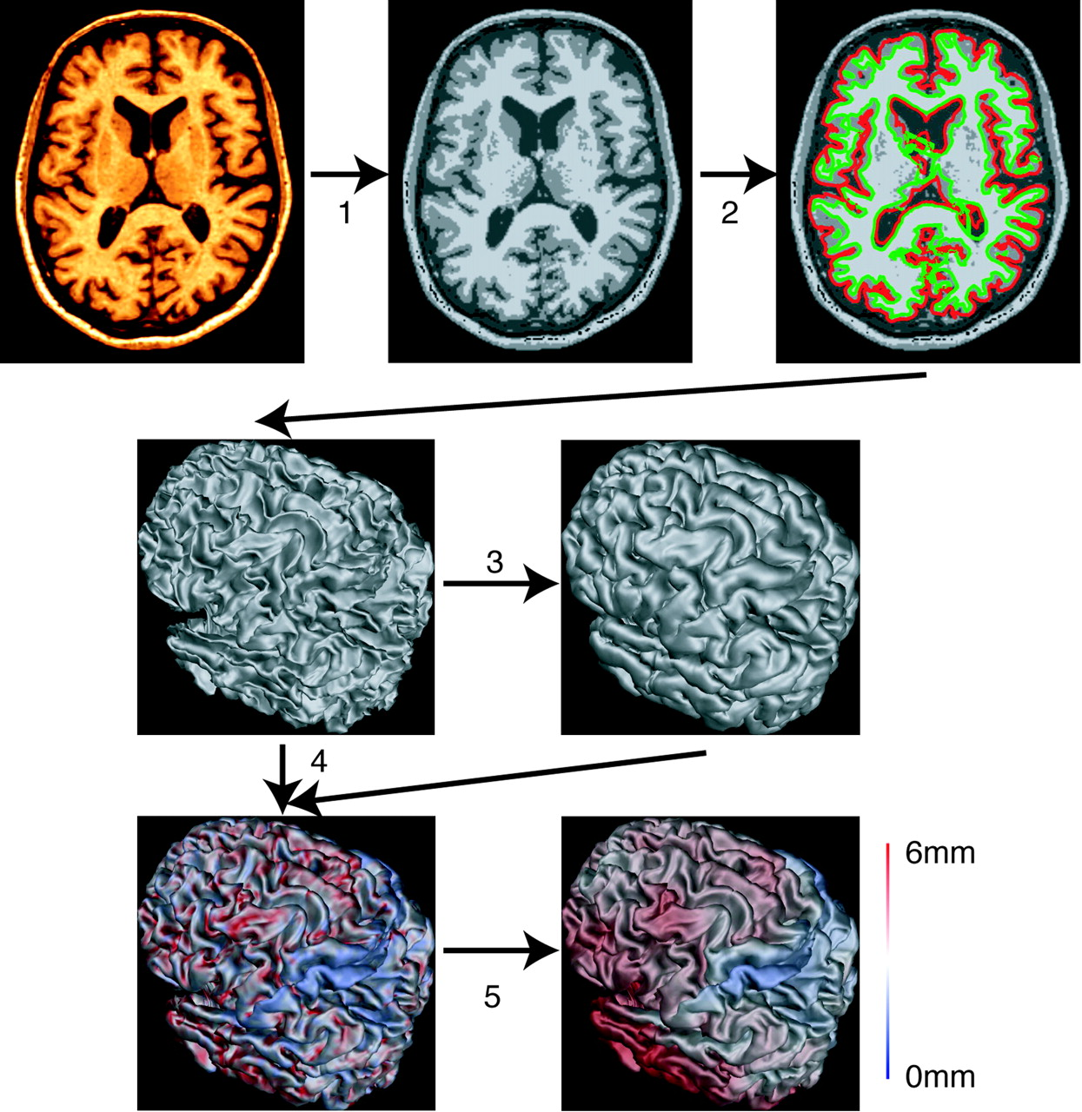
Figure 1. An overview of the steps involved in cortical thickness analysis. First, the images are non-uniformity ...
Notes:
Figure 1. An overview of the steps involved in cortical thickness analysis. First, the images are non-uniformity corrected and registered into stereotaxic space. They are then classified (1) and fit with a white matter surface (2). The gray surface is found by expanding out from the white (3). Cortical thickness is measured at every vertex (4), and blurred using a 20 mm surface-based kernel (5).
Unless provided in the caption above, the following copyright applies to the content of this slide: Cerebral Cortex V 15 N 7 © Oxford University Press 2004; all rights reserved

Slide 2
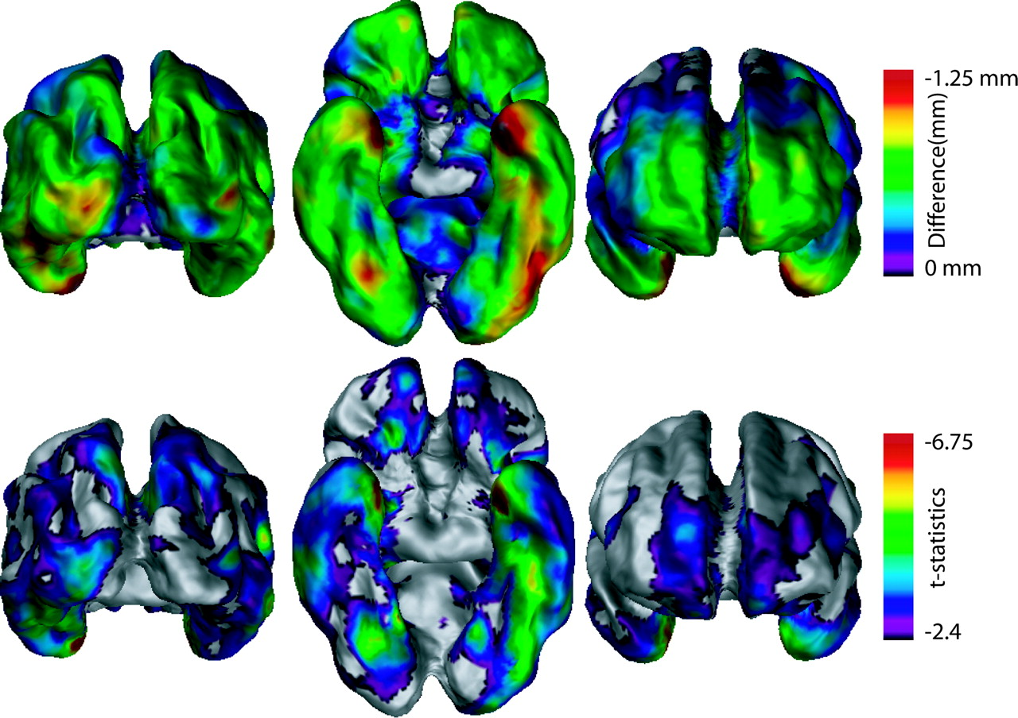
Figure 2. t-statistical (lower panel) and cortical thickness (upper panel) difference maps in 19 AD subjects versus 17 ...
Notes:
Figure 2. t-statistical (lower panel) and cortical thickness (upper panel) difference maps in 19 AD subjects versus 17 controls (age effect removed by regression). Results from the statistical analysis are displayed at each vertex of the surface of a standardized brain in terms of t-statistical color maps as well as color maps displaying the estimated cortical thickness difference in millimeters (the regression slope) between the two groups. Significant differences can be seen in the temporal lobes, especially the entorhinal and perirhinal cortices, as well as medial frontal and parietal lobes and left associative visual areas.
Unless provided in the caption above, the following copyright applies to the content of this slide: Cerebral Cortex V 15 N 7 © Oxford University Press 2004; all rights reserved

Slide 3
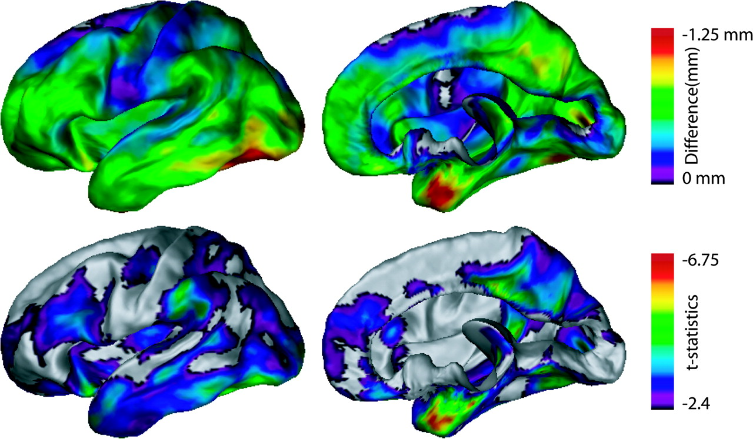
Figure 3. t-statistical (lower panel) and cortical thickness (upper panel) difference maps in 19 AD subjects versus 17 ...
Notes:
Figure 3. t-statistical (lower panel) and cortical thickness (upper panel) difference maps in 19 AD subjects versus 17 controls (age effect removed by regression). The display emphasizes the differences in the left lateral and right medial views. Significant differences can be seen in the posterior and anterior cingulate, the left dorsolateral prefrontal cortex, most of the temporal lobes, and the left supramarginal gyrus.
Unless provided in the caption above, the following copyright applies to the content of this slide: Cerebral Cortex V 15 N 7 © Oxford University Press 2004; all rights reserved

Slide 4
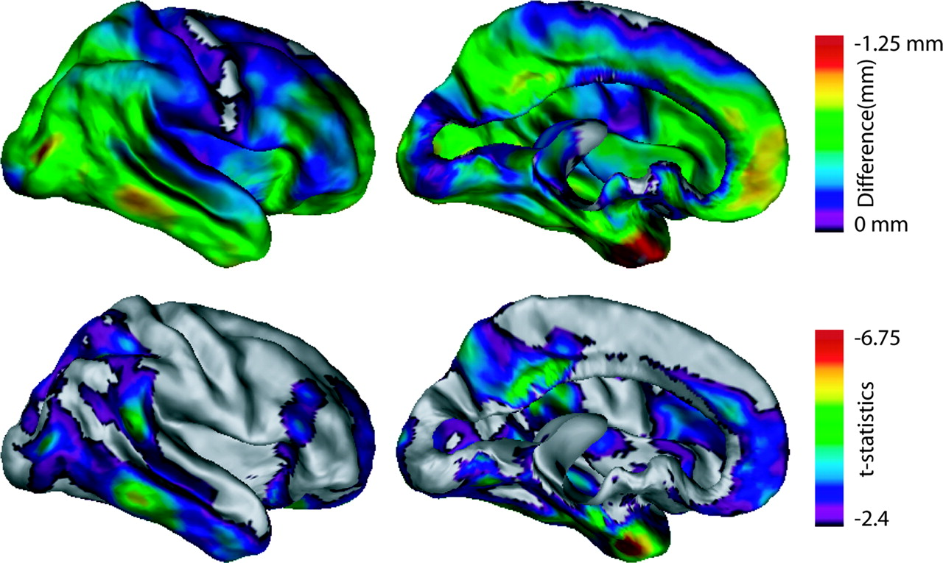
Figure 4. t-statistical (lower panel) and cortical thickness (upper panel) difference maps in 19 AD subjects versus 17 ...
Notes:
Figure 4. t-statistical (lower panel) and cortical thickness (upper panel) difference maps in 19 AD subjects versus 17 controls (age effect removed by regression). The display emphasizes the differences right lateral and left medial views. Significant differences can be found throughout the temporal lobes, the posterior and anterior cingulate. Compared with the left hemisphere, the difference in the supramarginal gyrus and the dorsolateral prefrontal cortex is reduced.
Unless provided in the caption above, the following copyright applies to the content of this slide: Cerebral Cortex V 15 N 7 © Oxford University Press 2004; all rights reserved

Slide 5
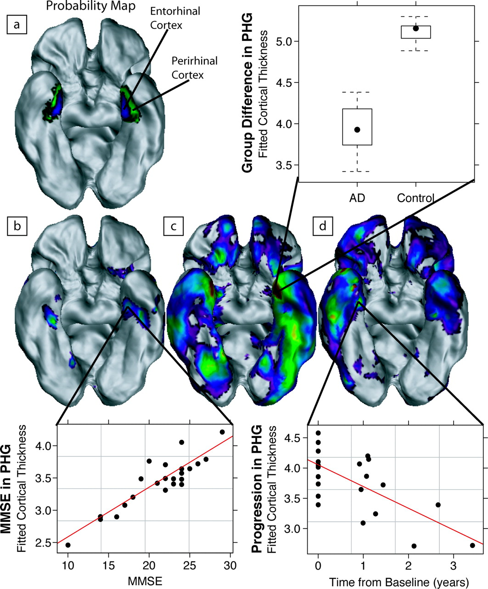
Figure 5. Regional analysis using the cortical thickness methodology in AD versus normal controls displaying ...
Notes:
Figure 5. Regional analysis using the cortical thickness methodology in AD versus normal controls displaying differences in the entorhinal cortex. The four cortical views show: (a) the probability maps of the entorhinal and perirhinal cortices in this population; (b) the t-statistics of the MMSE regression; (c) the group analysis; and (d) the time difference from baseline. The color scales are the same as in Figures 2–4, 6 and 7 respectively. The graphs illustrate the effects at the vertex indicated by the black lines. Atrophy of the PHG is clearly implicated in each of the three analyses shown.
Unless provided in the caption above, the following copyright applies to the content of this slide: Cerebral Cortex V 15 N 7 © Oxford University Press 2004; all rights reserved

Slide 6
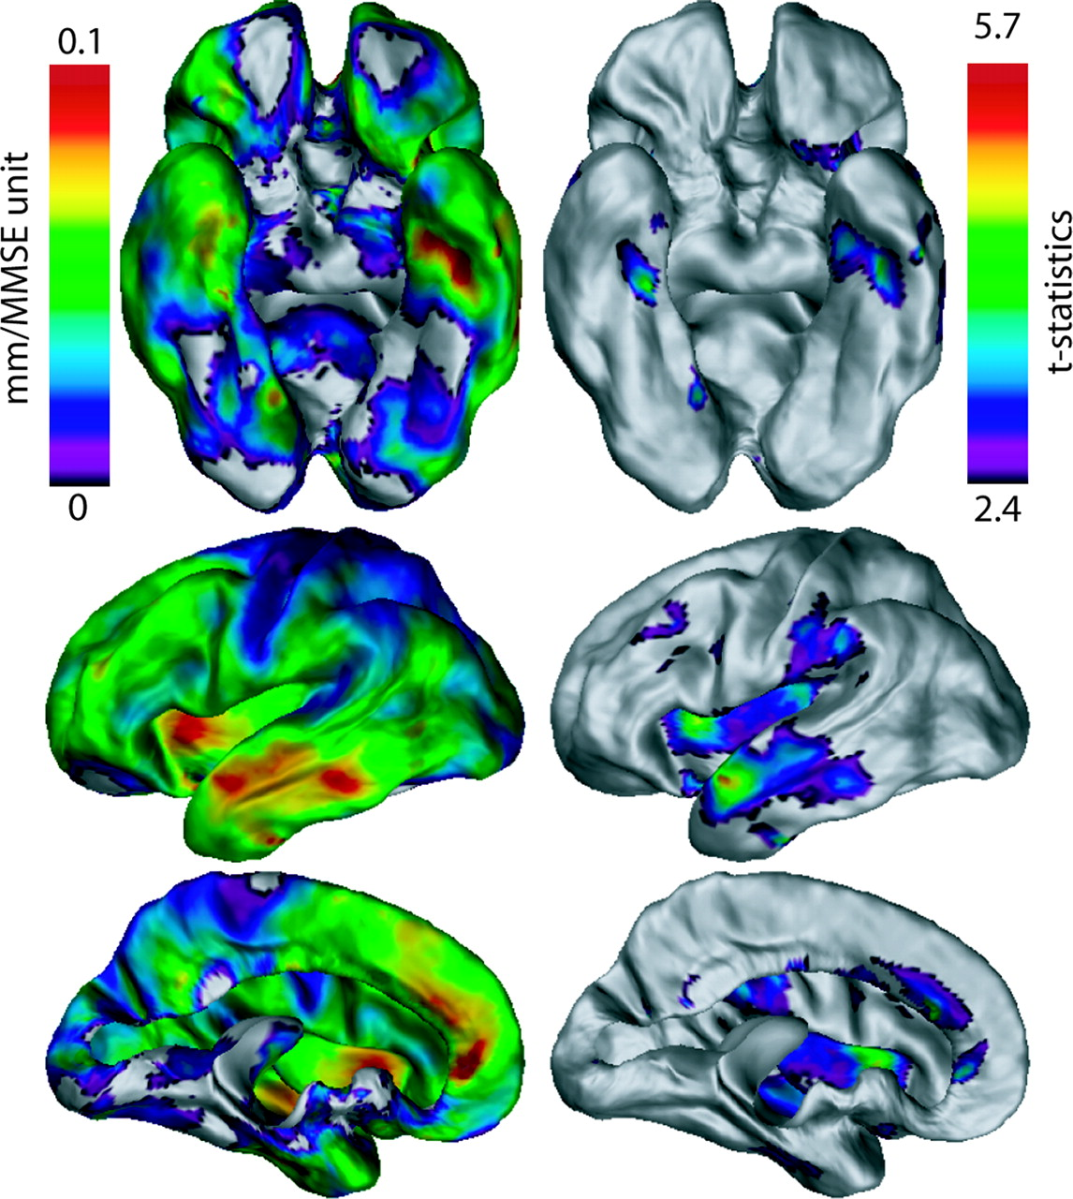
Figure 6. t-statistical (right column) and cortical thickness (left column) maps of the MMSE regression against ...
Notes:
Figure 6. t-statistical (right column) and cortical thickness (left column) maps of the MMSE regression against cortical thickness in 19 AD subjects. Significant correlations can be seen in the lateral temporal lobes, the left insula, left anterior cingulate and bilateral para-hippocampal gyri.
Unless provided in the caption above, the following copyright applies to the content of this slide: Cerebral Cortex V 15 N 7 © Oxford University Press 2004; all rights reserved

Slide 7
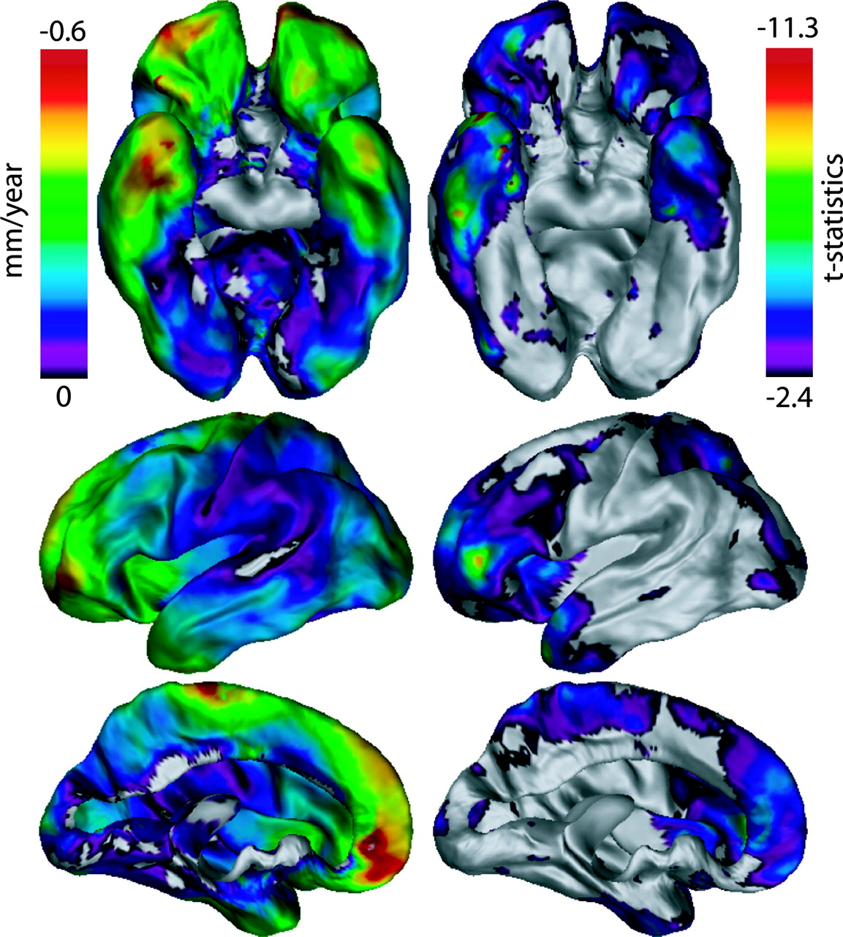
Figure 7. t-statistical (right column) and cortical thickness (left column) maps of the regression against time from ...
Notes:
Figure 7. t-statistical (right column) and cortical thickness (left column) maps of the regression against time from baseline. Significant correlations can be seen in the anterior temporal lobes, anterior frontal lobes, and lateral posterior cortex.
Unless provided in the caption above, the following copyright applies to the content of this slide: Cerebral Cortex V 15 N 7 © Oxford University Press 2004; all rights reserved

