Slide 1
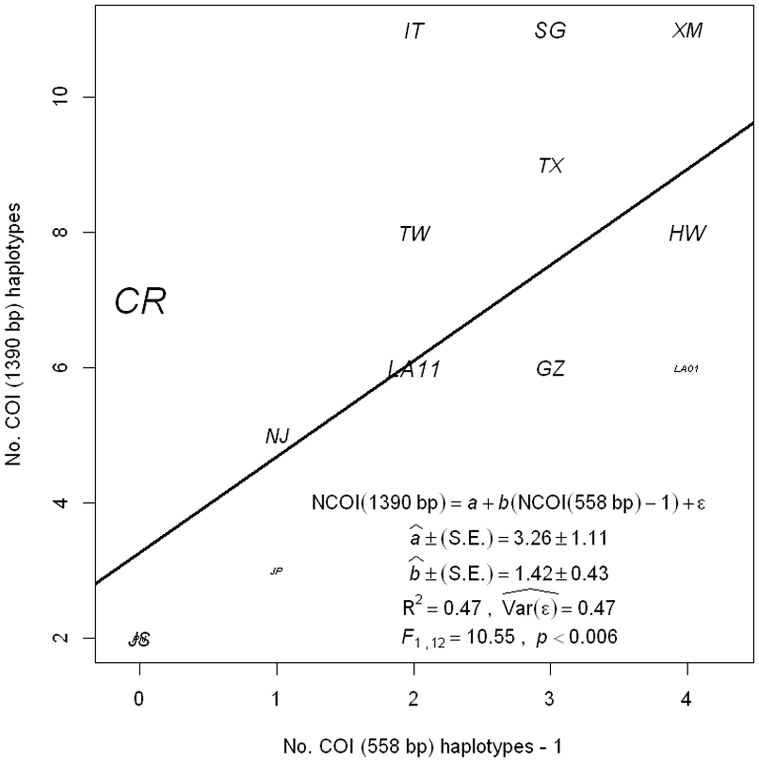
Fig. 1. Haplotype number for the long COI gene as function of the short COI gene by sampled location. For site code, ...
Notes:
Fig. 1. Haplotype number for the long COI gene as function of the short COI gene by sampled location. For site code, see Table 2. In the plot, character size is proportional to the number of sampled mosquitoes, and the solid line indicates the estimated linear regression. The regression equation is presented inside the plot, where the number of long sequence COI haplotypes (NCOI [1,390 bp]) is a function of the number of short sequence COI haplotypes (NCOI [558 bp]) minus one. The one is subtracted from NCOI (558 bp) to interpret the intercept as the NCOI (1,390 bp) when there is one haplotype in NCOI (558 bp). Parameter estimates for the intercept, a, the slope, b, and the error variance VAR(ε), are also presented in the figure. The error was assumed to be normally distributed. In the linear regression, weights proportional to the inverse of the samples used to estimate the number of haplotypes were used, following the assumption that haplotype sampling has an error proportional to sample size.
Unless provided in the caption above, the following copyright applies to the content of this slide: © The Authors 2015. Published by Oxford University Press on behalf of Entomological Society of America. All rights reserved. For Permissions, please email: journals.permissions@oup.com

Slide 2
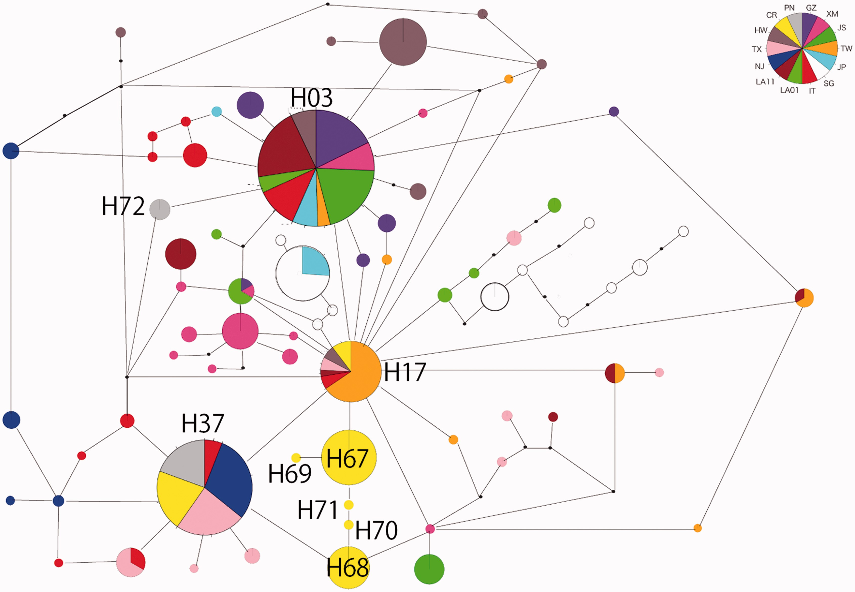
Fig. 2. Haplotype network based on mitochondrial COI (1,390 bp) of Ae. albopictus with all individuals collected in ...
Notes:
Fig. 2. Haplotype network based on mitochondrial COI (1,390 bp) of Ae. albopictus with all individuals collected in Costa Rica, Panamá, and the 12 populations reported by Zhong et al. (2013). Small black dots indicate hypothetical haplotypes not observed across the samples. Circle size is proportional to haplotype frequency, and lines between haplotypes indicate a mutational change. For haplotype codes, indicated by an H followed by two numbers, and population codes, indicated with colors in the figure, please refer to the text and Table 2, respectively. Further details about haplotype codes are presented in the Supp Table 3 (online only).
Unless provided in the caption above, the following copyright applies to the content of this slide: © The Authors 2015. Published by Oxford University Press on behalf of Entomological Society of America. All rights reserved. For Permissions, please email: journals.permissions@oup.com

